Slide 1

Detection and Removal of Malwares
Advanced Malware Analysis Training Series
Monnappa/Nagareshwar
www.SecurityXploded.com

Slide 2
Disclaimer
The Content, Demonstration, Source Code and Programs presented here is "AS IS" without any warranty or conditions of any kind. Also the views/ideas/knowledge expressed here are solely of the trainer’s only and nothing to do with the company or the organization in which the trainer is currently working.
However in no circumstances neither the Trainer nor SecurityXploded is responsible for any damage or loss caused due to use or misuse of the information presented here.

Slide 3
Acknowledgement
Special thanks to Null community for their extended support and co-operation.
Special thanks to ThoughtWorks for the beautiful venue.
Thanks to all the trainers who have devoted their precious time and countless hours to make it happen.

Slide 4

Advanced Malware Analysis Training
This presentation is part of our Advanced Malware Analysis Training program. Currently it is delivered only during our local meets for FREE of cost.
For complete details of this course, visit our Security Training page.

Slide 5
Who Are We?
Nagareshwar
  Founder of SecurityXploded
  Reversing, Malware Analysis, Crypto, Secure Coding
  Twitter: @tnagareshwar
Monnappa
  Info Security Investigator @ Cisco
  Member of SecurityXploded (SX)
  Reverse Engineering, Malware Analysis, Memory Forensics
  Twitter: @monnappa22

Slide 6
Part I
The Trailer
(by Nagareshwar)

Slide 7
Contents of Part 1
What is Virus/Malware/Worm
Symptoms of Infection
Agent in Action
Last Resort
Anti-Malware Tips

Slide 8
What is Virus/Malware/Worm ?
Malware: Software written for malicious purposes
- destroy data, steal money, annoy users
Virus: Malware which requires human intervention to spread
- require user to click on the exe, open a document or visit a website
Worm: Malware which can spread automatically
- automatically infect other systems in the network
- spreads through plug & play devices

Slide 9
Symptoms of Infection
Unusual Behaviour in Applications
System Slowdown
(Suddenly) Laptop Getting Heated Heavily
Password Change/Reset Emails for your Bank or Online Accounts
Surprise Financial Transactions on your Credit Cards ☺

Slide 10
Agent in Action
Full Anti-virus Scan (manual)
- detect known malwares if any
Rootkit Scan
- GMER, SpyDLLRemover (helps in removal of malware DLLs)
Scan the Infected or Suspicious file with VirusTotal
- Get the name of virus/malware family
- Use VirusTotal Scanner Tool for quick scan
Check with AV sites like McAfee, Symantec for the detected Malware
- to understand infection details or for any removal steps

Slide 11
Agent in Action (contd)
BHO Scan (System Slowdown)
- Run SpyBHORemover and disable unusable BHOs
Delete Locked/Hidden/Protected Malware Files
- Use GMER to delete Hidden Files/Registry Keys
- Boot with BackTrack, mount your drives and delete the files/registry keys
Change Passwords of Bank & other important accounts
- Facebook, Google, Twitter, PayPal etc.

Slide 12
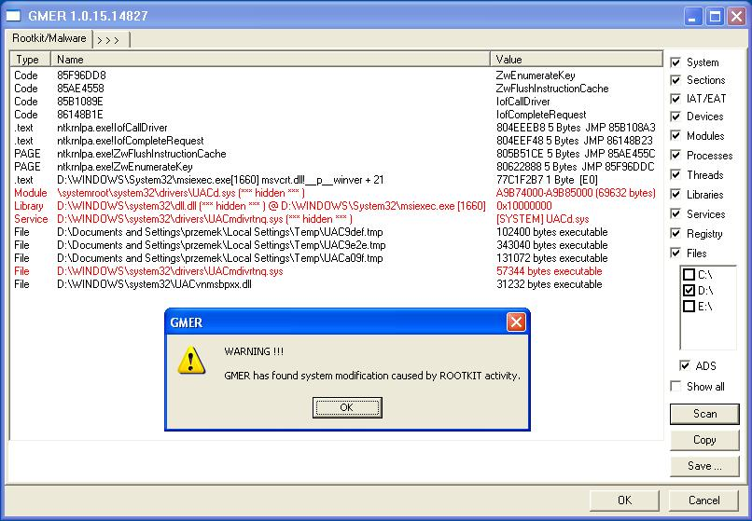
Rootkit Scan using GMER

Slide 13
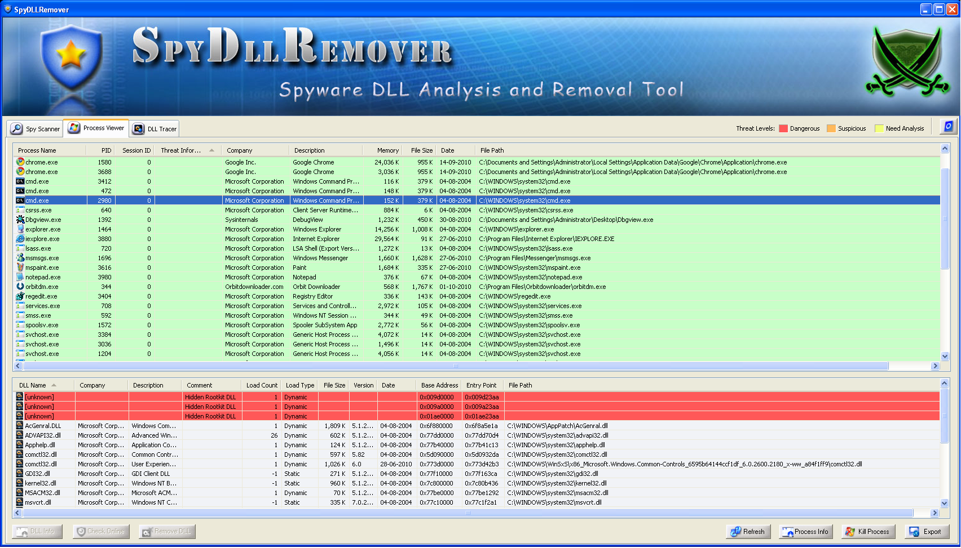
Remove Malware DLLs using SpyDLLRemover

Slide 14
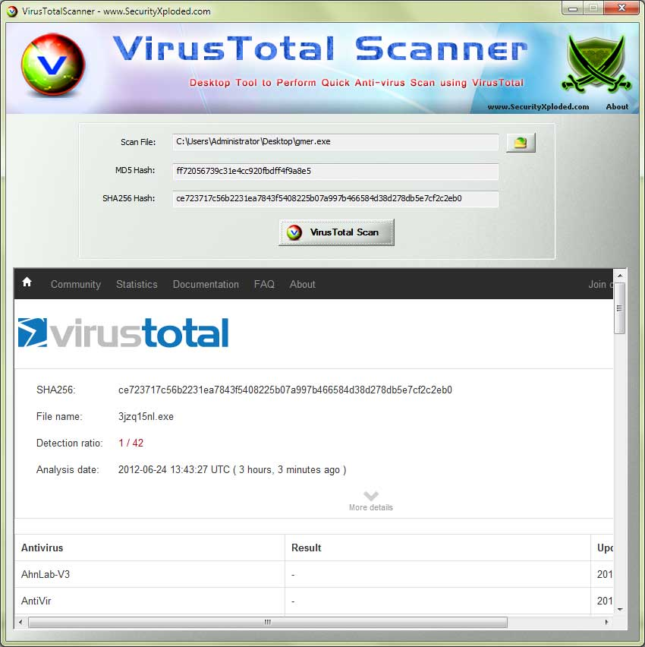
VirusTotal Scanner Tool

Slide 15
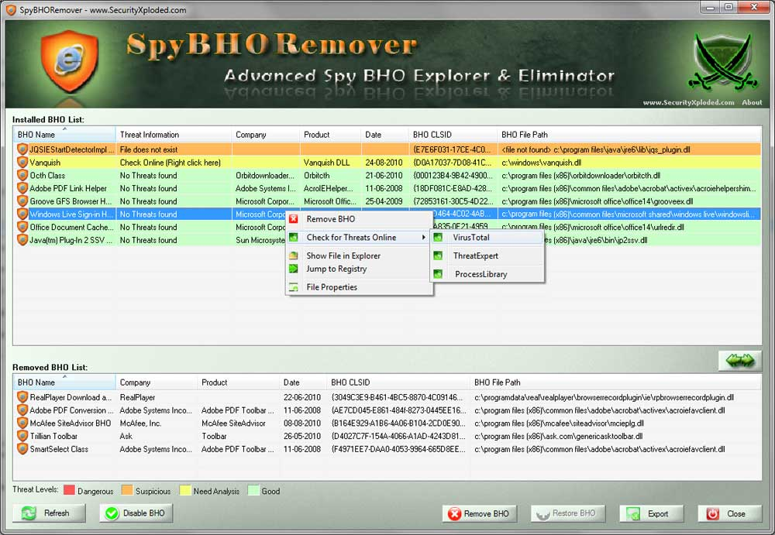
Remove BHOs using SpyBHORemover

Slide 16
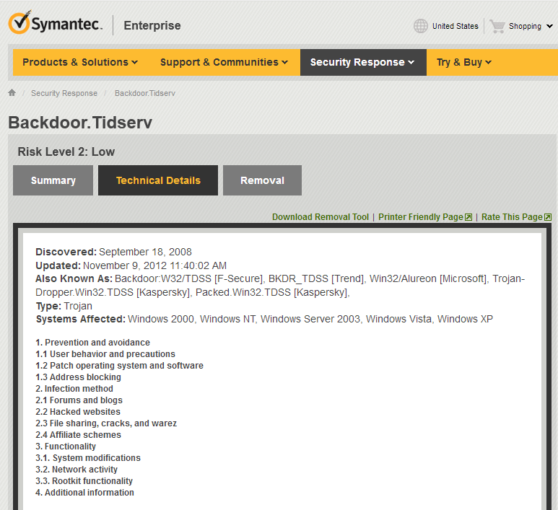
Threat Report on Virus

Slide 17
Last Resort
In case of full system or widespread infections,
System Restore to ‘Right Restore Point’
- look at the dates of infected files and it should give you right date to restore from
Format and Re-install OS
- clean-up other drives if necessary
Scan other systems/devices in your Network
- Your laptops, office systems or friends system may be infected as well

Slide 18
Anti-Malware Tips
Never Trust your AntiVirus for Full Protection
- It cannot detect advanced virus especially rootkit oriented ones,
- Smart virus can disable AV auto protection silently giving you false sense of security
Always Scan any EXE with VirusTotal
- scan files downloaded from Internet and even files sent by close friends
- Use VirusTotal Scanner for quick scan
Disable AutoRun
- most malwares use this mechanism spread very effectively
- prevent getting infected through USB stick and stop it from spreading

Slide 19
Anti-Malware Tips (contd)
Keep tab on your Startup programs
- Use HijackThis or AutoRuns from SysInternals
Monitor Worms coming through Network
- Use NetShareMonitor
Backup your Critical Files Periodically
- One who Laughs last is the one who had the backup :)

Slide 20
Part II
The Real Show
(by Monnappa)

Slide 21
Contents of Part 2
Detection and Removal
Persistent Mechanism
Demo 1
Demo 2
Demo 3
Demo 4

Slide 22
Detection and Removal
1) Isolate the system from the rest of the network
2) Look for suspicious file, process, network and registry values
3) Identify the file generating the suspicious activity
4) Isolate the suspicious file
5) verify if the file is malicious
6) Identify the persistence mechanism
7) Break its persistence mechanism
8) Delete the malicious files from the system
9) monitor for suspicious activities (repeat step 2 to step 8)

Slide 23
Persistent mechanism
Below are some of the persistent mechanism used by malware:
1) Run Registry key
2) Appinit_DLL’s
3) WinLogon Notify
4) Runs as Service
5) Service DLL
6) BHO

Slide 24
Demo 1

Slide 25
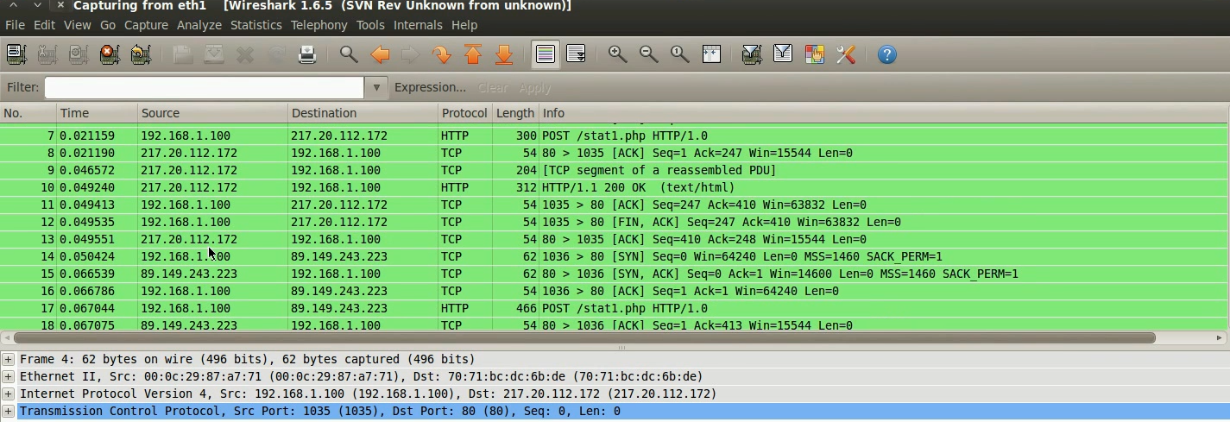
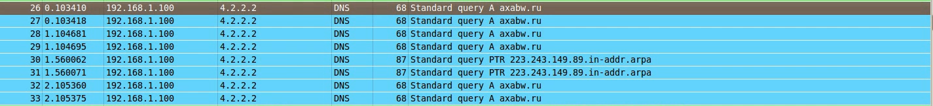
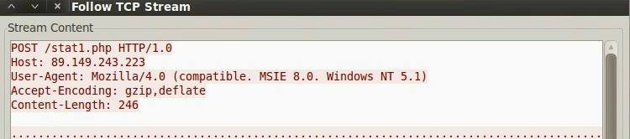
Suspicious Network Activity
Packet capture shows suspicious activity from 192.168.1.100
www.SecurityXploded.com

Slide 26
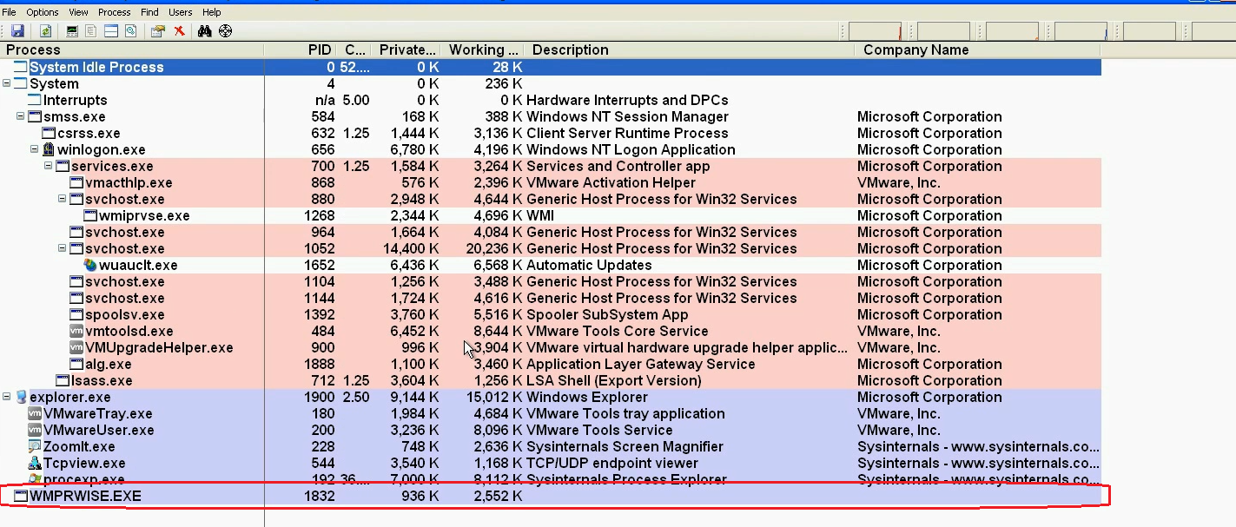
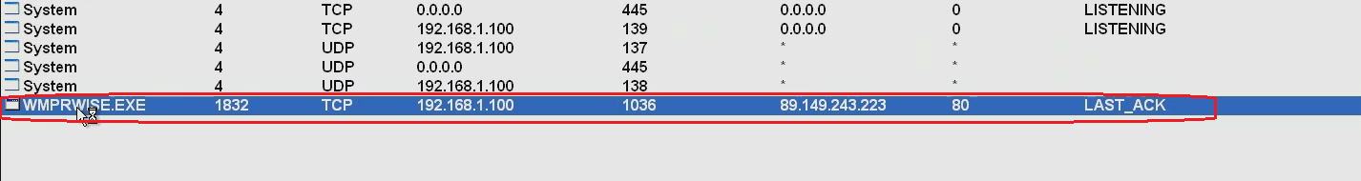
Suspicious Process
Process explorer shows suspicious process on192.168.1.100
www.SecurityXploded.com

Slide 27
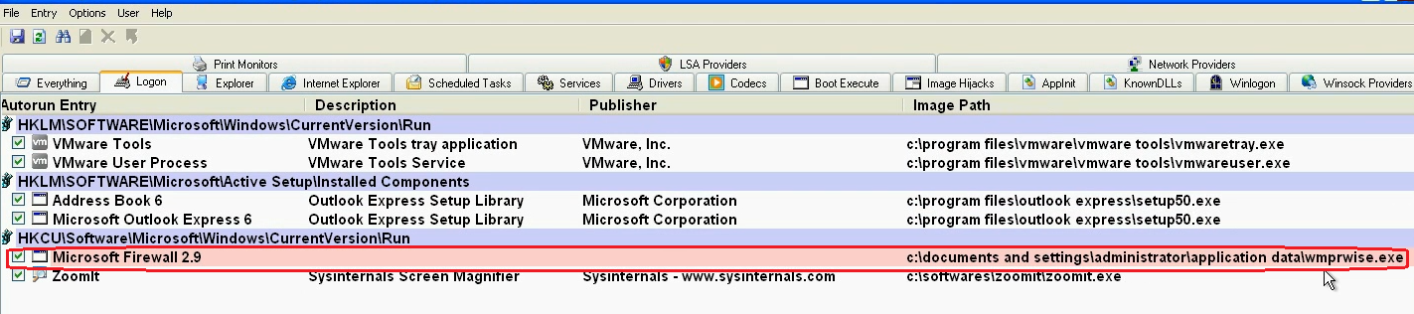
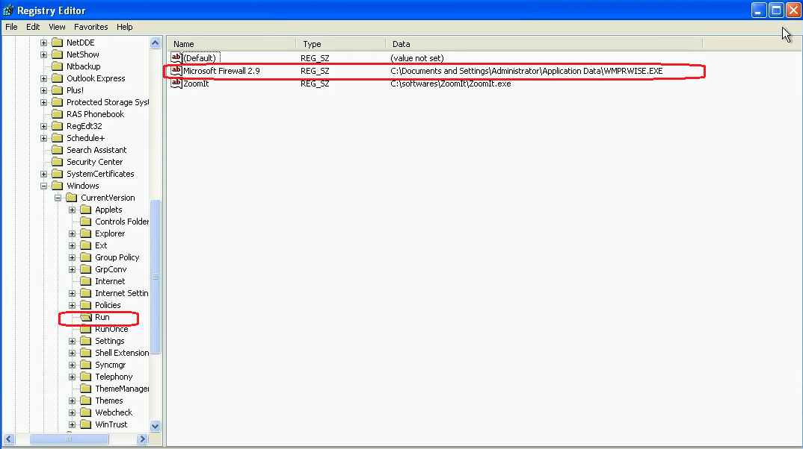
Persistence Mechanism
Registers the malicious executable in the “Run” registry key, to survive reboot
www.SecurityXploded.com

Slide 28
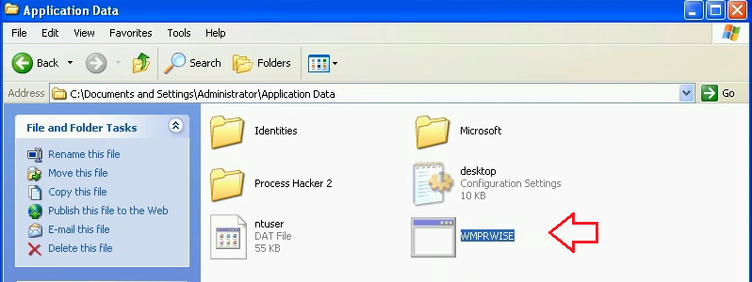
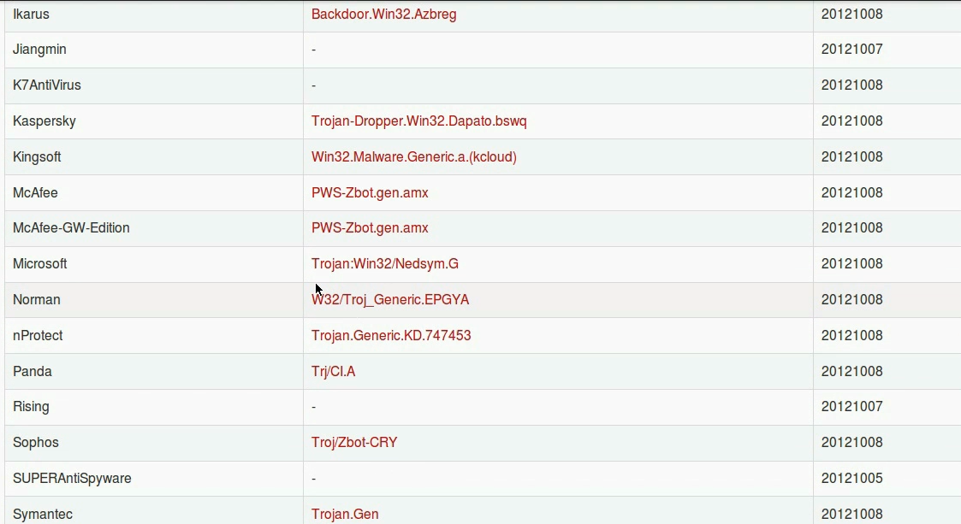
VirusTotal Results
Suspicious file was confirmed to be malicious
www.SecurityXploded.com

Slide 29
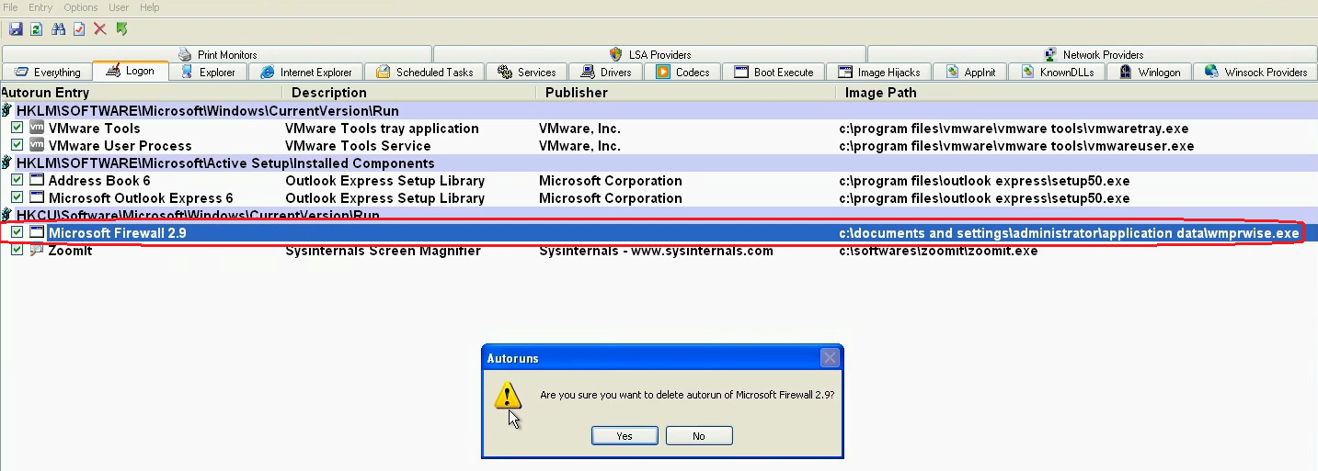
Breaking the Persistence
Deleting the registry value removes the persistence mechanism used by the malware
www.SecurityXploded.com

Slide 30
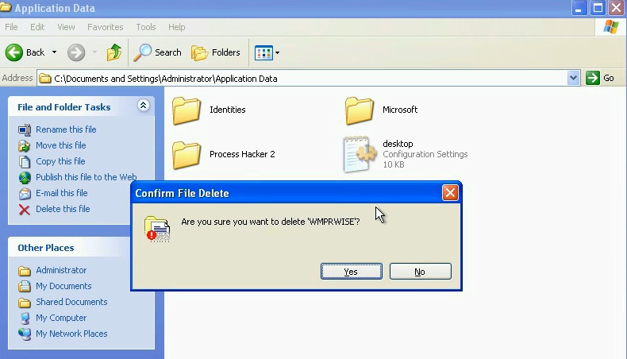
Removal
Deleting the malicious file to remove the malware from the system
www.SecurityXploded.com

Slide 31
Demo 2

Slide 32
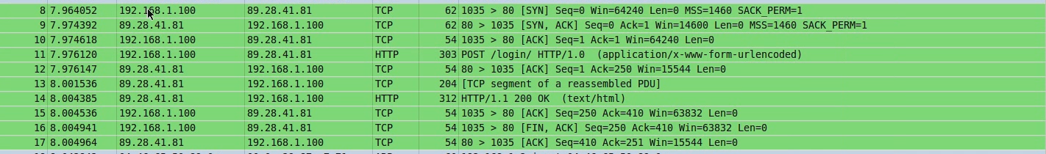
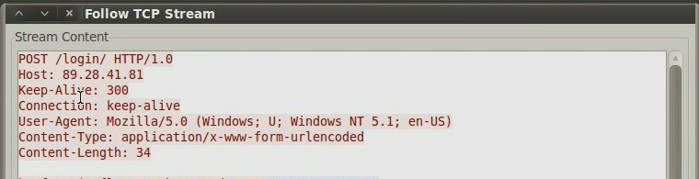
Suspicious Network Activity
Packet capture shows suspicious activity from 192.168.1.100
www.SecurityXploded.com

Slide 33
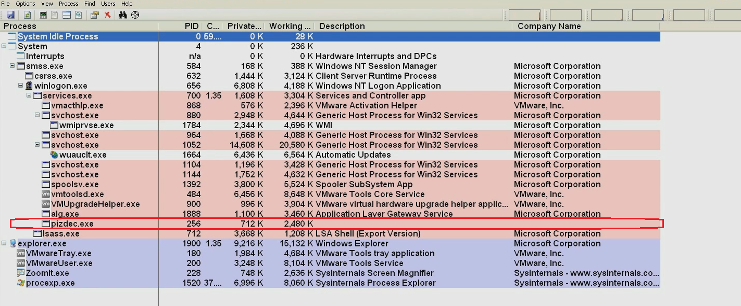
Suspicious Process
Process explorer shows suspicious process on192.168.1.100
www.SecurityXploded.com

Slide 34
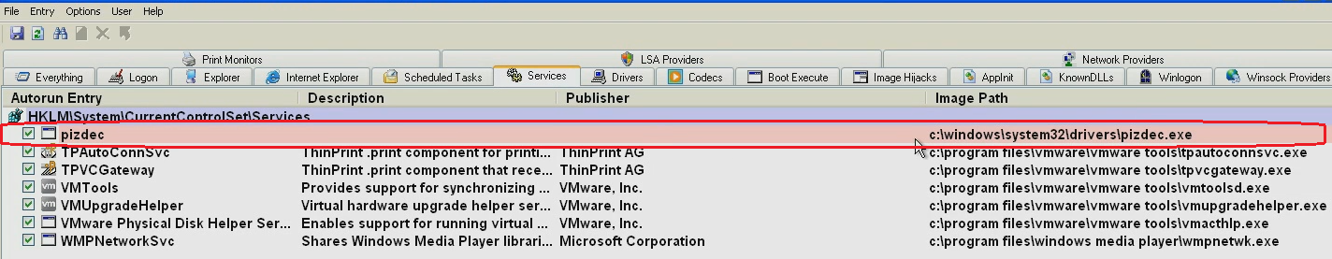
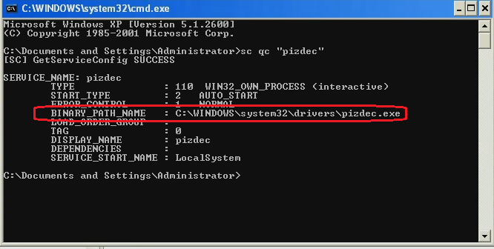
Persistence Mechanism
Malware runs as service which is set to auto-start
www.SecurityXploded.com

Slide 35
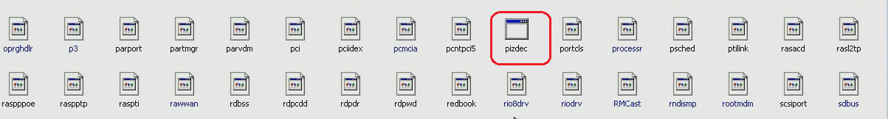
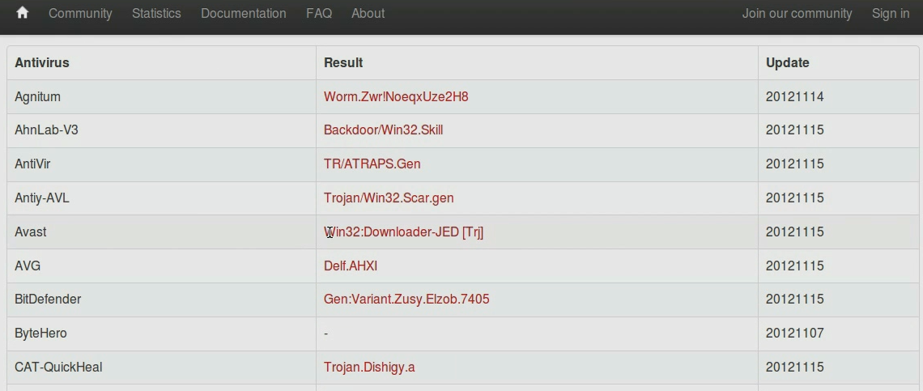
VirusTotal Results
Suspicious file was confirmed to be malicious
www.SecurityXploded.com

Slide 36
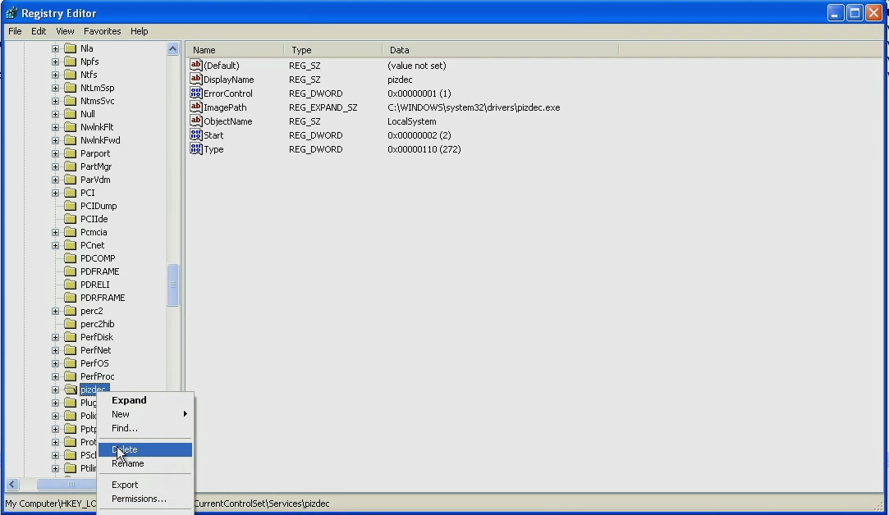
Breaking the Persistence
Deleting the registry value removes the persistence mechanism used by the malware
www.SecurityXploded.com

Slide 37
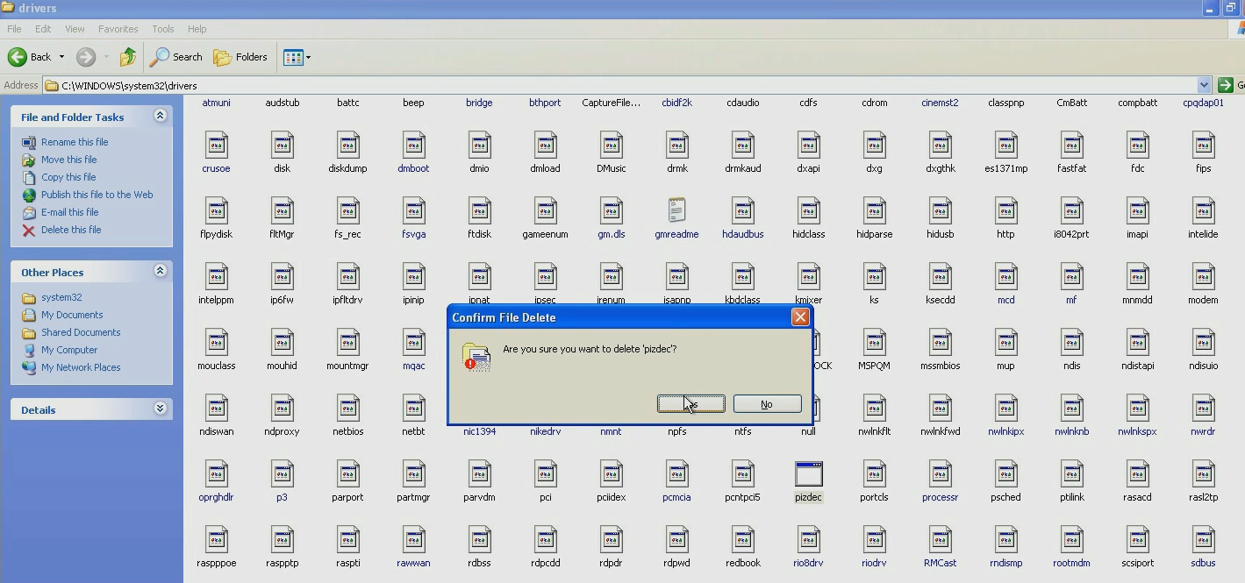
Removal
Deleting the malicious file to remove the malware from the system
www.SecurityXploded.com

Slide 38
Demo 3

Slide 39
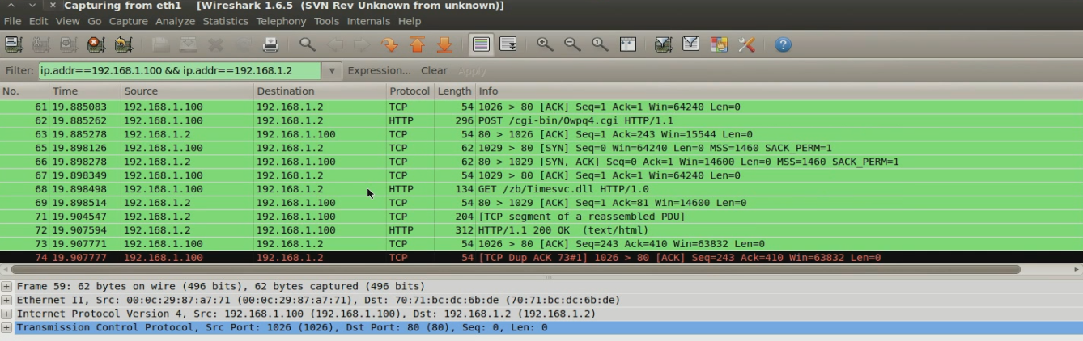
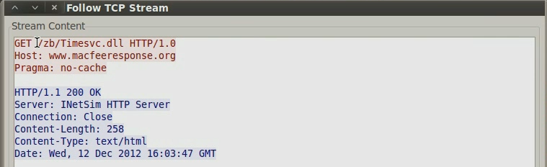
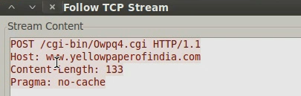
Suspicious Network Activity
Packet capture shows suspicious activity from 192.168.1.100
www.SecurityXploded.com

Slide 40
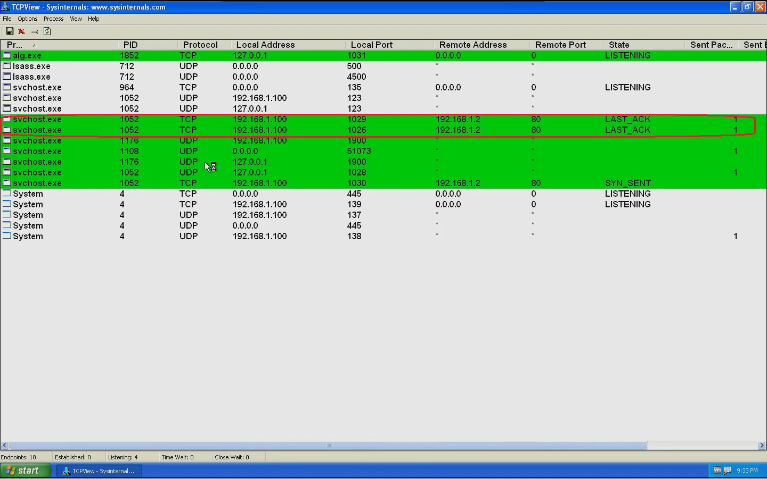
Suspicious Process
Below screenshot shows svchost.exe (pid 1052) making connections on port 80
www.SecurityXploded.com

Slide 41
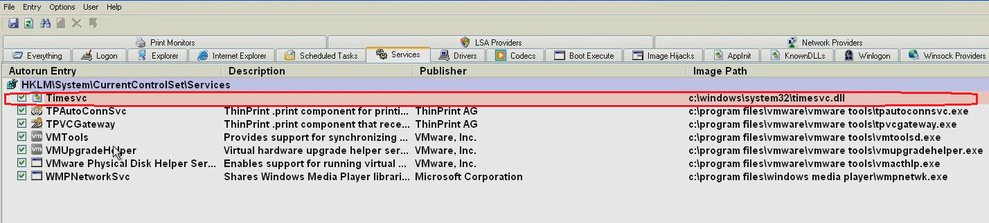
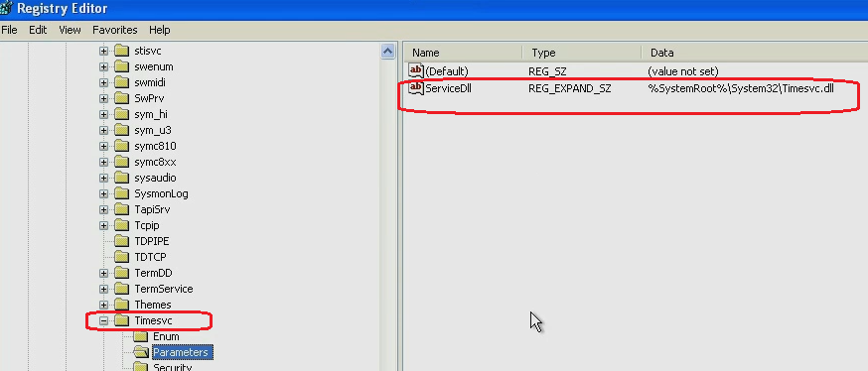
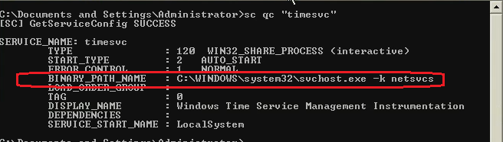
Persistence Mechanism
Malware installs a service DLL under the “netsvcs” svchost group
www.SecurityXploded.com

Slide 42
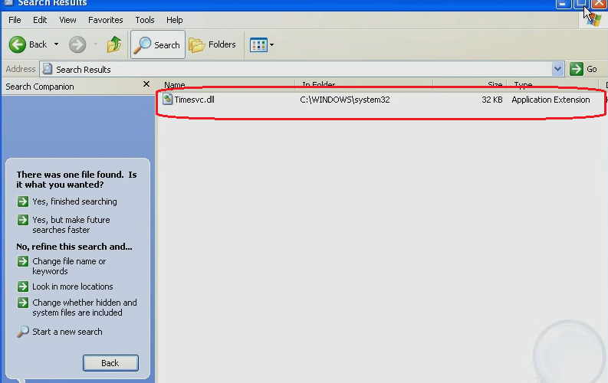
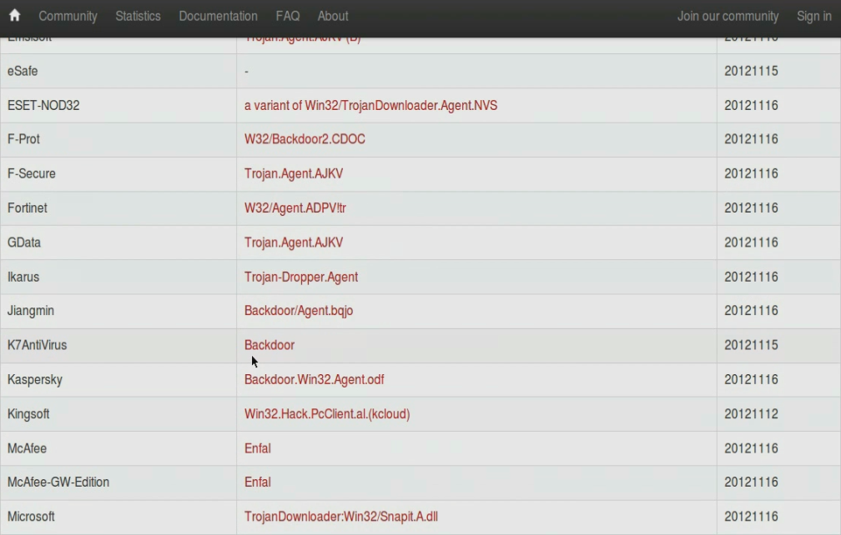
VirusTotal Results
Suspicious file was confirmed to be malicious
www.SecurityXploded.com

Slide 43
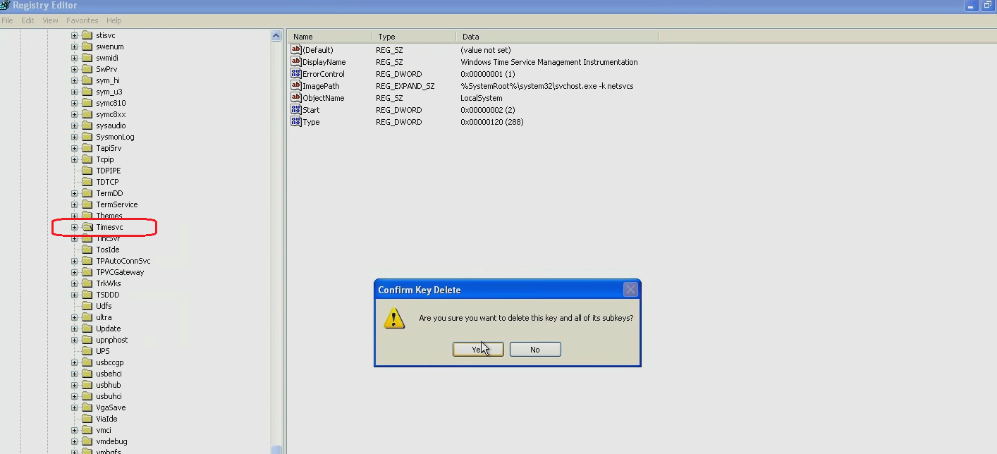
Breaking the Persistence
Deleting the registry key removes the persistence mechanism used by the malware
www.SecurityXploded.com

Slide 44
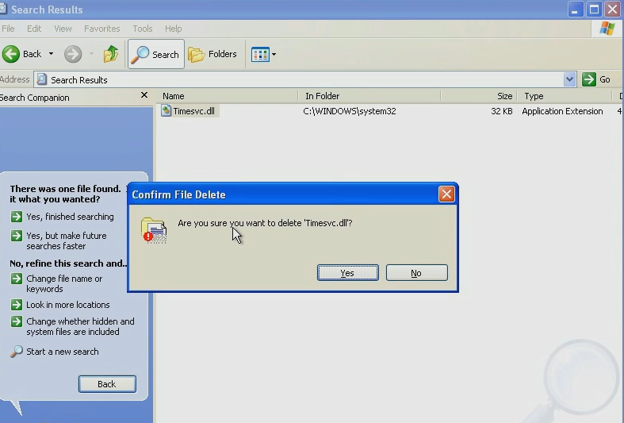
Removal
Deleting the malicious file to remove the malware from the system
www.SecurityXploded.com

Slide 45
Demo 4

Slide 46
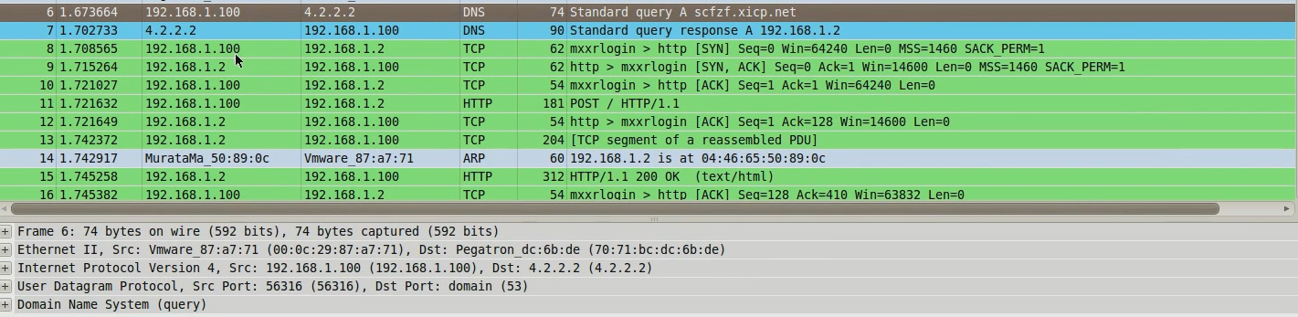
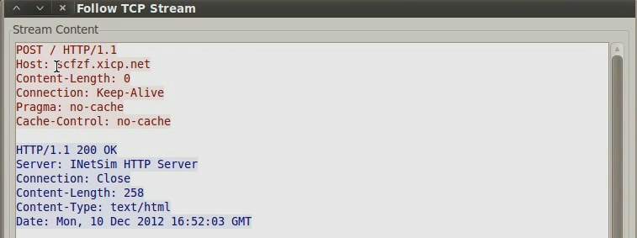
Suspicious Network Activity
Packet capture shows suspicious activity from 192.168.1.100
www.SecurityXploded.com

Slide 47
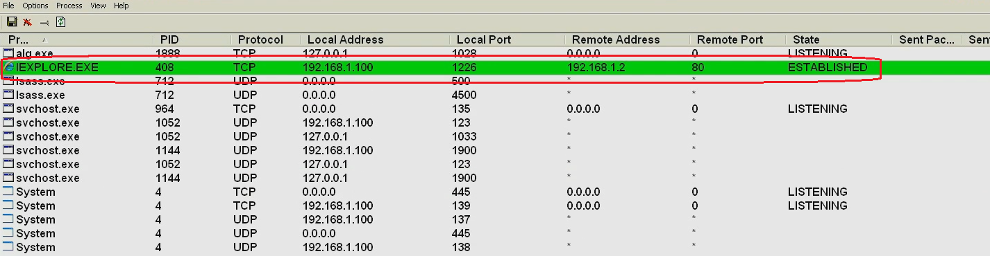
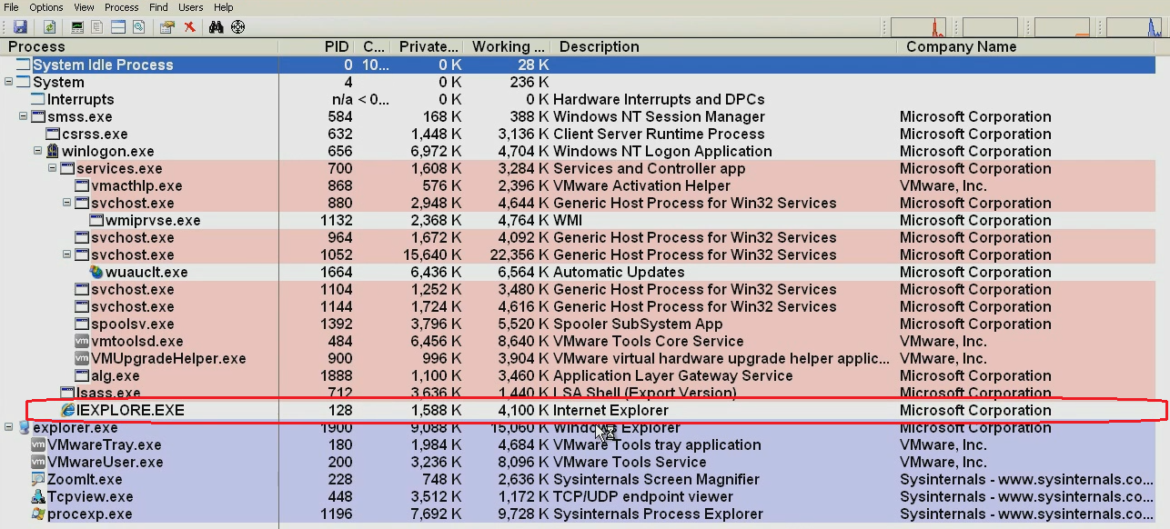
Suspicious Process Activity
Shows iexplore.exe making connections on port 80 (even though iexplore.exe was not run manually)
www.SecurityXploded.com

Slide 48
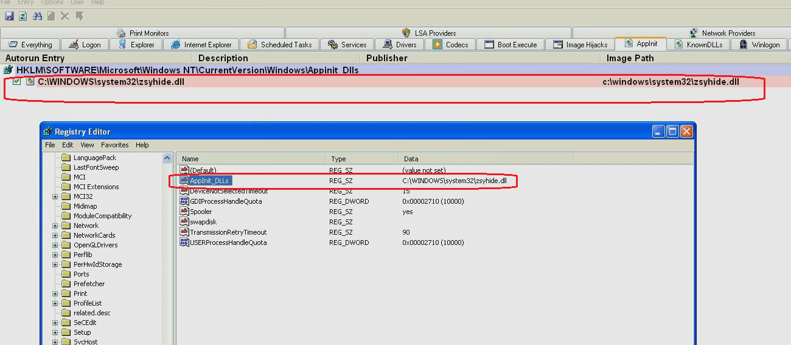
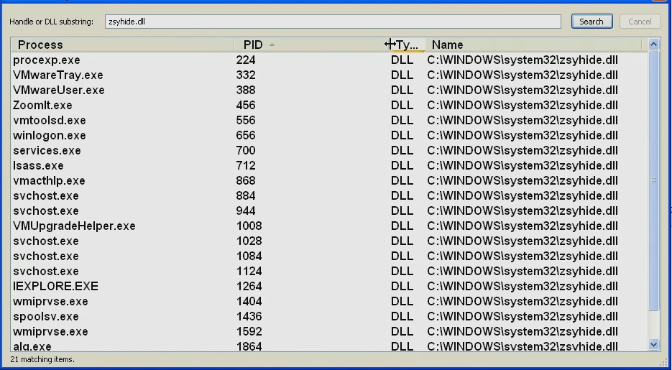
Persistence Mechanism
Malware installs Appinit DLL which loads the DLL into all the process which loads user32.dll
www.SecurityXploded.com

Slide 49
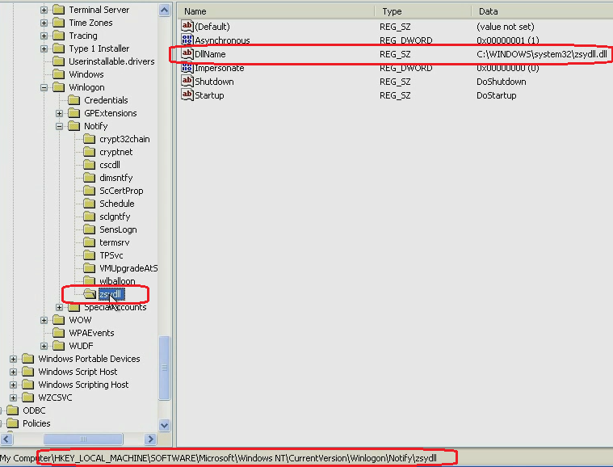
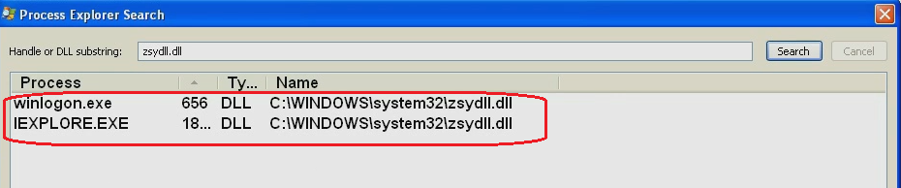
Persistence Mechanism (contd)
Malware hooks to the winlogon event
www.SecurityXploded.com

Slide 50
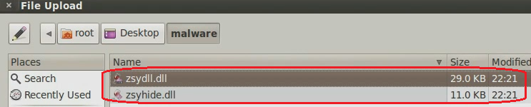
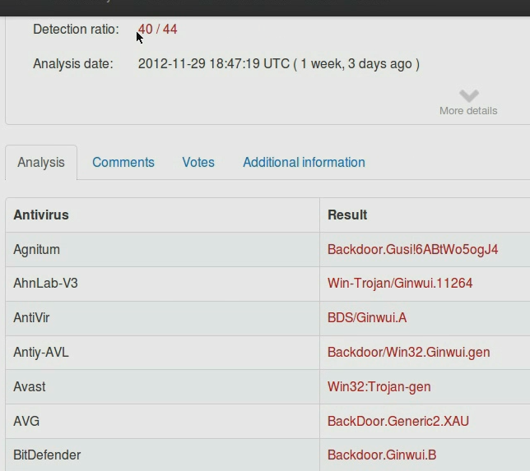
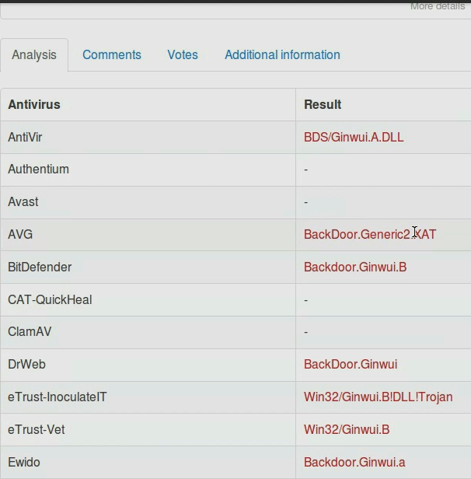
VirusTotal Results
Suspicious files were confirmed to be malicious
www.SecurityXploded.com

Slide 51
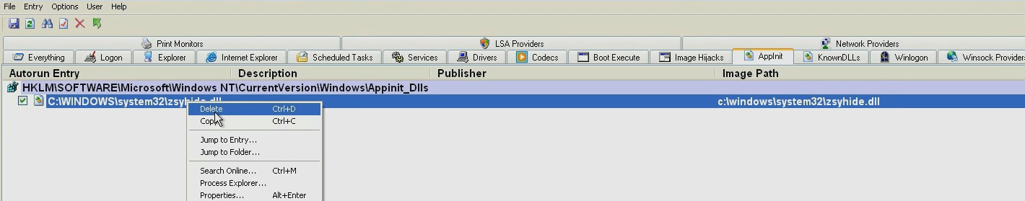
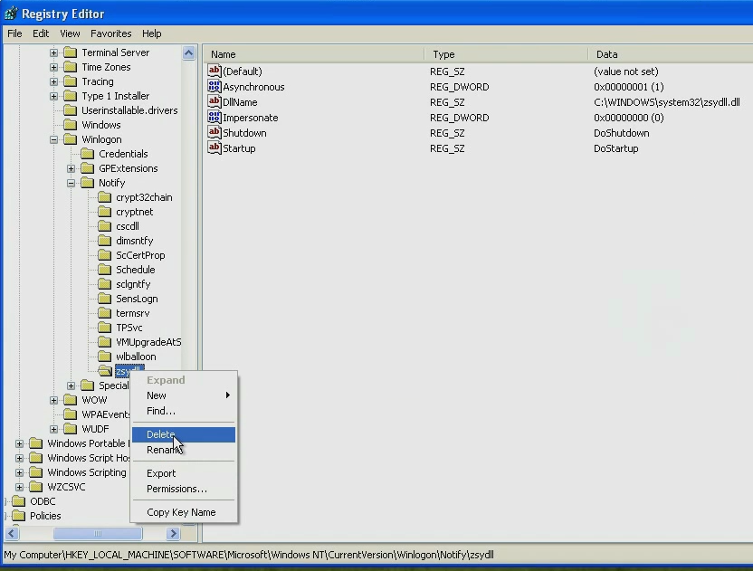
Breaking the Persistence
Deleting the registry key removes the persistence mechanism used by the malware
www.SecurityXploded.com

Slide 52
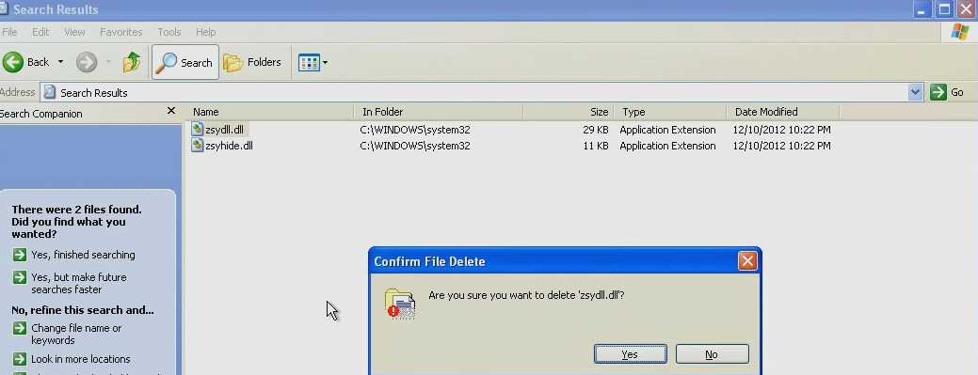

Removal
Deleting both the malicious files to remove the malware from the system
www.SecurityXploded.com

Slide 53
Reference
Complete Reference Guide for Advanced Malware Analysis Training
[Include links for all the Demos & Tools]

Slide 54
Thank You !
www.SecurityXploded.com

