Slide 1

Part 1 -Reversing and Decrypting Communications of
HeartBeat RAT
Advanced Malware Analysis Training Series
Monnappa
www.SecurityXploded.com

Slide 2
Disclaimer
The Content, Demonstration, Source Code and Programs presented here is "AS IS" without any warranty or conditions of any kind. Also the views/ideas/knowledge expressed here are solely of the trainer’s only and nothing to do with the company or the organization in which the trainer is currently working.
However in no circumstances neither the Trainer nor SecurityXploded is responsible for any damage or loss caused due to use or misuse of the information presented here.

Slide 3
Acknowledgement
Special thanks to Null community for their extended support and co-operation.
Special thanks to ThoughtWorks for the beautiful venue.
Thanks to all the trainers who have devoted their precious time and countless hours to make it happen.

Slide 4

Advanced Malware Analysis Training
This presentation is part of our Advanced Malware Analysis Training program. Currently it is delivered only during our local meets for FREE of cost.
For complete details of this course, visit our Security Training page.

Slide 5
Who am I
Monnappa
  m0nna
  Member of SecurityXploded
  Info Security Investigator @ Cisco
  Reverse Engineering, Malware Analysis, Memory Forensics
  Email: monnappa22@gmail.com
  Twitter: @monnappa22
  LinkedIn: http://www.linkedin.com/pub/monnappa-ka-grem-ceh/42/45a/1b8

Slide 6
Contents
Overview of Advanced threats
HeartBeat APT campaign
Part 1A – Demo (Decrypting the communications of HeartBeat RAT)
Part 1B – Demo (Reverse Engineering the HeartBeat RAT)
References
www.SecurityXploded.com

Slide 7
Overview of advanced threats
Sophisticated
Stealthy
Multistaged
Targeted
Uses zero day exploits
Designed for long term manipulation

Slide 8
HeartBeat APT Campaign
Targeted attack exposed by Trend Micro document
    http://blog.trendmicro.com/trendlabs-security-intelligence/pulsing-the-heartbeat-apt/
Targeted organizations related to the South Korean government (political parties, media outfits, South Korean military)
“HeartBeat RAT" was used to gain access over their targets network
In this session, we will
  Part 1a) Decrypt the communications of HeartBeat RAT
  Part 1b) Reverse Engineer the HeartBeat RAT
www.SecurityXploded.com

Slide 9
Part 1A – Demo
Decrypting The Communications Of HeartBeat rat

Slide 10
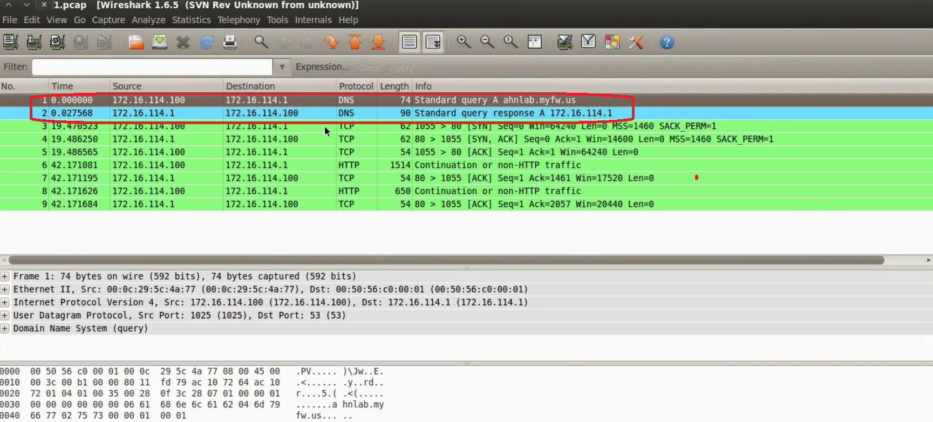
HeartBeat RAT Network Traffic
Below screenshot shows the HeartBeat RAT traffic on port 80 and also shows connection to a malicious domain
www.SecurityXploded.com

Slide 11
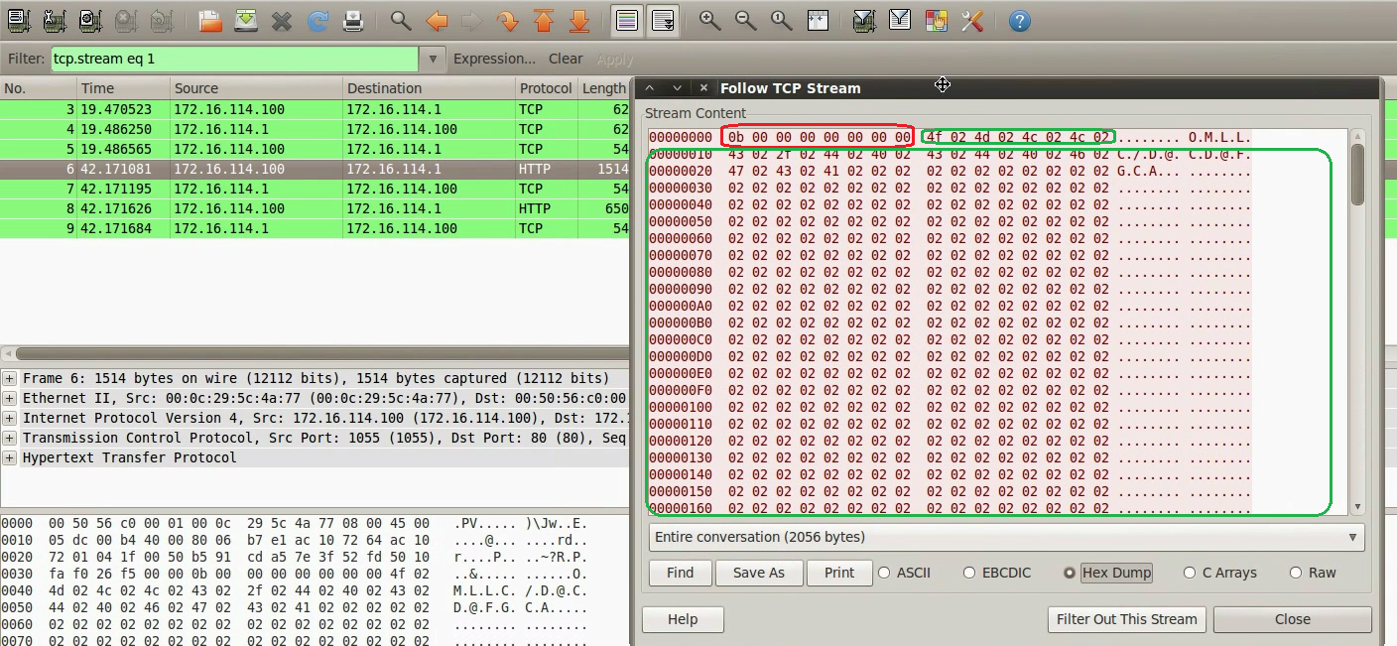
Encrypted communications of HeartBeat RAT
The one shown in Red is the Header and green shows the Encrypted Traffic
www.SecurityXploded.com

Slide 12
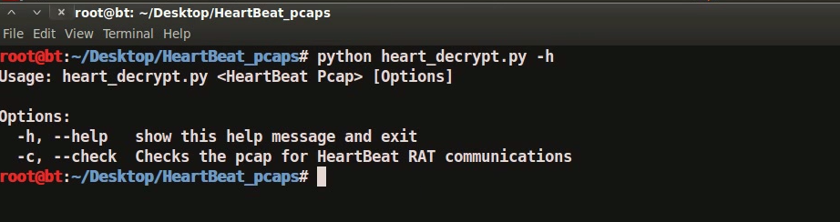
Decryption Script (heart_decrypt.py)
The below screenshot shows the script usage
www.SecurityXploded.com

Slide 13
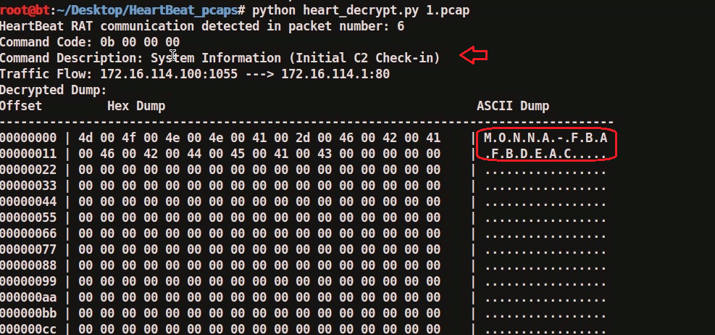
Decrypted Communication
The below screenshot shows the Decrypted C2 check-in. The one marked in RED is the hostname of the infected machine
www.SecurityXploded.com

Slide 14
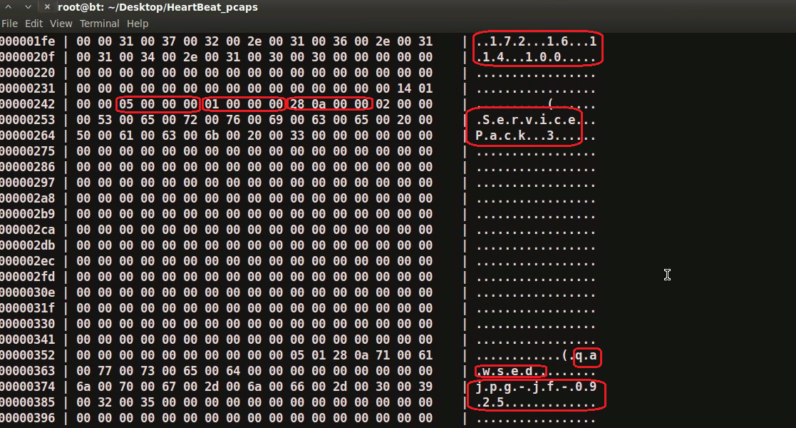
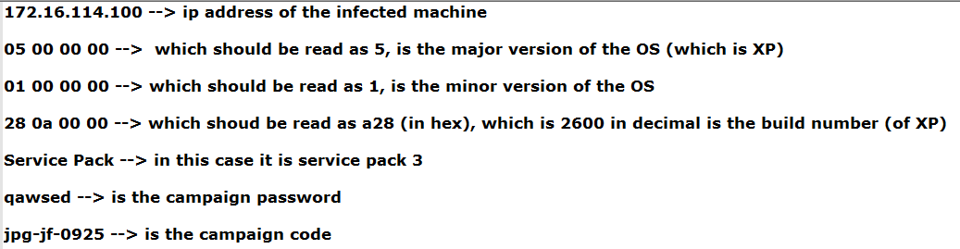
Decrypted Communication (contd...)

Slide 15
Part 1b – Demo
Reverse Engineering The HeartBeat rat

Slide 16
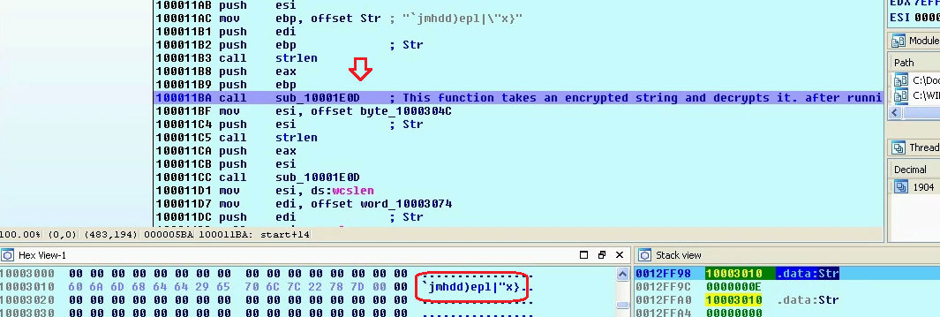
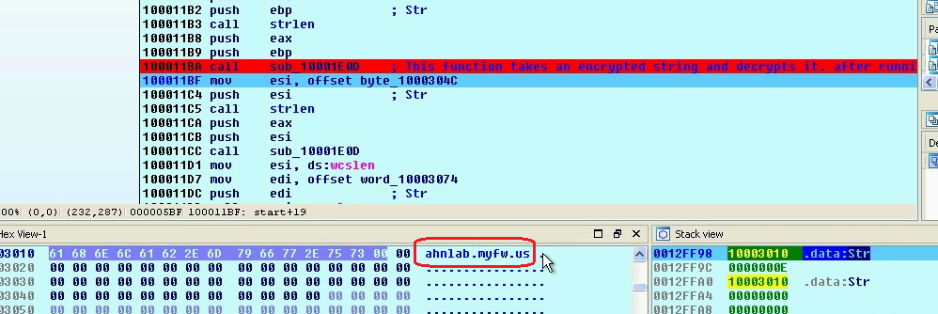
Malware Decrypts Strings
Below screenshots show the malware decrypting the C2 domain
www.SecurityXploded.com

Slide 17
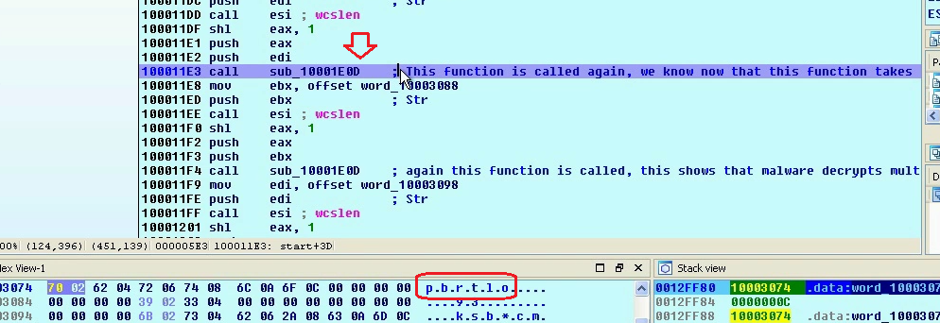
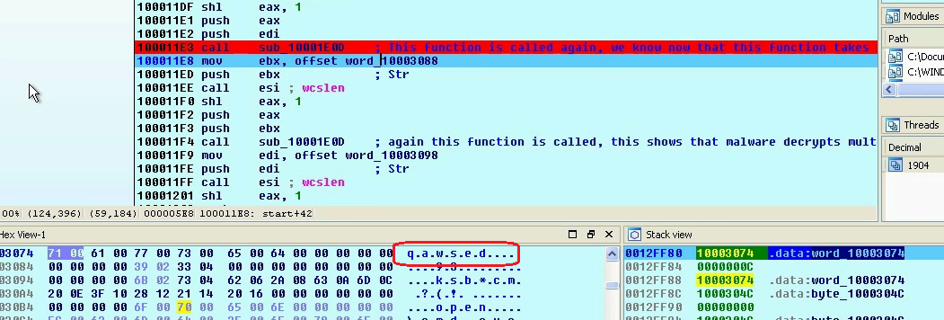
Malware Decrypts Strings (contd...)
Below screenshots show the malware decrypting the campaign password “qawsed”

Slide 18
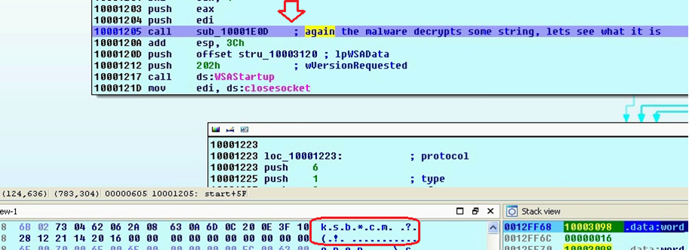
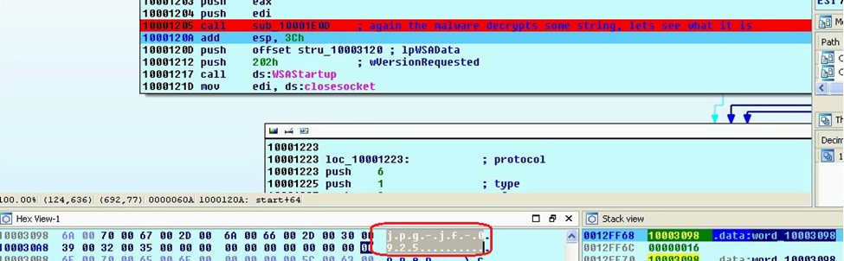
Malware Decrypts Strings (contd...)
Below screenshots show the malware decrypting the campaign code “jpg-jf-0925”
www.SecurityXploded.com

Slide 19
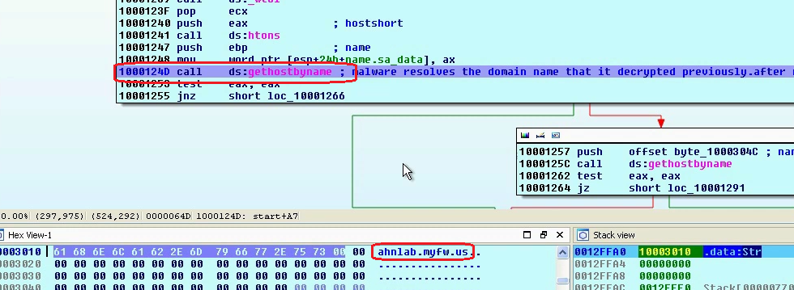
Malware Resolves C2 Domain
Below screenshots show the malware resolving the C2 domain and the corresponding network traffic

Slide 20
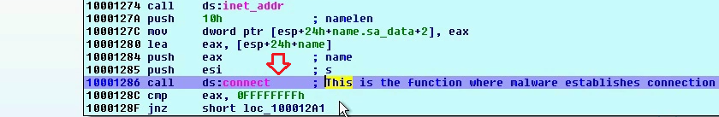
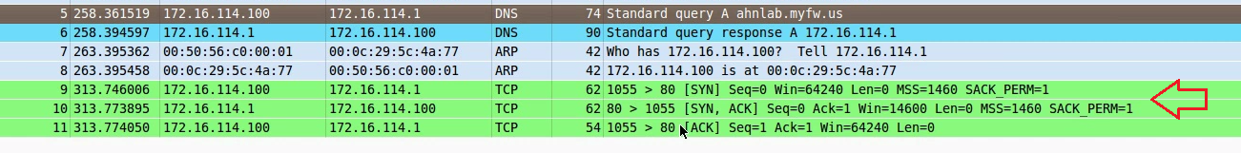
Malware Connects to C2 Domain
Below screenshots show the malware establishing connection to the C2 domain
www.SecurityXploded.com

Slide 21
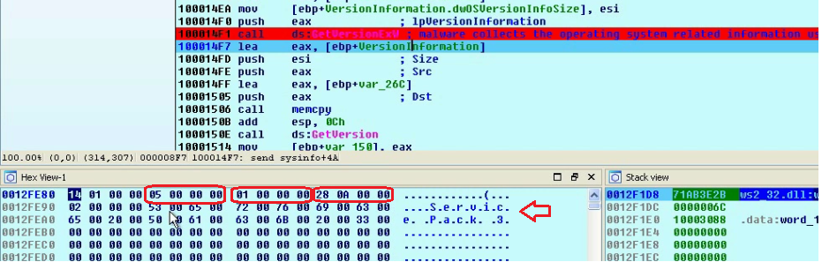
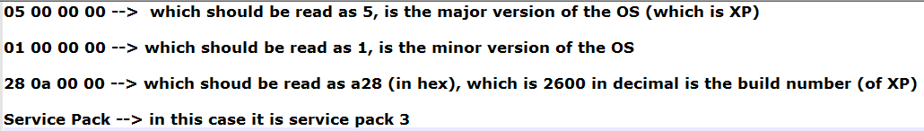
Malware Collects System Information
Below screenshots show the malware collecting the system information
www.SecurityXploded.com
www.SecurityXploded.com

Slide 22
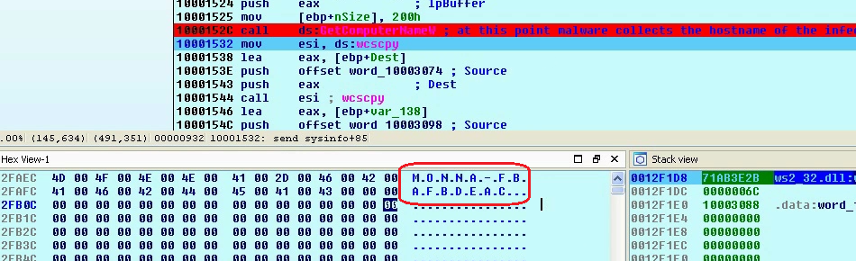
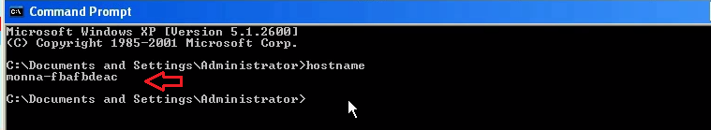
Malware Collects Hostname Information
Below screenshots show the malware collecting the hostname information
www.SecurityXploded.com
www.SecurityXploded.com
www.SecurityXploded.com

Slide 23
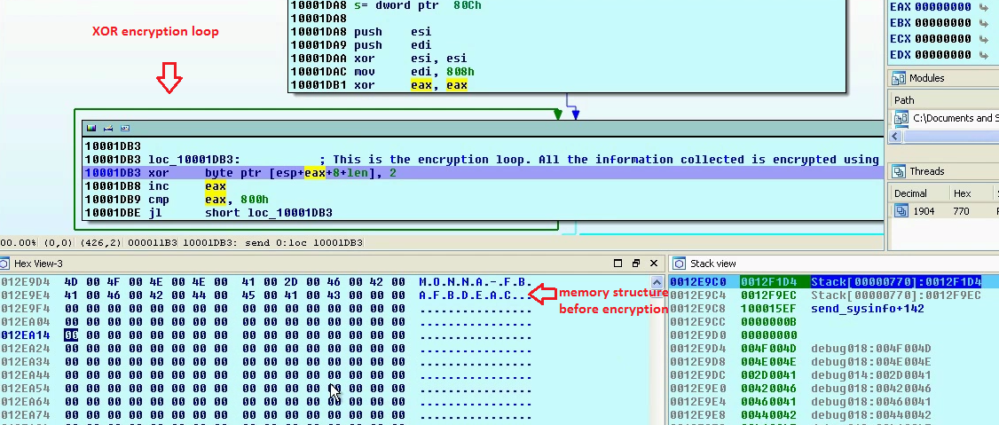
Malware uses XOR encryption
malware uses xor algorithm (key 0x2) to encrypt the collected data
www.SecurityXploded.com
www.SecurityXploded.com
www.SecurityXploded.com
www.SecurityXploded.com

Slide 24
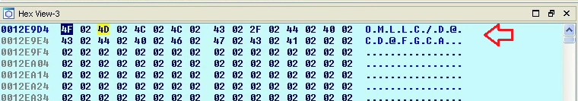
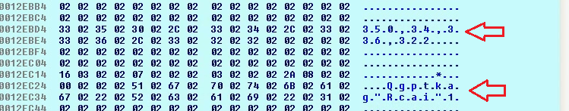
Malware uses XOR encryption (contd...)
Below screenshot shows the encrypted data
www.SecurityXploded.com
www.SecurityXploded.com
www.SecurityXploded.com
www.SecurityXploded.com

Slide 25
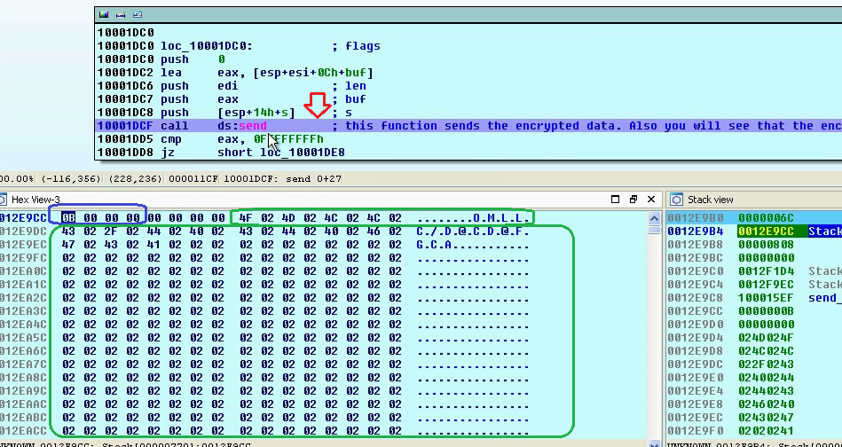
Malware Sends the Encrypted Data
Malware sends the encrypted data to the C2
www.SecurityXploded.com
www.SecurityXploded.com
www.SecurityXploded.com
www.SecurityXploded.com

Slide 26
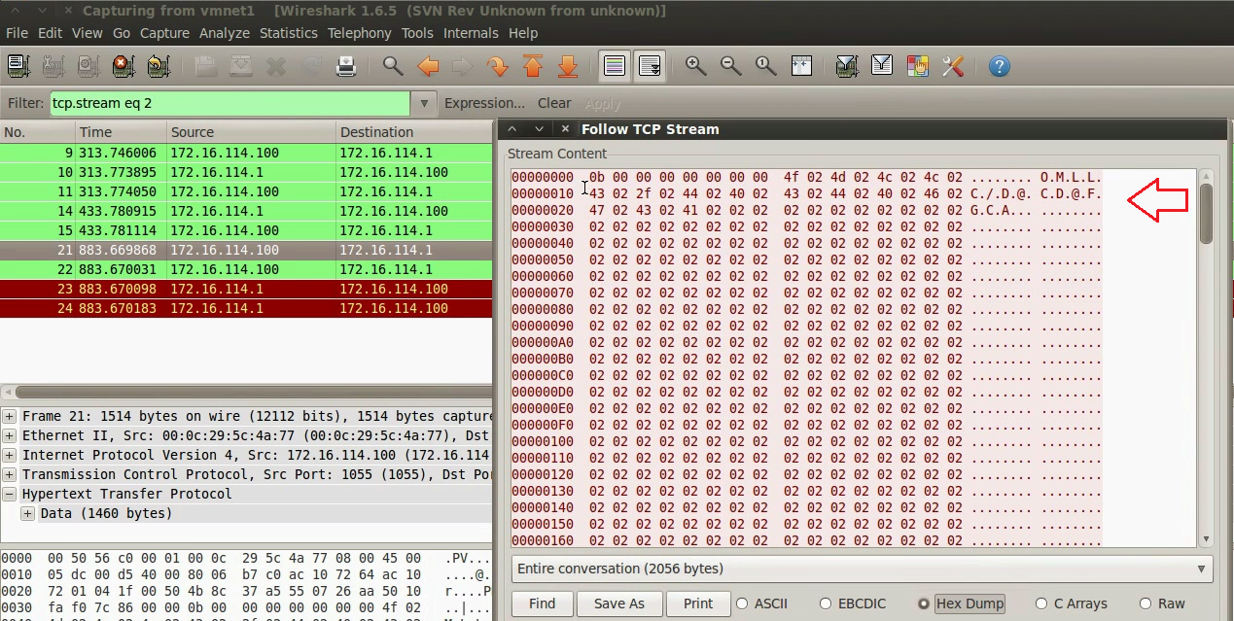
Malware Sends the Encrypted Data (contd...)
The packet capture shows the encrypted traffic
www.SecurityXploded.com
www.SecurityXploded.com
www.SecurityXploded.com
www.SecurityXploded.com

Slide 27
References
Complete Reference Guide for Advanced Malware Analysis Training
[Include links for all the Demos & Tools]
www.SecurityXploded.com

Slide 28
Thank You !
www.SecurityXploded.com

