Slide 1

Part 2 - Dissecting the HeartBeat APT RAT Functionalities
Advanced Malware Analysis Training Series
Monnappa
www.SecurityXploded.com

Slide 2
Disclaimer
The Content, Demonstration, Source Code and Programs presented here is "AS IS" without any warranty or conditions of any kind. Also the views/ideas/knowledge expressed here are solely of the trainer’s only and nothing to do with the company or the organization in which the trainer is currently working.
However in no circumstances neither the Trainer nor SecurityXploded is responsible for any damage or loss caused due to use or misuse of the information presented here.

Slide 3
Acknowledgement
Special thanks to Null community for their extended support and co-operation.
Special thanks to ThoughtWorks for the beautiful venue.
Thanks to all the trainers who have devoted their precious time and countless hours to make it happen.

Slide 4

Advanced Malware Analysis Training
This presentation is part of our Advanced Malware Analysis Training program. Currently it is delivered only during our local meets for FREE of cost.
For complete details of this course, visit our Security Training page.

Slide 5
Who am I
Monnappa
m0nna
Member of SecurityXploded
Info Security Investigator @ Cisco
Reverse Engineering, Malware Analysis, Memory Forensics
Email: monnappa22@gmail.com
Blog: http://malware-unplugged.blogspot.in
Twitter: @monnappa22
LinkedIn: http://www.linkedin.com/pub/monnappa-ka-grem-ceh/42/45a/1b8

Slide 6
Contents
HeartBeat RAT Functionalities
Part 2A - Demo
Part 2B - Demo
Part 2C – Demo
Part 2D – Demo
Part 2E– Demo
Part 2F– Demo
Part 2G - Demo
References
www.SecurityXploded.com

Slide 7
HeartBeat RAT Functionalities
In this session, we will cover below HeartBeat RAT functionalities
Part 2a) Decrypting various communications
Part 2b) Functionality 1 - Process enumeration
Part 2c) Functionality 2 - Process termination
Part 2d) Functionality 3 - Create and Write to File
Part 2e) Functionality 4 - Launch new application (create process)
Part 2f) Functionality 5 - Reverse Shell
Part 2g) Functionality 6 - Restart System
www.SecurityXploded.com

Slide 8
Part 2A – Demo Decrypting various communications of Heartbeat RAT

Slide 9
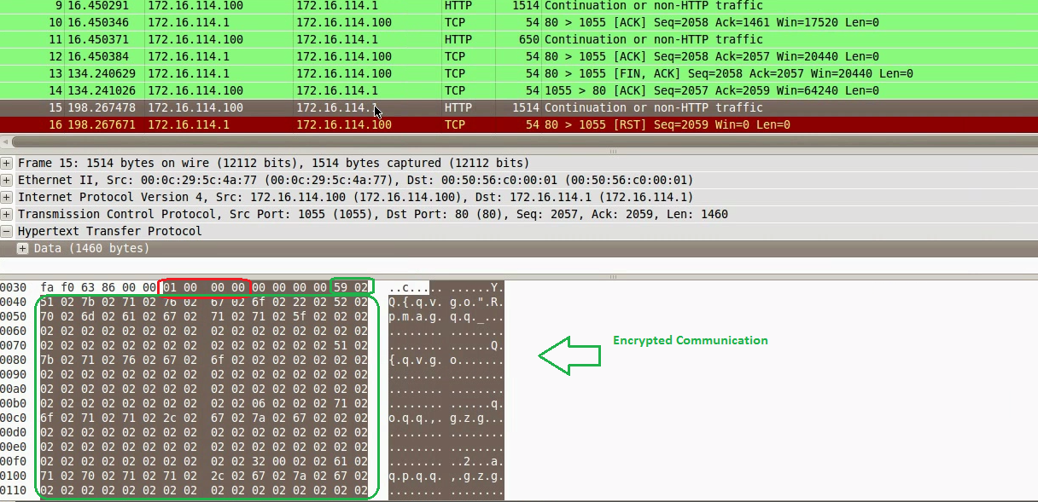
Encrypted Process listing
Below screenshot shows the encrypted process listing sent to the C2 server
www.SecurityXploded.com

Slide 10
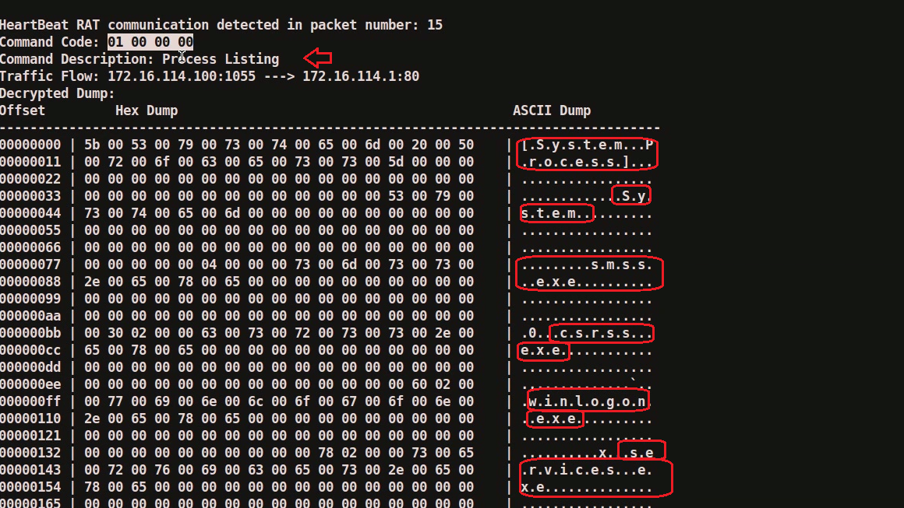
Decrypted Process listing
Below screenshot shows the decrypted process listing
www.SecurityXploded.com

Slide 11
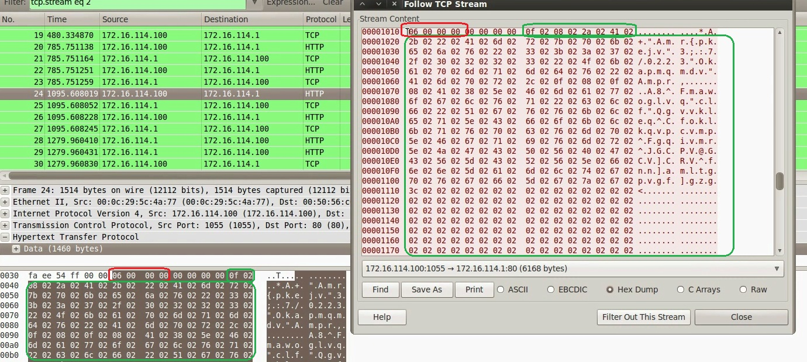
Encrypted Reverse Shell
Below screenshot shows the encrypted reverse shell sent by the malware
www.SecurityXploded.com

Slide 12
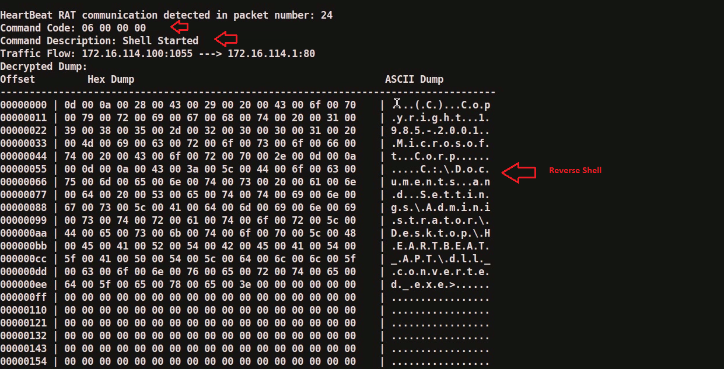
Decrypted Reverse Shell
Below screenshot shows the decrytped reverse shell
www.SecurityXploded.com

Slide 13
Part 2B – Demo Hb rat functionality 1 - Process enumeration

Slide 14
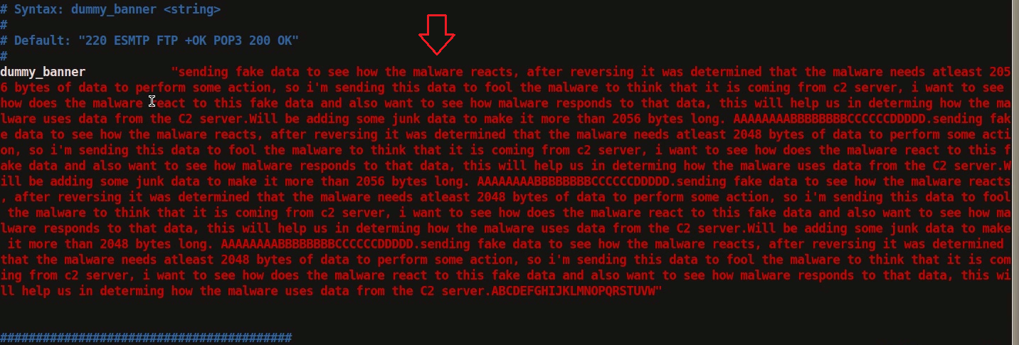
Sending Fake Data
Since malware expects atleast 2056 bytes of data, sending more than 2056 bytes of fake data
www.SecurityXploded.com

Slide 15
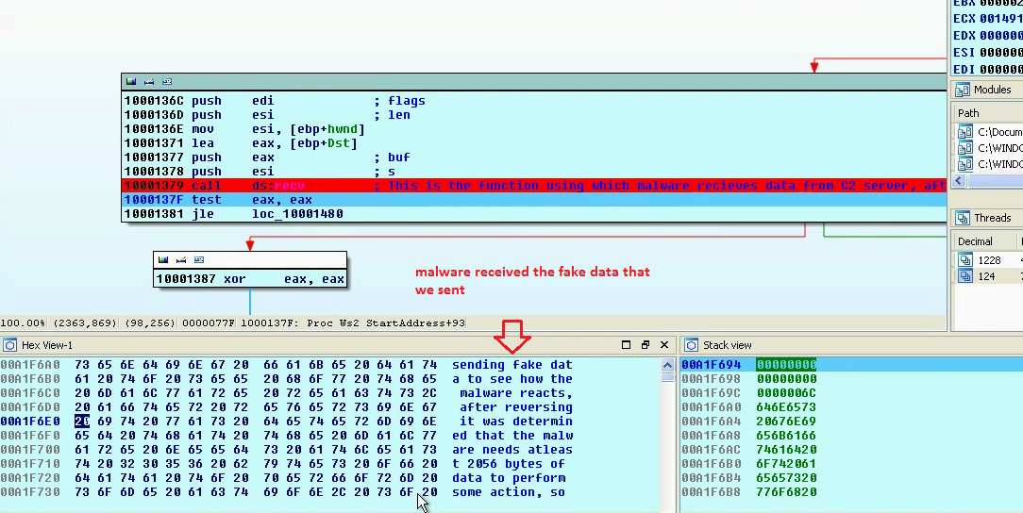
Malware Received Fake Data
Malware received the fake date we sent
www.SecurityXploded.com

Slide 16
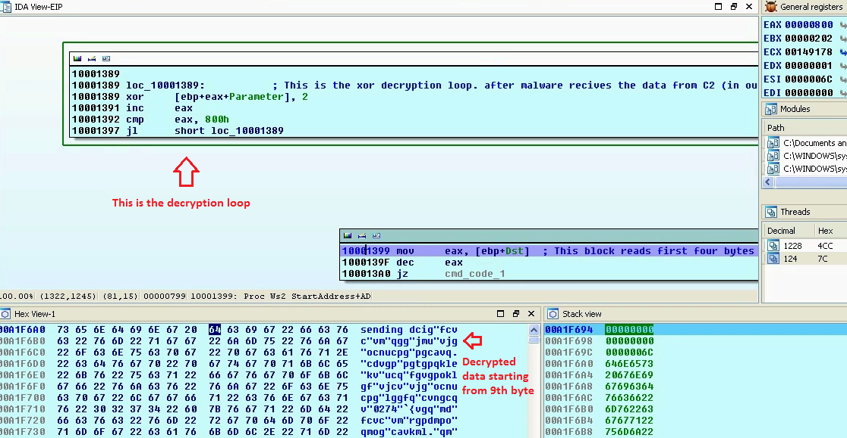
Malware Decrypts Received Data
Malware decrypts the received data from 9th byte
www.SecurityXploded.com

Slide 17
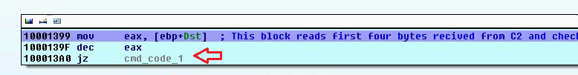
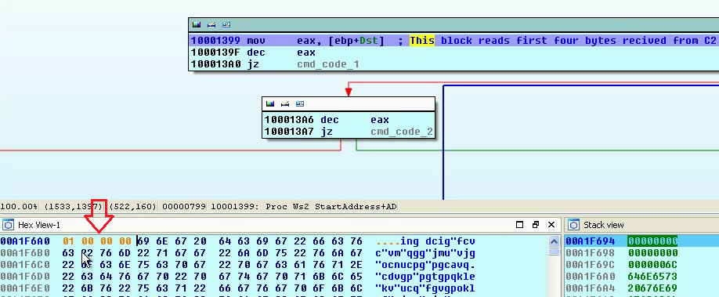
Malware Checks for Command Code 1
Malware checks if the first four byte is 01 00 00 00, so modifying the first four bytes
www.SecurityXploded.com

Slide 18
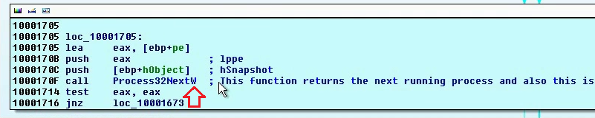
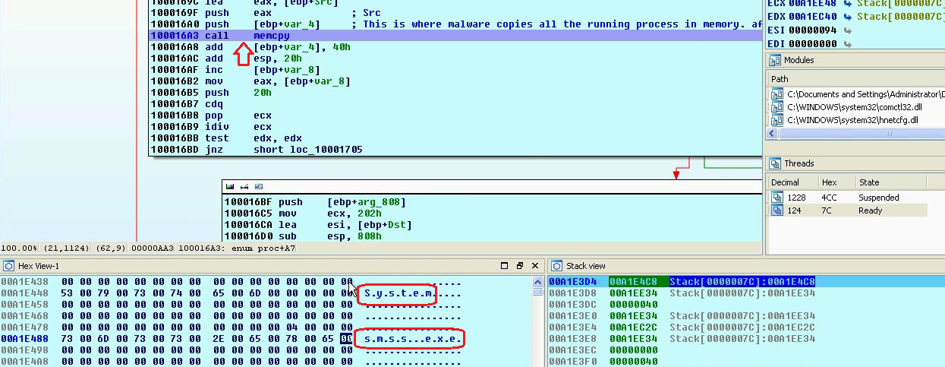
Malware Enumerates Processes
When malware receives the command code 1 (01 00 00 00), its enumerates processes on the system

Slide 19
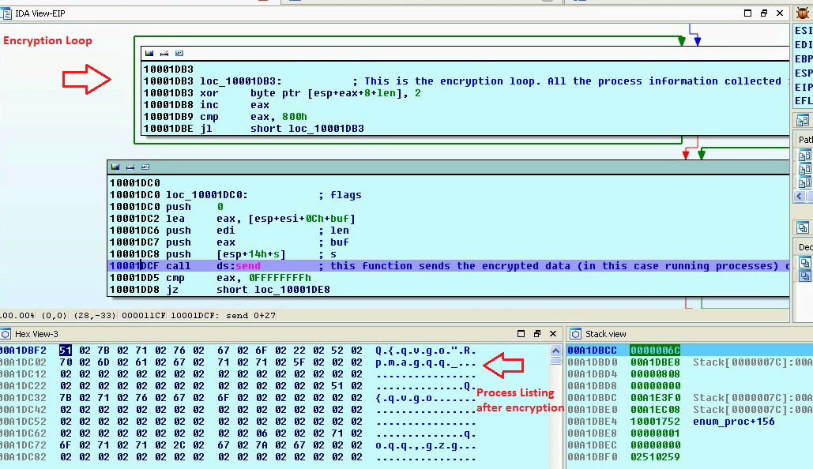
Encrypts Enumerated Processes
Malware encrypts the enumerated processes using the xor encryption algorithm

Slide 20
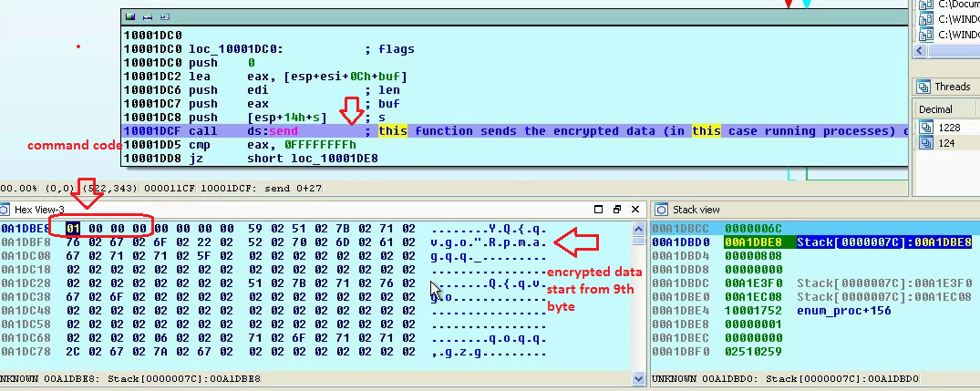
Sends Encrypted Process Listing
Malware sends encrypted process listing to the C2 (command and control) server

Slide 21
Part 2C – Demo Hb rat functionality 2 – Process termination

Slide 22
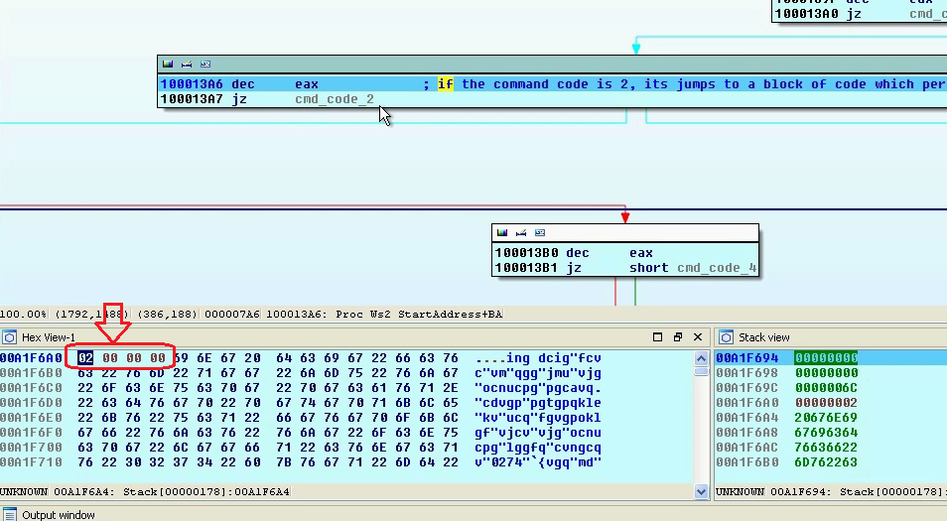
Malware Checks for Command Code 2
Malware checks if the first four byte is 02 00 00 00, so modifying the first four bytes

Slide 23
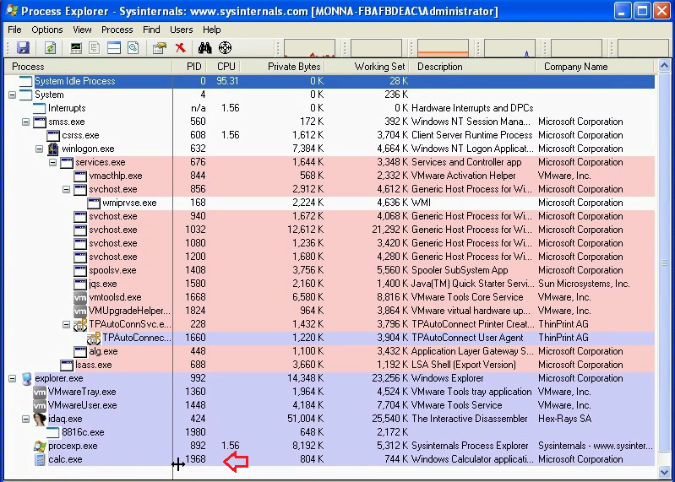
Terminate the calc.exe (pid 1968)
Malware interprets 9th byte as process id and terminates the process with that process id. Lets give malware the process id of calc.exe
www.SecurityXploded.com

Slide 24
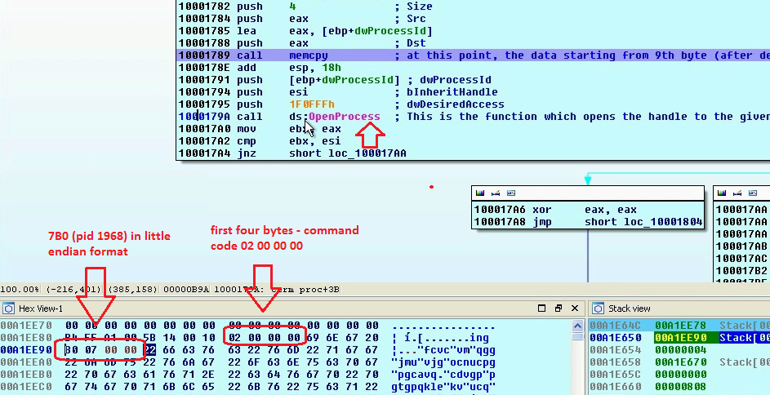
Opens Handle to Process
Malware opens handle to the calc.exe pid 1968
www.SecurityXploded.com

Slide 25
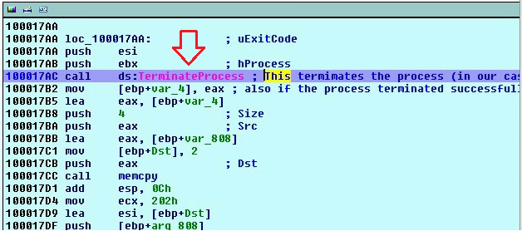
Terminates calc.exe process
Malware terminates the process by calling “TerminateProcess” API call

Slide 26
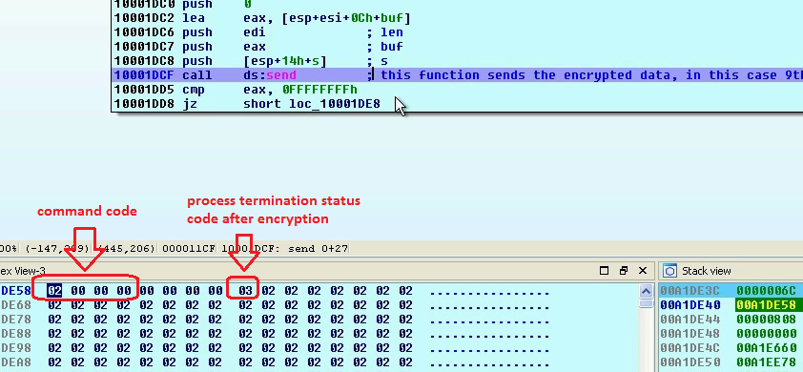
Malware Sends Encrypted Status Code
After terminating the process, malware encrypts the process termination status code and sends it to C2
www.SecurityXploded.com

Slide 27
Part 2D – Demo Hb rat functionality 3 – Create and Write to File

Slide 28
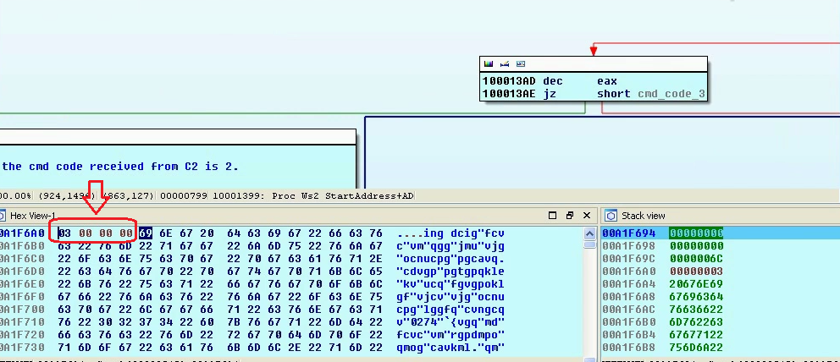
Malware Checks for Command Code 3
Malware checks if the first four byte is 03 00 00 00, so modifying the first four bytes
www.SecurityXploded.com

Slide 29
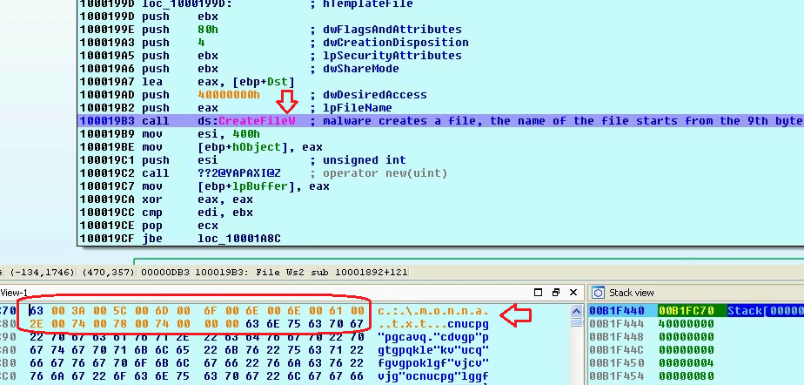
Malware Creates File
Malware reads the data starting from the 9th byte It interprets this as the file name and creates a file

Slide 30
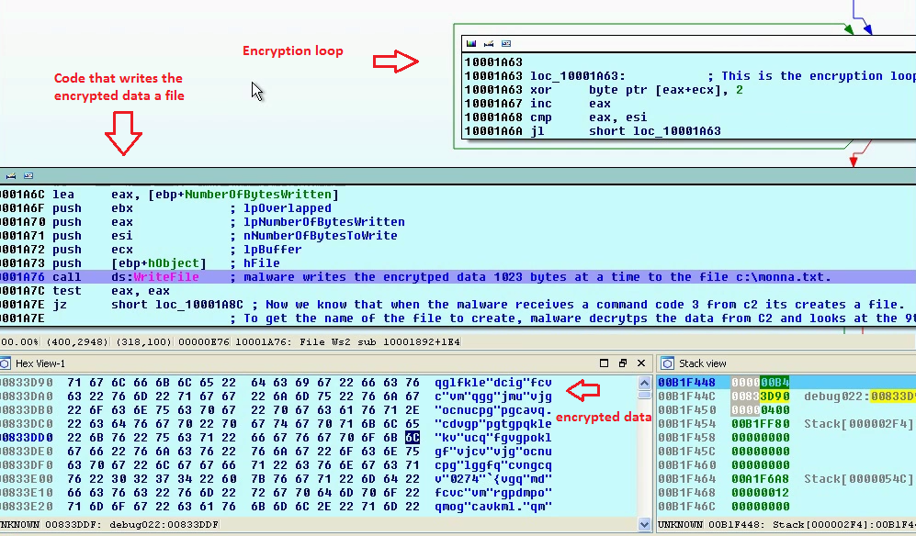
Malware Writes Encrypted Data
Malware receives data from C2, encrypts it and writes the encrypted data to the file.
www.SecurityXploded.com

Slide 31
Part 2E – Demo Hb rat functionality 4 – Launch new application

Slide 32
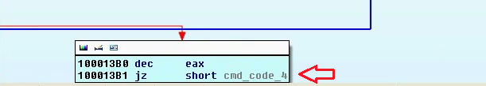
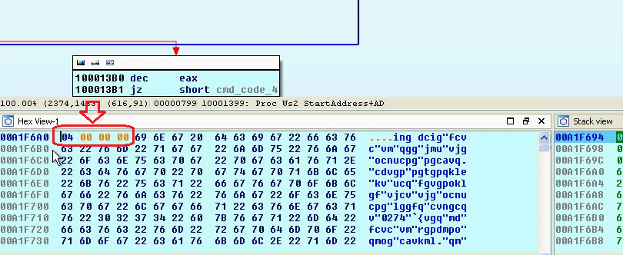
Malware Checks for Command Code 4
Malware checks if the first four byte is 04 00 00 00, so modifying the first four bytes
www.SecurityXploded.com

Slide 33
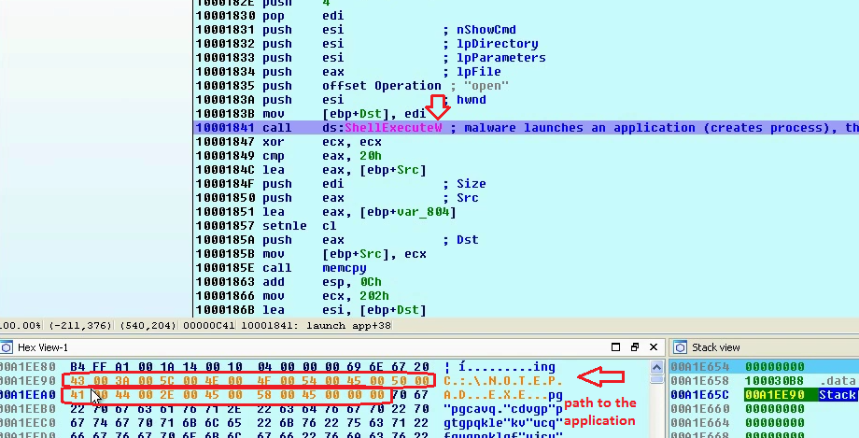
Malware Launches Application
Malware reads bytes starting from the 9th byte and interprets this as the path to the application to launch.
www.SecurityXploded.com
www.SecurityXploded.com

Slide 34
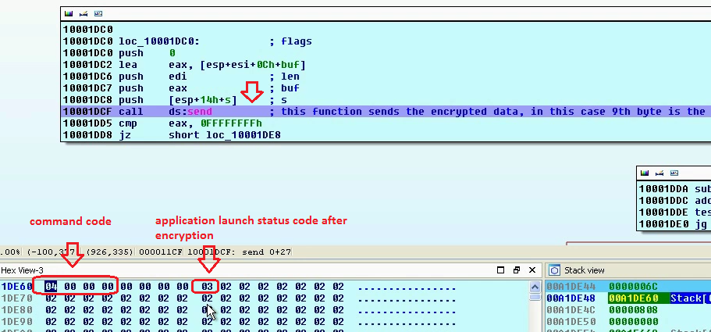
Sends Encrypted Status Code
After launching the new application, malware encrypts the application launch status code and sends it to C2
www.SecurityXploded.com
www.SecurityXploded.com
www.SecurityXploded.com

Slide 35
Part 2F – Demo Hb rat functionality 5 – reverse shell

Slide 36

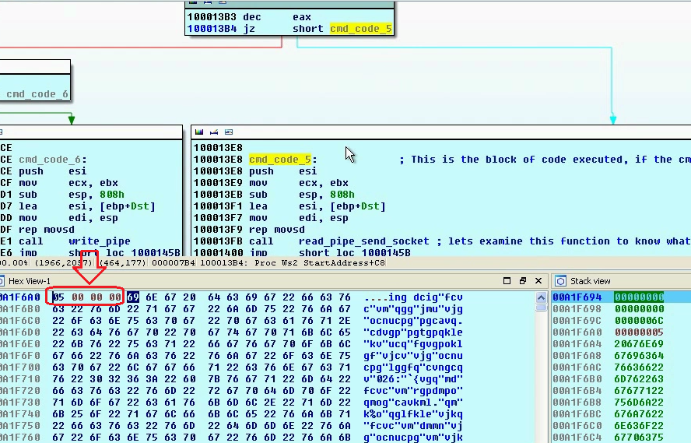
Malware Checks for Command Code 5
Malware checks if the first four byte is 05 00 00 00, so modifying the first four bytes
www.SecurityXploded.com
www.SecurityXploded.com
www.SecurityXploded.com
www.SecurityXploded.com

Slide 37
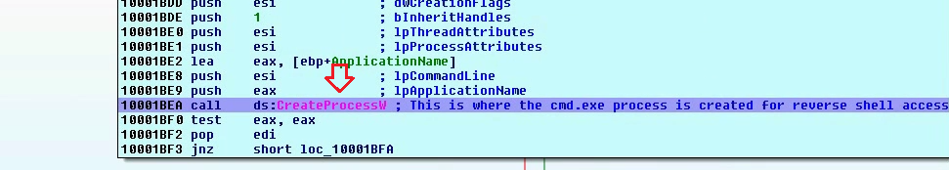
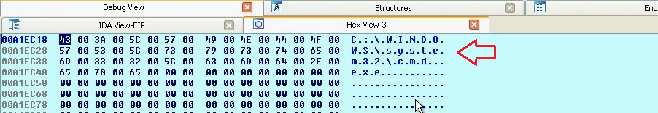
Malware launches cmd.exe
Malware creates cmd.exe process
www.SecurityXploded.com
www.SecurityXploded.com
www.SecurityXploded.com
www.SecurityXploded.com

Slide 38
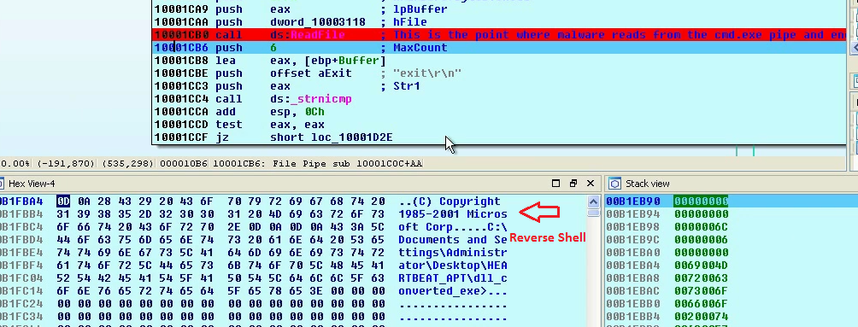
Malware creates Reverse Shell
Malware creates Reverse Shell
www.SecurityXploded.com
www.SecurityXploded.com
www.SecurityXploded.com
www.SecurityXploded.com

Slide 39
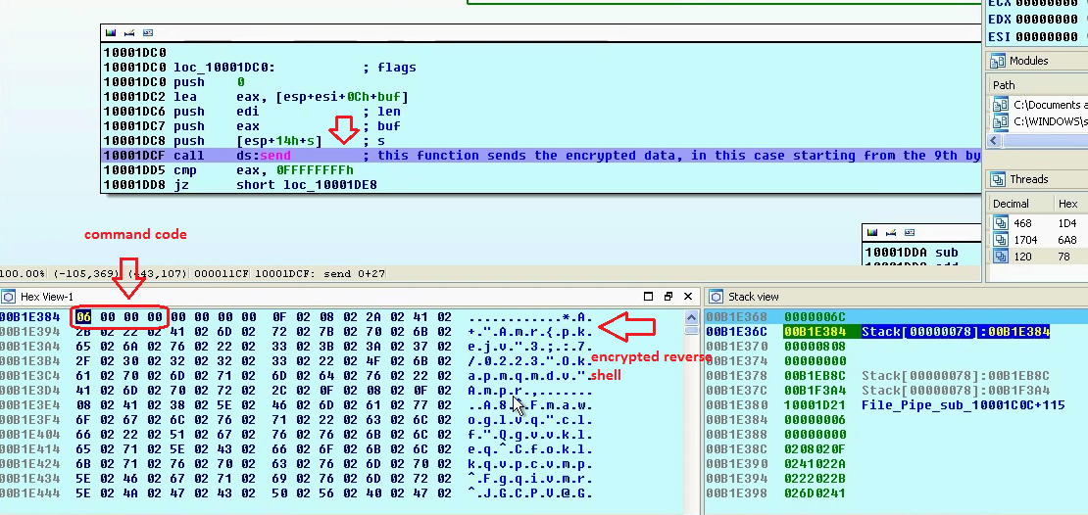
Sends Encrypted Reverse Shell
Malware sends encrypted reverse shell to the C2
www.SecurityXploded.com
www.SecurityXploded.com
www.SecurityXploded.com
www.SecurityXploded.com

Slide 40
Part 2G – Demo Hb rat functionality 6 – restart system

Slide 41
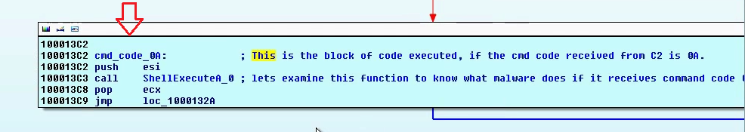
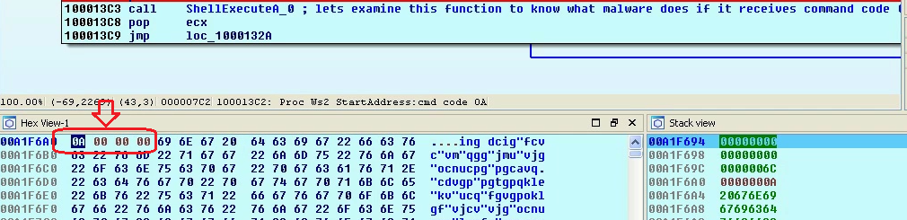
Malware Checks for Command Code 0A
Malware checks if the first four byte is 0A 00 00 00, so modifying the first four bytes
www.SecurityXploded.com
www.SecurityXploded.com
www.SecurityXploded.com
www.SecurityXploded.com

Slide 42
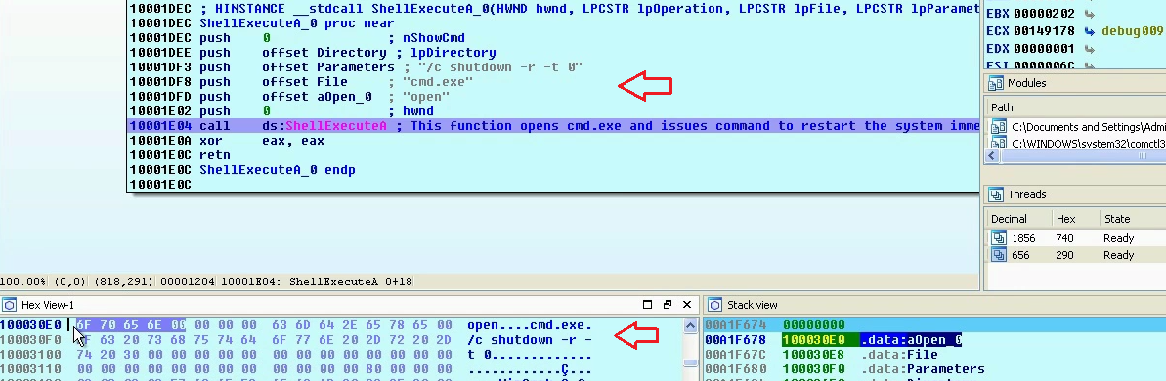
Malware Restarts The System
Malware restarts the system
www.SecurityXploded.com
www.SecurityXploded.com
www.SecurityXploded.com
www.SecurityXploded.com

Slide 43
References
Complete Reference Guide for Advanced Malware Analysis Training
[Include links for all the Demos & Tools]
www.SecurityXploded.com

Slide 44
Thank You !
www.SecurityXploded.com

