Slide 1

Botnet Analysis - I
Advanced Malware Analysis Training Series
Amit Malik
www.SecurityXploded.com

Slide 2
Disclaimer
The Content, Demonstration, Source Code and Programs presented here is "AS IS" without any warranty or conditions of any kind. Also the views/ideas/knowledge expressed here are solely of the trainer’s only and nothing to do with the company or the organization in which the trainer is currently working.
However in no circumstances neither the Trainer nor SecurityXploded is responsible for any damage or loss caused due to use or misuse of the information presented here.

Slide 3
Acknowledgement
Special thanks to Null community for their extended support and co-operation.
Special thanks to ThoughtWorks for the beautiful venue.
Thanks to all the trainers who have devoted their precious time and countless hours to make it happen.

Slide 4

Advanced Malware Analysis Training
This presentation is part of our Advanced Malware Analysis Training program. Currently it is delivered only during our local meets for FREE of cost.
For complete details of this course, visit our Security Training page.

Slide 5
Who am I?
Amit Malik
  Member, SecurityXploded
  Security Researcher, McAfee Labs
  Reversing, Malware Analysis, Exploit Analysis/Development etc.
  E-mail: m.amit30@gmail.com

Slide 6
Content
Bots and Botnets
Important point #1 (Registers etc.)
Important point #2 (Procedure calls etc.)
Important point #3 (code injection etc.)
Case Study: Waledac Botnet
  Waledac C&C communication
  Rapid Reversing Techniques
  Waledac Analysis (C&C)
  Summary

Slide 7
Bots and Botnets
What is a Bot and Botnet?
Commercialized and Infrastructure based malware class.
C&C – Command and Control
Centralized C&C communication
Distributed C&C communication (e.g: P2P)
Some Popular Bots
  Kehlios, Carberp, Zeus, Nittol, Alureon, Maazben, Waledac etc.

Slide 8
Important point #1
Pay very close attention to the following registers in the code.
  Fs:[0]
  Fs:[18]
  Fs:[30]
When function returns check EAX register
Check ECX when you are in loop
ESI and EDI locations during string copy ops.

Slide 9
Fs:[0] (SEH)
Fs:[0] holds SEH (Structured Exception Handler) address
Some malicious programs abuses SEH in order to fool novice reverse engineer.
  Example code
    Mov eax, some address
    Push eax
    Push dword ptr fs:[0]
    Mov fs:[0], esp ; EAX addr now becomes SEH.
    Some invalid instruction that generate an exception and transfer the execution to the address (which was in EAX).

Slide 10
Fs:[18] and Fs:[30]
Fs:[18] holds TEB (Thread Environment Block) Address
  From TEB structure we can access stack base, stack end and PEB address.
  Use dt nt!_TEB –r1 command in windbg to see the TEB structure.
Fs:[30] holds PEB (Process Environment Block) Address
  From PEB we can access some key information like process heaps, loaded modules, some debugger detection flags.
  Use dt nt!_PEB –r2 command in windbg to see the PEB structure

Slide 11
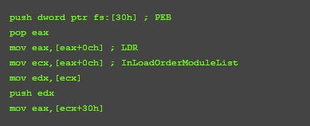

Fs:[18] and fs:[30] example codes
Loaded modules enumeration (Extremely important) – IAT rebuilding, get function addresses etc.
Debugger detection

Slide 12
Important point #2
Asynchronous procedure calls (APC)
  IRQL (Interrupt Request Level) 1
  Used by malicious softwares to fool beginner reverse engineers
  WriteFileEx, ReadFileEx, SetWaitableTimer,
  SetWaitableTimerEx, QueueUserAPC API can be used to execute code via APC
  http://msdn.microsoft.com/en-us/library/windows/desktop/ms681951(v=vs.85).aspx

Slide 13
E.g. ReadFileEx
Reads data from the specified file or input/output (I/O) device. It reports its completion status asynchronously, calling the specified completion routine when reading is completed or cancelled and the calling thread is in an alertable wait state.
BOOL WINAPI ReadFileEx( _In_ HANDLE hFile, _Out_opt_ LPVOID lpBuffer, _In_ DWORD nNumberOfBytesToRead, _Inout_ LPOVERLAPPED lpOverlapped, _In_opt_ LPOVERLAPPED_COMPLETION_ROUTINE lpCompletionRoutine );

Slide 14
Role of SleepEx and Similar APIs
Suspends the current thread until the specified condition is met. Execution resumes when one of the following occurs:
  An I/O completion callback function is called.
  An asynchronous procedure call (APC) is queued to the thread.
  The time-out interval elapses.
  SleepEx, SignalObjectAndWait,MsgWaitForMultipleObjectsEx, WaitForMultipleObjectsEx, or WaitForSingleObjectEx
DWORD WINAPI SleepEx( _In_ DWORD dwMilliseconds, _In_ BOOL bAlertable );
If the parameter is TRUE and the thread that called this function is the same thread that called the extended I/O function (ReadFileEx or WriteFileEx), the function returns when either the time-out period has elapsed or when an I/O completion callback function occurs. If an I/O completion callback occurs, the I/O completion function is called. If an APC is queued to the thread (QueueUserAPC), the function returns when either the timer-out period has elapsed or when the APC function is called.

Slide 15
Important point #3
Code Injection – Very well explained in our couple of articles, check article section at securityxploded.
Malwares often inject code to some legitimate processes to bypass host based security solutions or to minimize the footprints
Injected code can be direct executable code or can be a DLL(Dynamic Link Library).
OpenProcess, VirtualAllocEx, WriteProcessMemory, CreateRemoteThread, NtCreateThreadEx, ZwCreateThread, APC APIs
Services – CreateService, StartService.
New Process – CreateProcessA/W, ShellExecute/Ex, WinExec etc.
**Process Hollowing and variants, In-Memory execution, Packers etc.

Slide 16
Case Study: Waledac botnet
Popular e-mail spam botnet
Taken down by microsoft in march 2010
Around 90,000 computers were infected
Capable to send 1.5 billion spam messages a day. (1% of the total global spam volume)
http://en.wikipedia.org/wiki/Waledac_botnet
In this presentation we will focus only on C&C communication

Slide 17
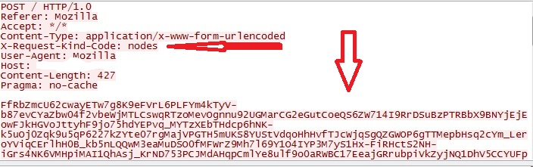
Waledac C&C Communication
Bzip, AES, base64 encryption/encoding algorithms used in the network communication
Custom header field in HTTP protocol
P2P style communication over HTTP protocol

Slide 18
Waledac C&C Communication
Ok, We have enough information to start our analysis
Now our task is to
  Indentify which functions are responsible for encryption
  Identify which function is responsible for sending the request
  Identify what sent into the request (Clear Text)
Challenge
  Lots of code (around 950 KB, ~14 MB IDB binary)
  More than 4,000 functions
  Completely unaware about the malware behaviour (code based)

Slide 19
Rapid Reversing Techniques
Tracing - most common approach
  Instruction based tracing
    Pros
      Complete flow including branching /decisions made by program during execution
      Powerful, given time and space provides solid results
    Cons
      Very slow (each instruction logging)
      Huge output, difficult to analyze
      For huge code base nearly impossible
  Functions call based tracing
    Pros
      Functions call flow during execution
      Provides fair details about the binary
    Cons
      Not very helpful in malware analysis (packers, run rime executable code generation etc.)

Slide 20
Rapid Reversing Techniques
  API call based tracing
    Pros
      Can log all API calls even from newly allocated regions i.e. run rime unpacked code or run rime generated code
      Provides good details about the malware and system interaction
      Excellent for malware analysis, more advanced and sophisticated techniques can be used like API call clustering, API call based execution path diffing, Automated unpacking etc.
    Cons
      Efficiency and flexibility is based on the actual tracing software otherwise it can be very painful like instruction based tracing (hook hopping, API calls in big loops etc.)
These techniques are often used with conditions after a specific point/address

Slide 21
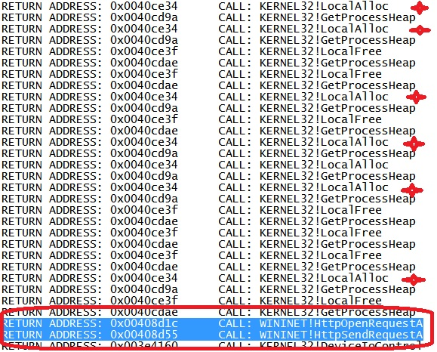
  Waledac Analysis (C&C)
Our encryption routines should be near this code segment. We will look into function call flow of the malware upto this code so that we can get better understanding of the nearby code.

Slide 22
Continue...
In snapshot we see following things
  Calls to LocalAlloc API (Another point confirming encryption routines near the code)
  Call to HttpSendRequestA API (send the encrypted payload to C&C server)
Now identify the functions that are calling the above APIs, How ?
Static cross references doesn’t provide much details so we will use tracing.
* I am not going to share my tracing tools so please don’t make request for them ☺.

Slide 23
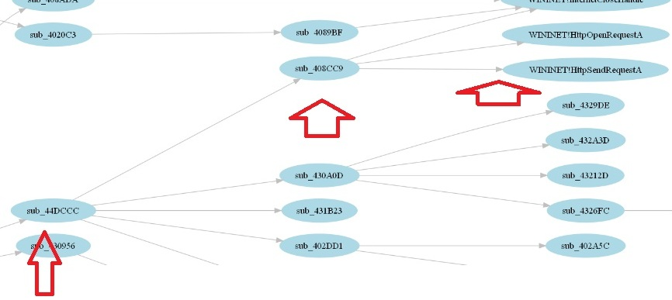
Continue...
Below snapshot is from single shot function call ( and partial API) tracing of the malware.
We can mark sub_44DCCC as start point, because sub_408CC9 is directly calling our APIs.

Slide 24
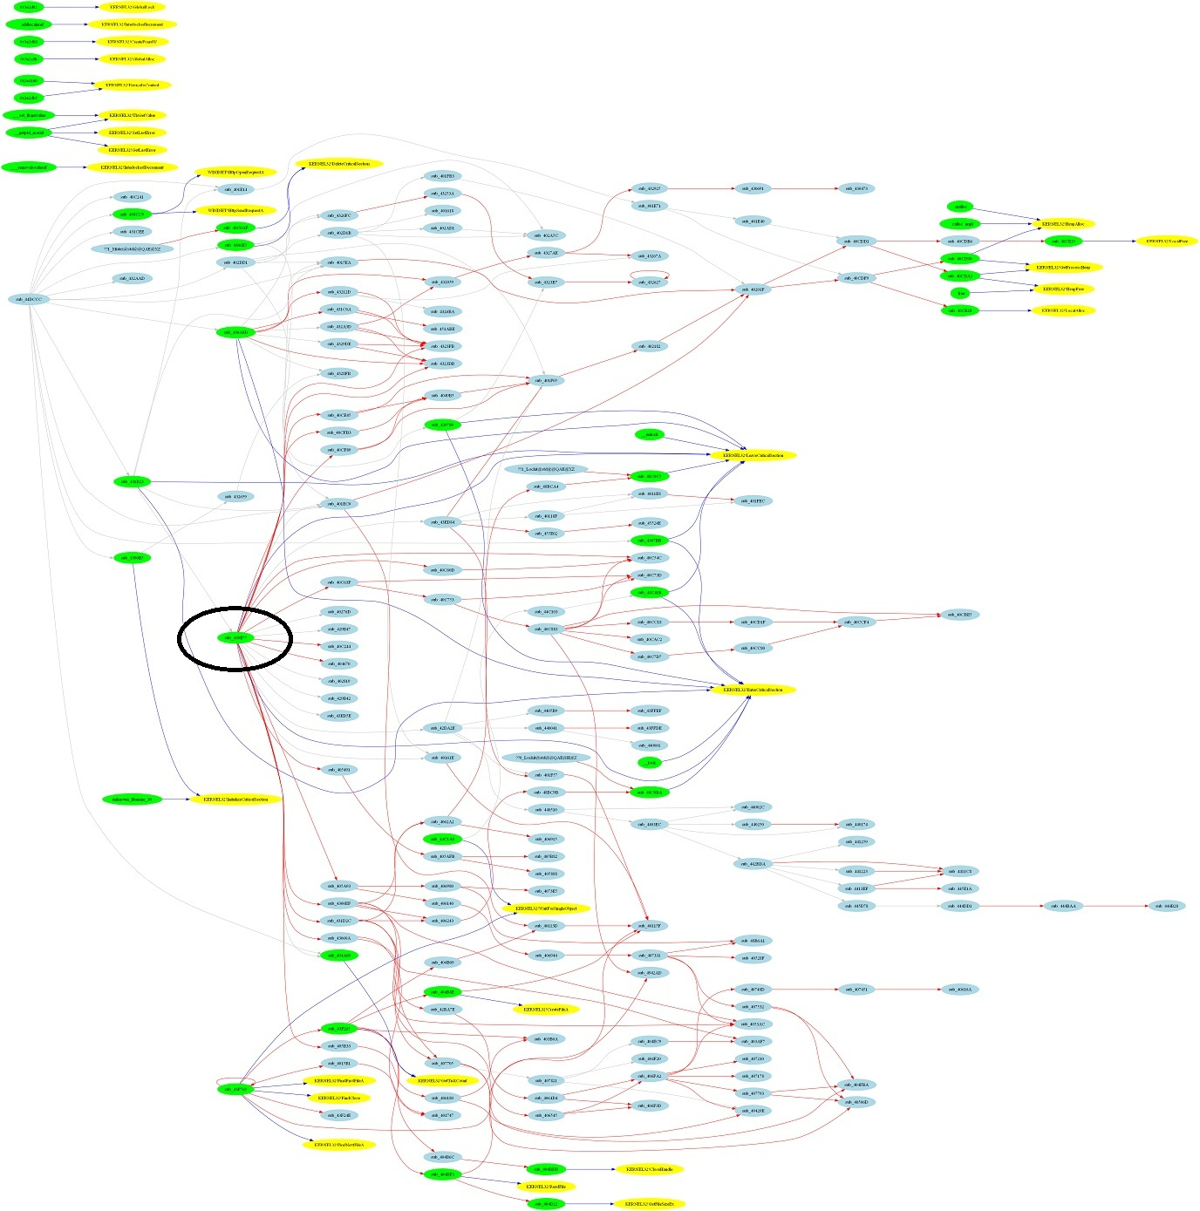
Tracing Function SUB_44DCCC
Full function and API trace of the function sub_44DCCC.
Inside sub_44DCCC we see an another call (zoom-next slide) to a function which seems to hold 60% of code for sub_44DCCC and also calls LocalAlloc API, so that is our function.

Slide 25
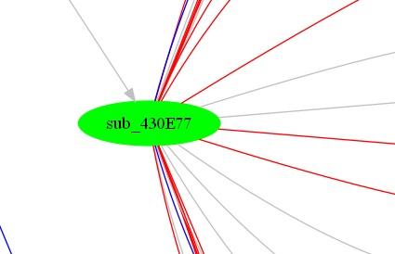
Important Function
Put breakpoint on this function, run, put breakpoint on LocalAlloc, use single stepping (F8) and wait for LocalAlloc call.
Monitor LocalAlloc returned pointer, and keep single stepping on. Eventually you will see the answer of all the questions.
So pretty simple huh?? Try it yourself. ☺

Slide 26
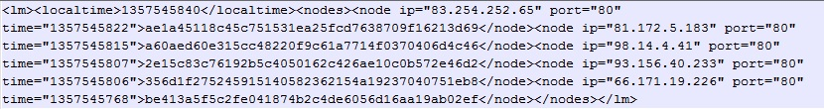
C&C Payload (Clear Text)
Waledac uses xml style in its payload as we can see in the below snapshot.
However to know the meaning and purpose of this payload we need more analysis and threat intelligence, but most of the time it will suffice. ☺

Slide 27
Demonstration
https://vimeo.com/57755964

Slide 28
Summary
Complete analysis and threat report can take weeks to months, depending on the threat.
Tracing methods are extremely helpful in large code base malwares. Actually tracing is much more powerful, think about taint analysis.
Reverse Engineering Automation is a fascinating and useful study area.
VERA (ether dependent), Zynamics BinNavi (not very useful for malware analysis) etc. can be used to accelerate reverse engineering but they are not very flexible. (inclusion, exclusion, trace from one node to another node etc.)
I know it’s a lots of load on your brain but try to understand the malware yourself.
Malware MD5 : 0A0E0AD7175B17A5D6AFFC73279BDA8B

Slide 29
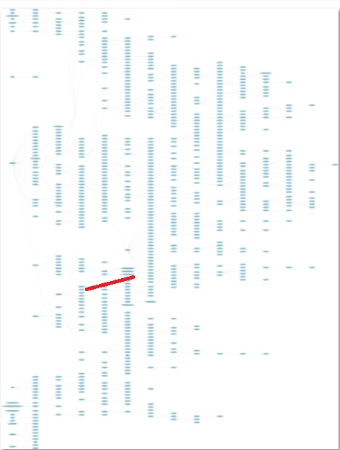
Single Shot Function Call Trace
In our analysis we discussed only the marked area in this snapshot.
This trace still not covering entire malware calls (because c&c is down)

Slide 30
Reference
Complete Reference Guide for Advanced Malware Analysis Training
[Include links for all the Demos & Tools]

Slide 31
Thank You !
www.SecurityXploded.com

