Slide 1

Botnet Analysis – II (Dynamic Taint Analysis)
Advanced Malware Analysis Training Series
Amit Malik
www.SecurityXploded.com

Slide 2
Disclaimer
The Content, Demonstration, Source Code and Programs presented here is "AS IS" without any warranty or conditions of any kind. Also the views/ideas/knowledge expressed here are solely of the trainer’s only and nothing to do with the company or the organization in which the trainer is currently working.
However in no circumstances neither the Trainer nor SecurityXploded is responsible for any damage or loss caused due to use or misuse of the information presented here.

Slide 3
Acknowledgement
Special thanks to Null community for their extended support and co-operation.
Special thanks to ThoughtWorks for the beautiful venue.
Thanks to all the trainers who have devoted their precious time and countless hours to make it happen.

Slide 4

Advanced Malware Analysis Training
This presentation is part of our Advanced Malware Analysis Training program. Currently it is delivered only during our local meets for FREE of cost.
For complete details of this course, visit our Security Training page.

Slide 5
Who am I?
Amit Malik
Member, SecurityXploded
Security Researcher, McAfee Labs
Reversing, Malware Analysis, Exploit Analysis/Development etc.
E-mail: m.amit30@gmail.com

Slide 6
Content
Recap
Botnets
Analysis techniques
Automation and Our sessions
Advanced Analysis and Detection Technologies
Execution flow graphs
Data flow graphs i.e dynamic taint analysis (DTA)
Exploit detection
Malware analysis and detection
Finally, A joke (APT – Advanced Persistent Threat)

Slide 7
Recap
In previous session we discussed,
Botnets
Rapid Reversing Techniques (RRT)
Waledac botnet analysis using RRT
The RRTs we discussed earlier are the basic block of today's presentation
We will cover automation in our upcoming sessions (details, next slide)

Slide 8
Automation and Our Sessions
We will cover different aspects of automation in our upcoming sessions
Reversing Automation - Harsimran Walia
Sandbox or automated malware analysis systems – Monnapa
Today’s presentation is more on scientific solutions rather than normal automation stuff.

Slide 9
Advanced Analysis and Detection Technologies
Security is a real complex problem at present.
Threats are going more and more sophisticated.
Traditional technologies are not enough to detect today’s threats.
So what we do now?
Well, couple of technologies proposed earlier but DTA is the fascinating and powerful one, although used since 1989 ☺ (pearl programming language).
Let’s talk about the RRTs first and then DTA.

Slide 10
Execution Flow Graphs
Using RRTs we generate graph and analyze the application.
Can we use the same concept to solve another problem?
“A sample is first executed on the virtual machine but didn’t generated any network traffic, same sample again executed on the real system and this time generated the network traffic.”
In minimum possible time identify the code segment which is responsible for detecting the VM or deviating the execution flow on virtual machine.

Slide 11
Execution Flow Graphs
Generate the execution flow graph on VM and real machine and then compare them.
Example:
Instead of VM and real system let’s call them state 1 and state 2.
API Call Graph - VM
.......
LoadLibraryA
ExitProcess
.......
LoadLibraryA
UrlDownloadToFile
WinExec
API Call Graph – Real System

Slide 12
Execution Flow Graphs Limitations
Can’t use in detection, too coarse-grained approach.
Good for analysis but not always.
We need more fine-grained approach.
“Data” is the most important point of the entire system.
We need to track some specific data in order to claim some malicious behavior of any binary.

Slide 13
Dynamic Taint Analysis
Track information or data flow inside binary during execution.
Information flow?
What type of data?
Data from all untrusted sources, normally user input, file read, network read etc.
Three main components
Taint source: user input, file read, network read etc.
Taint: data from taint sources (labeled data – memory start address and size, registers.)
Taint propagation: flow of tainted data in binary

Slide 14
Taint Propagation
Data can be affected by two operations
Data movement operations
Arithmetic operations (Including all operations that are based on arithmetic operations like boolean etc.)
IL (Intermediate Language)
Taint Propagation
In data movement operation, destination will be tainted if and only if source is tainted.
Example: mov eax,tainted data
mov ebx,eax
here in 2nd instruction ebx is tainted because eax is tainted.
Taint propagation is transitive.
A => T(B), B => T(C) means A => T(C)
In arithmetic operation, result will be tainted if any byte or bit of the operands is tainted.
In some situations the above propagation methods may fail. eg: xor eax,eax, result should not be tainted in such cases.

Slide 15
Data (Taint) Flow Graph
A graph can be generated based on how taint propagates.
Resulting graph can be checked against the policies to detect the malicious behavior of binary.
What policies?
Some rules that are either generated manually or learned by the machine to distinguish between normal data flow and malicious data flow.
Example: if a tainted variable is used in command execution on operating system then we have some serious problems.

Slide 16
DTA Applications
Exploit Detection
If any time EIP points in user supplied data or in other words if EIP is in tainted memory/data range.
Malware analysis and detection
Provides the answer to the question “how interested data is utilized by the application”
In-depth insight into the binary
Good analysis reports for forensic analysis, malware analysis
Detection can be done using some rules.

Slide 17
Key logger Detection using DTA
Generate clean state (normal state) data flow graphs and use them as policies.
How user name and password data propagates in your browser?
How password data propagates during windows authentication, etc. ?
In key logging
We will see the deviation in data propagation.
Clean state graphs works as a reference i.e data should be utilized by application according to the clean state graphs
In key logging the deviation of data flow trigger the suspicious behavior.

Slide 18
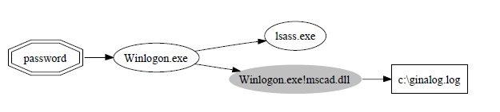
Cont..
Graph from TEMU [see reference]

Slide 19
C&C Detection using DTA
Initially discussed in JackStraws paper [see reference]
What type of data is sent by the application to the server?
What type of data is received by the application from the server?
*Correlate both type of data
See if combination* violates any normal behavior
Example
Application read the machine ID, OS version from registry and send it to the server.
Server send some response after that application download a binary and executes the downloaded binary.
The above data propagation clearly denotes a malicious behavior.

Slide 20
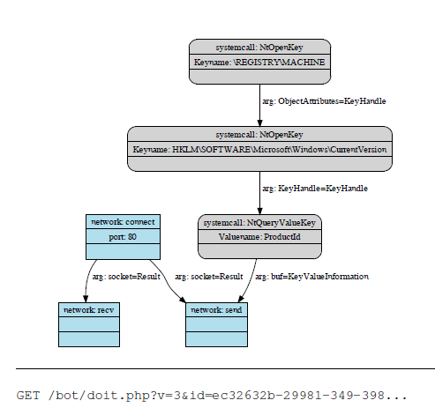
Cont...
Graph from Jackstraws [see reference]

Slide 21
Tools for Implementation
We need to instrument two things
Data movement operations
Arithmetic Operations
*Memory and registers
Scope
Single process
Whole system
Tools
DBI (Dynamic Binary Instrumentation) – PIN from intel
Qemu
Python (pydbg + pyEmu etc.)

Slide 22
DTA Limitations
Can only explore single execution path
However, forward symbolic execution can be used in order to predict event based actions but still not very accurate.
Too expensive for consumer products (slower execution etc.)
Taint propagation methods can be evaded
Complex implementation, usually combined with machine learning logics.

Slide 23
Few systems on DTA
Dytan
Valgrind
TTAnalyze
JackStraws
BitBlaze (TaintQemu/TEMU)

Slide 24
APT
Advanced Persistent threat
What do you think about “persistent” word here.
Symptoms
Similar exe and dll names like system files
Similar registry key names like system registry keys
In some situations less noisy (low network traffic etc.)
Or may be event triggered (logic bombs)
APT and you
For you APT is just a normal malware.

Slide 25
Reference
Complete Reference Guide for Advanced Malware Analysis Training
[Include links for all the Demos & Tools]

Slide 26
Thank You !
www.SecurityXploded.com

