Slide 1

Anti-Analysis Techniques
Advanced Malware Analysis Training Series
Swapnil Pathak
www.SecurityXploded.com

Slide 2
Disclaimer
The Content, Demonstration, Source Code and Programs presented here is "AS IS" without any warranty or conditions of any kind. Also the views/ideas/knowledge expressed here are solely of the trainer’s only and nothing to do with the company or the organization in which the trainer is currently working.
However in no circumstances neither the Trainer nor SecurityXploded is responsible for any damage or loss caused due to use or misuse of the information presented here.

Slide 3
Acknowledgement
Special thanks to Null community for their extended support and co-operation.
Special thanks to ThoughtWorks for the beautiful venue.
Thanks to all the trainers who have devoted their precious time and countless hours to make it happen.

Slide 4

Advanced Malware Analysis Training
This presentation is part of our Advanced Malware Analysis Training program. Currently it is delivered only during our local meets for FREE of cost.
For complete details of this course, visit our Security Training page.

Slide 5
Who am I?
Swapnil Pathak
Security Researcher
Reversing, Malware Analysis, Exploit Analysis etc.
E-mail: swapnilpathak101@gmail.com

Slide 6
Agenda
Introduction
Anti-Reversing techniques
Anti-Debugging
Anti-VM
Anti-Anti-Reversing techniques
Q & A

Slide 7
Anti-Reversing
Implementation of techniques in code to hinder attempts at reverse engineering or debugging a target binary.
Used by commercial protectors, packers and malicious software
Covers
Anti-Debugging
Anti-VM
Anti-Disassembly
Code Obfuscation

Slide 8
Anti-Debug Techniques
Techniques implemented to detect if the program is running under control of a debugger.
Categorized as below
API Based
Flags Based
Timing Based
Exception Based
Breakpoint Detection

Slide 9
PEB (Process Environment Block)
Structure maintained by OS for each running process
Contains user mode parameters associated with a process
Including loaded modules list, debugger status etc
Referenced through fs:[30h]
!peb command in Windbg

Slide 10
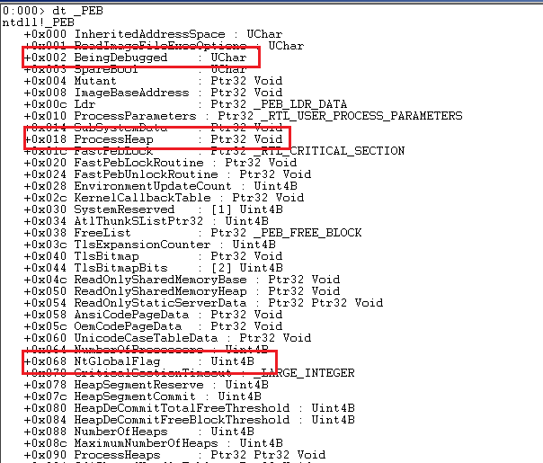

Slide 11
API Based
IsDebuggerPresent
Exported by kernel32.dll
Function accepts no parameters
Checks if BeingDebugged flag in Process Environment Block (PEB) is set
Returns 1 if process is being debugged, 0 otherwise
call IsDebuggerPresent
test eax,eax
jnz debugger_detected
CheckRemoteDebuggerPresent => NtQueryInformationProcess
CheckRemoteDubggerPresent(Handle to the target process, Pointer to a variable
Sets the variable to TRUE if the specified process is being debugged or FALSE otherwise
push offset dbg
push -1
call CheckRemoteDebuggerPresent
test eax, eax
jne debugger_detected

Slide 12
API Based
NtQueryInformationProcess => ZwQueryInformationProcess
Exported by ntdll.dll
Retrieves information about the specified process.
NtQueryInformationProcess(ProcessHandle, ProcessInformationClass, ProcessInformation, ProcessInformationLength, ReturnLength)
ProcessHandle – Handle to the process for which information is to be retrieved.
ProcessInformationClass : Type of process information to be retrieved.
Accepts following values : ProcessBasicInformation(0x0), ProcessDebugPort(0x07), ProcessWow64Information(0x26), ProcessImageFileName(0x27)
ProcessDebugPort : Retrieves port number of the debugger for the process.
Non Zero value indicates that the process is being debugged.

Slide 13
API Based
OutputDebugString
Exported by kernel32.dll
Accepts one parameter : Null terminated string to be displayed
Sends a string to the debugger for display
Sends an error if there is no active debugger for the process to receive the string.
No error indicates presence of a debugger.
FindWindow
Exported by user32.dll
Used to search windows by name or class.
Detect debugger with graphical user interface

Slide 14
API Based
CloseHandle
Exported by kernel32.dll
Involves passing invalid handle
If debugger present EXCEPTION_INVALID_HANDLE (0xC0000008) will be raised
Above exception if intercepted by an exception handler, indicates presence of a debugger.
push 12ab ; any illegal value
call CloseHandle

Slide 15
Flags Based
BeingDebugged Flag
Present in PEB ( Process Environment Block) at offset 0x2
Set to 1 if the process is being debugged.
mov eax, dword [fs:0x30]
movzx eax, byte [eax + 0x02] ; PEB.BeingDebugged
test eax, eax
jnz debugger_detected

Slide 16
Flags Based
NTGlobal Flag
Present in PEB ( Process Environment Block) at offset
0x68 - 32 bit systems
0xBC - 64 bit systems
Contains value 0x70 if the process is being debugged.
FLG_HEAP_ENABLE_TAIL_CHECK(0x10), FLG_HEAP_ENABLE_FREE_CHECK(0x20), FLG_HEAP_VALIDATE_PARAMETERS(0x40)
mov eax, fs :[30h]
mov eax, [eax+68h]
and eax, 0x70
test eax, eax
jne debugger_detected

Slide 17
Flags Based
Heap Flags
ProcessHeap present in PEB ( Process Environment Block) at offset 0x18
Has Flags and ForceFlags Fields set to 0x02 (HEAP_GROWABLE) and 0x0 respectively if the process is not being debugged.
mov eax, fs:[30h]
mov eax, [eax + 18h] ; eax = PEB.ProcessHeap
cmp [eax + 10h] , 0 ; ProcessHeap.ForceFlags
jne debugger_detected
cmp [eax + 0x0c], 2 ; ProcessHeap.Flags
jne debugger_detected

Slide 18
Timing Based
Timing Checks
Compares time spent executing instructions normally and while being debugged.
Longer time taken compared to normal run indicates that the binary is being debugged.
RDTSC ( Read Time Stamp Counter)
GetTickCount()
QueryPerformanceCounter()
rdtsc
mov eax, ebx
…….
rdtsc
sub eax, ecx
cmp eax, 0x100
ja debugger_detected

Slide 19
Exception Based
Interrupts
Consists of inserting interrupt instructions in middle of valid sequence of instructions.
INT3 breakpoint (0xCC, 0xCD 0x03)
INT 1 single step INT2D are stepped through inside the debugger, exception is raised.
If the process is being debugged, exception handler is not invoked as the debugger typically handles the exception
Checks such as setting of flags inside exception handler are used to detect presence of the debugger.

Slide 20
Breakpoint Detection
Hardware Breakpoints
Whenever an exception occurs, a context structure is created and passed to the exception handler.
Context structure contains values of general registers, control registers, debug registers.
Binary being debugged with hardware breakpoints in use will contain values in debug registers indicating presence of debugger.
Memory Breakpoints
Implemented using Guard pages.
Guard Pages are set using the PAGE_GUARD page protection modifier.
Address accessed part of Guard Page will result in STATUS_GUARD_PAGE_VIOLATION exception.
Process being debugged under Ollydbg will treat this as a memory breakpoint and no exception will be raised.

Slide 21
VM Detection
Techniques implemented to detect if the binary is being executed in a virtual environment.
Techniques include
Memory based
Backdoor I/O communication port
Process/Registry

Slide 22
Techniques
Memory specific techniques include Red Pill
Only one IDT, GDT, LDT per processor.
IDT : Used by OS to determine correct response to interrupts and exceptions
GDT/LDT : Define characteristics of the various memory areas used during program execution such as base address, size and access privileges.
IDTR, GDTR, LDTR are internal registers that store the address of these respective tables.
To avoid conflicts between host and guest OS , virtual machine needs to relocate IDT, GDT, LDT
SIDT, SGDT and SLDT are instructions to retrieve values from IDTR, GDTR and LDTR respectively.
Base address stored in the register define if under Virtualized environment.
IDT is at 0x80ffffff in Windows, 0xE8xxxxxx in VirtualPC, 0xFFxxxxxx in Vmware.

Slide 23
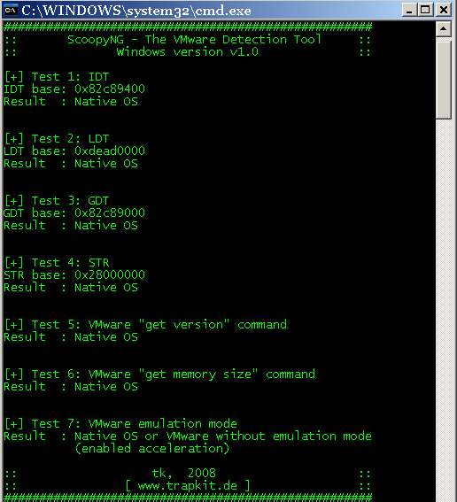
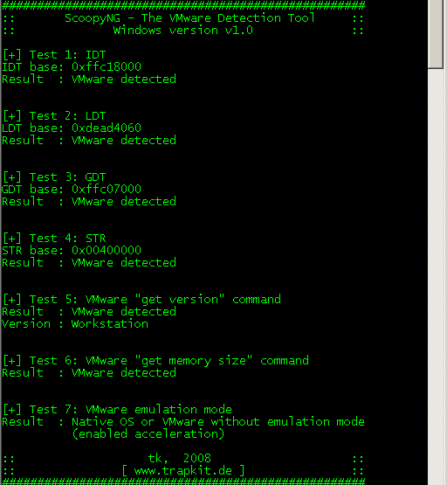

Slide 24
Techniques
Backdoor I/O port
OS running inside a VMWware uses port name ‘VX’ for communication between the host and guest OS.
Data from this port can be read using various opcodes using “IN” instruction
0x0A provides Vmware version.
0x14 gets the memory size.
Value checked against ‘VMXh’ to detect presence of Vmware
Process/Service Check
Check for Vmware related process, services
Process Name ( Associated Service Name )
vmacthlp.exe ( Vmware Physical Disk Helper Service )
vmtoolsd.exe ( Vmware Tools )

Slide 25
Anti-Anti-Debug Techniques
Manually patch values in memory, registers, return values from APIs
NOP sequence of instructions
Use of Plugins
OllyAdvanced
HideDebugger
Phantom
Anti-Anti-Debugger Plugins : https://code.google.com/p/aadp/

Slide 26
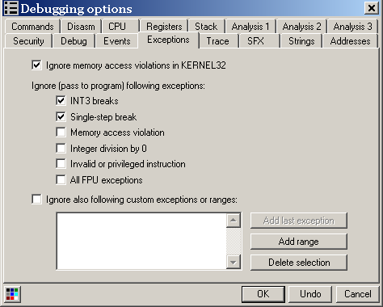
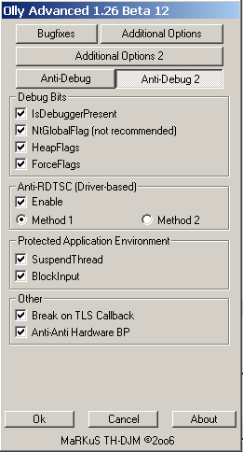
OllyDbg Screenshots

Slide 27
References
Complete Reference Guide for Advanced Malware Analysis Training
[Include links for all the Demos & Tools]

Slide 28
Thank You !
www.SecurityXploded.com

