Slide 1

Reversing Automation
Advanced Malware Analysis Training Series
Harsimran Walia/Amit Malik
www.SecurityXploded.com

Slide 2
Disclaimer
The Content, Demonstration, Source Code and Programs presented here is "AS IS" without any warranty or conditions of any kind. Also the views/ideas/knowledge expressed here are solely of the trainer’s only and nothing to do with the company or the organization in which the trainer is currently working.
However in no circumstances neither the Trainer nor SecurityXploded is responsible for any damage or loss caused due to use or misuse of the information presented here.

Slide 3
Acknowledgement
Special thanks to Null community for their extended support and co-operation.
Special thanks to ThoughtWorks for the beautiful venue.
Thanks to all the trainers who have devoted their precious time and countless hours to make it happen.

Slide 4

Advanced Malware Analysis Training
This presentation is part of our Advanced Malware Analysis Training program. Currently it is delivered only during our local meets for FREE of cost.
For complete details of this course, visit our Security Training page.

Slide 5
Who am I?
Harsimran Walia
Member, SecurityXploded
Research Scientist, McAfee Labs
Reversing, Malware Analysis, Exploit Analysis/Development etc.
Personal site: http://harsimranwalia.info
E-mail: walia.harsimran@gmail.com
Twitter: b44nz0r

Slide 6
Content
Automation
Python scripts
Use of modules
Tools/Modules discussed
PEfile
PyDbg
IDAPython

Slide 7
PEfile
Python module to read and work with Portable Executable (PE) files
pefile requires understanding of the layout of a PE file (already covered)
Tasks that pefile makes possible are:
Modifying and writing back to the PE image
Header Inspection
Sections analysis
Retrieving data
Warnings for suspicious and malformed values
Packer detection with PEiD’s signatures

Slide 8


Pefile (hands-on)
Load a PE (create an instance)
Reading important PE header attributes
Modifying values
All PE instance values support assignment followed by a call to write function to write the modified exe to system

Slide 9



Pefile (hands-on)
PE sections – fetching detail about sections
File Info
Output
Output

Slide 10
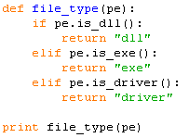

Pefile (hands-on)
Type of file (exe/dll/driver)
List of imported dlls and imported functions

Slide 11
Pydbg
Open Source Python debugger
Developed by Pedram Amini as the main component of PaiMei framework
It uses user-defined callback functions
These functions can implement actions to take on hitting a breakpoint, exception etc
Upon execution of the callback function the control is passed back to pydbg to execute the program normally

Slide 12
Pydbg installation
Download or git clone: https://github.com/OpenRCE/pydbg
Pre-reqs
Python 2.7
c-types python library
Copy the pydbg files to Python-2.7\Lib\site-packages\pydbg
pydasm.pyd is compiled for Python 2.6, lets fix this!
Open pydasm.pyd in any hex-editor(010 etc) and search python
Change python26.dll to python27.dll
Save and replace with original

Slide 13
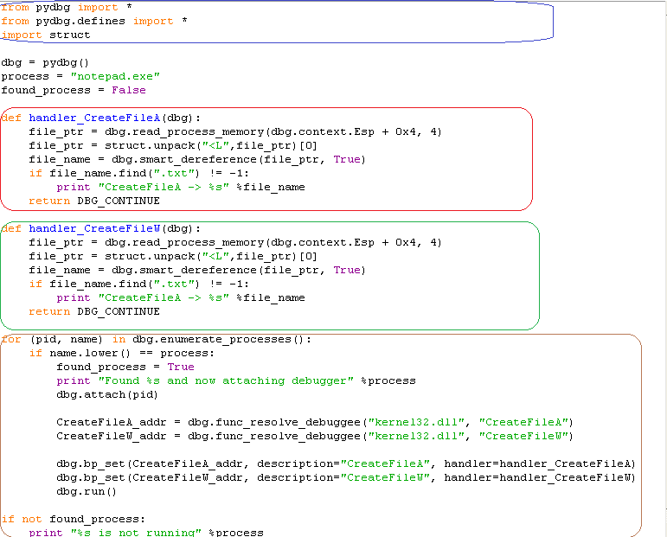
Pydbg (hands-on)
Import required pydbg modules and struct
Breakpoint handler for CreateFileA
Extract the parameter from the stack = filename
Breakpoint handler for CreateFileW
Look for process to debug
Attach debugger to process
Set breakpoint on function entry address
Attach a breakpoint handler

Slide 14
IDA Python
An IDA Pro plugin
Integrates Python, allowing scripts to run in IDA Pro
IDAPython Scripts have access to
IDA Plugin API,
IDC and all modules available for Python

Slide 15
Installation
Download the plugin from https://code.google.com/p/idapython
Match the IDAPro and python version before downloading
Copy the ''python'' directory from the extracted plugin to the IDA Pro install directory (%IDADIR%)
Copy the plugin executable to ''%IDADIR%\plugins\''

Slide 16
Hands-on
Utility functions
ScreenEA()
Obtains the address of where your cursor is currently positioned on the IDA screen.
GetInputFileMD5()
Returns the MD5 hash of the binary loaded in IDA, which is useful for tracking changes in the binary
Functions
Functions( long StartAddress, long EndAddress )
Returns a list of all function start addresses contained between StartAddress and EndAddress.
LocByName( string FunctionName )
Returns the address of a function based on its name.
GetFunctionName( long Address )
Given an address, returns the name of the function the address belongs to.

Slide 17
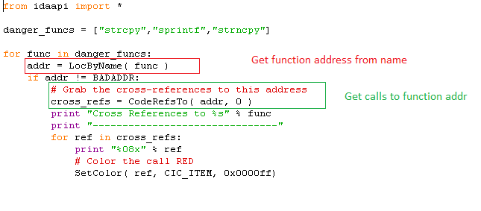
Hands-on
Try running on war-ftpd.exe

Slide 18
Demo..
ExeScan
http://www.securityxploded.com/exe-scan.php
Malpimp
http://www.securityxploded.com/malpimp.php

Slide 19
Reference
Complete Reference Guide for Advanced Malware Analysis Training
[Include links for all the Demos & Tools]

Slide 20
Thank You !
www.SecurityXploded.com

