Slide 1

Malware Sandbox Analysis
Advanced Malware Analysis Training Series
Monnappa KA
www.SecurityXploded.com

Slide 2
Disclaimer
The Content, Demonstration, Source Code and Programs presented here is "AS IS" without any warranty or conditions of any kind. Also the views/ideas/knowledge expressed here are solely of the trainer’s only and nothing to do with the company or the organization in which the trainer is currently working.
However in no circumstances neither the Trainer nor SecurityXploded is responsible for any damage or loss caused due to use or misuse of the information presented here.

Slide 3
Acknowledgement
Special thanks to Null community for their extended support and co-operation.
Special thanks to ThoughtWorks for the beautiful venue.
Thanks to all the trainers who have devoted their precious time and countless hours to make it happen.

Slide 4

Advanced Malware Analysis Training
This presentation is part of our Advanced Malware Analysis Training program. Currently it is delivered only during our local meets for FREE of cost.
For complete details of this course, visit our Security Training page.

Slide 5
Who am I?
Monnappa
Member, SecurityXploded
Info Security Investigator @ Cisco
Reversing, Malware Analysis, Memory Forensics.
Email: monnappa22@gmail.com
Twitter: @monnappa22
LinkedIn: http://www.linkedin.com/pub/monnappa-ka-grem-ceh/42/45a/1b8

Slide 6
Content
Sandbox Overview
Why Sandbox Analysis
Sandbox Architecture
Online Sandboxes
Custom Sandbox (Sandbox.py)
Sandbox.py working
Sandbox.py report
Demo 1&2 (Sandbox Analysis)

Slide 7
Sandbox Overview
Execute malware in a controlled/monitored environment
Monitors file system, registry, process and network activity
Outputs the results in multiple formats
Examples of Sandboxes
Cuckoo Sandbox
ThreatExpert
Anubis
CWSandbox

Slide 8
Why Sandbox Analysis?
To determine:
The nature and purpose of the malware
Interaction with the file system
Interaction with the registry
Interaction with the network
To determine identifiable patterns

Slide 9
Sandbox Architecture
Samples
Submit
Host Machine
Analysis Machine (VM)
Launch
Controller
Sample
Monitoring tools
Reports
PCAPS
Artifacts
Reports

Slide 10
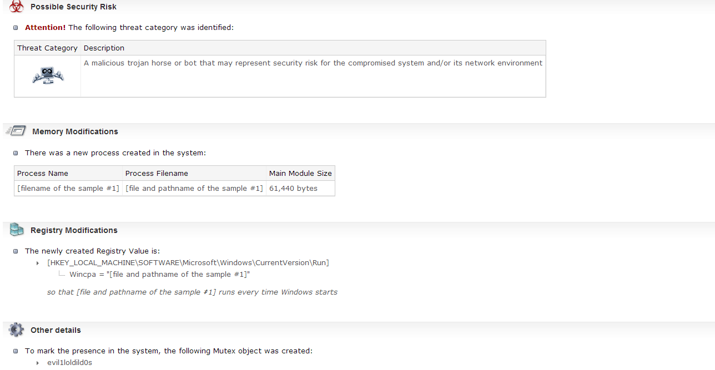
Online Sandbox –ThreatExpert results

Slide 11
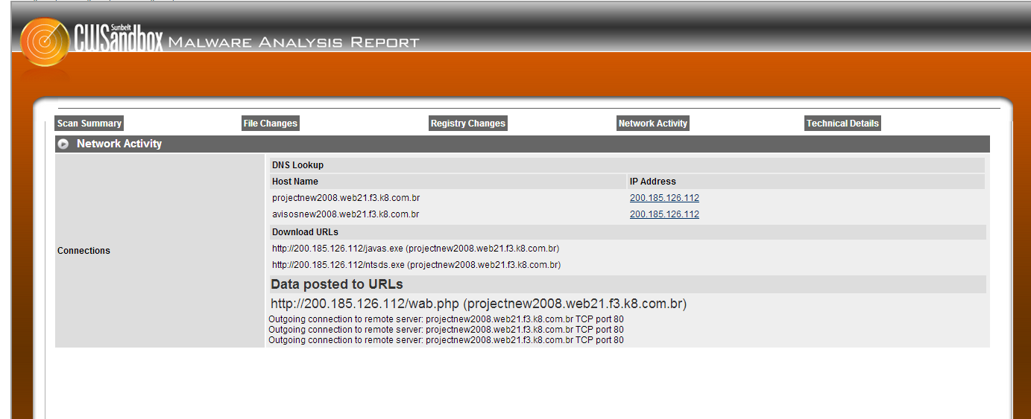
Online Sandbox –CWSandbox results

Slide 12
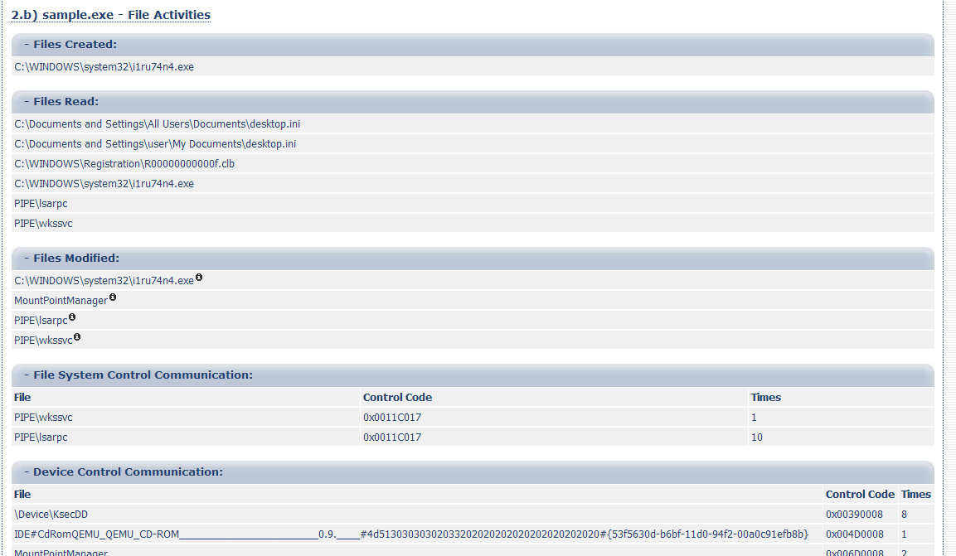
Online Sandbox –Anubis results

Slide 13
Custom Sandbox – sandbox.py
Automates static, dynamic and Memory analysis using open source tools
Written in python
Can be run in sandbox mode or internet mode
In sandbox mode it can simulate internet services (this is the default mode)
Allows you to set the timeout for the malware to run (default is 60 seconds)
Stores final reports, pcaps, desktop screeshot , and malicious artifacts for later analysis

Slide 14
Sandbox.py (working)
Takes sample as input
Performs static analysis
Reverts VM to clean snapshot
Starts the VM
Transfers the malware to VM
Runs the monitoring tools ( to monitor process, registry, file system, network activity)
Executes the malware for the specified time

Slide 15
Sandbox.py (working contd)
Stops the monitoring tools
Suspends the VM
Acquires the memory image
Performs memory analysis using Volatility framework
Stores the results (Final reports, destkop screenshot, pcaps and malicious artifacts for later analysis)

Slide 16
Sandbox.py Report
Static analysis results:
File type (uses magic python module)
Cryptographic hash (md5sum – uses hashlib python module)
VirusTotal results (python script using VirusTotal’s public api)
Determines packers used by malware (uses yara-python)
Determines the capabilities of the malware like IRC, P2P etc etc (uses yara-python module)

Slide 17
Sandbox.py report
Dynamic analysis results:
Determines File system activity
Determines Process activity
Determines Registry activity
Monitor Network activity
Displays DNS summary
Shows TCP conversations
Displays HTTP requests & HTTP request tree

Slide 18
Sandbox.py report
Memory analysis results:
uses Volatility advanced memory forensics framework
displays process, hidden process in memory
displays network connections, terminated network connections
displays listening sockets
determines api hooks, code injection and embedded executable in memory
displays DLL’s loaded by the process memory
displays services in memory
displays the registry keys (like run registry key)

Slide 19
Demo 1, 2 & 3 (Sandbox analysis)
All Training Demo Videos are available at
http://securityxploded.com/security-training-videos.php

Slide 20
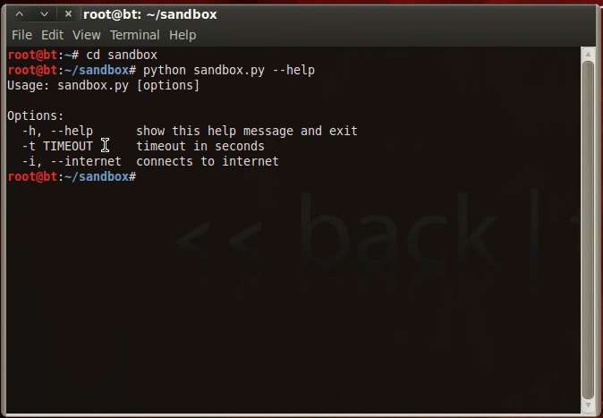
Sandbox.py – Help option
The below screenshot shows the sandbox.py help option

Slide 21
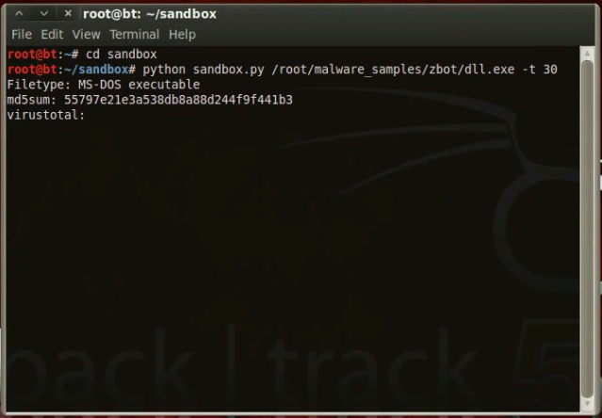
Sandbox.py – Input
The below screenshot shows the sandbox.py taking sample as input to run it for 30 seconds

Slide 22
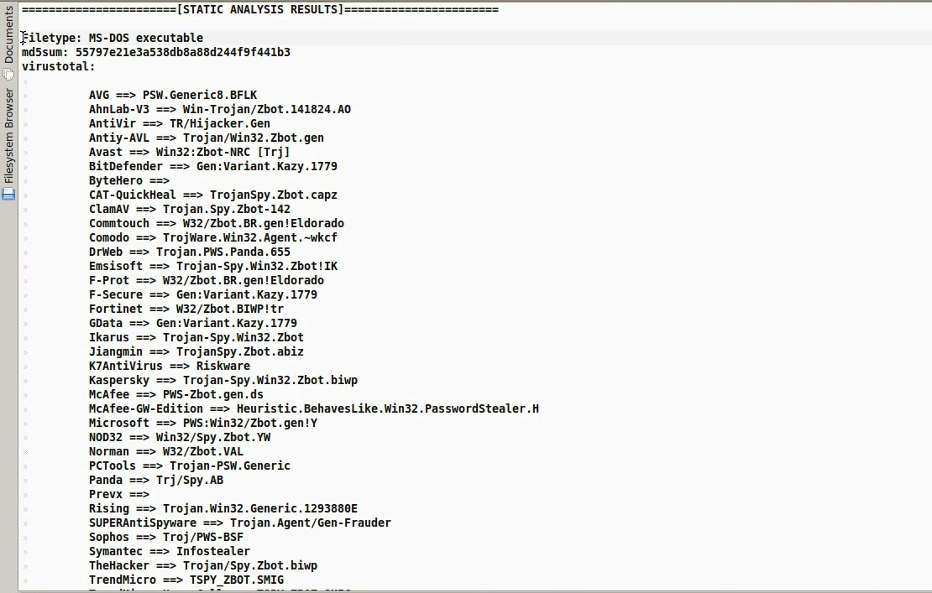
Sandbox.py – Static Analysis
The below screenshot shows the static analysis results after executing the sample

Slide 23
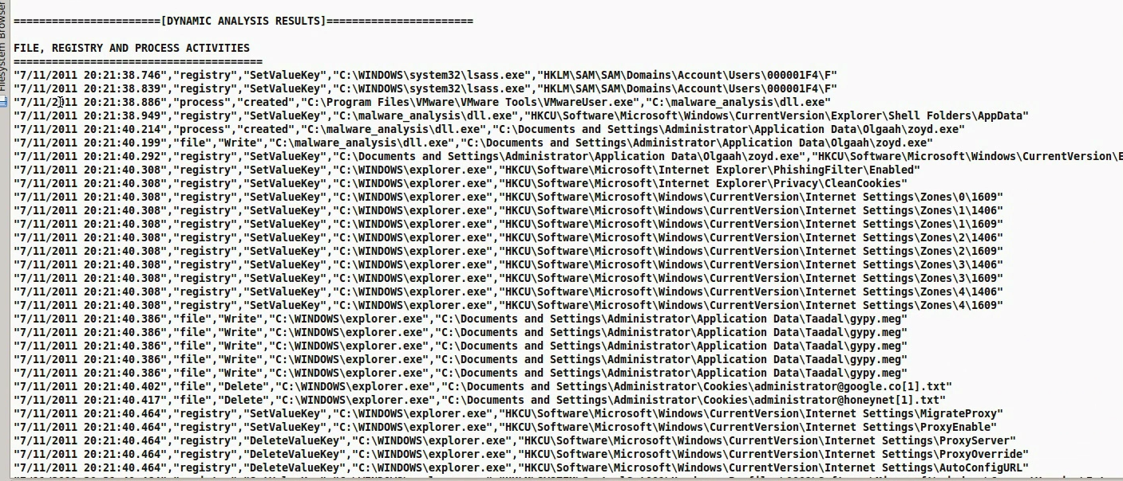
Sandbox.py – Dynamic Analysis
The below screenshot shows the dynamic analysis results after executing the sample

Slide 24
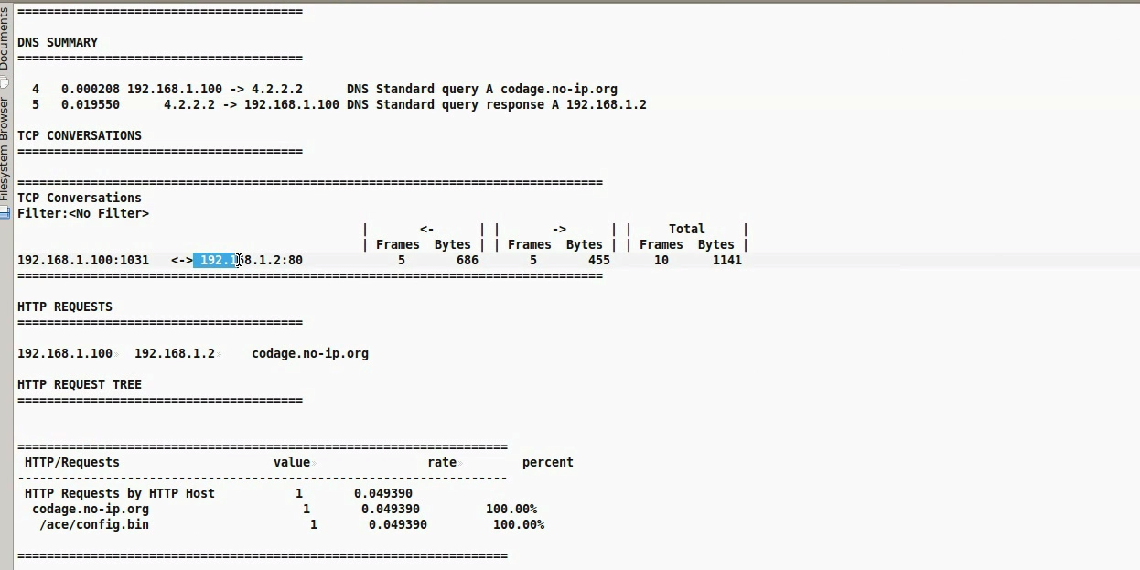
Sandbox.py – Network Activity
The below screenshot shows the network activity after executing the sample

Slide 25
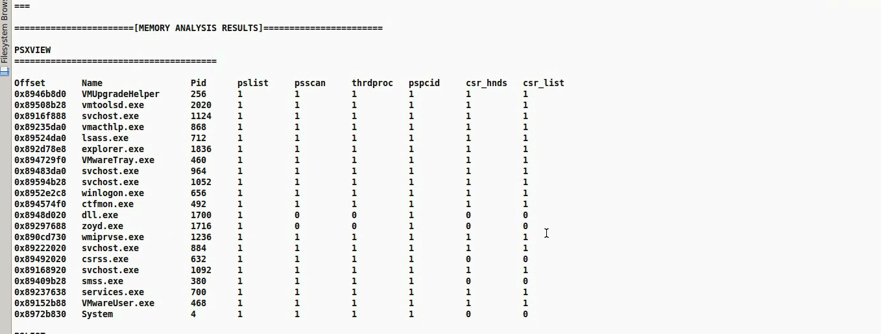
Sandbox.py – Memory Analysis
The below screenshot shows the memory analysis results after executing the sample

Slide 26
Reference
Complete Reference Guide for Advanced Malware Analysis Training
[Include links for all the Demos & Tools]

Slide 27
Thank You !
www.SecurityXploded.com

