Slide 1

Malware Memory Forensics
Advanced Malware Analysis Training Series
Monnappa
www.SecurityXploded.com

Slide 2
Disclaimer
The Content, Demonstration, Source Code and Programs presented here is "AS IS" without any warranty or conditions of any kind. Also the views/ideas/knowledge expressed here are solely of the trainer’s only and nothing to do with the company or the organization in which the trainer is currently working.
However in no circumstances neither the Trainer nor SecurityXploded is responsible for any damage or loss caused due to use or misuse of the information presented here.

Slide 3
Acknowledgement
Special thanks to Null community for their extended support and co-operation.
Special thanks to ThoughtWorks for the beautiful venue.
Thanks to all the trainers who have devoted their precious time and countless hours to make it happen.

Slide 4

Advanced Malware Analysis Training
This presentation is part of our Advanced Malware Analysis Training program. Currently it is delivered only during our local meets for FREE of cost.
For complete details of this course, visit our Security Training page.

Slide 5
Who am I
  Monnappa (m0nna)
  Member of SecurityXploded
  Info Security Investigator @ Cisco
  Reverse Engineering, Malware Analysis, Memory Forensics
  GREM, CEH
  Email: monnappa22@gmail.com
  Twitter: @monnappa22
  LinkedIn: http://www.linkedin.com/pub/monnappa-ka-grem-ceh/42/45a/1b8

Slide 6
Contents
Why Memory Forensics?
Steps in Memory Forensics
Volatility Quick Overview
Volatility help and plugins
Demo 1
Demo 2
www.SecurityXploded.com

Slide 7
Why Memory Forensics?
Finding and extracting forensic artefacts
Helps in malware analysis
Determining process, network, registry activities
Reconstructing original state of the system
Assists with unpacking, rootkit detection and reverse engineering
www.SecurityXploded.com

Slide 8
Steps in Memory Forensics
Memory acquisition - Dumping the memory of a target machine
- tools: Win32dd/Win64dd, Memoryze, DumpIt, FastDump
- In Virtual machine: Suspend the VM and use .vmem file
Memory analysis - Analyzing the memory dump for forensic artefacts
- tools: Volatility, Memoryze
www.SecurityXploded.com

Slide 9
Volatility Quick Overview
Advanced memory Forensics Framework written in python
Installation details:
- http://code.google.com/p/volatility/wiki/FullInstallation
Use -h or --help option to get list of command-line switches
- example: python vol.py –h
Use -f <filename> and --profile to indicate the memory dump you are analyzing
example: python vol.py -f mem.dmp --profile=WinXPSP3x86
To know the --profile info use below command:
example: python vol.py -f mem.dmp imageinfo
www.SecurityXploded.com

Slide 10
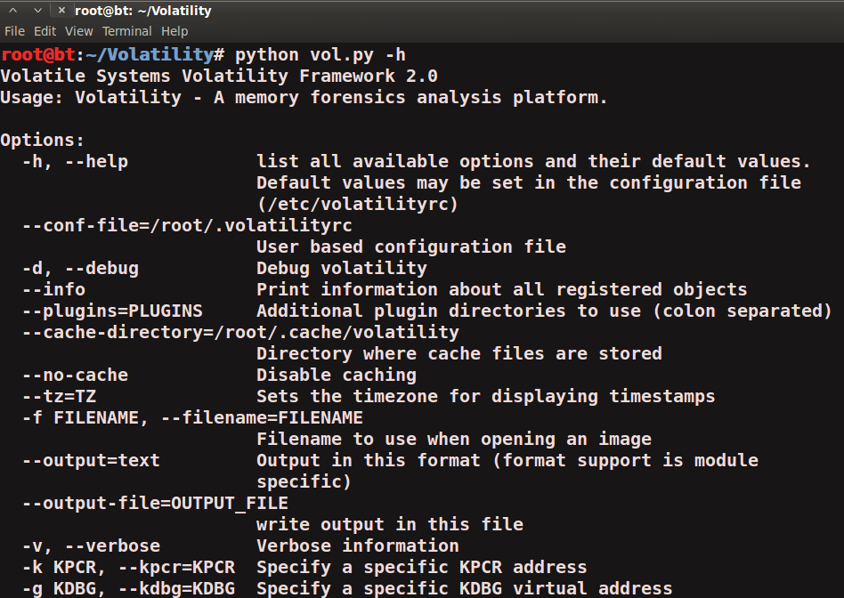
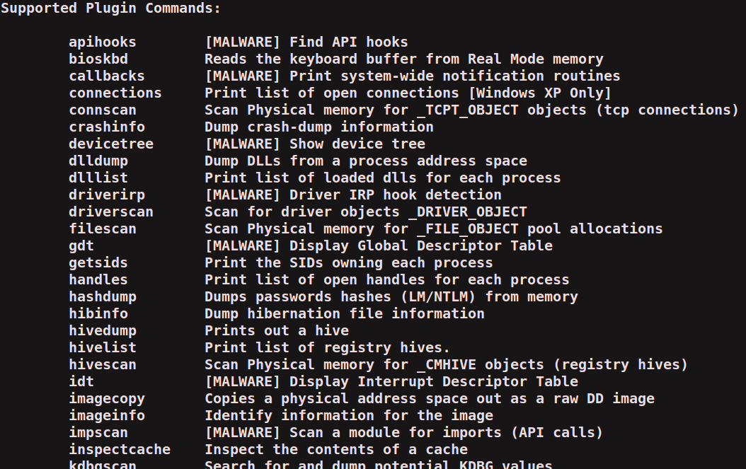
Volatility help and plugins
-h or –help option displays help and available plug-in commands in volatility.
www.SecurityXploded.com

Slide 11
Demo 1

Slide 12
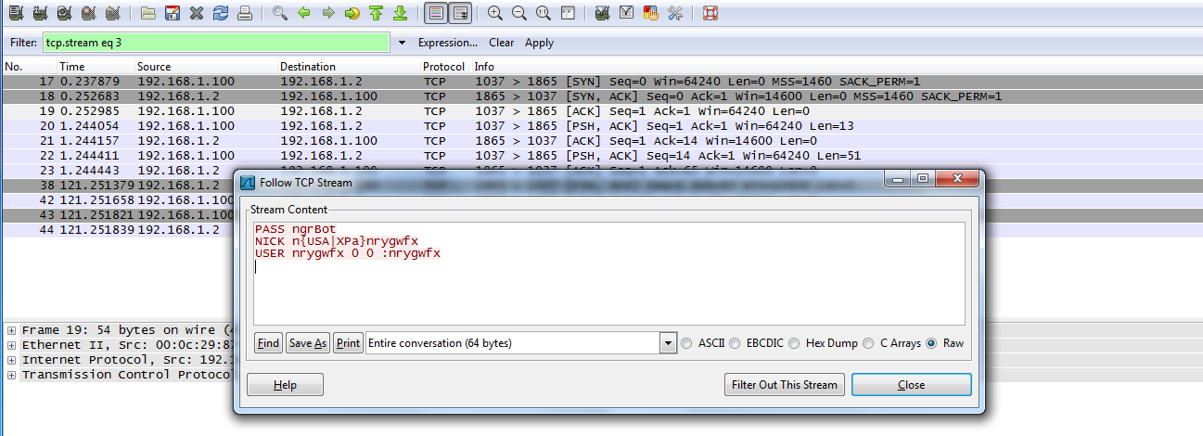
Demo-Scenario 1
Your security device alerts on a malicious irc connection to ip address 192.168.1.2 on port 1865 from a source ip 192.168.1.100 (shown below). you are asked to investigate and perform memory forensics on the machine 192.168.1.100
- To start with, acquire the memory image “infected.dmp” from 192.168.1.100, using memory acquisition tools (like Dumpit or win32dd)
- Analyze the memory dump “infected.dmp”
www.SecurityXploded.com

Slide 13
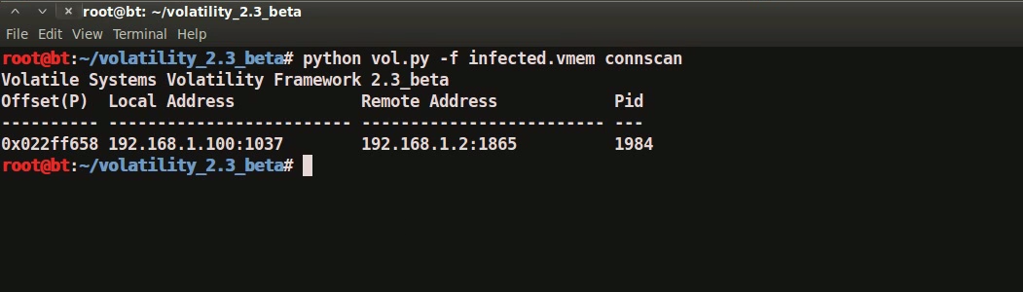
Step 1 – Start With what you know
Volatility’s connscan module shows connection to the malicious ip on port 1865 by pid 1984
www.SecurityXploded.com

Slide 14
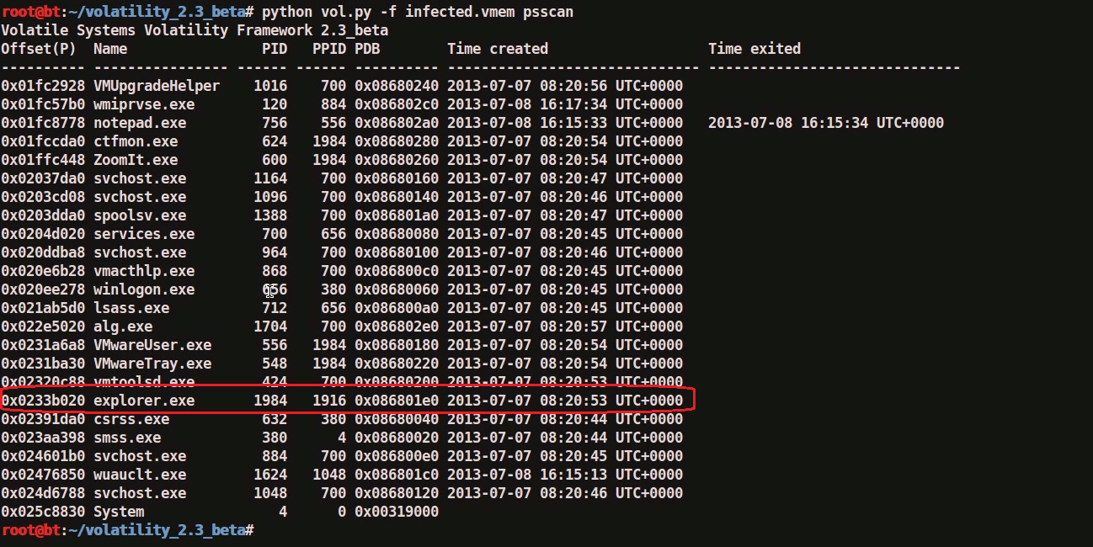
Step 2 – Who is Pid 1984?
“psscan” shows pid 1984 belongs to explorer.exe
www.SecurityXploded.com

Slide 15
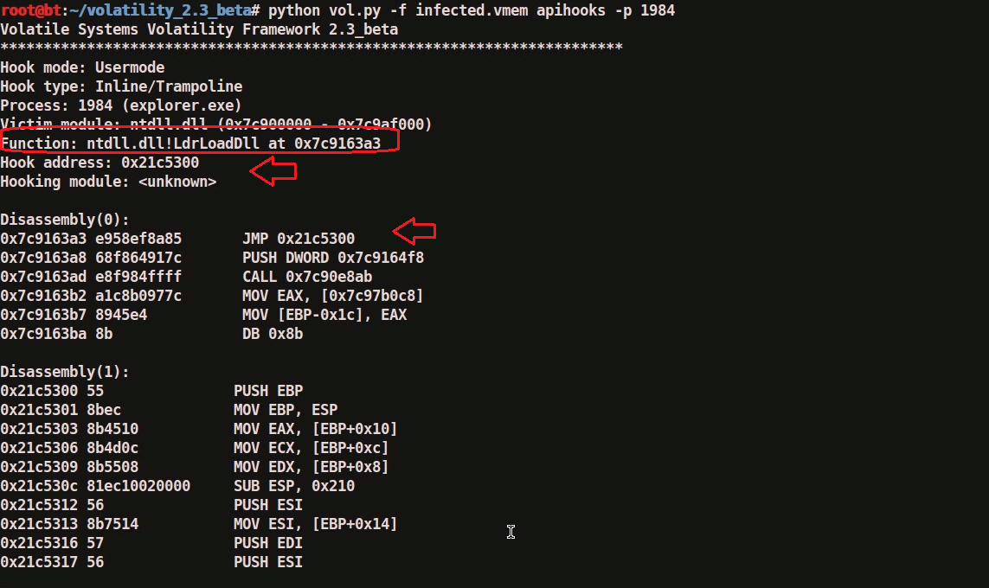
Step 3 – apihooks in explorer.exe
apihooks module show, inline api hooks in explorer.exe (pid 1984) and jump to an unknown location
www.SecurityXploded.com

Slide 16
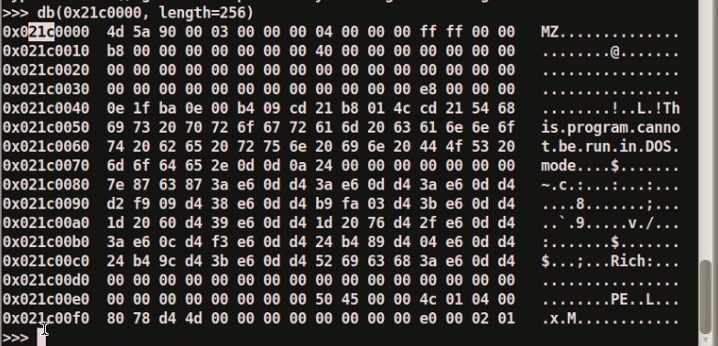
Step 4 – Embedded exe in explorer.exe
Printing the bytes show the presence of embedded executable in explorer.exe
www.SecurityXploded.com

Slide 17
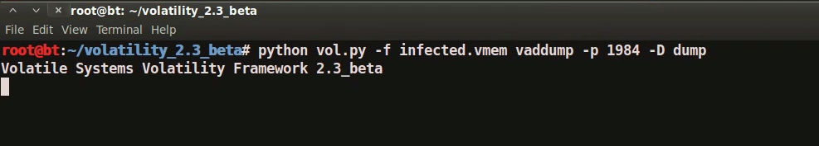
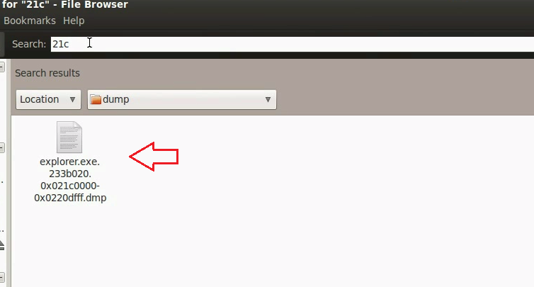
Step 5 – dumping the embedded exe
vaddump dumps the embedded exe from explorer.exe
www.SecurityXploded.com

Slide 18
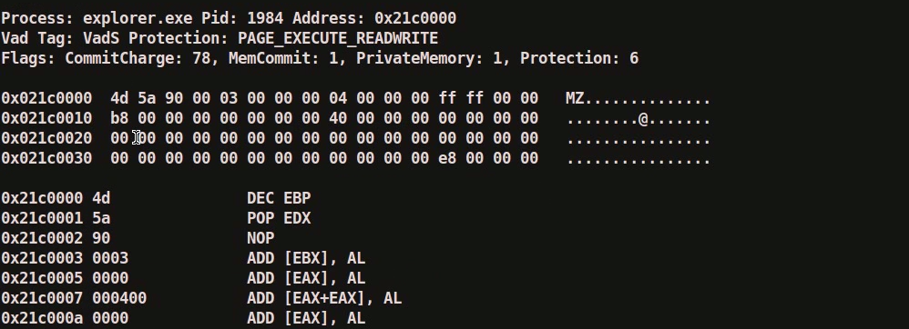
Step 6 – embedded exe by malfind plugin
Malfind plugin can also be used to detect embedded exe and dump it as shown below
www.SecurityXploded.com

Slide 19
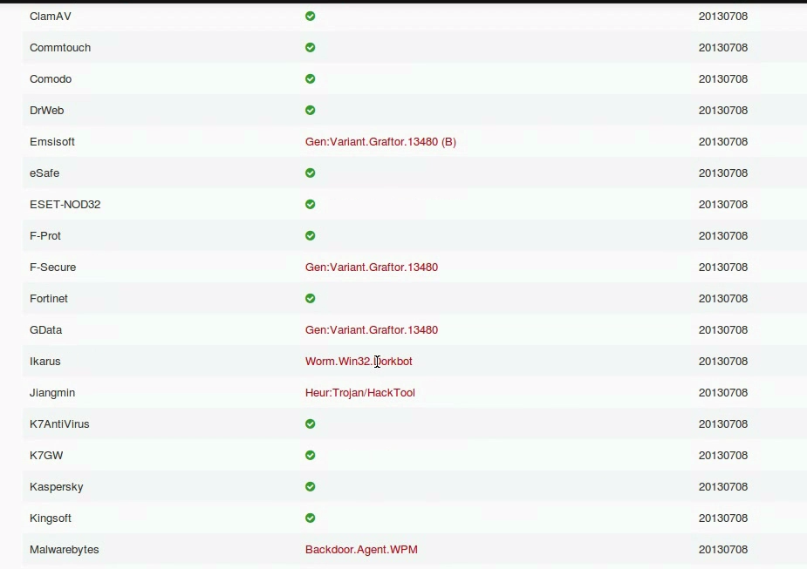
Step 7 – VirusTotal submission
Submission to virustotal, confirms the dumped executable to be malicious
www.SecurityXploded.com

Slide 20
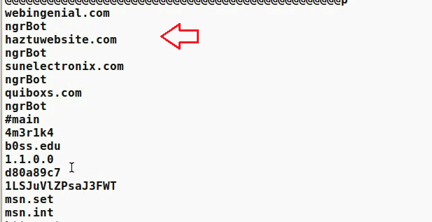
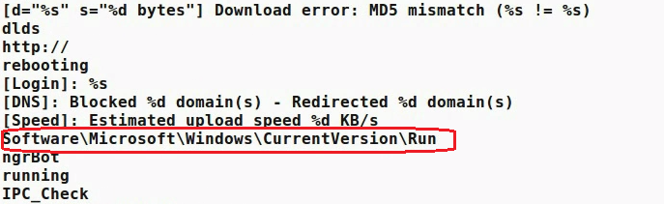
Step 8 – getting more information
Strings extracted from the dumped executable, show reference to interesting artifacts (domains and the registry key)
www.SecurityXploded.com

Slide 21
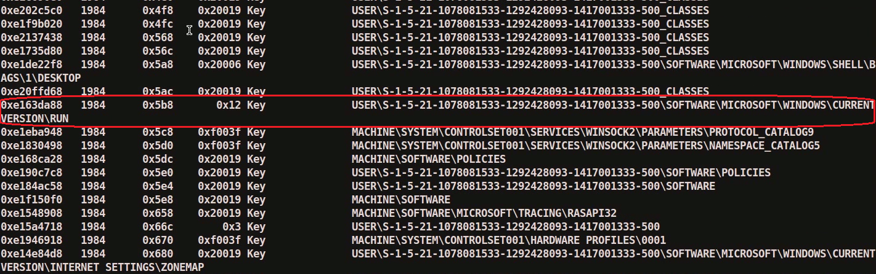
Step 9 – explorer.exe handles
Handles in the explorer.exe (pid 1984) shows the presence of the run registry key
www.SecurityXploded.com

Slide 22
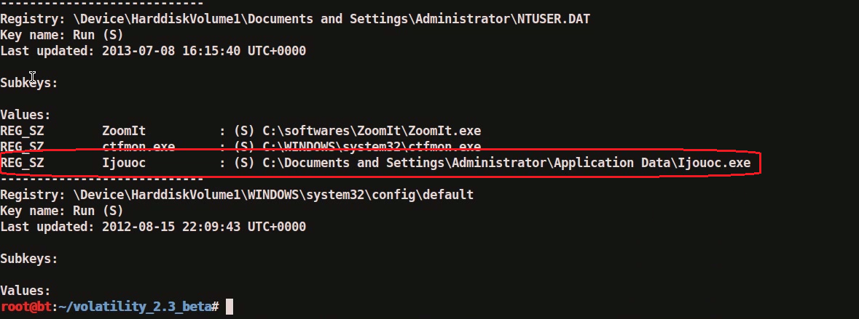
Step 10 – Printing the registry key
Malware adds values to registry key to survive the reboot
www.SecurityXploded.com

Slide 23
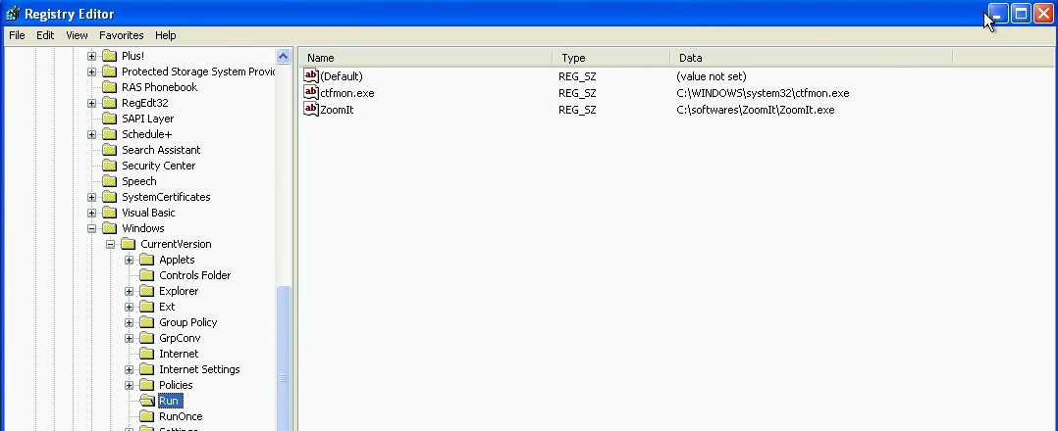
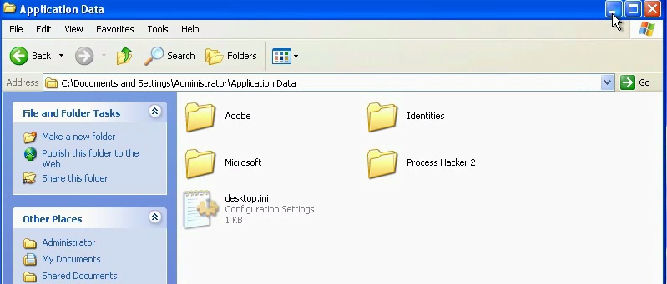
Step 11 – examining the infected system
Malware hides the registry value and the malicious file on the infected system
www.SecurityXploded.com

Slide 24
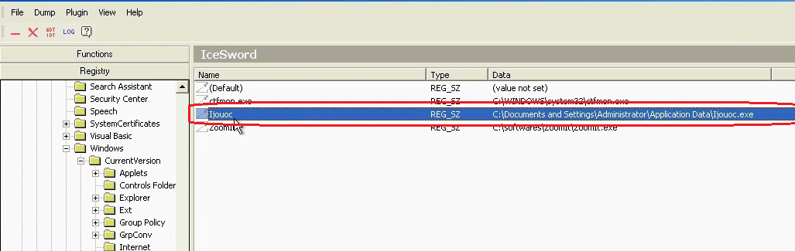
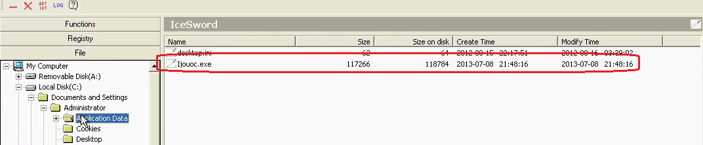
Step 12 – Finding the malware on infected system
Rootkit detection tool detects the hidden file and the registry entry
www.SecurityXploded.com

Slide 25
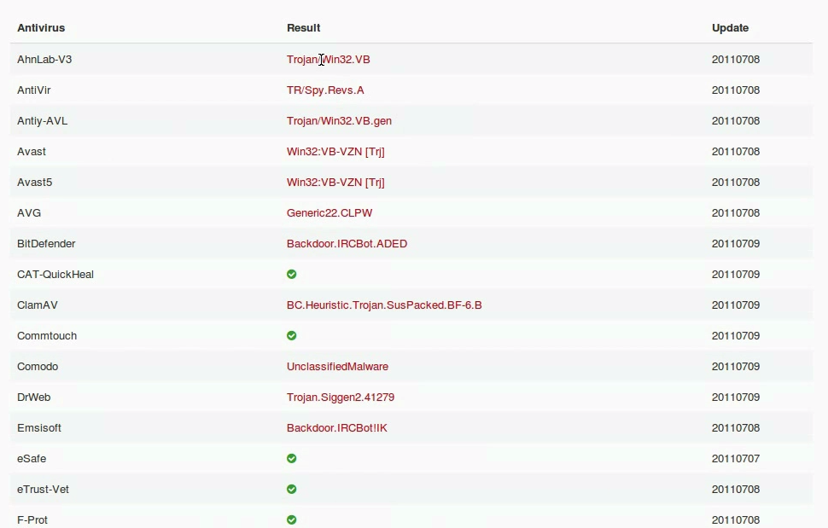
Step 13 – VirusTotal submission
Submitting the malicious file from the infected system to virustotal confirms the file to be malicious
www.SecurityXploded.com

Slide 26
Demo 2

Slide 27
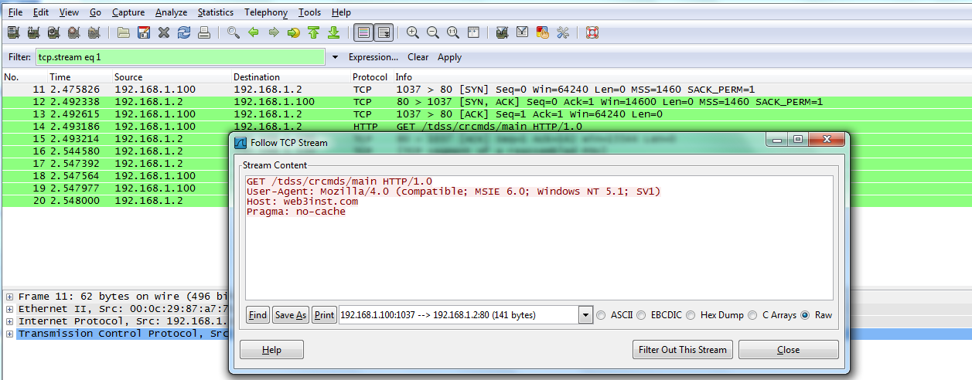
Demo-Scenario 2
Your security device alerts on malicious http connection to the domain “web3inst.com” which resolves to 192.168.1.2, communication is detected from a source ip 192.168.1.100 (shown below)..you are asked to investigate and perform memory forensics on the machine 192.168.1.100
- To start with, acquire the memory image “infected.dmp” from 192.168.1.100, using memory acquisition tools (like Dumpit or win32dd)
- Analyze the memory dump “infected.dmp”
www.SecurityXploded.com

Slide 28
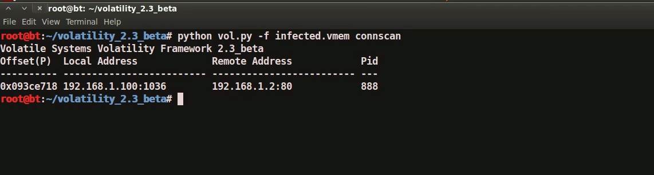
Step 1 – Network connections
Volatility’s connscan module shows connection to the malicious http connection by pid 888
www.SecurityXploded.com

Slide 29
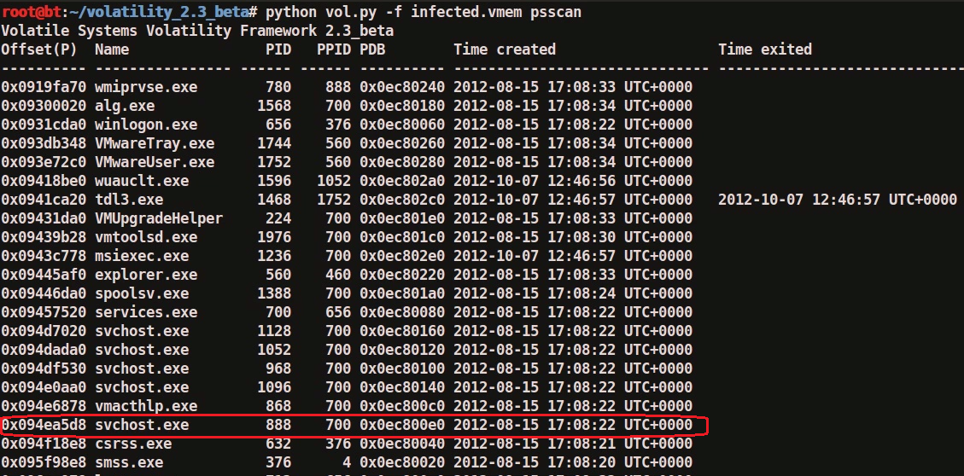
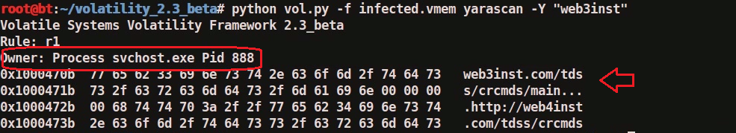
Step 2 – process determination and YARA scan
Volatility’s psscan shows pid 888 is associated with svchost.exe and YARA scan shows that malicious domain is found in the address space of pid 888 (svchost.exe)
www.SecurityXploded.com

Slide 30
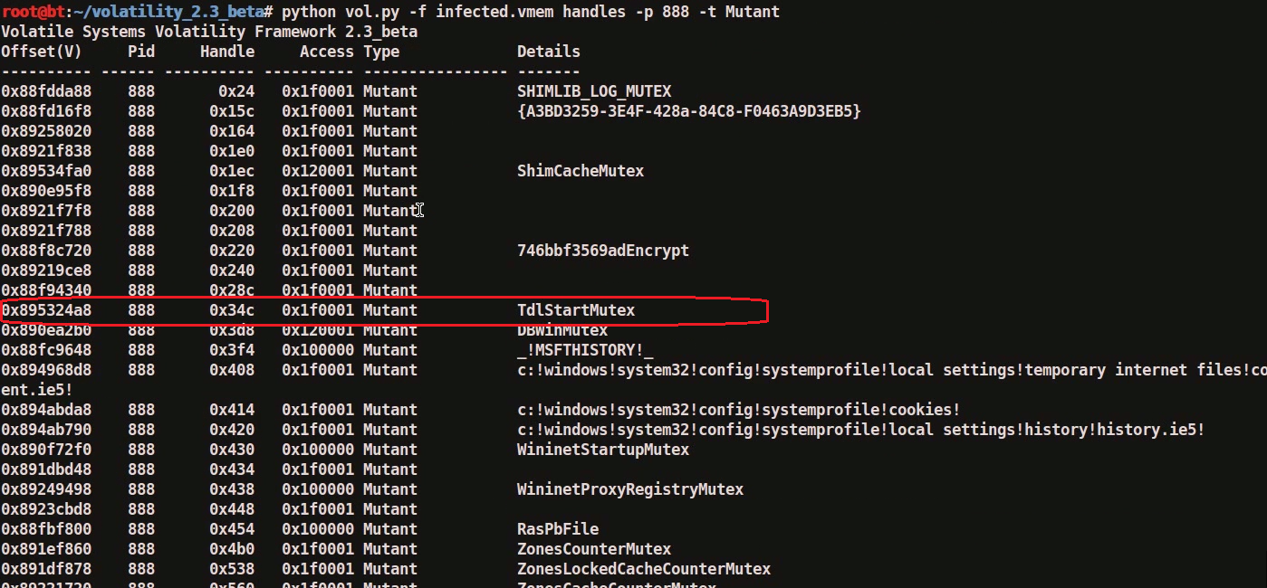
Step 3 – Suspicious mutex in svchost.exe
Volatility’s mutantscan shows suspicious mutex
www.SecurityXploded.com

Slide 31
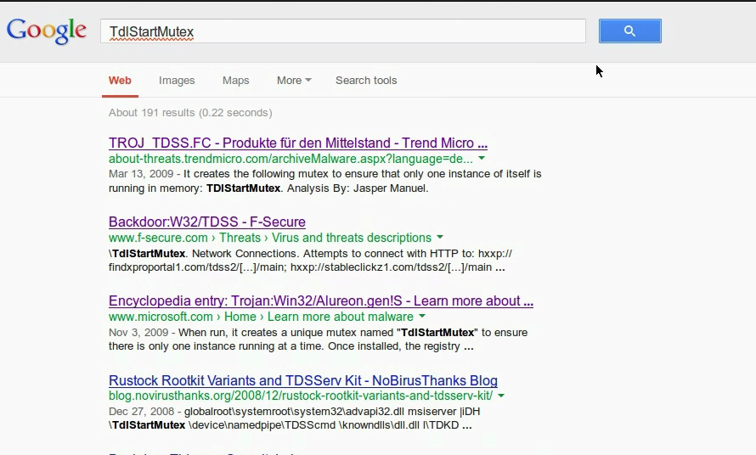
Step 4 – malicious mutex
Google search shows that this suspicious mutex is associated with TDSS rootkit
www.SecurityXploded.com

Slide 32
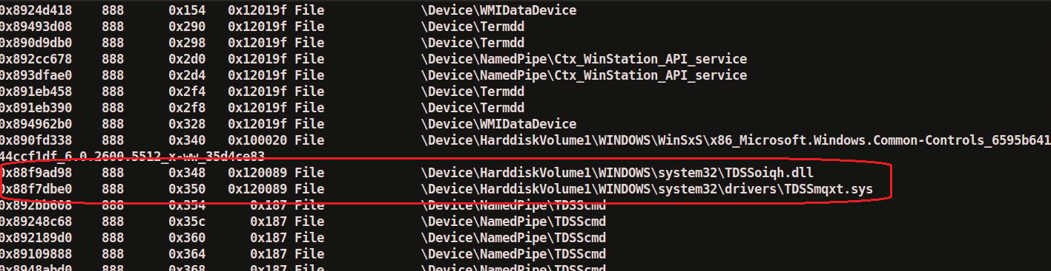
Step 5 – File handles
Examining file handles in svchost.exe (pid 888) shows handles to suspicious files (starting with TDSS)
www.SecurityXploded.com

Slide 33
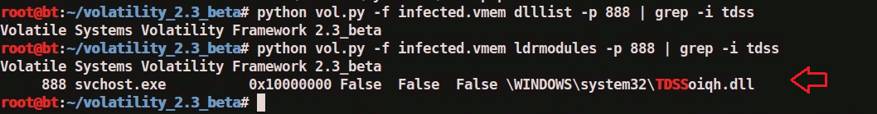
Step 6 – Hidden DLL
Volatility’s dlllist module couldn’t find the DLL starting with “TDSS” whereas ldrmodules plugin was able to find it. This confirms that the DLL (TDSSoiqh.dll) was hidden, malware hides the DLL by unlinking from the 3 PEB lists
www.SecurityXploded.com

Slide 34
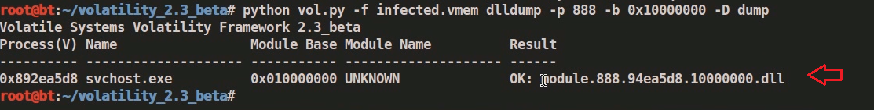
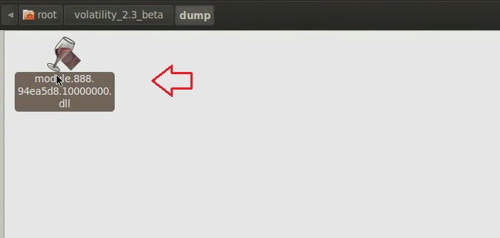
Step 7– Dumping the hidden DLL
Volatility’s dlldump module dumps the hidden dll
www.SecurityXploded.com

Slide 35
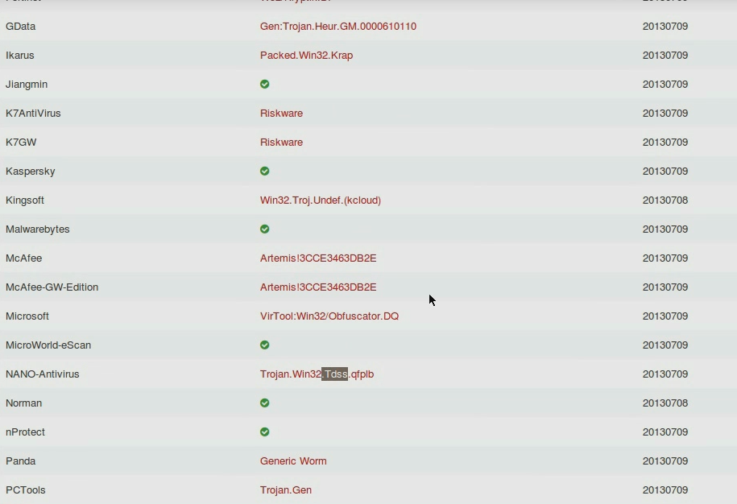
Step 8– VirusTotal submission of DLL
Submitting the dumped dll to VirusTotal confirms that it is malicious
www.SecurityXploded.com

Slide 36
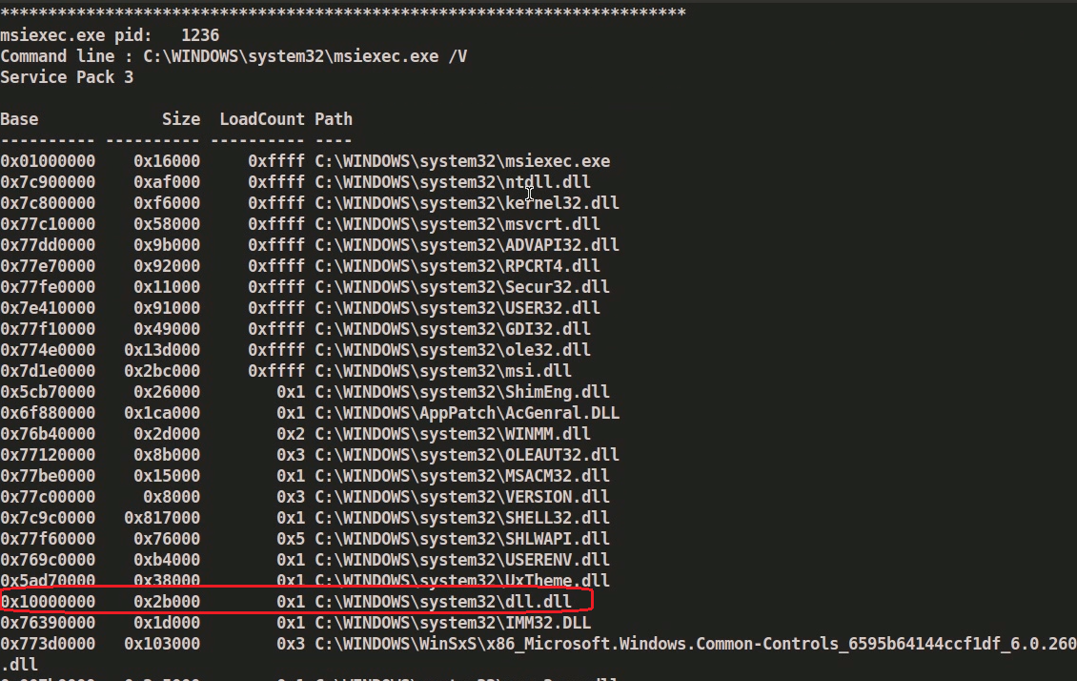
Step 9 – Suspicious DLL loaded by msiexec
dlllist shows suspicious dll loaded by msiexec.exe
www.SecurityXploded.com

Slide 37
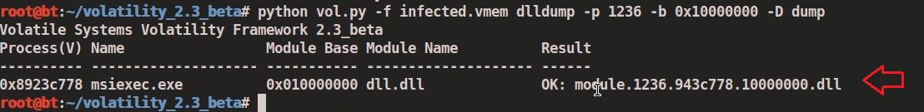
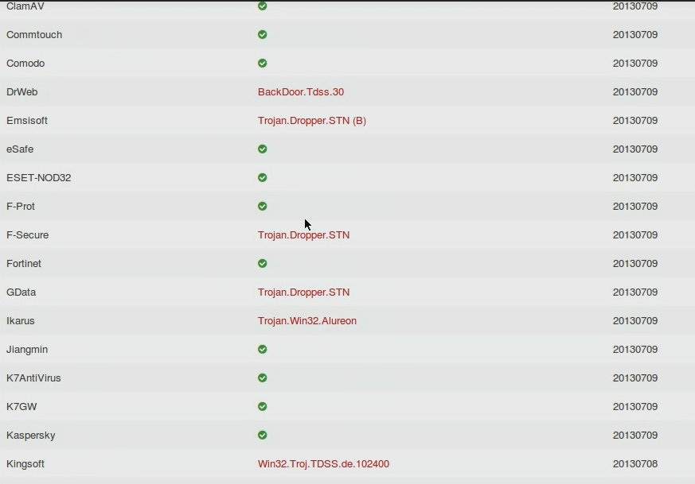
Step 10– Dumping DLL and VT submission
Dumping the suspicious DLL (dll.dll) and submitting to VirusTotal confirms that this is associated with TDSS rootkit
www.SecurityXploded.com

Slide 38
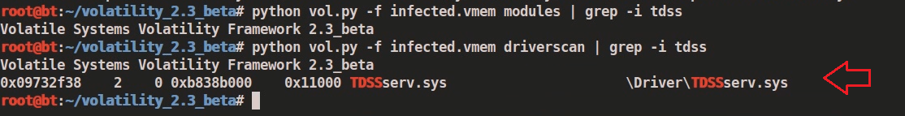
Step 11– Hidden Kernel driver
Volatility’s modules plugin couldn’t find the drivers starting with “TDSS” whereas driverscan plugin was able to find it. This confirms that the kernel driver (TDSSserv.sys) was hidden
www.SecurityXploded.com

Slide 39
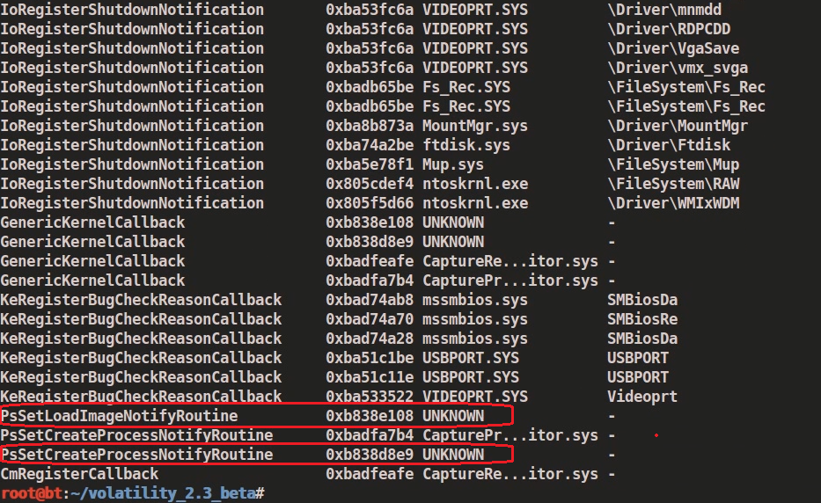
Step 12– Kernel Callbacks
Callbacks were set by an unknown driver. The below screenshot shows that this unknown driver falls under the address range of TDSSserv.sys
www.SecurityXploded.com

Slide 40
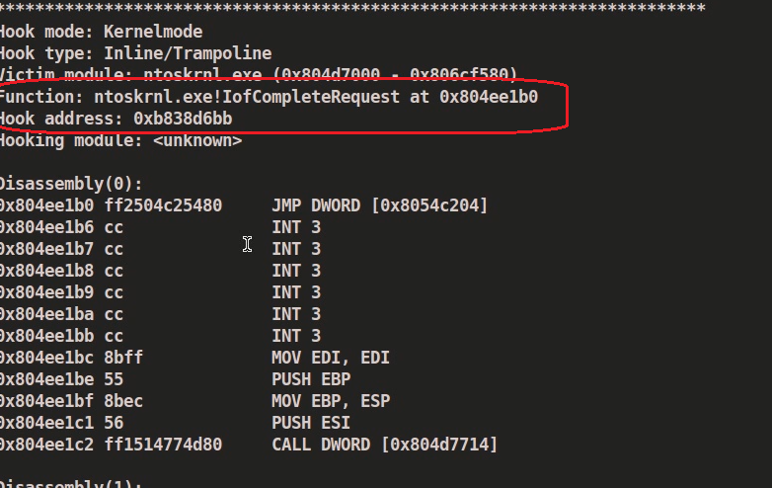
Step 13– Kernel API hooks
Malware hooks the Kernel API and the hook address falls under the address range of TDSSserv.sys
www.SecurityXploded.com

Slide 41
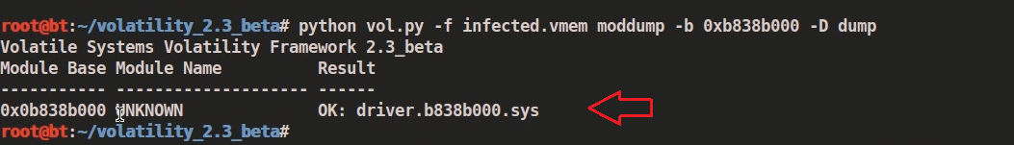
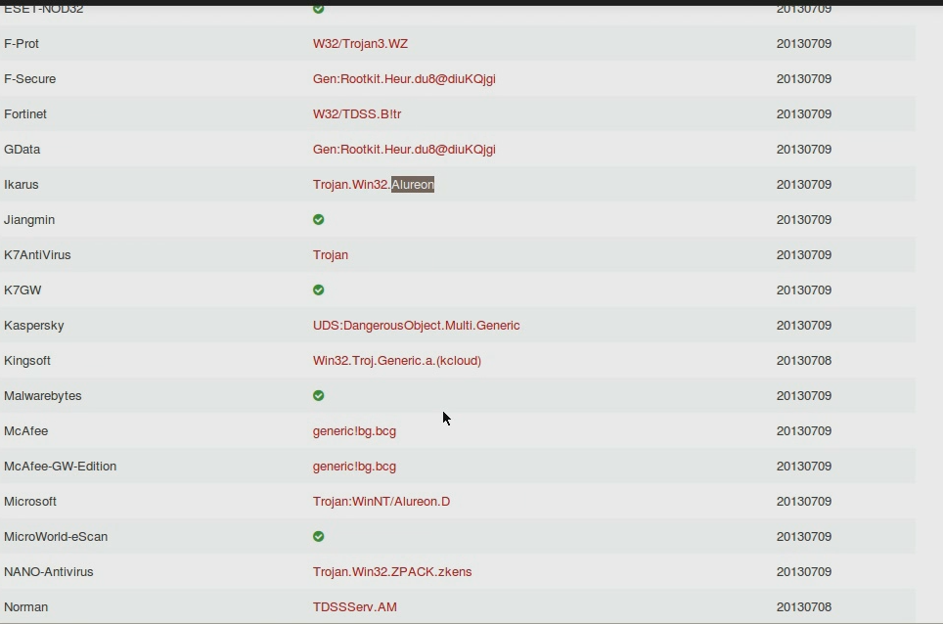
Step 14– Dumping the kernel driver
Dumping the kernel driver and submitting it to VirusTotal confirms that it is TDSS (Alureon) rootkit
www.SecurityXploded.com

Slide 42
Reference
Complete Reference Guide for Advanced Malware Analysis Training
[Include links for all the Demos & Tools]
www.SecurityXploded.com

Slide 43
Thank You !
www.SecurityXploded.com

