Slide 1

Introduction to Android
Advanced Malware Analysis Training Series
Swapnil Pathak
www.SecurityXploded.com
Notes:
1

Slide 2
Disclaimer
The Content, Demonstration, Source Code and Programs presented here is "AS IS" without any warranty or conditions of any kind. Also the views/ideas/knowledge expressed here are solely of the trainer’s only and nothing to do with the company or the organization in which the trainer is currently working.
However in no circumstances neither the Trainer nor SecurityXploded is responsible for any damage or loss caused due to use or misuse of the information presented here.
Notes:
2

Slide 3
Acknowledgement
Special thanks to Null community for their extended support and co-operation.
Special thanks to ThoughtWorks for the beautiful venue.
Thanks to all the trainers who have devoted their precious time and countless hours to make it happen.
Notes:
3

Slide 4

Advanced Malware Analysis Training
This presentation is part of our Advanced Malware Analysis Training program. Currently it is delivered only during our local meets for FREE of cost.
For complete details of this course, visit our Security Training page.
Notes:
4

Slide 5
Who am I?
Swapnil Pathak
  Security Researcher
  Reversing, Malware Analysis, Exploit Analysis etc.
  E-mail: swapnilpathak101@gmail.com
Notes:
5

Slide 6
Agenda
Introduction
Architecture
Security Features
Application Format
Permissions
Dalvik bytecode
Analysis lab setup
Q & A
www.SecurityXploded.com

Slide 7
Introduction
Linux based OS designed for mobile devices such as smartphones and tablets.
500 million devices activated
1.3 million activations per day by Q3 of 2012
1+ million apps available for download at Google Play Store
Source : Wikipedia

Slide 8
Introduction
Mobile malware on the rise, Android most at Risk - McAfee
Android users are prime target for malware – PC World
New Android malware app turns phone into surveillance device - ThreatPost
New Android Trojan app exploits previously unknow flaws, researchers say – Computer World

Slide 9
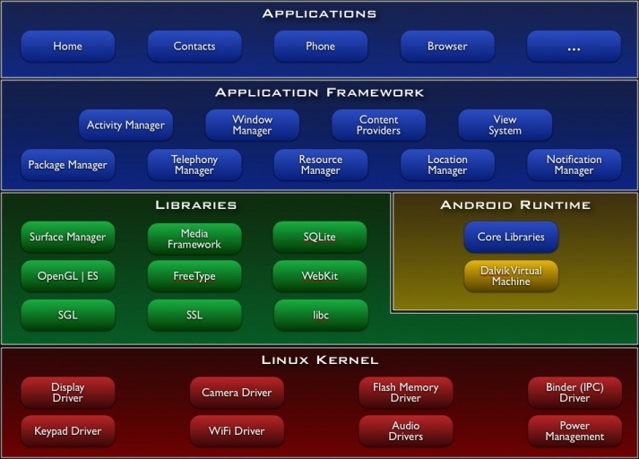
Android Architecture

Slide 10
Security Features
System and Kernel Security
- Application Sandbox
Each application assigned a unique user id (UID) and executed as a separate process
Implemented in kernel, all software above the kernel are run inside the sandbox
Memory Management
- Hardware based NoExecute (NX) to provide code execution on stack and heap
- Address Space Layout Randomization to randomize key locations in memory
Permissions
Application Signing

Slide 11
Application Format
.apk file extension
Similar to archive file can be extracted using 7-zip
Archive contains
  AndroidManifest.xml
  Classes.dex (Compiled source code)
  Res directory
  Asset directory
  META-INF directory

Slide 12
Application Format
Basic elements of Applications
  AndroidManifest.xml : Specifies the permissions requested by the application
  Activities : Represents a single screen with user interface
  Services : Executes in background in its own process or in the context of another applications process.
  Content Providers : Provides access to private and shared data
  Broadcast receivers : Code that responds to system wide events
  Intent – Actions that activate activity, service and broadcast receivers
http://developer.android.com/guide/components/fundamentals.html

Slide 13
Permissions
Permissions updated with each OS release.
CALL_PHONE – Initiate phone call
CAMERA – To access camera on the device
INTERNET – To open network sockets.
INSTALL_PACKAGES – To install packages.
READ_CONTACTS – To read users contact data
READ_LOGS – Low level system log files.
READ_PHONE_STATE , READ_PROFILE
READ_SMS, RECEIVE_SMS,SEND_SMS, WRITE_SMS
WRITE_APN_SETTINGS
RECORD_AUDIO
ACCESS_FINE_LOCATION, ACCESS_COARSE_LOCATION

Slide 14
Dalvik Virtual Machine and Bytecode
Applications programmed in java are compiled into java bytecode (.class files)
dx tool compiles the java bytecode into dalvik bytecode (classes.dex) which is executed on Dalvik virtual machine.
Dalvik VM, an open source software, responsible for running apps.
Register based VM, optimized for low memory requirements.
Consist of virtual registers

Slide 15
Dalvik Virtual Machine and Bytecode
.method public add(II)I
.limit registers 4
; this: v1 (Ltest2;)
; parameter[0] : v2 (I)
; parameter[1] : v3 (I)
add-int v0,v2,v3 ; v0=v2+v3
return v0
.end method

Slide 16
Analysis Setup – Tools of the Trade
Android Emulator
Smali(assembler)/Baksmali(dissasembler), dedexer
Apktool
Dex2Jar
JD-GUI
Androguard
Tcpdump-arm
Android Reverse Engineering Virtual Machine

Slide 17
Research Projects
Malgenome Project
Appanalysis.org
Sandia MegDroid
HoneyDroid
Understanding the Dalvik bytecode with Dedexer tool – Gabor Paller

Slide 18
Reference
Complete Reference Guide for Advanced Malware Analysis Training
[Include links for all the Demos & Tools]
www.SecurityXploded.com

Slide 19
Thank You !
www.SecurityXploded.com
Notes:
19

