Slide 1

APPLICATION VIRTUALIZATION
Nagareshwar Talekar
Founder
SecurityXploded.com

Slide 2


What is Virtualization?
“Virtualization is abstraction of computing resources”
Single resource is virtualized into multiple resources
  Hosting multiple virtual machines on single physical machine
Multiple resources are virtualized into single resource
  Storage Virtualization: single virtual disk is formed using multiple physical disks.

Slide 3
Different Types of Virtualization
Server Virtualization
Storage Virtualization
Data Virtualization
Desktop Virtualization
Application Virtualization

Slide 4
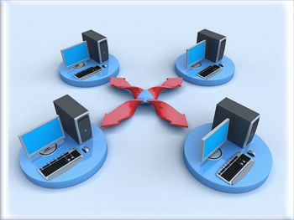
Application Virtualization
Application is executed inside the isolation environment completely encapsulating it from the underlying O/S.

Slide 5
Application Virtualization
Steps in App Virtualization
Packaging the Application
  Application is installed within custom packager which records all files, registry and settings related to app.
Delivering App to the Target System
  The packaged application is delivered to target system through USB, web or custom Push mechanism.
Executing App in Virtual Environment
  Finally application is executed within the Virtual environment, completely isolated from other applications and underlying operating system.

Slide 6
Application Virtualization cont…
Implementation of App Virtualization Technology
  File I/O Redirection
  Registry Redirection
  COM Isolation
  .NET Isolation
  Service Isolation
  Driver Isolation

Slide 7
Application Virtualization cont…
File I/O Redirection
Redirecting and controlling file I/O requests from the virtual application sandbox.
Example:
  Input:
  C:\Program Files\
  Redirected Input:
  C:\<app_sandbox_path>\C\Program Files
Notes:
* API Hooking
- CreateFile, OpenFile, ReadFile, WriteFile
- NtCreateFile, NtOpenFile etc
* File System Driver
- handles all file requests, each such request contains the path which will be redirected to VN location

Slide 8
Application Virtualization cont…
File I/O Redirection Implementation
API Hooking at USER Level
  Hooking Kernel32.dll - CreateFile, OpenFile, DeleteFile etc
  Hooking Ntdll.dll – NtCreateFile, NtOpenFile, NtDeleteFile etc
API Hooking at Kernel Level
  Hooking SSDT – NtCreateFile, NtOpenFile etc
File System Filter Driver or Mini-Filter
  Write file system driver to redirect virtualized file requests.
Notes:
User land - less risky, easy, all process needs to be hooked, dll injection may not be supported in later versions, no privilege required
Kernel land – one place hook, load on system for processing every redirection, risky – blue screens
* filter driver/mini filter: one place for all and any FILE api functions. Risky – blue screens, load on kernel
*

Slide 9
Application Virtualization cont…
Registry Redirection
Redirecting and controlling registry read/write requests from virtual application.
Example:
  Input:
  HKCU\Software\Microsoft
  Redirected Input:
  HKCU\Software\<MyApp_Sandbox>\HKCU\Software\Microsoft
Notes:
- hooking registry calls, regopenkey, regcreatekeyex function
- ntregopenkey, ntregqueryvalue

Slide 10
Application Virtualization cont…
Registry Redirection Implementation
API Hooking at USER Level
  Hooking advapi32.dll - RegCreateKeyEx, RegDeleteKeyEx etc
  Hooking Ntdll.dll – NtCreateKey, NtDeleteKey etc
API Hooking at Kernel Level
  Hooking SSDT – NtCreateKey, NtDeleteKey etc
Notes:
- at user level no additional privileges required , it can take on and take off on the fly
- hooking registry calls, regopenkey, regcreatekeyex function
- ntregopenkey, ntregqueryvalue

Slide 11
Application Virtualization cont…
Service/Driver Isolation
Isolation of Service/Driver which is required for the smooth functioning of application
For example, Adobe reader depends on FlexNet Licensing service without which it will not start
Start a special service which will take care of managing the other virtual services
Driver Isolation is very difficult as they are tightly coupled with operating system

Slide 12
Advantages of Application Virtualization
No more Application Installation
Faster Application Deployment
Easier & Efficient Management of Applications
Significant Cost Reduction
Enhanced Security

Slide 13
Application Virtualization & Security
Improved Security for the Operating System and other applications.
Application Isolation allows insecure, incompatible apps to run safely.
Safe Browsing, No need to worry about Zero-Day Exploits
Provides Ideal Environment Virus/Malware Testing

Slide 14
Players in App Virtualization
VMware: ThinApp
Microsoft: App-V
Citrix: Application Streaming
Symantec: Altiris SVS
Spoon: Web based Streaming
Sandboxie by Ronen Tzur

Slide 15
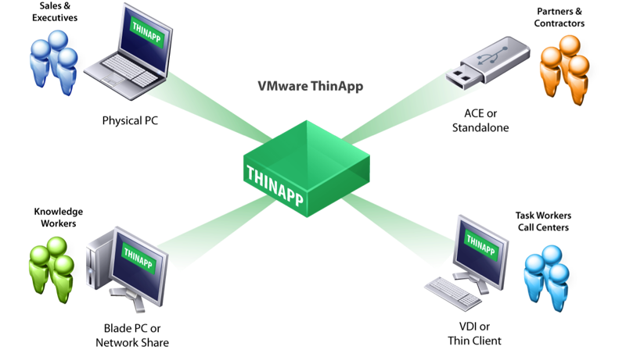
Example : VMWare - ThinApp
VMware – ThinApp
Notes:
- How it works
- app is packaged and exe is created
- this exe when launched it extracts automatically and runs around
- Howz the isolation is done
- Demo ???

Slide 16
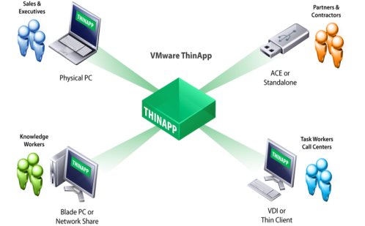
Example : VMWare - ThinApp
Application is packaged using ThinApp Packager and single EXE/MSI is created
This EXE/MSI can be deployed to any system and executed directly
On Execution, it extracts packaged app and runs it within the isolated sandbox.
Does not require any AGENT to be installed on the client system
Notes:
- How it works
- app is packaged and exe is created
- this exe when launched it extracts automatically and runs around
- Howz the isolation is done
- Demo ???

Slide 17
DEMO: VMWare - ThinApp
Notes:
- How it works
- app is packaged and exe is created
- this exe when launched it extracts automatically and runs around
- Howz the isolation is done
- Demo ???

Slide 18
Example: SPOON
Applications are packaged using Spoon Studio and kept on the Spoon Servers.
User have to install Spoon Plugin on their system.
Next user can browse through Apps on Spoon.net and run the App directly within XVM.
User can package their favorite app using Spoon Studio and upload to Spoon Servers
Notes:
- Web based app Vn
- Install its vm called (XVM)
- Click on any app, which will be downloaded to local system
- it spawns XVM which runs the app within the sandbox

Slide 19
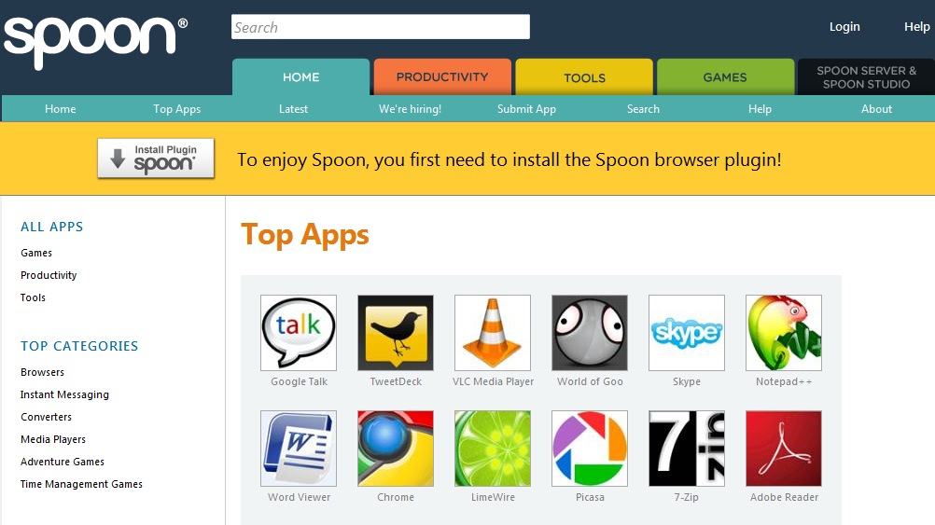
DEMO: SPOON

Slide 20
References
VMWare – ThinApp
Application Virtualization
Spoon – Adaptive Streaming
Microsoft – ‘App-V ‘
Sandboxie – App Virtualization
VMWare ThinApp Video Demonstration
Spoon.Net Video Demonstration
Notes:
http://en.wikipedia.org/wiki/Application_virtualization
http://www.vmware.com/products/thinapp/
http://spoon.net/
http://www.microsoft.com/systemcenter/appv/default.mspx
http://www.sandboxie.com/

Slide 21
Questions ?

Slide 22
Thank You
tnagareshwar@gmail.com

