Slide 1

Primer on Password Security
Nagareshwar Talekar
www.SecurityXploded.com
tnagareshwar@gmail.com

Slide 2
Contents
Part I - Operating System, Cryptography & Password Recovery
Part II - Password Cracking/Recovery Techniques
Part III – Advanced Password Stealing Methods
Part IV - Why they are after you and Tips for Protection !

Slide 3
Part I
Operating System, Cryptography & Password Recovery

Slide 4
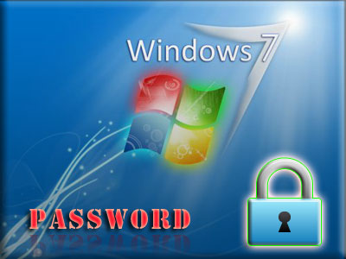
Windows Login Password Secrets
Windows 98 used to store the user account passwords in .PWL files in Windows directory.
Windows NT onwards stores the login password into registry hive files named 'SYSTEM' and 'SAM' at following location
C:\Windows\System32\Config

Slide 5
Windows Login Password Secrets
These password files are highly protected and not accessible while Windows is running even for the administrator.
SAM hive file refers to registry location
HKEY_LOCAL_MACHINE\SAM
SYSTEM hive file refers to registry location
HKEY_LOCAL_MACHINE\SYSTEM
These registry locations (user accounts related content) are visible only from ‘System Account’
Login Passwords are encrypted using one way hash algorithm known as LM/NTLM
Code Injection technique is used to dump these password hashes from System Process - LSASS.EXE

Slide 6
Windows Login Password Recovery - I
Live Password Recovery
Dumping the LM/NTLM password hashes of users using pwdump/lc5/cain&abel tools
Recovering the password using Online/RainbowCrack/BruteForce method.
Offline Password Recovery - Resetting the Password
Boot via Backtrack, mount the system partition and use chntpw tool to reset password.
Offline Password Recovery - Retrieving the original password
Boot from BackTrack or any Live CD
Copy SYSTEM & SAM files from \\Windows\System32\Config folder
Now on another system, use Cain&Abel/LC5 tool to get LM/NTLM hashes from these files
Finally get the original password using Online/RainbowCrack/BruteForce method.

Slide 7
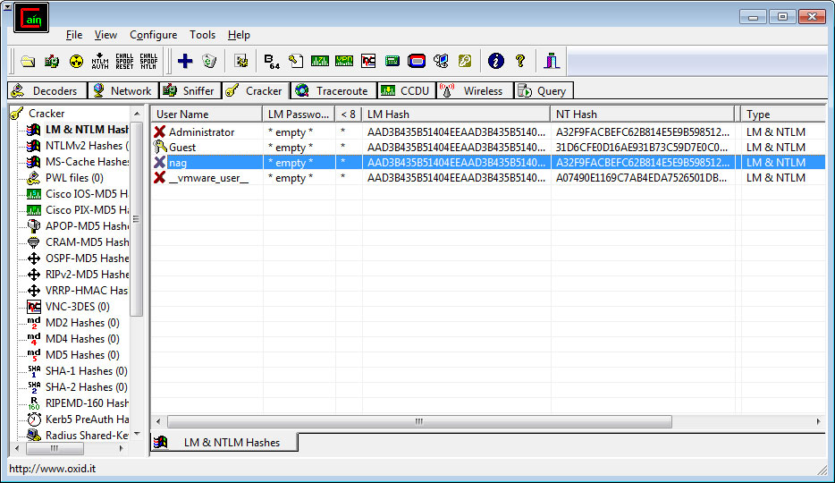
Windows Login Password Recovery - II
Screenshot - Dumping Local password hashes using Cain & Abel Tool

Slide 8
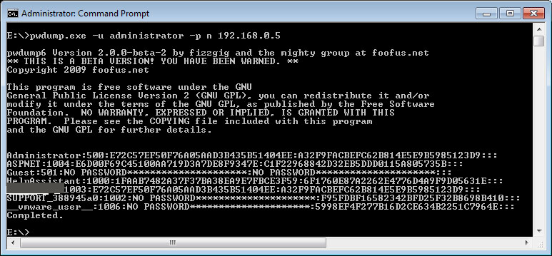
Windows Login Password Recovery - III
Bypass Windows Authentication using Kon-Boot
Login to any windows system without entering password using Kon-Boot
It dynamically modifies Windows kernel to bypass authentication
Remote System Password Recovery
Use pwdump tool to remotely dump the password hashes from live system
Then recover the password using Online/RainbowCrack/BruteForce Method
You need to know admin password of remote system.

Slide 9

Linux Login Password Secrets & Recovery
Linux stores user login information in /etc/password & /etc/shadow files
/etc/password contains only user login related info and encrypted password is actually stored in /etc/shadow file.
Contents of /etc/password
smithj:x:561:561:Joe Smith:/home/smithj:/bin/bash
Contents of /etc/shadow
smithj:Ep6mckrOLChF.:10063:0:99999:7:::
Use "John the Ripper" to crack Linux passwords

Slide 10


Operating System & Cryptography
Each OS provides built-in cryptography store & library for Secure storage of Secret/Sensitive Data
User Login credentials are used to keep it isolated and protected from other users.
Makes it easy & transparent for any application to use it.
Apps do not have to worry about security of sensitive data.
Windows - DPAPI & Credential Store
Linux
KDE => Kwallet
GNOME => Keyring
MAC - KeyChain

Slide 11
Windows Cryptography Internals
DPAPI - Data Protection Technology
Uses strong Triple-DES algorithm, SHA-1 algorithm and PBKDF2 password-based key derivation routine
Uses large secret sizes to greatly reduce the possibility of brute-force attacks to compromise the secrets
Only Logged in user can decrypt his/her previously encrypted data
It is possible to recover password from the disk if that user's login credential is known.
Using DPAPI from Your Application [user specific]
CryptProtectData - Encrypt your Password
CryptUnprotectData - Decrypt your Password

Slide 12
Windows Cryptography Internals
Other useful DPAPI functions
CryptEncrypt - [Generic] Encrypt Data
CryptDecrypt - [Generic] Decrypt Data
CryptProtectMemory - Encrypts memory region
CryptUnprotectMemory - Decrypts memory region
Applications using DPAPI
IE, Google Chrome, GTalk, Picassa, Google Desktop Search etc

Slide 13
Using Windows DPAPI
Just a few lines of code to Encrypt/Decrypt Passwords !
DATA_BLOB DataIn;
DATA_BLOB DataOut;
DATA_BLOB DataFinal;
DataIn.pbData = "My Secret Password";
DataIn.cbData = strlen("My Secret Password")+1;;
//Encrypt the Password
CryptProtectData(&DataIn, NULL, NULL, NULL, NULL, 0, &DataOut);
//Decrypt the password
CryptUnprotectData(&DataOut, NULL, NULL, NULL, NULL, 0, &DataFinal);
printf("Decrypted password is %s ", DataFinal.pbData);
Note : Above code is illustration purpose only

Slide 14
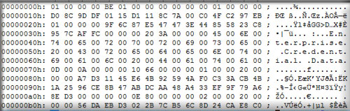
Windows DPAPI Secrets
Any data encrypted using DPAPI functions has following magic pattern
01 00 00 00 D0 8C 9D DF 01 15 D1 11 8C 7A 00 C0
Sample DPAPI encrypted data file

Slide 15
Windows Cryptography Internals
Credential Store - Provides Secure Storage mechanism to store sensitive data
Credential Store Types
Generic Password
Domain Password - Most Secure
Domain Visible Password / .NET Passport
Certificates
'Domain password' => It cannot be decrypted by even administrator. Only system process, LSASS.EXE has the privilege to play with it.
Generic Password/.NET Passport => Use functions CredEnumerate & CredUnprotectData to enumerate and decrypt all the stored passwords
Applications => Outlook, Windows Live Messenger, Remote Destktop, GMail Notifier, Network Passwords etc

Slide 16
Windows Cryptography Internals
Protected Storage - Older storage mechanism used by Windows
Protected Storage API functions exported from pstorec.dll are used store/enumerate the secret data
Used by older versions of Internet Explorer, Outlook & MSN Messenger

Slide 17
Part II
Password Cracking/Recovery Techniques

Slide 18
Password Cracking/Recovery Techniques I
Dictionary Method
Quickly find any dictionary based passwords
Brute-Force Method
Use a specific character set or combination such as lowercase, uppercase, numeric, special characters
Takes long time based on the length and character set used
Hybrid Method
Combination of dictionary word and brute force technique
Detect smart passwords such as password123, 123password etc
Pattern based Brute-Force Method
Here user knows the part of the password (say ending with 123)
Reduces the number of attempts and significantly reduces total time

Slide 19
Password Recovery Techniques II
GPU/Distributed based Brute-Force
Password cracking/recovery is performed on high end GPU based or distributed systems
Speeds up the recovery process significantly
Rainbow Crack
Hashes of known algorithm (such as LM/NTLM/MD5/SHA) for all possible character sets are pre-computed and kept in sorted tables
Then Password hash is searched in these tables to find the original plain text password.
Very efficient and fastest way to crack any complex passwords

Slide 20
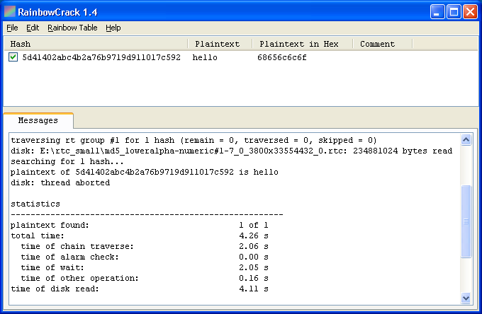
Rainbow Cracker Tool
Screenshot of RainbowCrack GUI Tool.

Slide 21
Creating your Own Password Tools
Preparation - Ask Google and get all possible password info for the target App
Goal 1 : Find out password storage location : Registry or File ?
Goal 2 : Password Decryption Algorithm
Reverse Engineering - Static Analysis using IDA Pro Disassembler
- Search for password strings/file names/registry key names
- Trace backwards, decompile the function
- Find the right function handling the password decryption
Reverse Engineering - Live Debugging using OllyDbg
- Break on CredEnumerate/CryptUnprotectData functions
- Directly debug/trace the password functions
- Decode the password decryption algorithm

Slide 22
Case Study : First ever Disclosure on Password Secrets of Apple Safari
Google Search - Failed : Almost no information on Safari password recovery
Goal 1 : Finding Password Storage Location
Random checks in %appdata%, %localappdata%, %programfiles% location - Found Nothing
Checked Registry : HKEY_CURRENT_USER - Found Nothing
Traced Safari with ProcMon & Found it !
C:\Users\Administrator\AppData\Roaming\Apple Computer\Preferences
Little more investigation and found exact password file "keychain.plist“
Goal 1.1 : Decoding the Password File
Tried manual decoding and smart guesses – FAILED
Found that it is using Windows DPAPI technology for encryption
Google search to find out what is plist ?
Found Tool - plutil.exe to convert plist to neat xml file

Slide 23
Case Study : Making of
Safari Password Decryptor
Goal 2 : Decrypting the Password
Debugging with breakpoint on CryptUnprotectdata & CryptDecrypt
It hit on CryptUnprotectdata (in CFNetwork.dll) and on return I had decrypted password
Here it was using entropy/salt for enhanced security
Goal 2.1 : Decoding the Entropy/Salt
Disassembled CFNetwork.dll to understand entropy/salt calculating function – Down !
Debugged again with breakpoint on salt function - Alice in the Wonderland :)
Finally copied the salt/entropy data and tested with dummy program – Worked !
Next step was to verify if this salt is constant or different for each system/user
Tested on Other system and it was Static !
Finally I wrote parser for xml password file and decryption code with salt to bring out - Safari Password Decryptor !

Slide 24
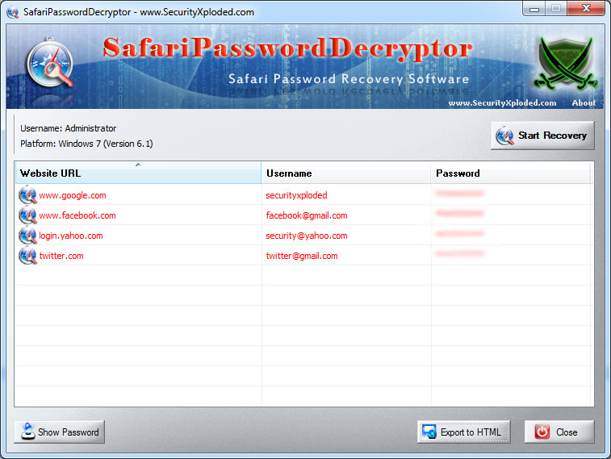
Safari Password Decryptor
Demonstration of Safari Password Decryptor in Action !

Slide 25
Part III
Advanced Password Stealing Methods

Slide 26
Password Sniffing on the Wire
Automatically capture plain text passwords flowing through wire
Capture Password for Services such as FTP, SMTP, HTTP Basic, POP3, IMAP4 etc
Network Password Sniffer Tools
Dsniff
SniffPass
Cain & Abel
FTPPasswordSniffer

Slide 27
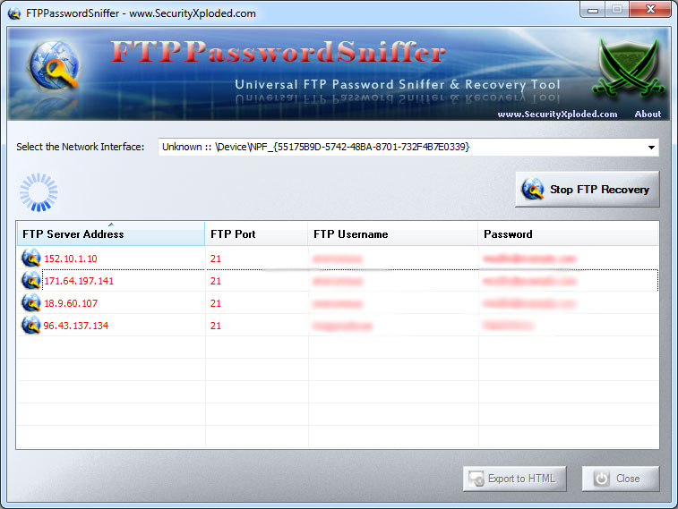
FTP Password Sniffing Demo

Slide 28
Advanced Password Stealing I
Man in the Middle Attack - SSL Sniffing
Use man in the middle attack to divert the target user's network session through attacker's system
Perform SSL MITM attack to get complete control over user session and steal credentials
Tools - Webscarab, Ettercap, Cain & Abel
Phishing
Users are redirected to duplicate/fake bank/mail login webpages and passwords are recorded
Using techniques such as DNS poisoning, Fake Websites, DNS Redirection, Scary Emails etc
Session Hijacking
Steal user mail or bank transaction session by stealing cookie or other session based parameters thorugh Sniffing.
Simultaneously access user session - view/perform privileges operations

Slide 29
Advanced Password Stealing II
Custom Hooks/Patches for Silent Password Stealing
Important applications such as browsers, messengers are patched
Using custom Dll/API hooks/runtime memory modification techniques
Write stolen passwords to file
Hardware Keyloggers
Switches for Keyboard Cables which can collect all keyboard data
Requires physical access, easy and highly stealthy, not detected by Anti-Keyloggers

Slide 30
Penetration Testing & Password Recovery
Once system is compromised - fire up a cmd prompt & use console based Password Tools
Crack/Recover following Passwords
Operating System - User Login passwords
Password stored by Popular Browsers (Firefox, Chrome, IE etc)
Password stored by Popular Messnegers (Gtalk, AIM, Windows Messenger, Trillian etc)
Password stored by Email Clients (Outlook, Thunderbird etc)
Stored Network Passwords
Application Specific Passwords (Facebook & Twitter Desktop Clients)
Sniff Passwords on the Network
Tools – Pwdump, Browser/Mail/IM/Network PasswordDecryptor, SniffPass etc

Slide 31
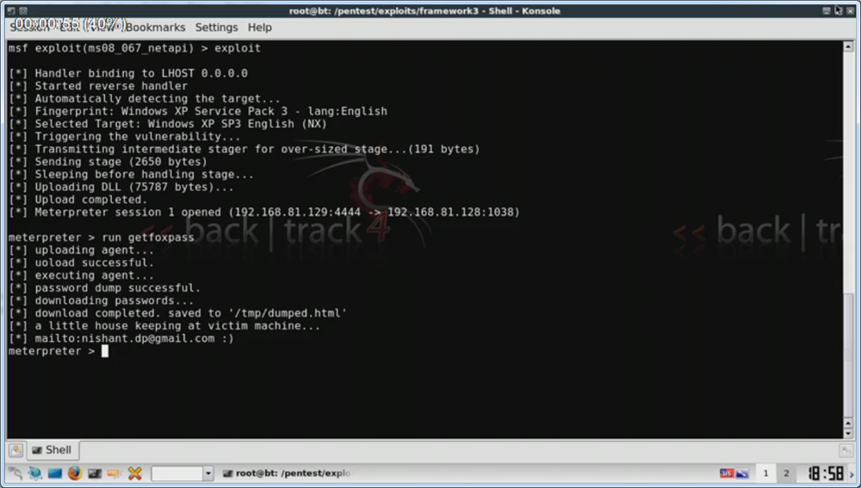
Demonstration
Stealing Browser Passwords using Metasploit – Penetration Testing Framework

Slide 32
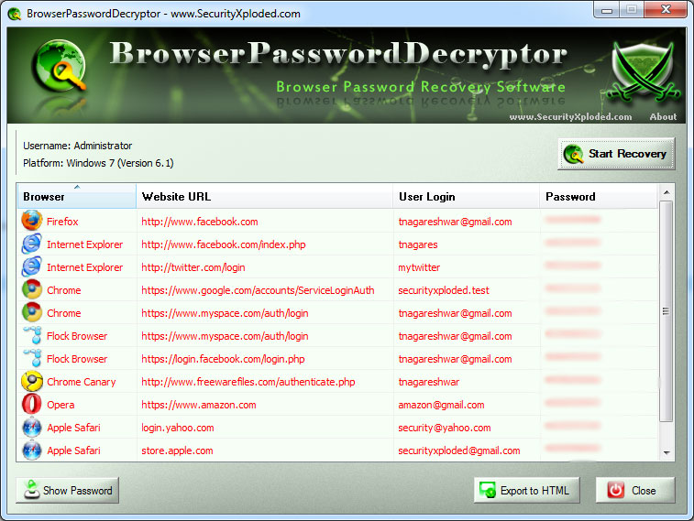
Browser Password Decryptor Demo
Recovering passwords stored by all popular web browsers.

Slide 33
Part IV
Why They are After You and Tips for Protection !

Slide 34
Why Hackers/Spywares/Trojans Steal your Passwords ?
Now it is all about MONEY - no more Status quo
Quickest, Easiest & Dirtiest way to make money
Use Automated Tools to build the worm integrated with latest zero day exploit
One Sophisticated Worm/Trojan can bring in Money worth 6+ digits

Slide 35
How They Make Money ?
Data is Highly precious - Are you a CEO, Higher Gov Officer, Nuke Researcher ?
Sell the Secret data to your Enemies - Competitor Companies, Opponent Countries.
Steal your credit card details and use it to buy Benz !
Get access to your bank/email/corporate account and demand money to give it back to you
Encrypt your hard disk and ask money to decrypt it !
Lock your Desktop and ask money to unlock it !
Many more innovative ways...!
Notes:
note => they do smaller trasactions some times less than 50$ so that it go unnoticed

Slide 36
How Spywares/Trojans Steal your passwords
Spread trojan/spyware through following means
game softwares
serial crackers
other freewares
network shares
malicious websites
malicious documents (PDF/Flash/Office)
Once compromised, trojan uses one of following ways to steal your passwords
KeyLoggers [Kernel/User level]
Password Crackers
Network Password Sniffers
Custom Hooks/Patches for Hot Applications to silently steal passwords

Slide 37
Password Protection – Tips I
Use unique password for all important accounts
Never store password for important accounts in browsers/messengers or other applications
Choose Strong Password – but not complex one ☺
use uppercase (even one will do) + lowercase + number/special character
choose uncommon special character
length should be above 8
Use master password (even simple one will do) to protect all the stored passwords
(example, Firefox )
Setup alternate email account for password reset operations
You are not Lucky to get 100 million $$$ - don’t reply to Lottery emails and give away your account details

Slide 38
Password Protection – Tips II
On compromise or spyware infection, change passwords of all main accounts (banks/mail/corporate/social network)
Do not do Bank or any Imp transactions and view mail accounts through
Wireless Network
Cyber Cafe
Shared System
In emergency case use SSL and make sure SSL certificate is valid/no warnings
Use one time password for online transactions wherever available !
Phishing Protection
Verify SSL GREEN status in the browser,
Check the URL if it is proper one
Do not click through email content - type it manually

Slide 39
Password Recovery Workshop
Post Lunch Session
Windows Password Cracking
Cain & Abel to dump Password hashes from Live system
BackTrack - Resetting the Windows Password
BackTrack and Cain/Abel - Offline Windows Password Recovery
Rainbow Password Cracking
Generating Rainbow Crack Tables
Using it to crack password hashes
Password Sniffing on Wire
Network Sniffing using WireShark
Using Password Sniffing Tools such as SniffPass/FtpPasswordSniffer
Browser & Messenger Password Recovery
Recovering passwords from Mozilla/Firefox/Chrome/Safari browsers
Recovering passwords from Messengers (GTalk, Windows Messenger, Trillian, Gaim etc)

Slide 40
References
Windows Login Password Recovery
Linux Password & Shadow File Formats
Windows Data Protection Technology – DPAPI
Exposing the Secret of Decrypting Network Passwords
Password Secrets of Popular Windows Applications
Browser Password Decryptor - All Browser Password Recovery Tool
The Rainbow Crack Project
Cain & Abel - The Windows multi purpose Password Tool
BackTrack - Most popular Linux Security Distribution
Pwdump6 - Windows Password Dumping Tool

Slide 41
Questions ?

Slide 42

Thank You !
www.SecurityXploded.com
[tnagareshwar@gmail.com]

