Slide 1

Part I – Lab Setup Guide
Reverse Engineering & Malware Analysis Training
Swapnil Pathak
Amit Malik
www.SecurityXploded.com

Slide 2
Disclaimer
The Content, Demonstration, Source Code and Programs presented here is "AS IS" without any warranty or conditions of any kind. Also the views/ideas/knowledge expressed here are solely of the trainer’s only and nothing to do with the company or the organization in which the trainer is currently working.
However in no circumstances neither the trainer nor SecurityXploded is responsible for any damage or loss caused due to use or misuse of the information presented here.

Slide 3
Acknowledgement
Special thanks to null & Garage4Hackers community for their extended support and cooperation.
Thanks to all the trainers who have devoted their precious time and countless hours to make it happen.

Slide 4

Reversing & Malware Analysis Training
This presentation is part of our Reverse Engineering & Malware Analysis Training program. Currently it is delivered only during our local meet for FREE of cost.
For complete details of this course, visit our Security Training page.

Slide 5
Who am I #1
Amit Malik (sometimes DouBle_Zer0,DZZ)
Member SecurityXploded & Garage4Hackers
Security Researcher
RE, Exploit Analysis/Development, Malware Analysis
Email: m.amit30@gmail.com

Slide 6
Who am I #2
Swapnil Pathak
Member SecurityXploded
Security Researcher
RE, Malware Analysis, Network Security
Email: swapnilpathak101@gmail.com

Slide 7
Introduction
This Guide is specific to our course
Although it will cover most of the tools and techniques for an analysis environment
Our main focus is on the famous tools
www.SecurityXploded.com

Slide 8
Virtualization
Run multiple OS on the single hardware at the same time.
Advanced functionalities like Snapshot, Revert Back, pause etc.
Automation
Controlled environment
www.SecurityXploded.com

Slide 9
Virtualization Tools
VmWare (Commercial)
VirtualBox (Open Source – free)
Images – XpSp2, XpSp3
www.SecurityXploded.com

Slide 10
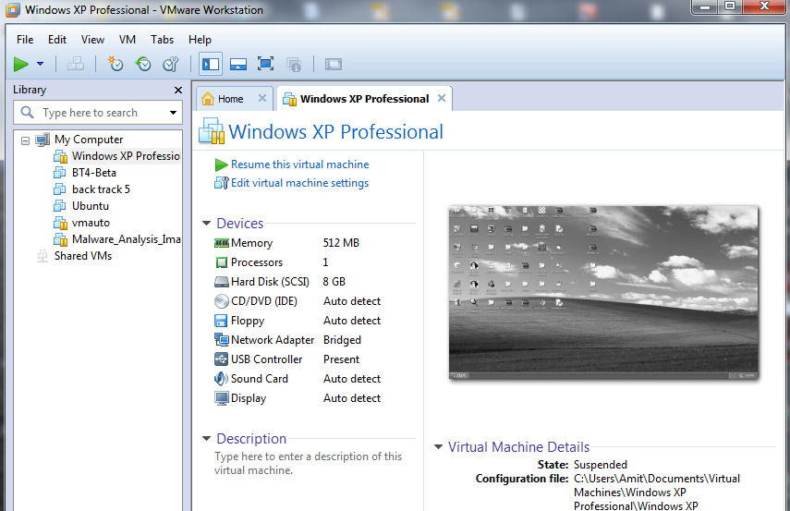
VmWare Image
www.SecurityXploded.com

Slide 11
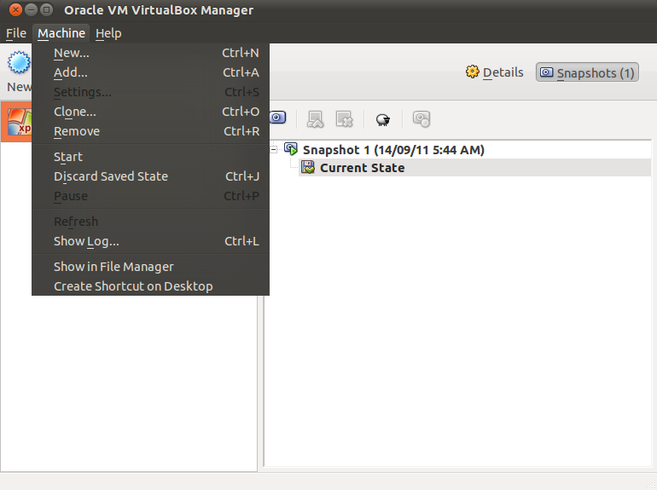
VirtualBox Image
www.SecurityXploded.com

Slide 12
Tools Development
Compiler/IDE
Dev C++ (Free) - preferred
Microsoft Visual C++ (Commercial)
Assemblers
MASM (Free) -preferred
NASM (Free)
Winasm (IDE) (Free)
Interpreters
Python (Free)
www.SecurityXploded.com

Slide 13
Tools Reverse Engg.
Disassembler:
IDA Pro (Download free version)
Debuggers
Ollydbg
Immunity Debugger
Windbg
Pydbg (optional)
www.SecurityXploded.com

Slide 14
Tools Reverse Engg. Cont.
PE file Format
PEview, PEbrowse, LordPE, ImpRec, Peid, ExeScan
Process Related
ProcMon, Process explorer
Network Related
Wireshark, TcpDump, Tshark, TCPView
File, Registry Related
Regshot, filemon, InstallwatchPro, CaptureBat
www.SecurityXploded.com

Slide 15
Tools Reverse Engg. Cont.
Misc.
CFFExplorer, Notepad++, Dependency Walker, Sysinternal tools
If something additional is required then we will cover that in the respective lecture
www.SecurityXploded.com

Slide 16
Reference
Complete Reference Guide for Reversing & Malware Analysis Training

Slide 17

Thank You !
www.SecurityXploded.com

