Slide 1

Practical Reversing VI - Exploit Development [advanced]
Reverse Engineering & Malware Analysis Training
Amit Malik
www.SecurityXploded.com

Slide 2
Disclaimer
The Content, Demonstration, Source Code and Programs presented here is "AS IS" without any warranty or conditions of any kind. Also the views/ideas/knowledge expressed here are solely of the trainer’s only and nothing to do with the company or the organization in which the trainer is currently working.
However in no circumstances neither the trainer nor SecurityXploded is responsible for any damage or loss caused due to use or misuse of the information presented here.

Slide 3
Acknowledgement
Special thanks to Null & Garage4Hackers community for their extended support and cooperation.
Thanks to all the Trainers who have devoted their precious time and countless hours to make it happen.
Thanks to ThoughtWorks for the beautiful and bigger venue.

Slide 4

Reversing & Malware Analysis Training
This presentation is a part of our Reverse Engineering & Malware Analysis training program. Currently it is delivered only during our local meet for FREE of cost.
For complete details of this course, visit our Security Training page.

Slide 5
Who am I #1
Amit Malik (sometimes DouBle_Zer0,DZZ)
Member SecurityXploded & Garage4Hackers
Security Researcher @ McAfee Labs
RE, Exploit Analysis/Development, Malware Analysis
Email: m.amit30@gmail.com

Slide 6
Agenda
The material in this presentation is a bit complicated so I will be using the zig-zag approach.
Recap
Protections (GS and SAFESEH)
Client side exploits and Heap Spray
Protections (DEP)
Protections (ASLR)
If time permits then few words on the following:
Heap buffer overflows

Slide 7
Recap
In previous session we covered:
Stack based buffer overflow
EIP overwrite (saved return address)
SEH Overwrite
We also discussed “why we need pop pop ret or other similar instruction in SEH overflow”
Now Question: Which one is more reliable or considered to be more reliable in terms of exploitation ?
Consider we have overwritten EIP and SEH successfully.

Slide 8
Protections Enforced by OS and Processor
ASLR
DEP
GS Cookies
SAFESEH
SEHOP
Forced ASLR
*Safe unlinking, Heap cookies etc. are also protection methods added into the OS.

Slide 9
Protections for stack based buffer overflow (Primary)
Fortunately or Unfortunately both protection schemes are based on compiler/Linker options.
* SEHOP is a different protection scheme based on run time SEH chain validation, It is not based on compiler options however can be enabled or disabled through registry.
EIP Overwrite ?
GS Cookie
SEH Overwrite ?
SafeSEH (SEHop*)

Slide 10
GS Cookie (/GS)
Put some random value (cookie – 32 bit) on stack before return address.
While returning, compare the value of saved cookie, if not same then we have an overwrite.
Generate “ Security Exception (if any)”, terminate the Application.

Slide 11
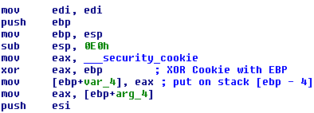


/GS Cookie Cont...
Function Start:
Cookie check function (see “function end” in below picture.)
Function end:

Slide 12
/GS Cookie Bypass
Generate exception before cookie check
Code dependent – if some overwritten variables are used before function return.
Overwrite stack up to the end, further overwrite will generate exception
Back to the question which exploitation (EIP or SEH) is more reliable ?
SEH method is considered to be a bit more safe and reliable regardless of this bypassing technique.

Slide 13
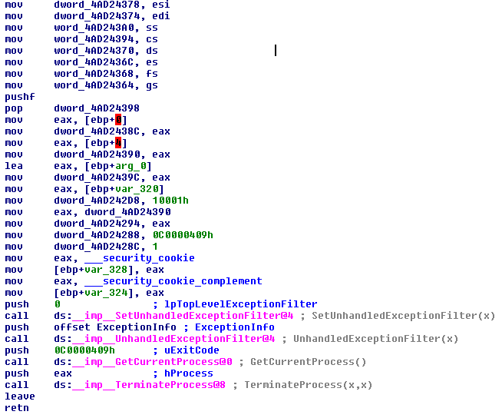
/GS Cookie Bypass Cont..
Leverage the implementation. Did you see something ?

Slide 14
SafeSEH
Compiler [Linker] /SAFESEH option
Static list of known good exception handlers for the binary.
Checks every time when a handler is called against the static list, if not in the list then handler is invalid and takes preventive measures.
Load configuration directory stores meta information about safe exception handlers.
If any module is not compiled with /SAFESEH then no check is done to ensure the integrity of the handler for that module.

Slide 15
/SAFESEH Bypassing
If any loaded module in the vulnerable binary is not /SAFESEH compiled then no check is done to ensure the integrity of the handler for that module, so we can use any p/p/r address from that module.
Use the address that is outside the address range of loaded modules.
Importance of forward and backward jump.
nseh
seh
payload
payload
nseh
seh
Forward jump
Backward
jump

Slide 16
DEP (Data Execution Prevention)
Two types:
Software DEP (forget it)
Hardware DEP (NX/XD enabled processors) – we will be talking about it in the rest of the session.
We can’t execute the code from non executable area anymore.
We are directly dealing with processer in this case.

Slide 17
DEP (HW) Bypass
ROP (Return Oriented Programming)
Use the system/existing code
How stack works ?
Main theme
Either make non executable area executable
Or allocate new area with executable permissions
How ?
Well, use ROP ☺

Slide 18
Stack Heap Flipping (Stack Pivoting)
I think this deserve a dedicated slide
Depending on the conditions we may have large ROP payload while space on stack may be less or may be our entire payload is on heap.
Flip the heap on to the stack so that we can get larger room.
Instructions like XCHG ESP[REG], REG[ESP] can be used.
We can also jump inside the valid instructions to change their meaning.
Example: jump one byte inside “setz al” instruction ( From Adobe U3D exploit in wild)

Slide 19
DEP (HW) Bypass (DEMO)
Methods
HeapCreate
VirtualAlloc
VirtualProtect
WriteProcessMemory (DEMO – simple, easy, demonstrate the entire concept – XpSp3)
Often times the small code chunks in ROP are termed as “gadgets”

Slide 20
DEP (HW) Bypass (DEMO)
http://vimeo.com/49069964

Slide 21
ASLR
Address Space Layout Randomization
Involves randomly positioning the memory areas like base address of the binary, position of stack and heap.
Compiler[linker] /DYNAMICBASE option

Slide 22
ASLR Bypass
Search for Non-ASLR loaded libraries in the vulnerable application or if possible load one. ☺
JRE ?
Memory leaks
Brute force
Heavily depends on vulnerability conditions

Slide 23
Client Side Exploits
Exploits that targets client applications like browsers, plugins, media players, readers etc.
Much more dangerous then any other form of exploits
Huge impact and landscape
Provides solid infection vector
Big malicious infrastructure.
Botnets, DDOS, Spam etc.

Slide 24
Heap Spray
A technique used in client side exploits
IT’S NOT A VULNERABILITY or CLASS OF VUL.
It’s a technique used for code execution.
Think about the followings again:
EIP overwrite
SEH overwrite
What we used in the above and why we used that ?
Heap spray provides very simple method for code execution.

Slide 25
Heap Spray Cont...
Fortunately or unfortunately client side scripting languages like javascript, vbscript etc. provides methods to allocate and deallocate memory on the client.
Which means we can make invalid memory addresses valid.
0x200... 0x300.. 0x500..
Valid address invalid address range
(allocated area)
Before Allocation
0x200... 0x400.. 0x500..
Valid address invalid address range
(allocated area)
After Allocation (0x300.. To 0x400.. Is valid now)

Slide 26
Heap Spray Cont..
Allocate memory and fill with nop + shellcode
Overwrite the EIP or SEH with any address within the newly allocated area (the nop region).
Here EIP overwrite or SEH overwrite can be by any means.
Stack buffer overflow, Heap buffer overflow, memory corruption, use after free etc..

Slide 27
Heap Spray (DEMO – IEPeers Vulnerability (IE6, IE7)
http://vimeo.com/49070337

Slide 28
Heap Spray (Stability Comments)
Use intelligent guesses
Stability depends on the exploitation conditions
Fragmented heap, choose little higher addresses.
Large number of allocations, choose little lower addresses ☺

Slide 29
Reference
Complete Reference Guide for Reversing & Malware Analysis Training

Slide 30

Thank You !
www.SecurityXploded.com

