Slide 1

Case Study – Rootkit Analysis
Reverse Engineering & Malware Analysis Training
Monnappa (m0nna)
www.SecurityXploded.com

Slide 2
Disclaimer
The Content, Demonstration, Source Code and Programs presented here is "AS IS" without any warranty or conditions of any kind. Also the views/ideas/knowledge expressed here are solely of the trainer’s only and nothing to do with the company or the organization in which the trainer is currently working.
However in no circumstances neither the trainer nor SecurityXploded is responsible for any damage or loss caused due to use or misuse of the information presented here.

Slide 3
Acknowledgement
Special thanks to null & Garage4Hackers community for their extended support and cooperation.
Special thanks to ThoughtWorks for the beautiful and bigger venue.
Thanks to all the trainers who have devoted their precious time and countless hours to make it happen.

Slide 4

Reversing & Malware Analysis Training
This presentation is part of our Reverse Engineering & Malware Analysis Training program. Currently it is delivered only during our local meet for FREE of cost.
For complete details of this course, visit our Security Training page.

Slide 5
Who am I
Monnappa
m0nna
Member of SecurityXploded (SX)
Info Security Investigator @ Cisco
Reverse Engineering, Malware Analysis, Memory Forensics
GREM
Email: monnappa22@gmail.com,
Twitter: @monnappa22
Linkedin: http://www.linkedin.com/pub/monnappa-ka-grem-ceh/42/45a/1b8

Slide 6
Contents
What is a Rootkit?
User Mode Rootkits
Kernel Mode Rootkits
Function Call cycle on Windows
Levels of hooking/modification on Windows
Demo 1 (mader– SSDT hook)
Demo 2 (prolaco – DKOM)
Demo 3 (darkmegi /waltrodock– installs device driver)
Demo 4 (carberp– syscall patch and inline API hook)
www.SecurityXploded.com

Slide 7
What is a Rootkit?
Program that perform system hooking or modifies functionality of OS
Hide files, processes, other objects to conceal its presence
Intercepts and alters the normal execution flow
Can contain both user mode and kernel mode components
Some rootkits can install as device drivers
Types: User Mode and Kernel Mode Rootkits
www.SecurityXploded.com

Slide 8
User Mode Rootkits
Runs in Ring 3
Hooking in user space or application space
Some common user mode Rootkit technqiues:
- IAT (Import Address Table) hooking
- Inline API hooking
Rootkit need to perform patching in the memory space of every running application
www.SecurityXploded.com

Slide 9
Kernel Mode Rootkits
Runs in Ring 0
System hooking or modification in kernel space
Some Kernel mode Rootkit techniques:
- SSDT (System Service Descriptor Table) hooking
- DKOM (Direct Kernel Object Manipulation)
- IDT (Interrupt Descriptor Table) hooking
- Installing as Device Drivers
- Driver IRP hooking
www.SecurityXploded.com

Slide 10
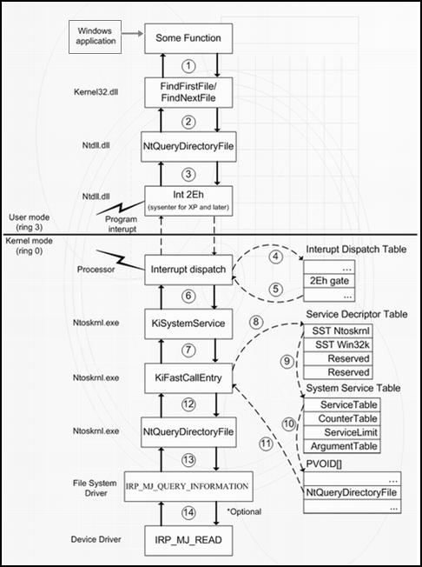
Function Call cycle on Windows
Below screenshot shows the API lifecycle on Windows system
www.SecurityXploded.com

Slide 11
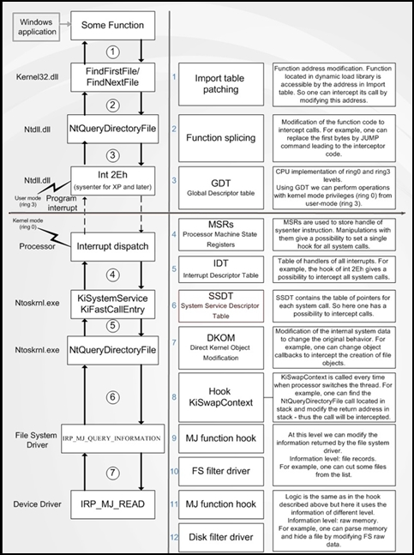
Levels of hooking/modification on Windows
The below screenshot shows tables and objects that Rootkit can hook/modify to hide its presence
www.SecurityXploded.com

Slide 12
NOTE
Rootkit Theory and Techniques will be covered in depth in our Advanced Training Series. This session focuses on the Rootkit Analysis.
Because of the time constraint, the demo uses a script “sandbox.py” which automates the behavioural analysis and memory analysis discussed in the Part 8 (Malware Memory Fornesics) and Part 9 (Advanced Malware Analysis) of the training session.
http://nagareshwar.securityxploded.com/2012/06/16/training-session-part-8-%E2%80%93-practical-reversing-iii-memory-forensics/
http://nagareshwar.securityxploded.com/2012/07/15/training-session-part-9-%E2%80%93-practical-reversing-iv-advanced-malware-analysis/
“sandbox.py” uses the tools CaptureBat (file, processs, registry activity), tshark (network activity), InetSim (simulating the services like dns, http, smtp) and Volatility (Memory Forensics) to produce the results. All these tools were discussed in Part 9 (Advanced Malware Analysis) of the training session.
www.SecurityXploded.com

Slide 13
Demo 1 (mader – SSDT Hooking ) http://youtu.Be/5cld2hukfbu

Slide 14
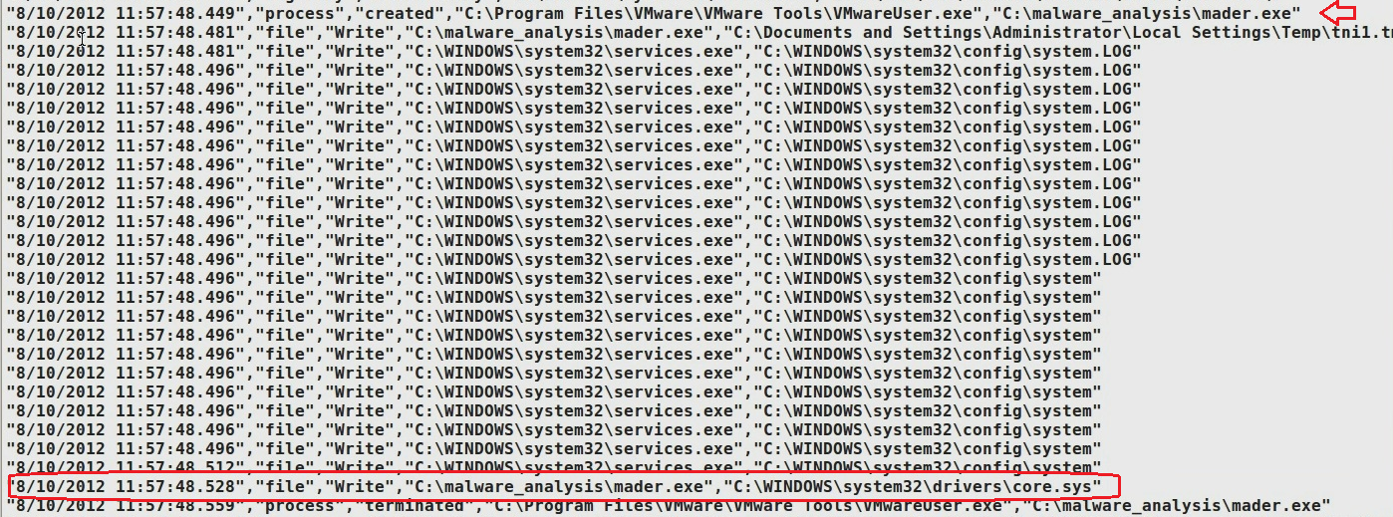
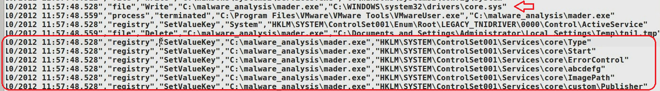
Executing the sample mader.exe
Executing the sample drops a driver and loads it as kernel service
www.SecurityXploded.com

Slide 15
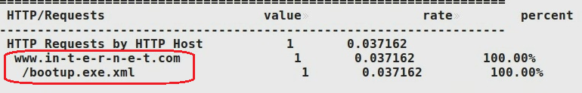
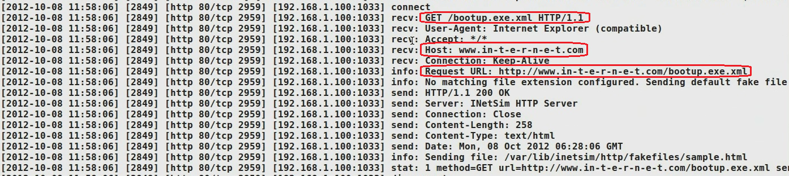
Network Activity
The malware makes dns query and downloads additional files
www.SecurityXploded.com

Slide 16
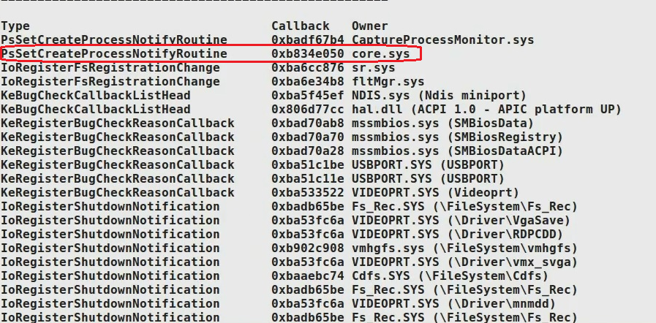
Kernel Callbacks
Rootkit uses callbacks to monitor for process creation activity
www.SecurityXploded.com

Slide 17
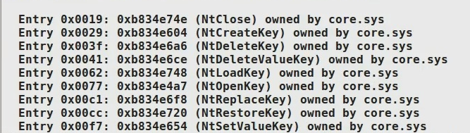
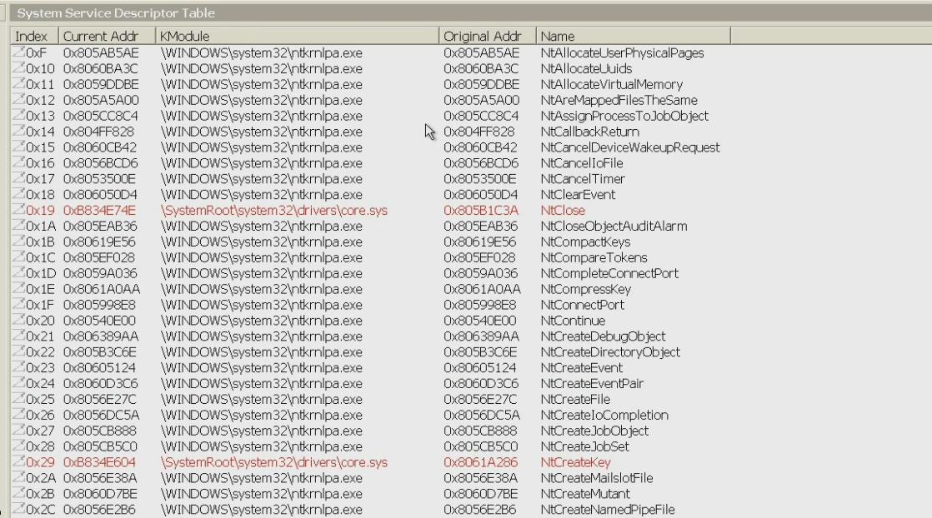
SSDT Hooking
Rootkit modifies the pointers in the SSDT to protect itself from deletion or removal
www.SecurityXploded.com

Slide 18
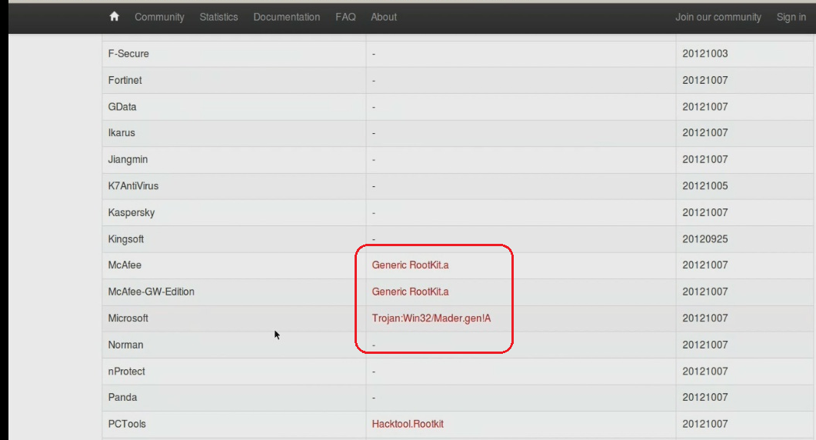
Rootkit Submission to VirusTotal
VirusTotal confirms the Rootkit after dumping and submitting the driver from memory
www.SecurityXploded.com

Slide 19
Demo 2 (prolaco – process hiding using dkom) http://youtu.be/J7odu8OkBYs

Slide 20
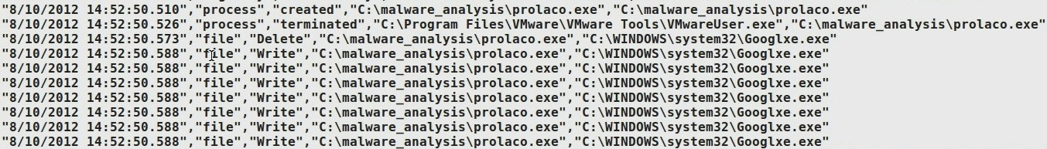
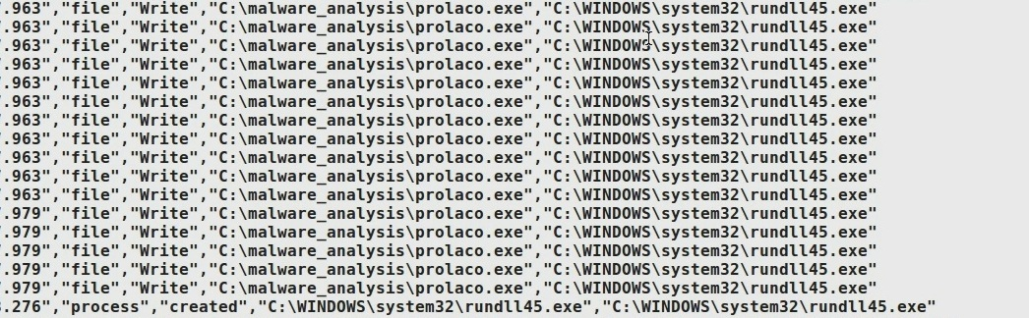
Executing the sample prolaco.exe
Prolaco.exe drops two files on “Googlxe.exe” and “Rundll45.exe” on the filesystem
www.SecurityXploded.com

Slide 21
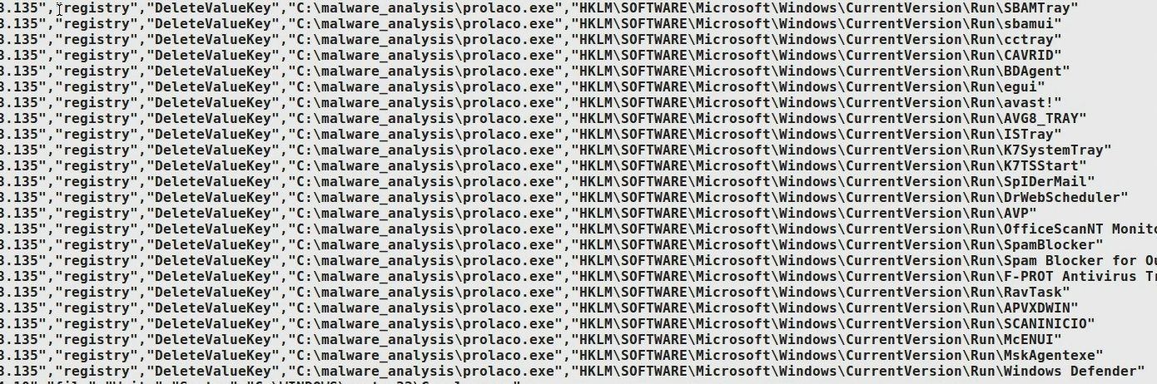
Disables Security Products
Prevents the security products from running by looking for the security products and deleting its registry key value
www.SecurityXploded.com

Slide 22
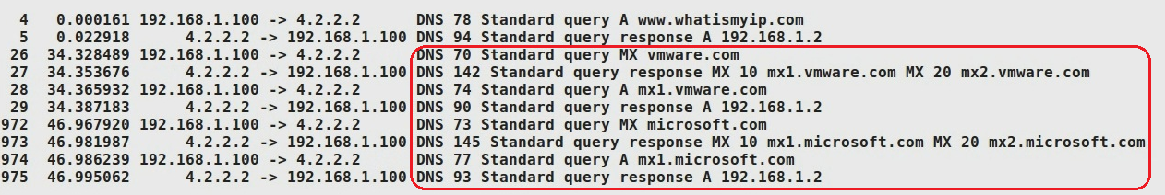
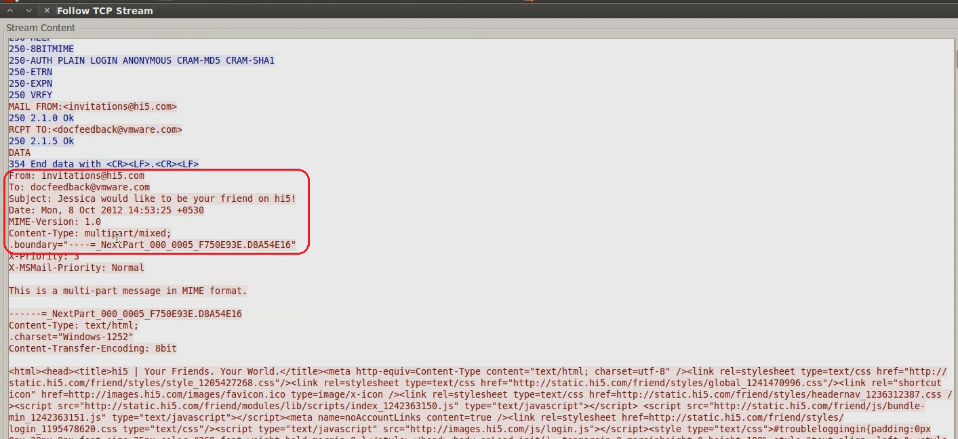
Sends Spam
The malware sends spam invitation mails to the some of the organizations
www.SecurityXploded.com

Slide 23

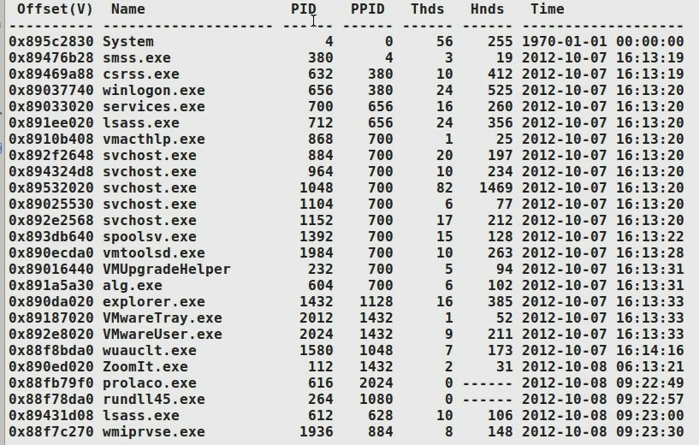
Hides the process
Process id 1080 sends the spam, but the rootkits hides that process from the process listing using DKOM technique
www.SecurityXploded.com

Slide 24
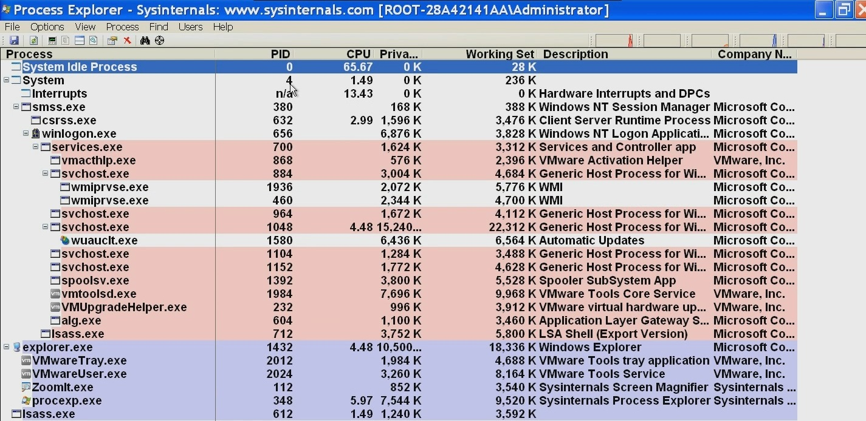
Hides Process from security tool
Hides the process from process explorer
www.SecurityXploded.com

Slide 25
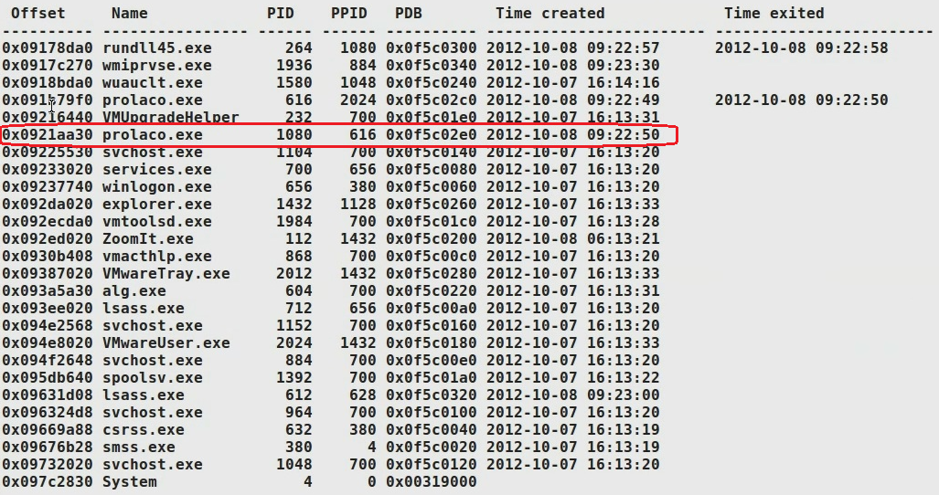
Detecting the hidden process
Comparing the process listing using Volatility’s “pslist” and “psscan” plugin, shows the hidden process prolaco.exe (pid 1080)
pslist
psscan
www.SecurityXploded.com

Slide 26
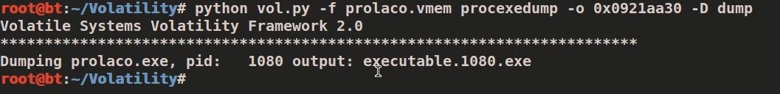
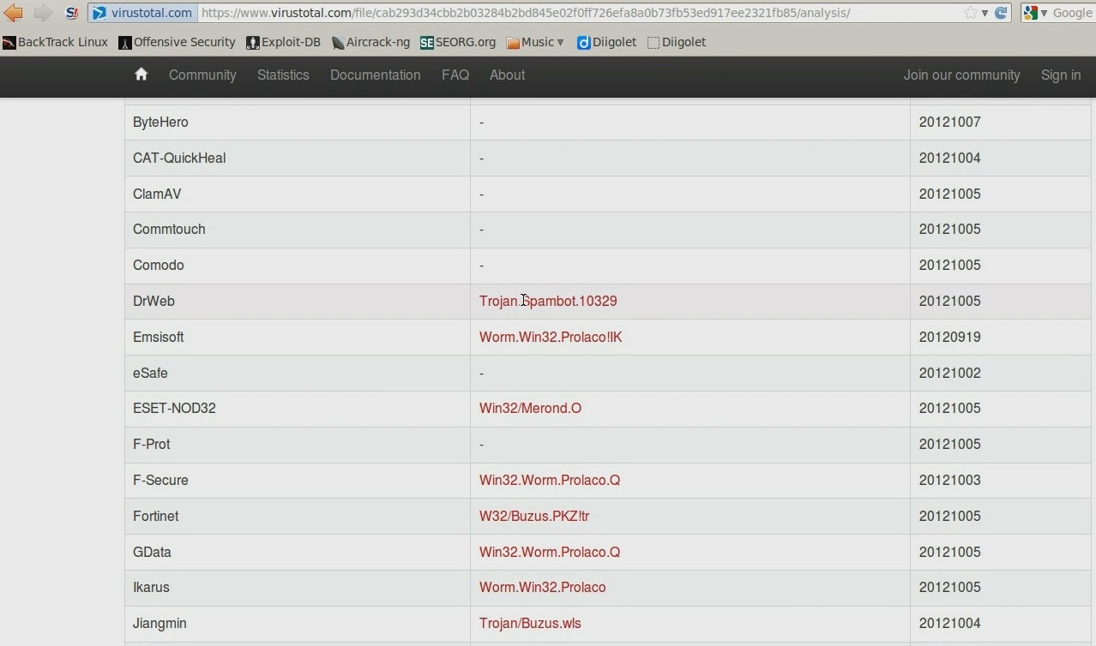
Dumping the hidden process
Dumping the hidden process from memory and submitting to VirusTotal confirms the presence of malicious hidden process
www.SecurityXploded.com

Slide 27
Demo 3 (Darkmegi/waltrodock – installs device driver) http://youtu.be/ZAWfu-tRzrc

Slide 28
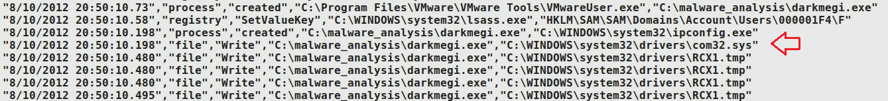
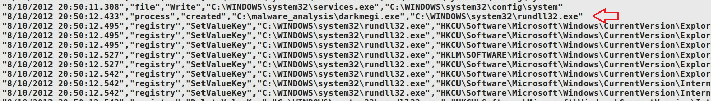
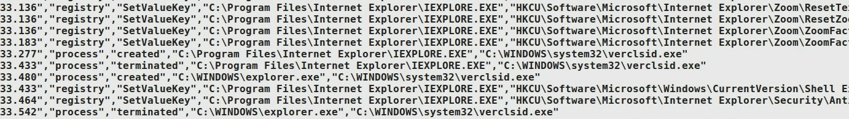
Executing the sample darkmegi.exe
The sample drops a driver and also invokes rundll32 and iexplore proces.
www.SecurityXploded.com

Slide 29
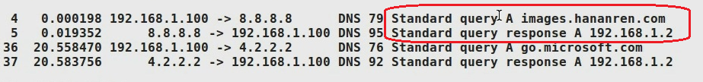
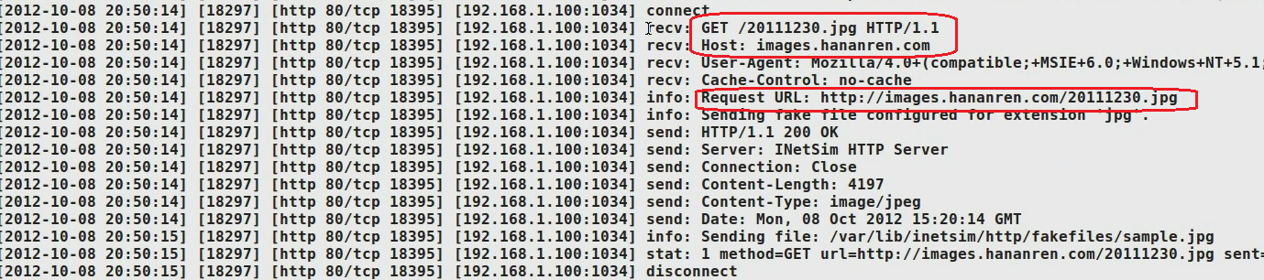
Network Activity
Makes dns query and download additional files
www.SecurityXploded.com

Slide 30
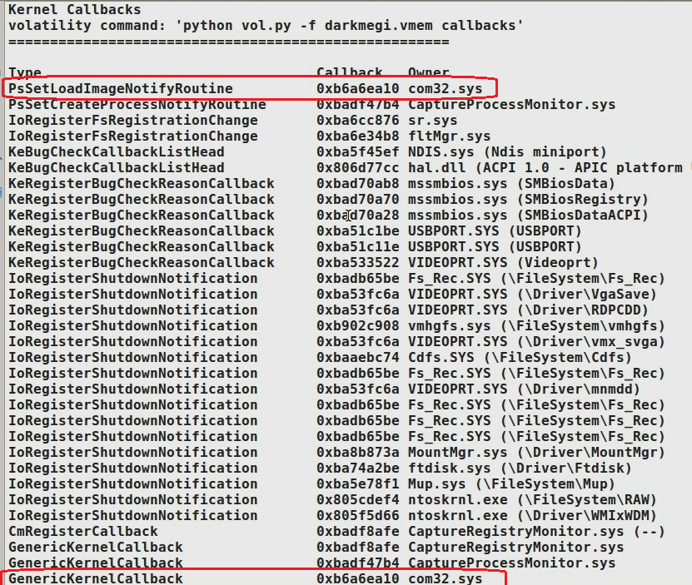
Sets Callbacks
Sets kernel callbacks to montior for an Image/DLL loading
www.SecurityXploded.com

Slide 31
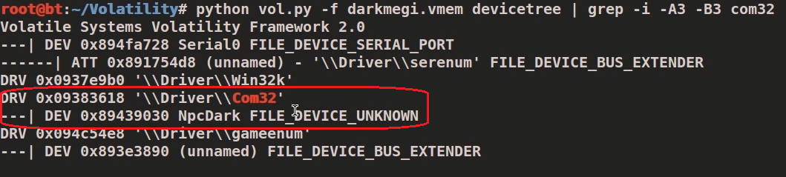
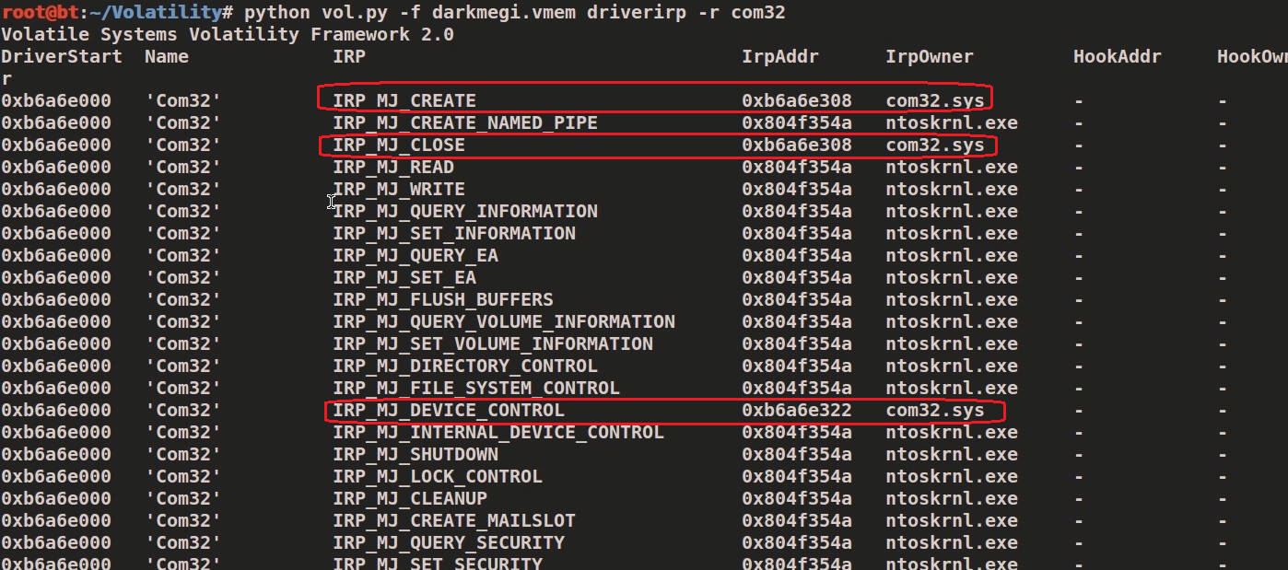
Examining the driver
The driver creates a device and accepts control codes from usermode programs
www.SecurityXploded.com

Slide 32
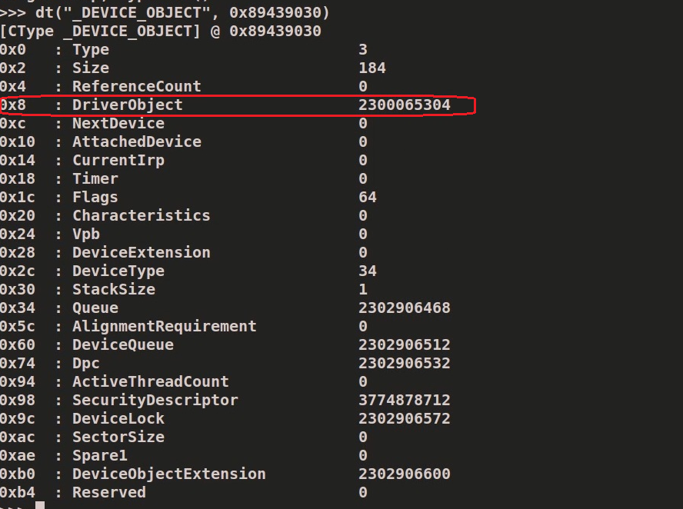
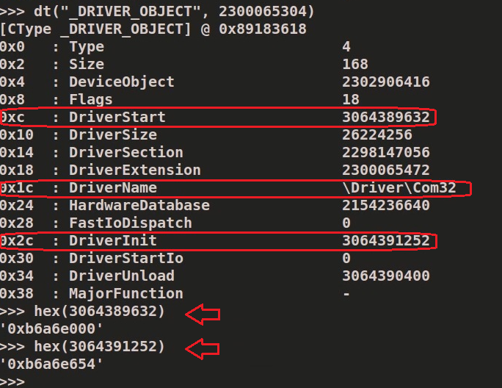
Device and Driver object
Examining the device and driver objects shows the base address and address of DriverEntry routine
www.SecurityXploded.com

Slide 33
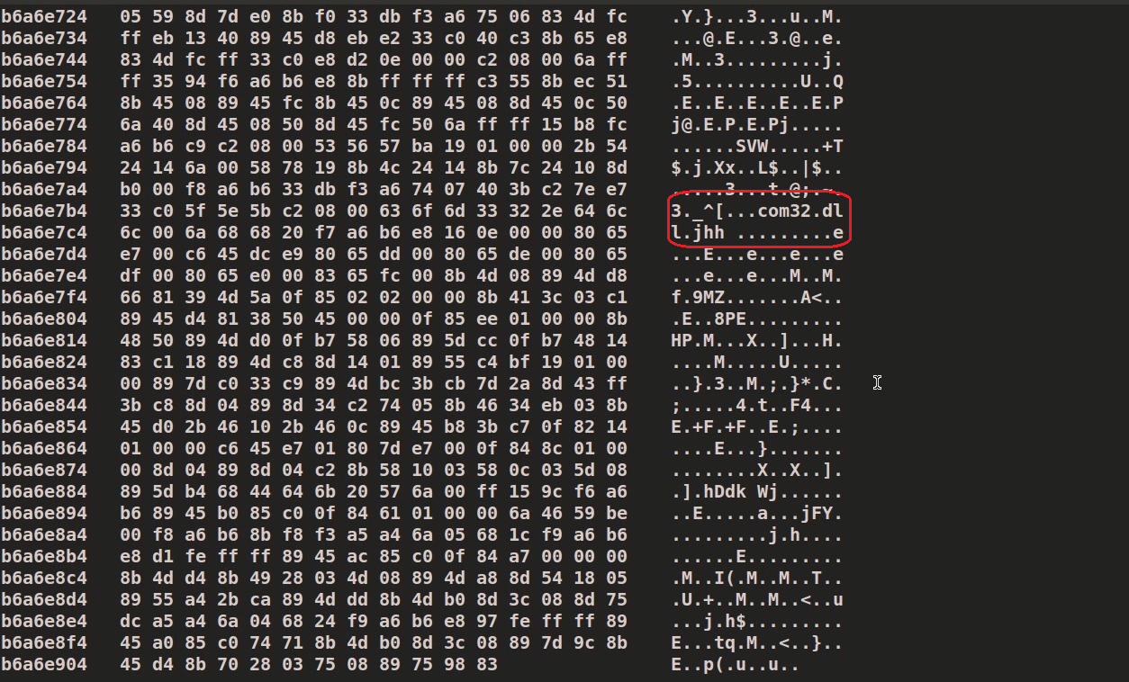
DriverEntry routine
Examining the DriverEntry routine shows the presence of a DLL “com32.dll”
www.SecurityXploded.com

Slide 34
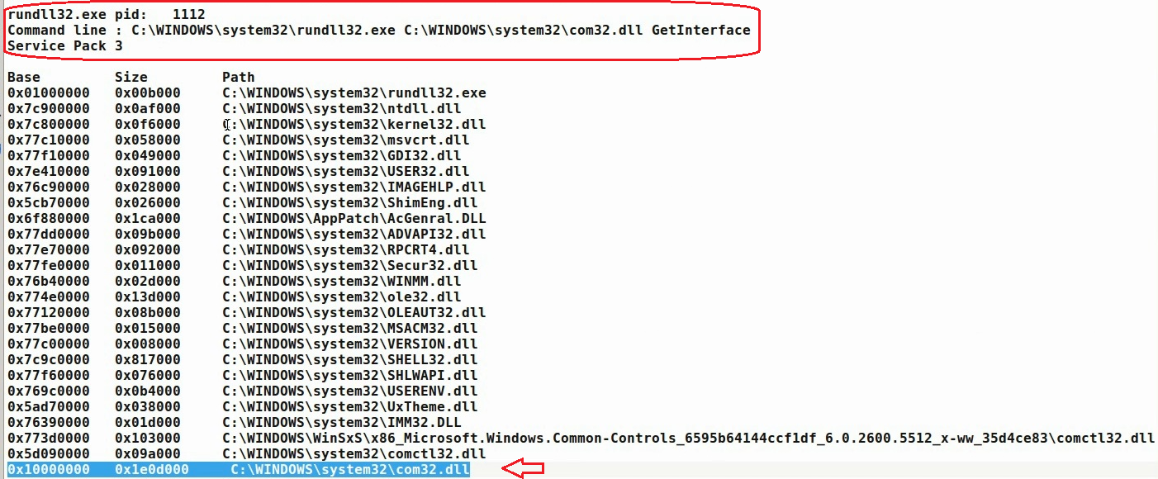
Dumping the DLL from memory
The DLL dumped from the memory, which was loaded by rundll32.exe
www.SecurityXploded.com

Slide 35
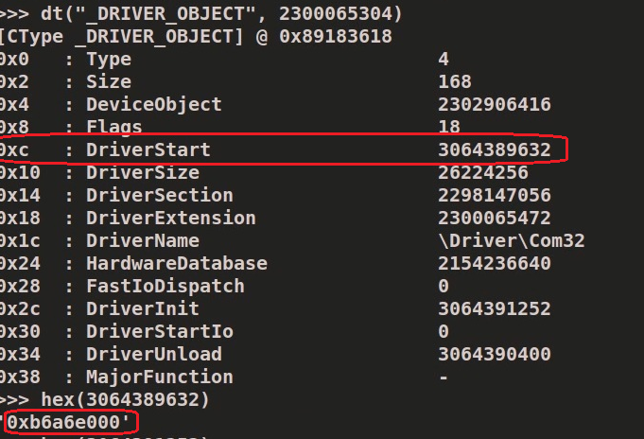
Dumping the Device Driver
Dumping the driver after determining the Driver’s base address
www.SecurityXploded.com

Slide 36
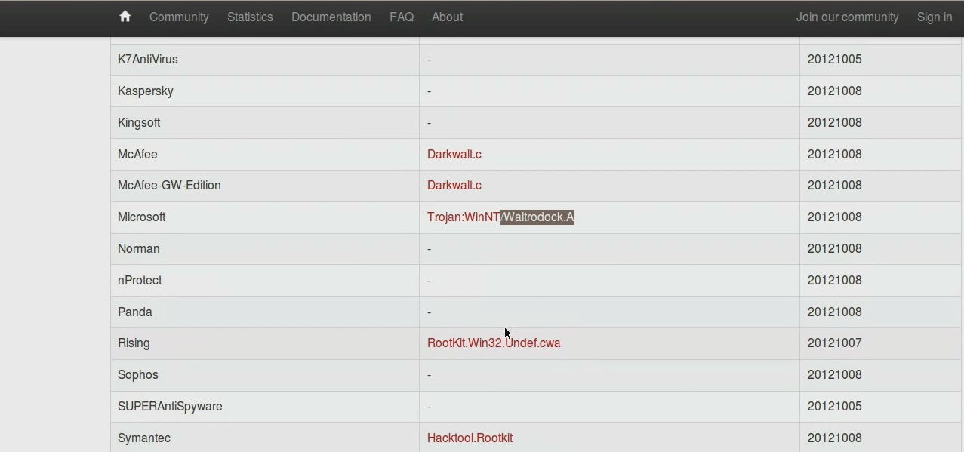
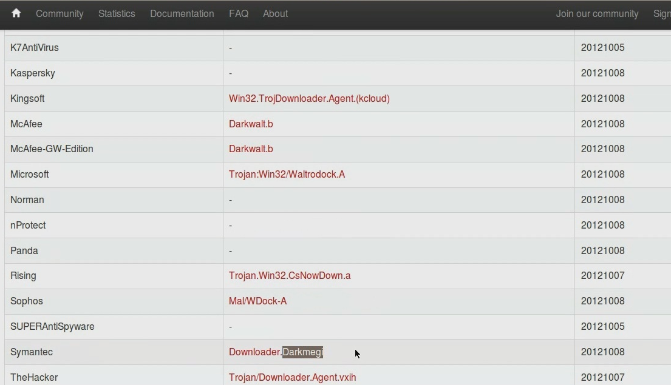
DLL and Driver Submission
VT confirms the Rootkit component after submitting the samples
VT results for dumped Driver
VT results for dumped DLL
www.SecurityXploded.com

Slide 37
Demo 4 (carberp – syscall patch and inline hooks) http://youtu.be/ui_qLL3_w7A

Slide 38
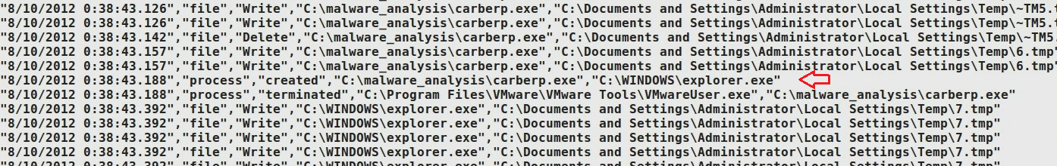
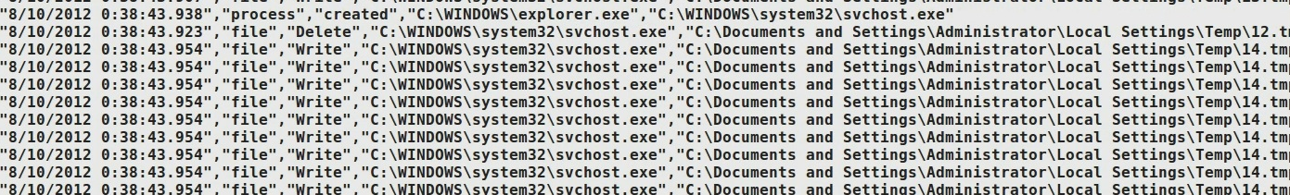
Executing the sample carberp.exe
The sample creates .tmp files and invokes explorer.exe and svchost.exe
www.SecurityXploded.com

Slide 39
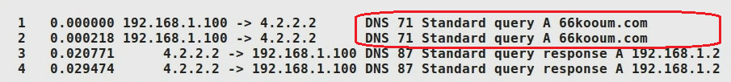
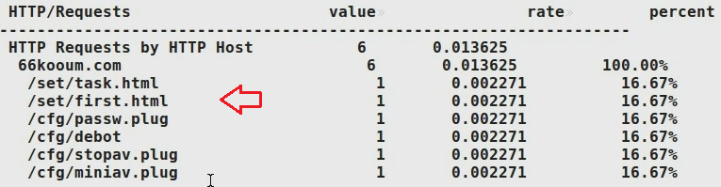
Network Activity
Malware performs dns and http activity
www.SecurityXploded.com

Slide 40
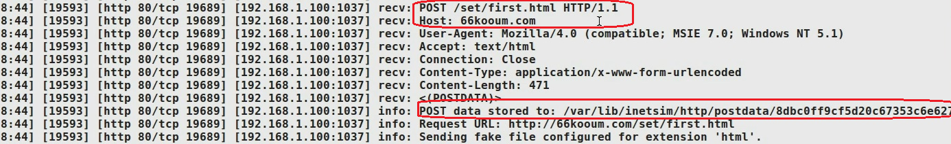
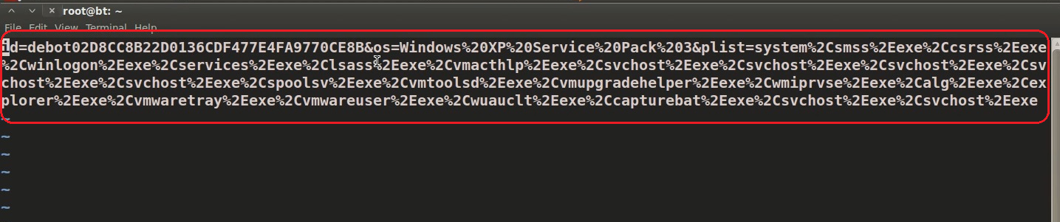
Submits process information
Submits process information on the system to the command and control server
www.SecurityXploded.com

Slide 41
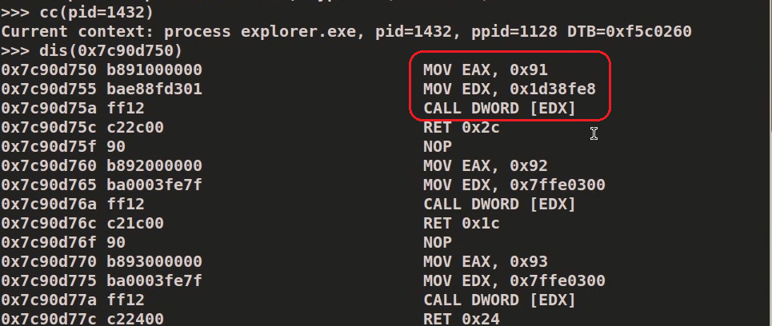
SYSCALL Patch
Patches SYSCALL in ntdll.dll to hide its presence
www.SecurityXploded.com

Slide 42
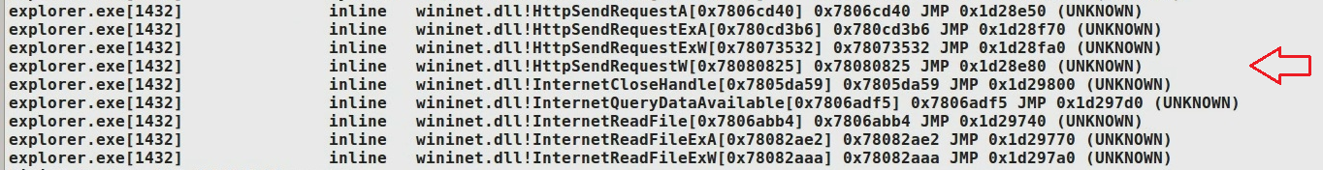
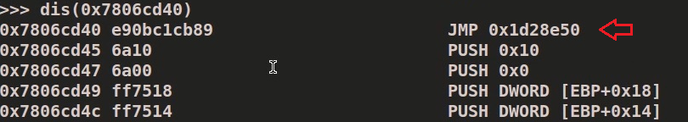
Inline API Hooks
Hooks API calls to steal http data, the hooking functions points to unknown location
www.SecurityXploded.com

Slide 43
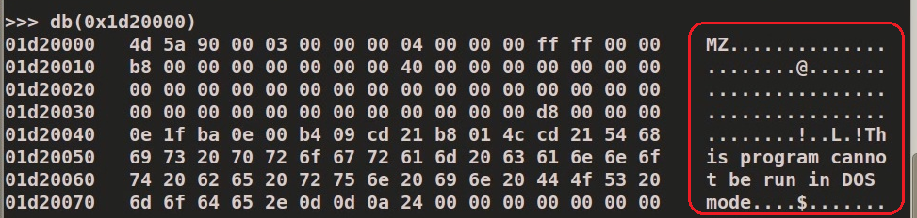
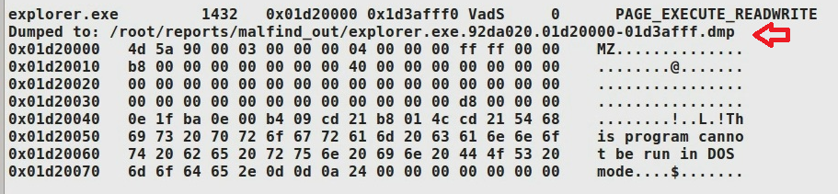
Embedded Executable
Dumping the embedded executable which was determined by examining the hooking function.
www.SecurityXploded.com

Slide 44
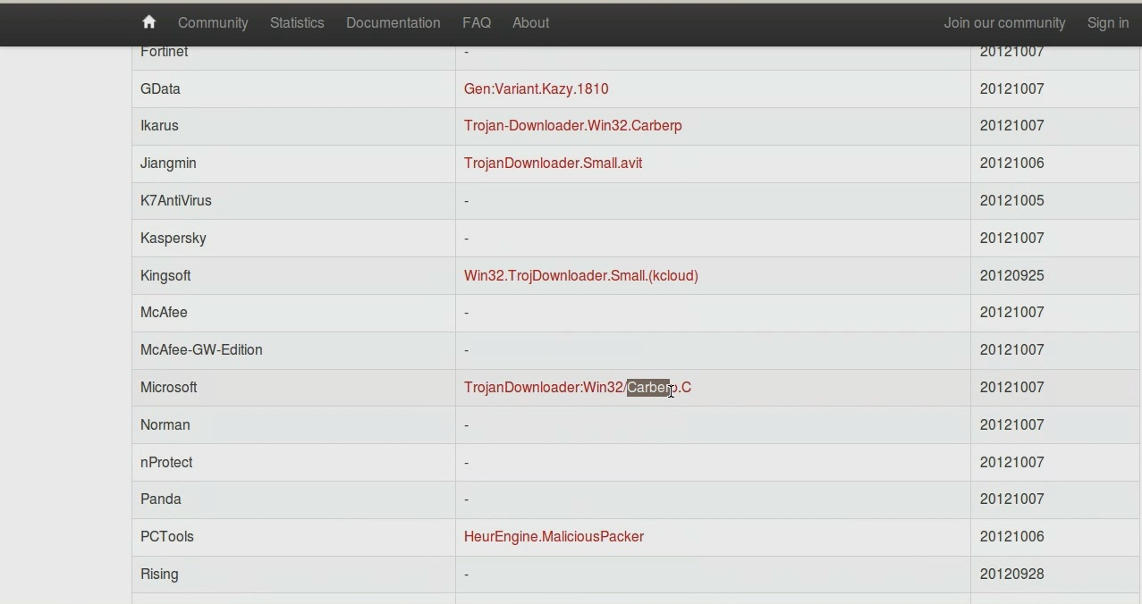
Embedded EXE Submission
VirusTotal confirms the executable as component of Carberp
www.SecurityXploded.com

Slide 45
Reference
Complete Reference Guide for Reversing & Malware Analysis Training
www.SecurityXploded.com

Slide 46
Thank You !
www.SecurityXploded.com

