Slide 1

Part II – Introduction to Windows Internals
Reverse Engineering & Malware Analysis Training
Swapnil Pathak
Amit Malik
www.SecurityXploded.com

Slide 2
Disclaimer
The Content, Demonstration, Source Code and Programs presented here is "AS IS" without any warranty or conditions of any kind. Also the views/ideas/knowledge expressed here are solely of the trainer’s only and nothing to do with the company or the organization in which the trainer is currently working.
However in no circumstances neither the trainer nor SecurityXploded is responsible for any damage or loss caused due to use or misuse of the information presented here.

Slide 3
Acknowledgement
Special thanks to null & Garage4Hackers community for their extended support and cooperation.
Thanks to all the trainers who have devoted their precious time and countless hours to make it happen.

Slide 4

Reversing & Malware Analysis Training
This presentation is part of our Reverse Engineering & Malware Analysis Training program. Currently it is delivered only during our local meet for FREE of cost.
For complete details of this course, visit our Security Training page.

Slide 5
Who am I #1
Amit Malik (sometimes DouBle_Zer0,DZZ)
  Member SecurityXploded & Garage4Hackers
  Security Researcher
  RE, Exploit Analysis/Development, Malware Analysis
  Email: m.amit30@gmail.com

Slide 6
Who am I #2
Swapnil Pathak
  Member SecurityXploded
  Security Researcher
  RE, Malware Analysis, Network Security
  Email: swapnilpathak101@gmail.com

Slide 7
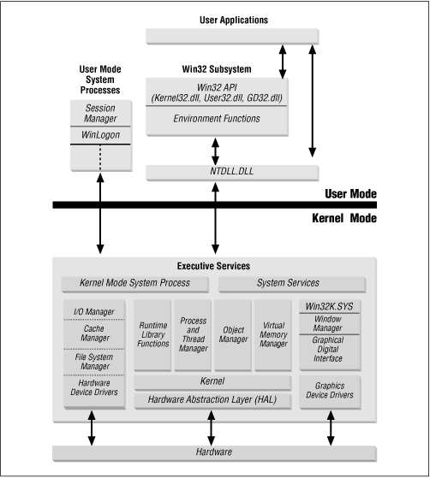
Windows Architecture

Slide 8
Memory Management
Virtual Memory
An invisible layer between a software and physical memory
Every process first get loaded into its virtual memory address space
Small units called “pages” are used to do mapping between physical memory and virtual memory.
Paging
- Memory management scheme that stores and retrieves data from secondary storage for use in main memory
Uses same size blocks called pages
Page table is used to translate virtual addresses in physical memory addresses

Slide 9
Memory Management Cont.
User Address Space
Allocated for user mode applications.
All processes execute in their own virtual space.
Use operating system dlls to interact with kernel
Kernel Address Space
- Strictly reserved for kernel, device drivers and operating system executive.
No user mode application can directly interact with the kernel.

Slide 10
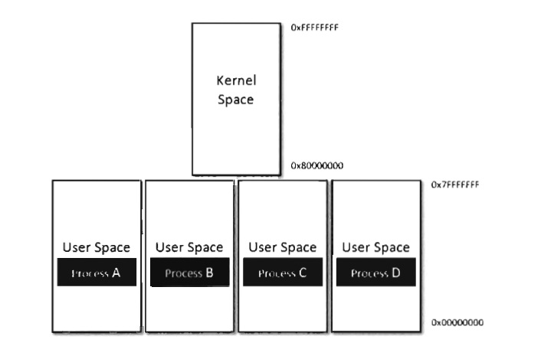
Kernel & User Address Space
Notes:
Picture is taken from : rootkit arsenal

Slide 11
Process and Thread
Process
Executing instance of an application.
Isolated address space
PEB data structure store information about process
PEB is an user space data structure
Threads
Multiple threads share the same address space in the process.
Each process has at least a single executing thread.
TEB data structure store information about thread

Slide 12
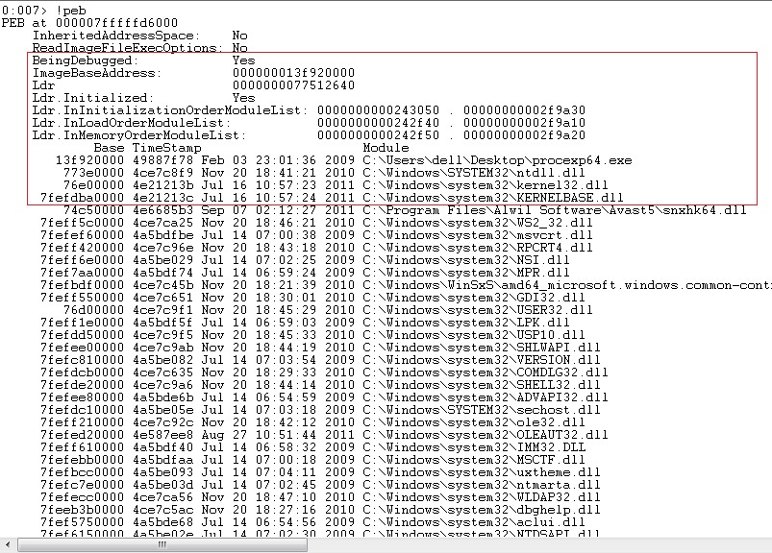
PEB (Process Environment Block)
An opaque data structure that store information about process in user space

Slide 13
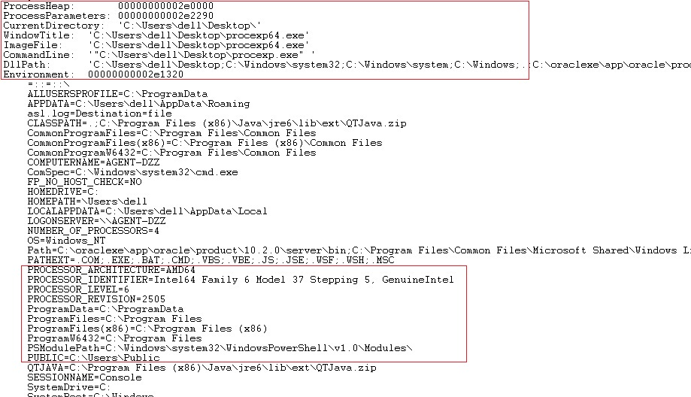
PEB Cont.

Slide 14
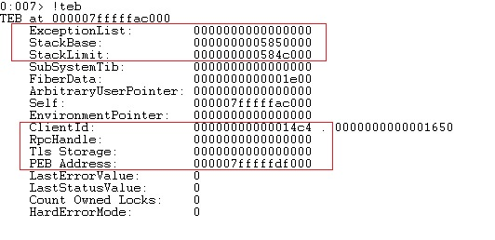
TEB (Thread Environment Block)
TEB is a data structure that store information about thread

Slide 15
Application Programming Interface
API
Includes functions, classes, data structures and variables
Interface between various software components to communicate with each other.
Windows APIs are used to interact with kernel or other modules.
MSDN
- Provides documentation for various API functions.
System Dlls
ntdll.dll, kernel32.dll, user32.dll, advapi32.dll, hal.dll etc

Slide 16
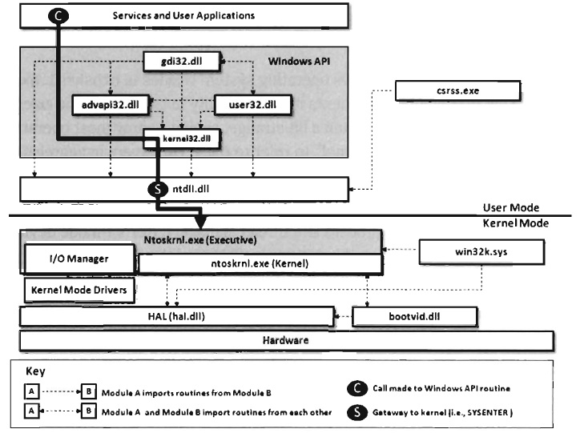
System Service Dispatching
Notes:
Picture is taken from : RootKit Arsenal (An awesome book)

Slide 17
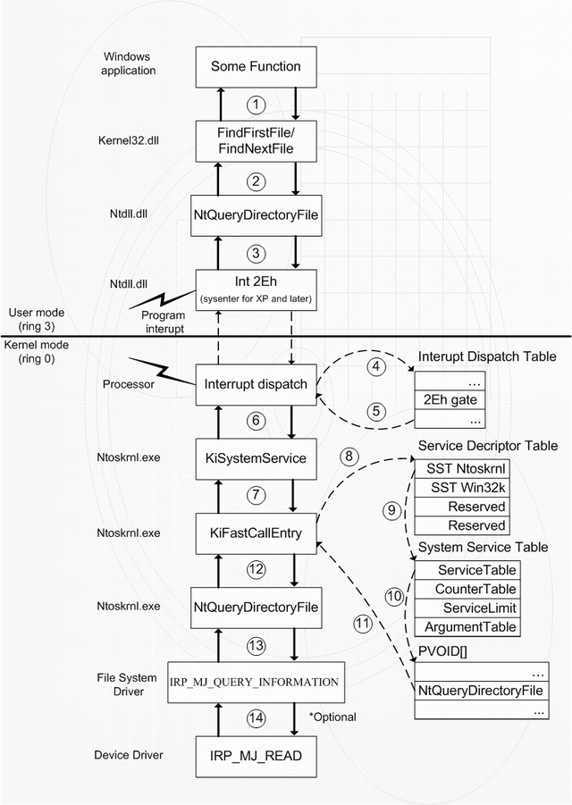
System Service Dispatching Cont.
Notes:
Picture source: http://www.codeproject.com/KB/system/hide-driver/NtCallScheme_small.png

Slide 18
Important API
File and Directories
CreateFile, GetSystemDirectory, ReadFile, WriteFile etc
Network
- socket, send, recv, URLDownloadToFile etc
Registry
RegOpenKey, RegSetValue, RegQueryValue etc

Slide 19
Important API Cont.
Processes, Threads, Synchronization using mutex, semaphore.
CreateProcess, ReadProcessMemory, WriteProcessMemory,CreateRemoteThread, CreateMutex etc
Memory
- VirtualAlloc, VirtualProtect ,HeapAlloc, LocalAlloc etc

Slide 20
Reference
Complete Reference Guide for Reversing & Malware Analysis Training

Slide 21
Thank You !
http://SecurityXploded.com

