Slide 1

Part III - Windows PE File Format Basics
Reverse Engineering & Malware Analysis Training
Swapnil Pathak
Amit Malik
www.SecurityXploded.com

Slide 2
Disclaimer
The Content, Demonstration, Source Code and Programs presented here is "AS IS" without any warranty or conditions of any kind. Also the views/ideas/knowledge expressed here are solely of the trainer’s only and nothing to do with the company or the organization in which the trainer is currently working.
However in no circumstances neither the trainer nor SecurityXploded is responsible for any damage or loss caused due to use or misuse of the information presented here.

Slide 3
Acknowledgement
Special thanks to null & Garage4Hackers community for their extended support and cooperation.
Thanks to all the trainers who have devoted their precious time and countless hours to make it happen.

Slide 4

Reversing & Malware Analysis Training
This presentation is part of our Reverse Engineering & Malware Analysis Training program. Currently it is delivered only during our local meet for FREE of cost.
For complete details of this course, visit our Security Training page.

Slide 5
Who am I #1
Amit Malik (sometimes DouBle_Zer0,DZZ)
Member SecurityXploded & Garage4Hackers
Security Researcher
RE, Exploit Analysis/Development, Malware Analysis
Email: m.amit30@gmail.com

Slide 6
Who am I #2
Swapnil Pathak
Member SecurityXploded
Security Researcher
RE, Malware Analysis, Network Security
Email: swapnilpathak101@gmail.com

Slide 7
PE File Format
PE – Portable Executable
PE is the native Win32 file format.
32-bit DLL, COM, OCX, Control Panel Applets(.CPL), .NET, NT kernel mode drivers are all PE File Format.

Slide 8
Why PE File Format
How windows loader loads the executable in memory.
How loader build the import and export table for a module in memory
From where to start the execution or Address of entry point
Answer of the question “how binary compiled on a version of windows works on another version of windows?”
Where should attacker attack ☺
Also today’s malwares are generally encrypted, packed. In order to rebuild the original binary we need to know how the binary is structured.

Slide 9
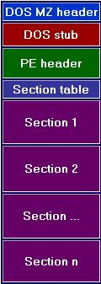
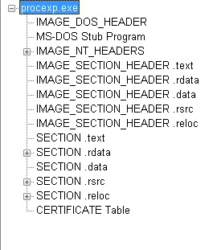
Basic Structure

Slide 10
Basic Structure Cont.
Most common sections found in executable are
Executable Code section (.text , CODE)
Data Sections (.data, .rdata, .bss, DATA)
Resources section (.rsrc)
Export Section (.edata)
Import Section (.idata)
Debug Information Section (.debug)

Slide 11
Headers – DOS Header
All PE files start with DOS header
First 64 bytes of the file.
Run program in DOS.
Runs the DOS stub
Usually the string
“This program must be run under Microsoft Windows”
e_lfanew is the pointer to PE or NT header
Structure defined in windows.inc or winnt.h

Slide 12
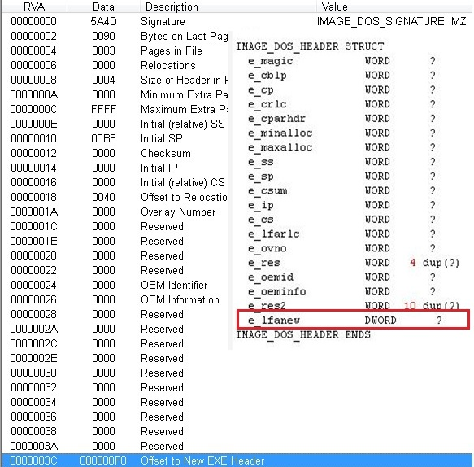
Header- DOS header cont.
e_magic = 4D, 5A (MZ)
e_lfanew is a DWORD which contains the offset of the PE header

Slide 13
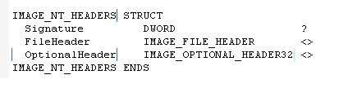

Headers – PE header
Begins with signature (DWORD) 50h, 45h, 00h, 00h
Letters “PE” followed by two terminating zeros
File Header- 20 Bytes – contains info about physical layout and properties of the file
Optional Header- 224 Bytes – contains info about the logical layout of the PE file – size given by member of File header

Slide 14
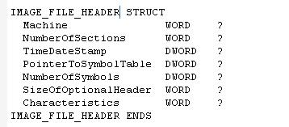
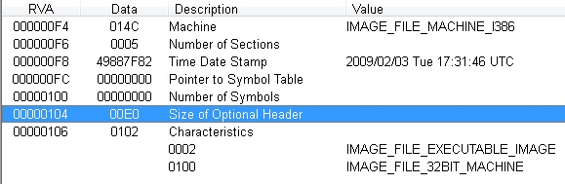
Headers – PE –> File header
Machine
NumberOfSections
SizeOfOptionalHeader
Characteristics

Slide 15
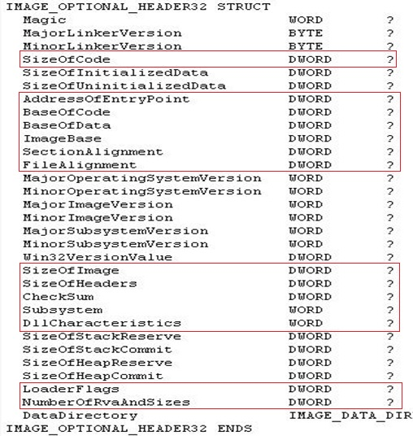
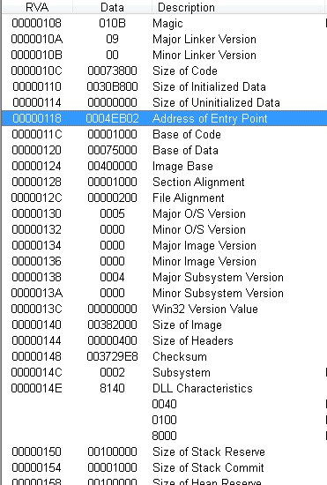
Header – PE –> Optional Header

Slide 16
Optional Header Cont.
AddressOfEntryPoint
ImageBase
SectionAlignment
FileAlignment
SizeOfImage
SizeOfHeaders
Subsystem
DataDirectory

Slide 17


Header – PE –> Optional –> Data Directory
Last 128 bytes of OptionalHeader
Array of 16 Image_Data_Directory structures
Each relating to an important data structure like the Import Table
Members
Virtual Address : RVA of the data structure
iSize : size in bytes of the data structure

Slide 18
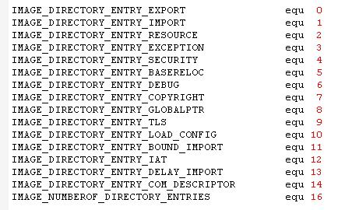
Data Directories

Slide 19
IMAGE_DIRECTORY_ENTRY_EXPORT
IMAGE_DIRECTORY_ENTRY_IMPORT
IMAGE_DIRECTORY_ENTRY_RESOURCE
IMAGE_DIRECTORY_ENTRY_TLS
IMAGE_DIRECTORY_ENTRY_IAT

Slide 20
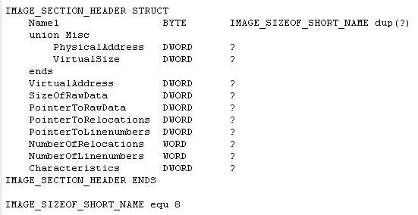
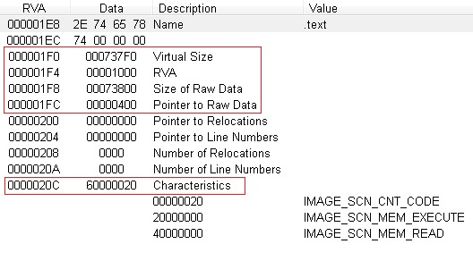
Headers - Section Header
Array of IMAGE_SECTION_HEADER
Equal to the numberofsections – FileHeader member.
Each structure size = 40 bytes

Slide 21
Section Header cont.
Name – Virtually can be anything in text
VirtualSize – Size of section in memory
VirtualAddress – section entry offset in memory (RVA)
SizeOfRawData – Size of section on disk
PointerToRawData – section entry offset on disk
Characteristics – Type of section (execuatble, data etc.)
Section Alignment and File Alignment are two important values from optional header that control the entry point of next section.

Slide 22
The structure of PE file on disk is exactly the same as when it is loaded into memory.
The windows loader maps the required sections in memory.
When sections are loaded into memory they are aligned to fit 4KB memory pages (Section Alignment), each section starting on a new page.

Slide 23
Type of PE file sections
Executable code
Data
Resources
Export section
Import section
Thread Local Storage (TLS)
Base Relocations (reloc.)

Slide 24
Export Section
Relevant to DLLs
Export functions in two ways
By name
By ordinal only
Ordinal – 16 bit value that uniquely defines a function in particular DLL

Slide 25
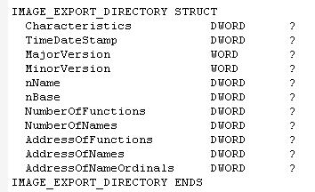
nName
nBase
NumberOfFunctions
NumberOfNames
AddressOfFunctions
AddressOfNames
AddressOfNameOrdinals

Slide 26
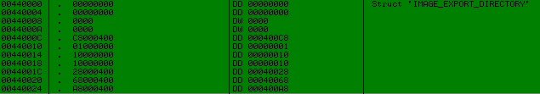
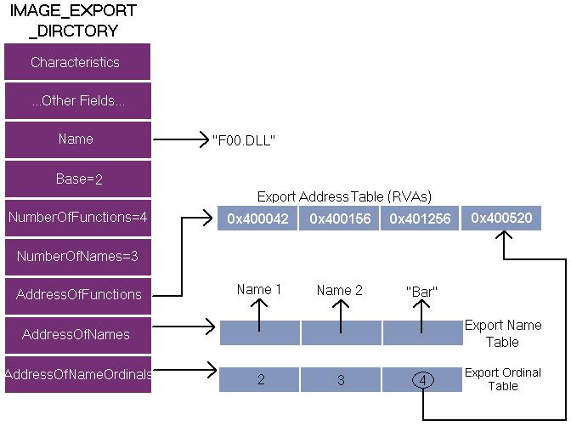
Export by Ordinal only
Export Forwarding

Slide 27
Import Section
Contains information about all functions imported by executable from DLLs
Loader maps all the DLLs used by the application into its address space
Finds the addresses of all the imported functions and makes them available to the executable being loaded.

Slide 28
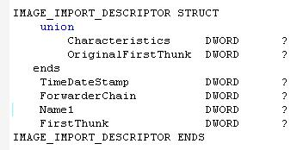
Import Directory
20 byte structure IMAGE_IMPORT_DESCRIPTOR
Number of structures = Number of DLLs imported
Last structure filed with zeros

Slide 29
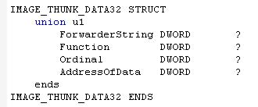

OriginalFirstThunk
Name1
FirstThunk
Hint
Name1

Slide 30
Each IMAGE_THUNK_DATA str corresponds to one imported function from the dll.
Arrays pointed by OriginalFirstThunk and FirstThunk run parallelly.
OriginalFirstThunk – Import Name Table – Never modified
FirstThunk – Import Address Table – Contain actual function addresses

Slide 31
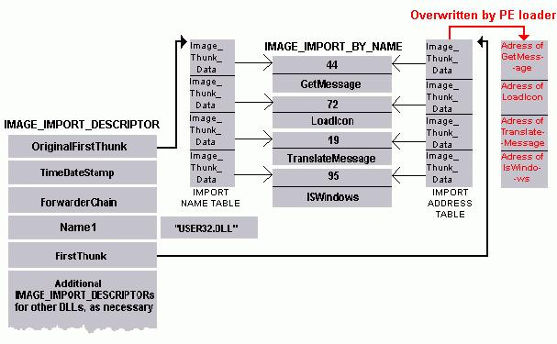

Functions exported by ordinal only
- No IMAGE_IMPORT_BY_NAME structure
IMAGE_THUNK_DATA contains the ordinal of the function
MSB used to identify the same
MSB is set, rest 31 bits are treated as an ordinal value.
Bound Imports

Slide 32
DEMO

Slide 33
Reference
Complete Reference Guide for Reversing & Malware Analysis Training

Slide 34
PE file format test
Write a program in “C” or “ASM” that will modify the Address of Entry point of an Executable (.exe) file with any random address.
Write a program in “C” or “ASM” that will add a new section into an executable (.exe)
For hints shoot us an email ☺

Slide 35
Thank You !
www.SecurityXploded.com

