Slide 1

Part 4 – Assembly Programming Basics
Reverse Engineering & Malware Analysis Training
Swapnil Pathak
Amit Malik
www.SecurityXploded.com

Slide 2
Disclaimer
The Content, Demonstration, Source Code and Programs presented here is "AS IS" without any warranty or conditions of any kind. Also the views/ideas/knowledge expressed here are solely of the trainer’s only and nothing to do with the company or the organization in which the trainer is currently working.
However in no circumstances neither the trainer nor SecurityXploded is responsible for any damage or loss caused due to use or misuse of the information presented here.

Slide 3
Acknowledgement
Special thanks to null & Garage4Hackers community for their extended support and cooperation.
Thanks to all the Trainers who have devoted their precious time and countless hours to make it happen.
www.SecurityXploded.com

Slide 4

Reversing & Malware Analysis Training
This presentation is part of our Reverse Engineering & Malware Analysis Training program. Currently it is delivered only during our local meet for FREE of cost.
For complete details of this course, visit our Security Training page.

Slide 5
Who am I #1
Amit Malik (sometimes DouBle_Zer0,DZZ)
Member SecurityXploded & Garage4Hackers
Security Researcher
RE, Exploit Analysis/Development, Malware Analysis
Email: m.amit30@gmail.com

Slide 6
Who am I #2
Swapnil Pathak
Member SecurityXploded
Security Researcher
RE, Malware Analysis, Network Security
Email: swapnilpathak101@gmail.com

Slide 7
Presentation Outline
Intro to x86-32
Assembly Language
Instructions
Stack Operations
Calling conventions
Demo

Slide 8
x86-32
32 bit instruction set architectures based on Intel 8086 CPU
Address a linear address space up to 4GB
8, 32 bit General Purpose Registers (GPR)
6,16 bit Segment Registers
EFLAGS and EIP register
Control Registers (CR0-CR4) (16 bits)
Memory Management Registers Descriptor Table Registers (GDTR, IDTR, LDTR)
Debug Registers ( DR0-DR7)

Slide 9
Registers Usage - RE
Register
Storage Locations.
Much faster access compare to memory locations.
EAX: Accumulator , mostly stores return values from functions (APIs)
EBX: Base index (for use with arrays)
ECX: Counter
EDX: Data/general
ESI: Source index for string operations.

Slide 10
Registers Usage – RE Cont.
EDI: Destination index for string operations.
ESP: Stack pointer for top address of the stack.
EBP: Stack base pointer for holding the address of the current stack frame.
EIP: Instruction pointer. Holds the program counter, the next instruction address.
Segment registers:
Used to address particular segments of memory ( code, data, stack )
!) CS: Code !!) SS: Stack
!!!) ES: Extra !V) DS: Data V) FS, GS

Slide 11
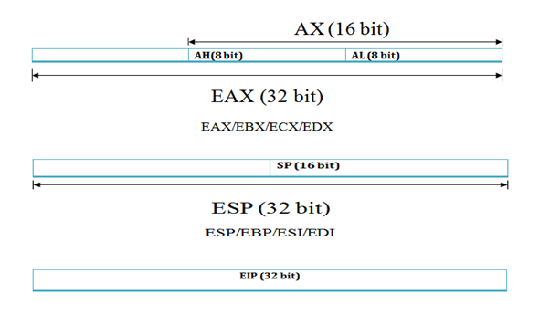
Registers – 32 bit (X86)

Slide 12
(R/E)Flags Register
Bit field of states
Status Flags
Carrry (CF) : set when an arithmetic carry/borrow has been generated out of the MSB.
Zero (ZF) : set when an arithmetic operation result is zero and reset otherwise.
Sign (SF) : set when an arithmetic operation set the MSB i.e. the result value was negative.
Trap (TF ) : when set permits operation of processor in single-step. Mostly used by debuggers.
Interrupt (IF) : determines whether the CPU should handle maskable hardware interrupts.
Direction (DF) : determines the direction (left-to-right or right-to-left) of string processing.
Overflow (OF) : indicates arithmetic overflow.

Slide 13
Assembly Language
Low level programming language
Symbolic representation of machine codes, constants.
Assembly language program consist of sequence of process instructions and meta statements
Assembler translates them to executable instructions that are loaded into memory and executed.
Basic Structure
[label] : opcode operand1, operand2
opcode – mnemonic that symbolize instructions
Example.
MOV AL, 61h => 10110000 01100001

Slide 14
Instructions
ADD dst, src
Adds the values of src and dst and stores the result into dst.
For example ADD EAX, 1
SUB dst, src
Subtracts src value from dst and stores the result in dst.
For example SUB EAX, 1
CMP dst, src
Subtracts src value from dst but does store the result in dst
Mostly used to set/reset decision making bits in EFLAGS register such as ZF
- For example CMP EAX, EBX

Slide 15
Instructions cont.
MOV dst, src
Moves data from src (left operand) to destination (right operand)
For example mov EDI, ESI
Note :
Both operands cannot be memory locations.
Both the operands must be of the same size
LEA dst, src
Stands for Load Effective Address.
Computes the effective address of src operand and stores it in dst operand.
For example LEA ECX,[EBX + 5]
Note:
Generally brackets denote value at memory locations.
In case of LEA it does simple arithmetic and stores it in dst

Slide 16
Instructions cont.
XOR dst, src
Performs a bitwise exclusive OR operation on the dst and src and stores the result in dst.
Each bit of the result is 1 if the corresponding bits of the operands are different, 0 if the corresponding bit are same
Note :
When used with same register clears the contents of the register
Optimized way to clear the register. Better than MOV EAX, 0

Slide 17
Instructions cont.
REP
Used with string operations
Repeats a string instruction until ECX (counter register) value is equal to zero.
For example REP MOVS byte ptr DS:[EDI], DS:[ESI]
LOOP
Similar to loops in high level languages
Used to execute sequence of instructions multiple times.
For example
MOV ECX, 10
Test : INC EBX
INC EAX
LOOP Test

Slide 18
Instructions cont.
TEST dst, src
Performs bitwise logical and between dst and src
Updates the Zero flag bit of the EFLAGS register
Mostly used to check if the return value of the function is not zero
For example TEST EAX, EAX
INT 3h
Breakpoint instruction
Used by debuggers to stop execution of the program at particular instruction

Slide 19
Instructions cont.
CALL address
Performs two functions
Push address of the next instruction on stack (return address)
Jump to the address specified by the instruction
For example CALL dword ptr [EAX+4]
RET
Transfers the control to the address previously pushed on the stack by CALL instruction
Mostly denotes the end of the function

Slide 20
Instructions cont.
Jump instructions
Categorized as conditional and unconditional
Unconditional jump instructions
JMP (Far Jump) – E9 – (Cross segments)
JMP ( Short Jump ) – EB – (-127 to 128 bytes)
JMP ( Near Jump ) – E9 – (in a segment)
For example JMP EAX
Conditional jump instructions
Jumps according to bit flags set in the EFLAGS register
JC, JNC, JZ, JNZ, JS, JNS, JO, JNO
Unsigned comparisons JA, JAE, JB, JBE
Signed comparisons JG, JGE, JL, JLE
Usually followed by CMP instruction

Slide 21
Instructions cont.
PUSH operand
Pushes operand on the stack
Decrements the stack pointer register by operand size
For example PUSH EAX
POP operand
Stores the value pointed by the stack pointer in operand
Increments the stack pointer register by operand size
For example POP EAX
Note: POP/PUSH EIP is an invalid instruction
PUSHF, POPF

Slide 22
Calling Conventions
Describes how the arguments are passed and values returned by functions.
Steps performed when a function is called
Arguments are passed to the called function
Program execution is transferred to the address of the called function
Called function starts with lines of code that prepare stack and registers for use within the function. Also known as function prologue.
For e.g.
push ebp
mov ebp, esp
or with enter instruction
Called function ends with lines of code that restore stack and registers set initially. Also known as function epilogue.
For e.g.
mov esp, ebp
pop ebp
ret
or with leave instruction
Passed arguments are removed from the stack, known as stack cleanup. Can be performed by both calling function or called function depending on the calling convention used.

Slide 23
Calling conventions cont.
__cdecl (C calling convention)
Arguments are passed from right to left and placed on the stack
Stack cleanup is performed by the caller
Return values are stored in EAX register
Standard calling convention used by C compilers
__stdcall (Standard calling convention)
Arguments are passed from right to left and placed on the stack
Stack cleanup is performed by the called function
Return values are stored in EAX register
Standard calling convention for Microsoft Win32 API
__fastcall (Fast calling convention)
Arguments passed are stored in registers for faster access
Thiscall
Arguments are passed from right to left and placed on the stack. this pointer placed in ECX
- Standard calling convention for calling member functions of C++ classes

Slide 24
Stack operations
Stack is a LIFO (Last In First Out) type data structure
Stacks grows downward in memory, from higher memory address to lower memory address
PUSH decrement the stack pointer i.e ESP
POP Increment the stack pointer i.e ESP
Each function has its own stack frame
Function prologue setup the stack frame for each function
Local variable of a function are stored into its stack frame

Slide 25
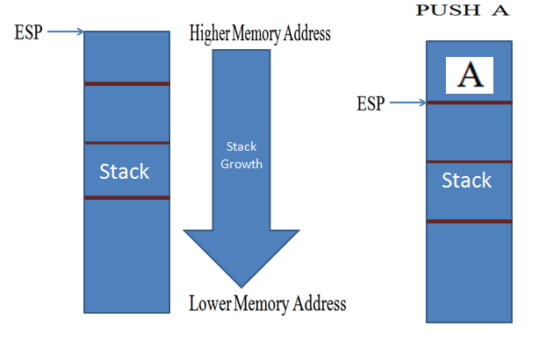
Stack #1

Slide 26
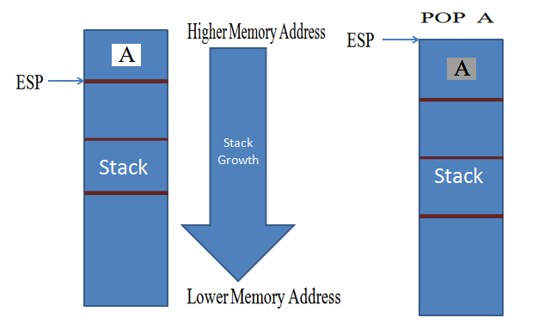
Stack #2

Slide 27
Stack #3
Each function creates its own stack.
Caller function stack: known as parent stack.
Called function stack: known as child stack.
For e.g.
main(){ ASM Pseudo:
sum(); _main:
} 123: push ebp
124: mov ebp,esp
125: sub esp,val
126: call _sum
127: mov esp,ebp
128: pop ebp
129: ret
Notes:
The first three instructions (123,124,125) are known as prologue. And last three instructions(127,128,129) are know as epilogue.
When main call the the sum it push the address of next instruction on stack..means 127 on stack and then create its stack. See next slides.

Slide 28
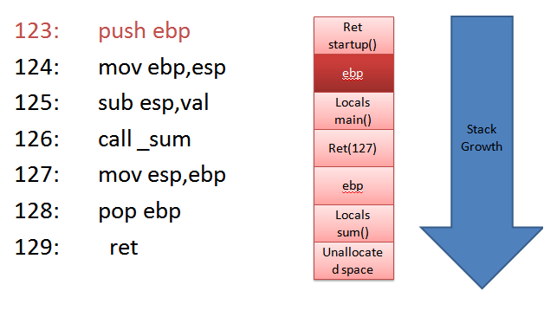
Stack #4
Notes:
Here main is preparing its stack. EBP (base pointer) register is used to track the variables. So we need to push parent function ebp on the stack so that when function return to parent function it can start normally.

Slide 29
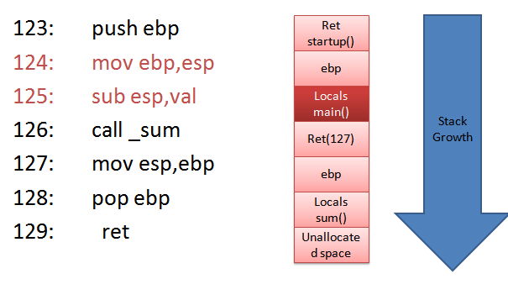
Stack #5
Notes:
The instruction mov ebp,esp setting the stack for main(or setting the ebp for main to track variables). And sub esp, val is creating the space for local variables of main function. Although in e.g. we have no local variable but this is for illustrative purpose.
NOTE: As we can see in the above pic that stack grows downward (from higher memory address to lower memory address) means something [ebp+val] point to parameters for function (can be pass by value or pass by reference) and everything [ebp-val] point to the local variable for that function.
*val- can be any value in hex..like 3,4,a,b etc. etc.
Note: ret (startup) address is the address of next instruction in startup function. Explanation of startup function is beyond the scope of this presentation. But main function return 0 or 1 to startup function. Means process successfully completed or error.

Slide 30
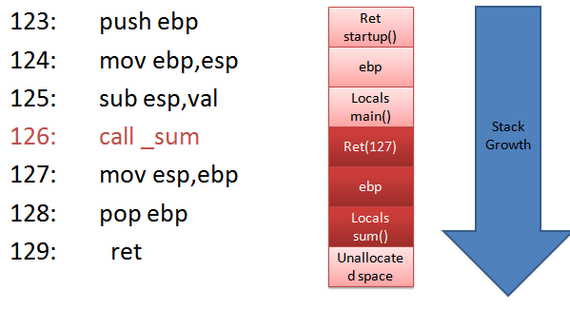
Stack #6
Notes:
Now main is calling sum. The first task is to push the address of next instruction means address 127 on stack. So that when function sum return it returns to 127 so that program execution continue in a normal way. Please note that no (another) instruction is required to push ret(127) on stack because call sum will do it for us.. Similar to like main, sum will creates its stack with similar instructions and also destroy its stack with similar instructions (127,128,129).
Note: The instructions to create stack and destroy stack.. may vary with compiler to complier and are the issues of compiler optimization..for eg.
Some compilers user push reg. instead of sub esp,val for integers.

Slide 31
DEMO (Source Code)
#include <stdio.h>
/*
Author: Amit Malik
http://www.securityxploded.com - Compile in Dev C++
*/
int mysum(int,int);
int main()
{
int a,b,s;
a = 5;
b = 6;
s = mysum(a,b); // call mysum function
printf("sum is: %d",s);
getchar();
}
int mysum(int l, int m) // mysum function
{
int c;
c = l + m;
return c;
}

Slide 32

DEMO (Video)

Slide 33
x86-64 Intro.
64 bit instruction set architectures based on Intel 8086 CPU
Address a linear address space up to 16TB
16, 64 bit General Purpose Registers (GPR)
6, 16 bit Segment Registers
RFLAGS and RIP register
Control Registers (CR0-CR4) and CR8 (16 bits)
Memory Management Registers Descriptor Table Registers (GDTR, IDTR, LDTR) size expanded to 10 bytes
Debug Registers ( DR0-DR7)

Slide 34
Reference
Complete Reference Guide for Reversing & Malware Analysis Training

Slide 35

Thank You !
www.SecurityXploded.com

