Slide 1

Part 5 – Reverse Engineering Tools Basics
Reverse Engineering & Malware Analysis Training
Swapnil Pathak
www.SecurityXploded.com

Slide 2
Disclaimer
The Content, Demonstration, Source Code and Programs presented here is "AS IS" without any warranty or conditions of any kind. Also the views/ideas/knowledge expressed here are solely of the trainer’s only and nothing to do with the company or the organization in which the trainer is currently working.
However in no circumstances neither the trainer nor SecurityXploded is responsible for any damage or loss caused due to use or misuse of the information presented here.

Slide 3
Acknowledgement
Special thanks to null & Garage4Hackers community for their extended support and cooperation.
Thanks to all the Trainers who have devoted their precious time and countless hours to make it happen.
www.SecurityXploded.com

Slide 4

Reversing & Malware Analysis Training
This presentation is part of our Reverse Engineering & Malware Analysis Training program. Currently it is delivered only during our local meet for FREE of cost.
For complete details of this course, visit our Security Training page.

Slide 5
Who am I
Swapnil Pathak
  Member SecurityXploded
  Security Researcher
  RE, Malware Analysis, Network Security
  Email: swapnilpathak101@gmail.com

Slide 6
Presentation Outline
PE Tools
  PE Editor
Disassemblers
  IDA Pro
Debuggers
  OllyDbg
Other Useful Tools

Slide 7
PE Tools
Portable Executable Editor
  Allow user to view, edit data structures present in PE file format
Some Common Use Cases:
  Change entry point of the executable
  View Import/Export/Sections within EXE
  Change characteristics of a file i.e. Dll to Exe
  Fix anomalies of PE files
PE editors
  Hiew, PE Editor, CFF Explorer, StudPE, LordPE etc

Slide 8
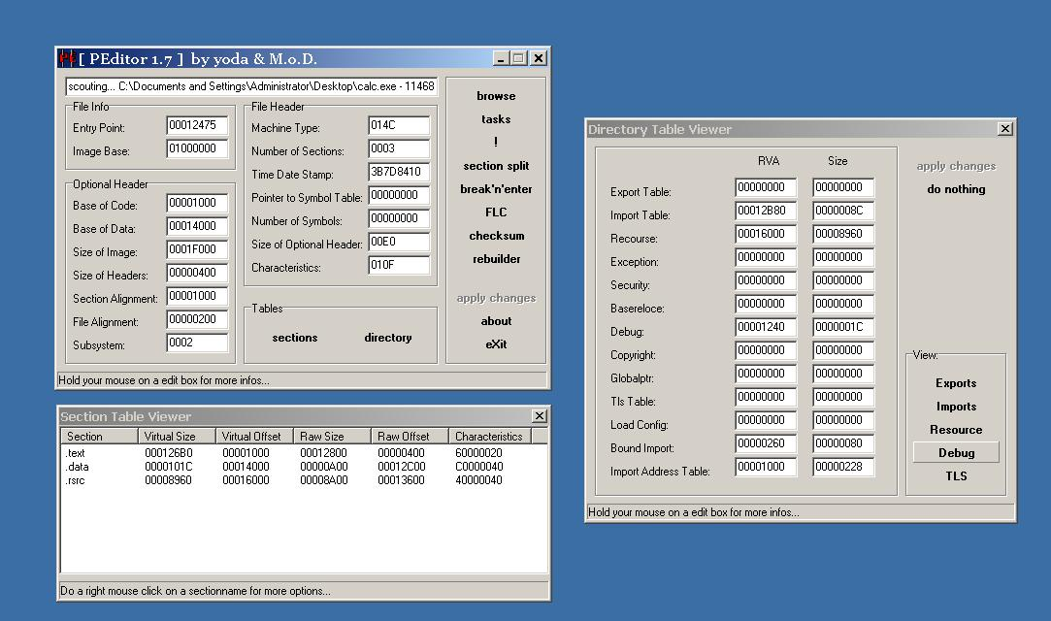
PE Editor

Slide 9
IDA Pro
Popular commercial software used for Reverse Engineering.
Disassembler and Debugger in one tool
Supports variety of executable formats for different processors and OS
Provides both Text & Graphical view of the code flow.
View strings, Imports, Exports referenced in the executable
Support Plugins
Some of the useful plugins
  X86 emulator
  IDAPython
  IDARub
  IDA Scripts
  Windbg

Slide 10
IDA Pro Functions
IDA Windows & purpose – IDA View, Hex View, Imports, Strings, Functions windows etc.
Graphs & Text view (use “space” to switch between views)
Xref To & Xref From – powerful feature
Jump & Search
Edit function names (N), Add comments (;)

Slide 11
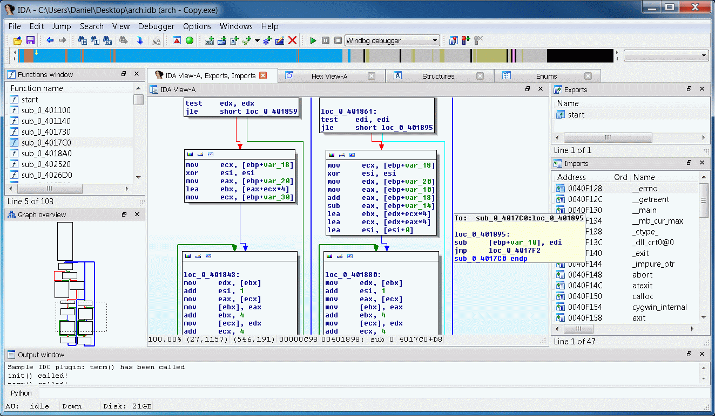
IDA Pro in Action

Slide 12
Ollydbg
Most Popular Ring 3 Debugger used in Reversing
Provides the below mentioned functionalities
  Debugging program step by step (Single Stepping)
  Software, Hardware and Memory based Breakpoints
  Examine the current state of the program wrt variables, memory etc.
  Change the flow or state of Program by directly editing Instructions, Registers or Memory.
Support Plugins, Here are popular ones,
  OllyDump
  OllyAdvanced
  OllyScript

Slide 13
Ollydbg Cont.
Different Windows – CPU, Registers, Dump, Stack screens
Trace Into, Trace Over, Exceptions
Integrate windows API help file in ollydbg
Shortcuts (imp. Only)
  F7 – Step into [call]
  F8 – Single step [execute call]
  F9 – Run
  F2 – Breakpoint

Slide 14
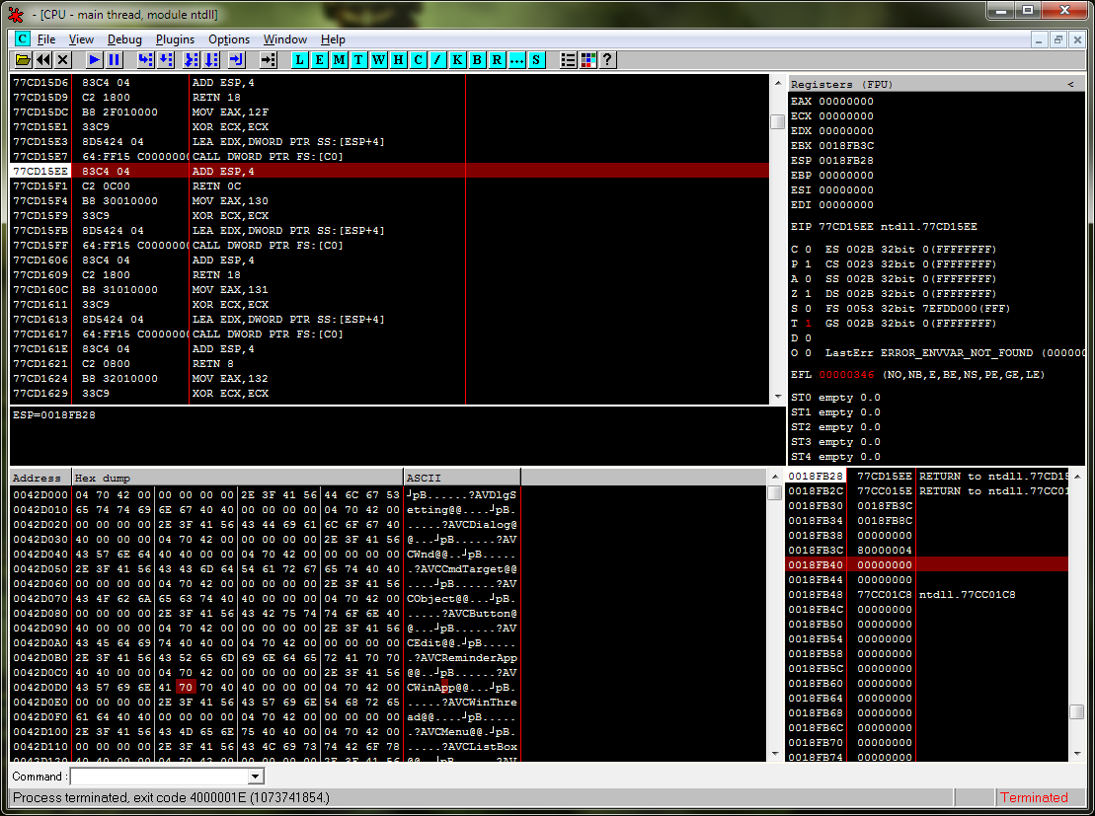
Ollydbg in Action

Slide 15
UPX Unpacking Ollyscript
Here is example for Unpacking UPX based Malwares using OllyScript in OllyDbg
var hwdBP // Local variable to store hardware breakpoint
var softBP // Local variable to strore software breakpoint
sti // Step into F7 command
findop eip, #61# // find next POPAD
mov hwdBP, $RESULT // Store $RESULT to hardware breakpoint local variable
bphws hwdBP, "x“ // Set hardware breakpoint (execute) on the next POPAD
run // Run F9 command
findop eip, #E9????????# // Find the next JMP
mov softBP, $RESULT // Store $RESULT to software breakpoint local variable
bp softBP
run // Run to JMP instruction
sti // Step into the OEP
cmt eip, "<<>>"
msg "OEP found, you can dump the file starting from this address"
ret
Source : http://x9090.blogspot.in/2009/07/ollyscript-tutorial-unpack-upx.html

Slide 16
Useful Tools
Packer Identifier Tools
  RDG packer detector
  PEID
  ExeScan

Slide 17
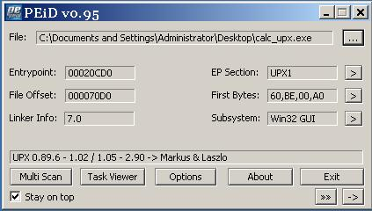
PEiD – PE Packer Identifier Tool

Slide 18
Reference
Complete Reference Guide for Reversing & Malware Analysis Training

Slide 19

Thank You !
www.SecurityXploded.com

