Slide 1

Practical Reversing (I)
Reverse Engineering & Malware Analysis Training
Harsimran Walia
www.SecurityXploded.com

Slide 2
Disclaimer
The Content, Demonstration, Source Code and Programs presented here is "AS IS" without any warranty or conditions of any kind. Also the views/ideas/knowledge expressed here are solely of the trainer’s only and nothing to do with the company or the organization in which the trainer is currently working.
However in no circumstances neither the trainer nor SecurityXploded is responsible for any damage or loss caused due to use or misuse of the information presented here.

Slide 3
Acknowledgement
Special thanks to null & Garage4Hackers community for their extended support and cooperation.
Thanks to all the Trainers who have devoted their precious time and countless hours to make it happen.

Slide 4

Reversing & Malware Analysis Training
This presentation is part of our Reverse Engineering & Malware Analysis Training program. Currently it is delivered only during our local meet for FREE of cost.
For complete details of this course, visit our Security Training page.

Slide 5
harsimranwalia.info
b44nz0r
Research Scientist @ McAfee Labs
Mechanical Engineer @IIT Delhi
Independent Security Researcher
  RE, Exploit Analysis/Development, Malware Analysis
Twitter : b44nz0r
Email : walia.harsimran@gmail.com

Slide 6
Outline
Break Point
Debug Registers
Flags
API Help

Slide 7
Types of Breakpoints
Software
Hardware
Memory

Slide 8
Breakpoint
Software breakpoints are set by replacing the instruction at the target address with 0xCC (INT3/ Breakpoint interrupt)
Hardware breakpoints are set via debug registers. Only 4 hardware breakpoints can be set
Debug registers:
  8 debug registers present
  DR0 – DR3 : Address of breakpoint
  DR6 : Debug Status – To determine which breakpoint is active
  DR7 : Debug Control – Flags to control the breakpoints such as break on read or on-write
Debug registers are not accessible in Ring 3

Slide 9
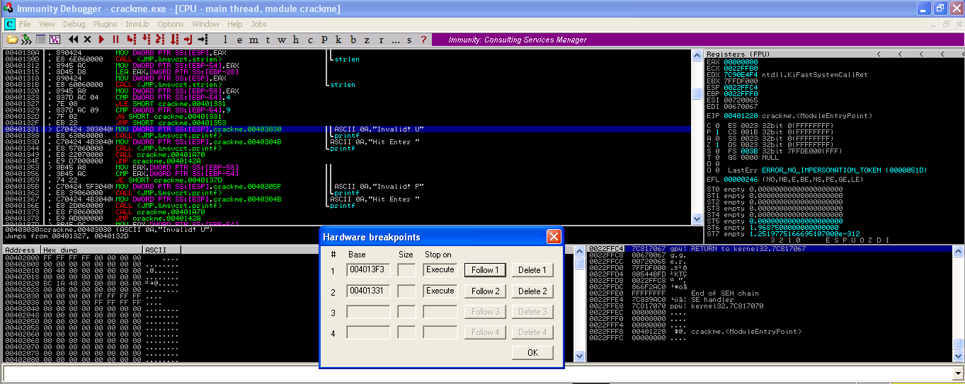
Hardware Breakpoints

Slide 10
Memory
To access memory, need of permissions
Lots of permissions
  PAGE_GUARD
  PAGE_READWRITE
  PAGE_EXECUTE
  PAGE_EXECUTE_READ
To set memory breakpoint,
  the permissions of that memory region is set to PAGE_GUARD
  whenever an access is made to that memory STATUS_GUARD_PAGE_VIOLATION exception is raised
  On getting the exception the debugger changes the permission back to the original
  Notifies the user of the breakpoint

Slide 11
Demo
Breakpoints

Slide 12
Flags (Eflags Register)
1 register – 32 bits
Each bit signifies a flag
Few important ones are:
Bit # | Abbreviation | Description
0 | CF | Carry flag
2 | PF | Parity flag
4 | AF | Adjust flag
6 | ZF | Zero flag
7 | SF | Sign flag
8 | TF | Trap flag (single step)
9 | IF | Interrupt enable flag
11 | OF | Overflow flag

Slide 13
Flags Demystified
Carry flag is used to indicate when an arithmetic carry or borrow has been generated out of the most significant ALU bit position
Parity flag indicates if the number of set bits is odd or even in the binary representation of the result of the last operation
Adjust flag is used to indicate when an arithmetic carry or borrow has been generated out of the 4 least significant bits
Zero Flag is used to check the result of an arithmetic operation, including bitwise logical instructions. It is set if an arithmetic result is zero, and reset otherwise
Sign flag is used to indicate whether the result of last mathematic operation resulted in a value whose most significant bit was set
A trap flag permits operation of a processor in single-step mode
Overflow flag is used to indicate when an arithmetic overflow has occurred in an operation, indicating that the signed two's-complement result would not fit in the number of bits used for the operation

Slide 14
Basic Reversing Techniques
Check for readable strings
Import table (IAT) for imported Windows API
Setting breakpoint on interesting API
Single stepping

Slide 15
Variables
Found under Names tab
    L - library function
    F - regular function
    C - instruction
    A - ascii string
    D - data
    I - imported name

Slide 16
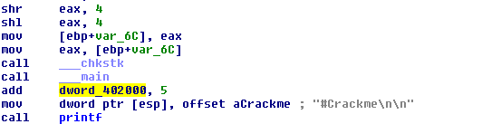
Contd..
Global variables are generally dword_<address>
  dword_402000 – as shown in image
Local variables are of the form var_<offset>
  var_6C – as shown in image

Slide 17
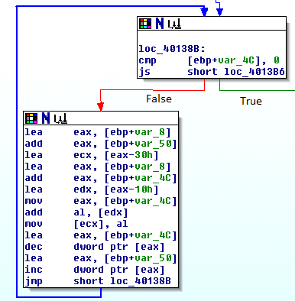
Loop in IDA
Red Line
  If condition is false
  (zero flag = 0)
Green Line
  If condition is true
  (zero flag = 1)

Slide 18
Demo
Reversing a Simple Crackme

Slide 19
Crackme Code
#include <stdio.h>
#include <string.h>
#include <stdlib.h>
int main()
{
char a[10],b[10],c[10],d[10];
int i,j,k,l,r,s;
printf("#Crackme\n\n");
printf("enter username: ");
scanf("%s",a);
printf("enter password: ");
scanf("%s",b);
k = strlen(a);
l = strlen(b);
if (k <5 || k >=10){
printf("\nInvalid! Username Length\n");
printf("\nHit Enter to Exit\n");
getchar();
} else {
if (l != k){
printf("\nInvalid! Password Length\n");
printf("\nHit Enter to Exit\n");
getchar();
} else {
i = k-1;
j = 0;
while (i >= 0){
c[j] = a[i]+i;
i--;
j++;
}
c[j] = 0;
r = strlen(c);
if (r == l){
i = strcmp(c,b);
if (i == 0){
printf("\nCongratulations! You did it..\n");
printf("\nHit Enter to Exit\n");
} else {
printf("\nAccess Denied! Wrong Password\n");
printf("\nHit Enter to Exit\n");
}
getchar();
}
}
}
getchar();
}
Notes:
#include <stdio.h>
#include <string.h>
#include <stdlib.h>
int main()
{
char a[10],b[10],c[10],d[10];
int i,j,k,l,r,s;
printf("#Crackme\n\n");
printf("enter username: ");
scanf("%s",a);
printf("enter password: ");
scanf("%s",b);
k = strlen(a);
l = strlen(b);
if (k <5 || k >=10){
printf("\nInvalid! Username Length\n");
printf("\nHit Enter to Exit\n");
getchar();
} else {
if (l != k){
printf("\nInvalid! Password Length\n");
printf("\nHit Enter to Exit\n");
getchar();
} else {
i = k-1;
j = 0;
while (i >= 0){
c[j] = a[i]+i;
i--;
j++;
}
c[j] = 0;
r = strlen(c);
if (r == l){
i = strcmp(c,b);
if (i == 0){
printf("\nCongratulations! You did it..\n");
printf("\nHit Enter to Exit\n");
} else {
printf("\nAccess Denied! Wrong Password\n");
printf("\nHit Enter to Exit\n");
}
getchar();
}
}
}
getchar();
}

Slide 20
References
Complete Reference Guide for Reversing & Malware Analysis Training

Slide 21

Thank You !
www.SecurityXploded.com

