Slide 1

Practical Reversing II – Unpacking EXE
Reverse Engineering & Malware Analysis Training
Nagareshwar Talekar
www.SecurityXploded.com

Slide 2
Disclaimer
The Content, Demonstration, Source Code and Programs presented here is "AS IS" without any warranty or conditions of any kind. Also the views/ideas/knowledge expressed here are solely of the trainer’s only and nothing to do with the company or the organization in which the trainer is currently working.
However in no circumstances neither the trainer nor SecurityXploded is responsible for any damage or loss caused due to use or misuse of the information presented here.

Slide 3
Acknowledgement
Special thanks to null & Garage4Hackers community for their extended support and cooperation.
Thanks to all the trainers who have devoted their precious time and countless hours to make it happen.

Slide 4

Reversing & Malware Analysis Training
This presentation is part of our Reverse Engineering & Malware Analysis Training program. Currently it is delivered only during our local meet for FREE of cost.
For complete details of this course, visit our Security Training page.

Slide 5
Who am I
Nagareshwar Talekar
Founder of SecurityXploded
Reverse Engineering, Malware Analysis, Cryptography, Password Forensics, Secure Coding etc.
Email: tnagareshwar at gmail.com

Slide 6
Contents
What is EXE Packing?
Purpose of Packing EXE
What is Unpacking?
Detection of Packer
Execution of Packed EXE Program
Standard Process of Unpacking EXE
Unpacking UPX using OllyDbg
DEMO - Unpacking UPX
Anti Anti-Debugging Plugins
References
www.SecurityXploded.com

Slide 7
What is EXE Packing/Protecting?
EXE Packing:
Compressing the Executable to a smaller Size
EXE Protecting:
Encrypting with Anti-Debugging Techniques to prevent Reversing
In Reversing world, both Packer & Protector is commonly referred as Packer.
Examples of Packers: UPX, AsProtect, Armadillo etc.
www.SecurityXploded.com

Slide 8
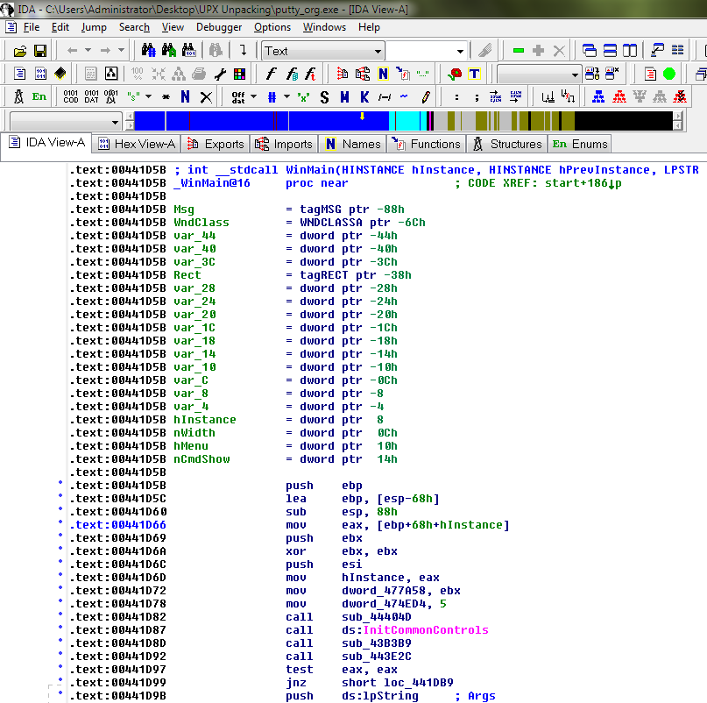
EXE - Before Packing
www.SecurityXploded.com

Slide 9
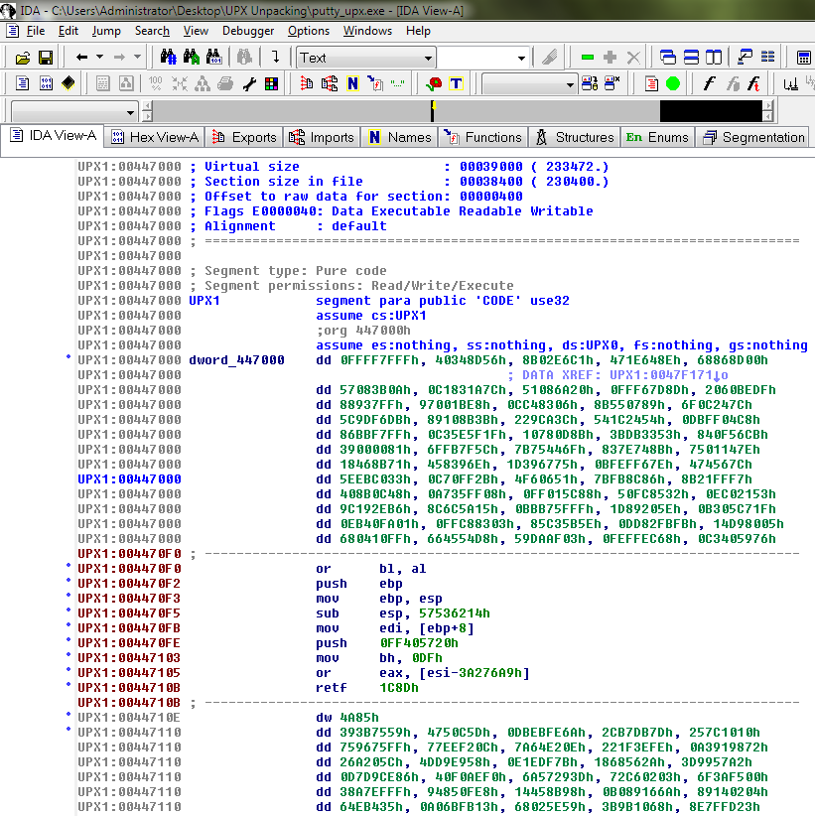
EXE - After Packing
www.SecurityXploded.com

Slide 10
Purpose of Packing EXE
Prevent Reverse Engineering [Crack License, Secret Code etc.]
Defeat Static Disassembling
Make Dynamic Debugging Difficult
Reduce the size of Executable file
Bypass Anti-virus Detections with multi-level Packing
It is used by Software Vendors to prevent Serial Cracking and Malware Authors to prevent analysis by AV Researchers.
www.SecurityXploded.com

Slide 11
What is Unpacking?
Extracting the Original Binary from the Packed Executable File.
Automatic Unpackers available for popular Packers.
May not work with different versions
Not available for Complex packers
Involves Live Debugging by Defeating Anti-Debugging techniques
www.SecurityXploded.com

Slide 12
Detection of Packer
Packer Detectors like PEiD, RDG, ExeScan etc
Detect the popular Packers
Show the version of Packer also
PE Viewer Tools like PEditor, PEview
Look at Section Table
Look at Import Table
www.SecurityXploded.com

Slide 13
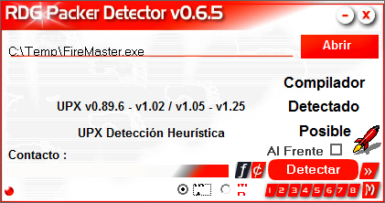
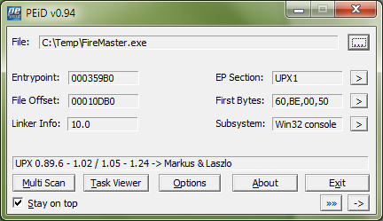
Packer Detectors
www.SecurityXploded.com

Slide 14
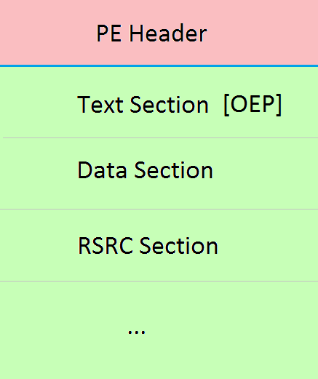
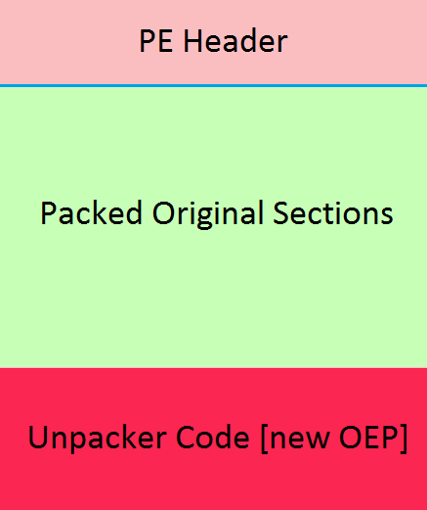
Structure of Packed EXE
Before Packing
After Packing
www.SecurityXploded.com

Slide 15
Execution of Packed EXE Program
Execution starts from new OEP
Saves the Register status using PUSHAD instruction
All the Packed Sections are Unpacked in memory
Resolve the import table of original executable file.
Restore the original Register Status using POPAD instruction
Finally Jumps to Original Entry point to begin the actual execution
www.SecurityXploded.com

Slide 16
Standard Process of Unpacking EXE
Debug the EXE to find the real OEP (Original Entry Point)
At OEP, Dump the fully Unpacked Program to Disk
[?] Fix the Import Table using ImpRec Tool
[?] Fix the PE Header
www.SecurityXploded.com

Slide 17
Unpacking UPX using OllyDbg
Load the UPX packed EXE file into the OllyDbg
Start tracing the EXE, until you encounter a PUSHAD instruction.
At this stage, put the Hardware Breakpoint (type 'hr esp-4' at command bar) so as to stop at POPAD instruction.
Other way is to manually search for POPAD (Opcode 61) instruction and then set Breakpoint on it.
www.SecurityXploded.com

Slide 18
Unpacking UPX using OllyDbg (contd)
Next press F9 to continue the Execution.
You will break on the instruction which is immediately after POPAD or on POPAD instruction [based on the method you have chosen]
Now start tracing with F7 and soon you will encounter a JMP instruction which will Jump to OEP in the original program.
At OEP, dump the whole program using OllyDmp plugin.
www.SecurityXploded.com

Slide 19
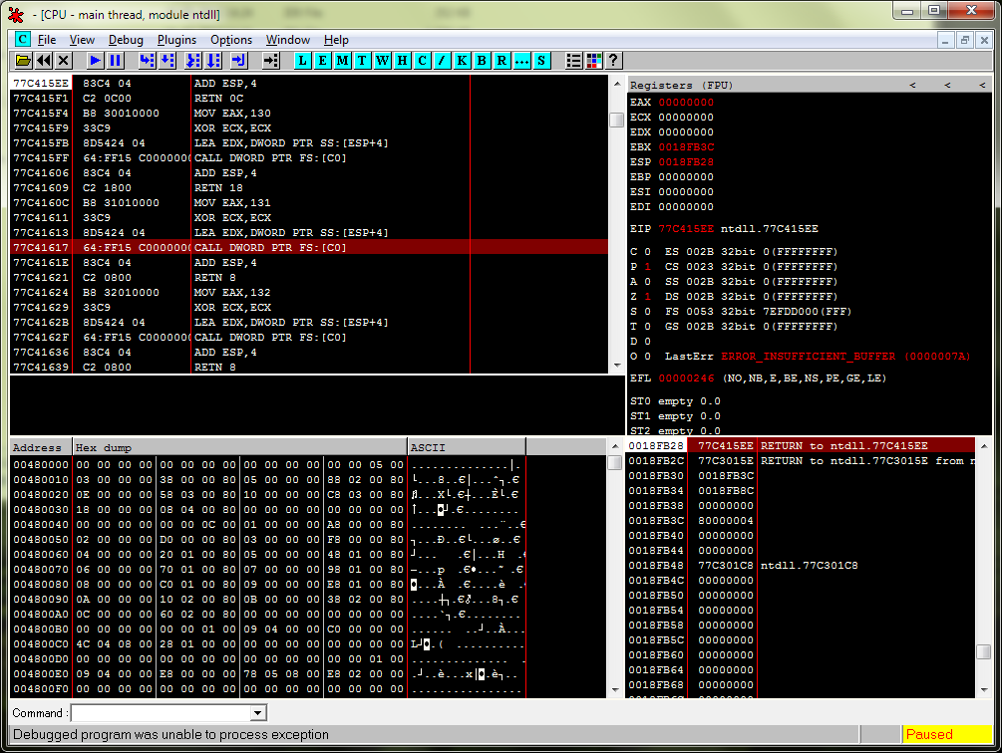
DEMO - Unpacking UPX
www.SecurityXploded.com

Slide 20
Anti Anti-Debugging Plugins
Here are useful OllyDbg Plugins for Anti Anti-Debugging
Olly Advanced
Hide Debugger
NtGlobalFlag
Anti Anti BPM
www.SecurityXploded.com

Slide 21
Useful Tips
Always use simple EXE for Unpacking exercises
Use same EXE for all – You will know the OEP & other magic numbers
Use Windows XP for better (less annoying) debugging experience.
Have Patience, Its an Art and takes time.
For best results, do it in the Moon Light ☺
www.SecurityXploded.com

Slide 22
What's Next?
Try Unpacking AsPack, AsProtect, PESpin, YodaP etc
Try Unpacking Packed DLL (Google - Neolite DLL Unpacking)
Try Advanced Packers: Armadillo ☺
www.SecurityXploded.com

Slide 23
Reference
Complete Reference Guide for Reversing & Malware Analysis Training

Slide 24
Thank You !
www.SecurityXploded.com

