Slide 1

Practical Reversing III – Malware Memory Forensics
Reverse Engineering & Malware Analysis Training
Monnappa (m0nna)
www.SecurityXploded.com

Slide 2
Disclaimer
The Content, Demonstration, Source Code and Programs presented here is "AS IS" without any warranty or conditions of any kind. Also the views/ideas/knowledge expressed here are solely of the trainer’s only and nothing to do with the company or the organization in which the trainer is currently working.
However in no circumstances neither the trainer nor SecurityXploded is responsible for any damage or loss caused due to use or misuse of the information presented here.

Slide 3
Acknowledgement
Special thanks to null & Garage4Hackers community for their extended support and cooperation.
Thanks to all the trainers who have devoted their precious time and countless hours to make it happen.

Slide 4

Reversing & Malware Analysis Training
This presentation is part of our Reverse Engineering & Malware Analysis Training program. Currently it is delivered only during our local meet for FREE of cost.
For complete details of this course, visit our Security Training page.

Slide 5
Who am I
Monnappa
  m0nna
  Member of SecurityXploded
  Info Security Investigator @ Cisco
  Reverse Engineering, Malware Analysis, Memory Forensics
  GREM, CEH
  Email: monnappa22@gmail.com

Slide 6
Contents
Why Memory Forensics?
Steps in Memory Forensics
Volatility Quick Overview
Volatility help and plugins
Demo
www.SecurityXploded.com

Slide 7
Why Memory Forensics?
Finding and extracting forensic artefacts
Helps in malware analysis
Determining process, network, registry activities
Reconstructing original state of the system
Assists with unpacking, rootkit detection and reverse engineering
www.SecurityXploded.com

Slide 8
Steps in Memory Forensics
Memory acquisition - Dumping the memory of a target machine
- tools: Win32dd/Win64dd, Memoryze, DumpIt, FastDump
- In Virtual machine: Suspend the VM and use .vmem file
Memory analysis - Analyzing the memory dump for forensic artifacts
- tools: Volatility, Memoryze
www.SecurityXploded.com

Slide 9
Volatility Quick Overview
Advanced memory Forensics Framework written in python
Installation details:
- http://code.google.com/p/volatility/wiki/FullInstallation
Use -h or --help option to get list of command-line switches
- example: python vol.py –h
Use -f <filename> and --profile to indicate the memory dump you are analyzing
example: python vol.py -f mem.dmp --profile=WinXPSP3x86
To know the --profile info use below command:
example: python vol.py -f mem.dmp imageinfo
www.SecurityXploded.com

Slide 10
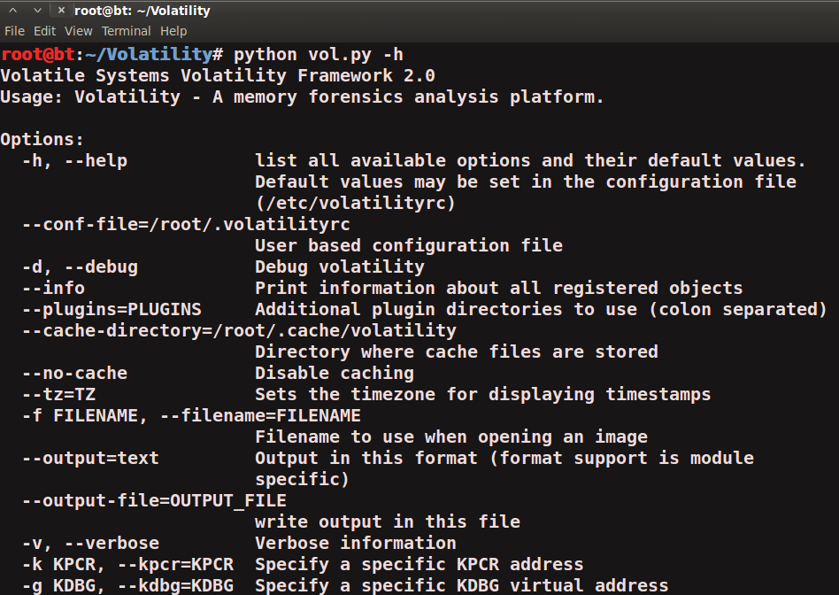
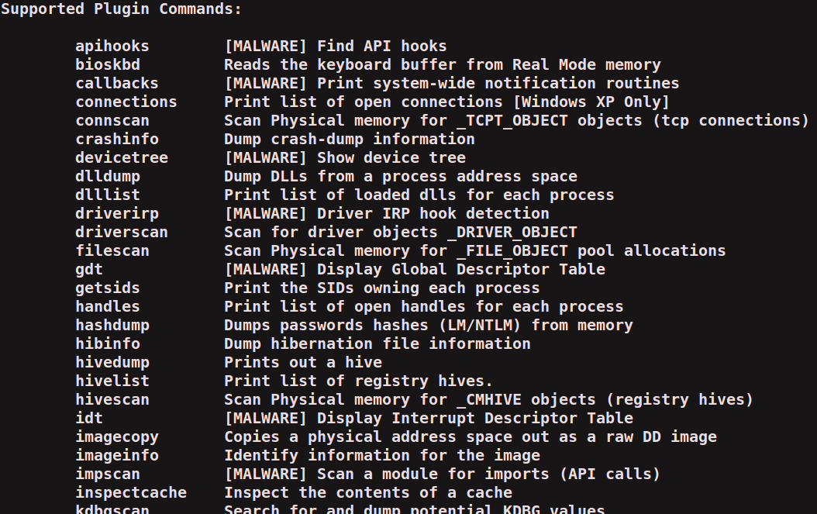
Volatility help and plugins
-h or –help option displays help and available plug-in commands in volatility.
www.SecurityXploded.com

Slide 11
Demo
http://youtu.be/YcVusDjnBxw

Slide 12
Demo-Scenario
Your security device alerts, show malicious http connection to ip address 208.91.197.54 from a source ip 192.168.1.100 on 8th june 2012 at around 13:30hrs...you are asked to investigate and do memory forensics on that machine 192.168.1.100
- To start with, acquire the memory image “infected.dmp” from 192.168.1.100, using memory acquistion tools (win32dd)
command: win32dd.exe /f infected.dmp
- Analyze the memory dump “infected.dmp”
www.SecurityXploded.com

Slide 13
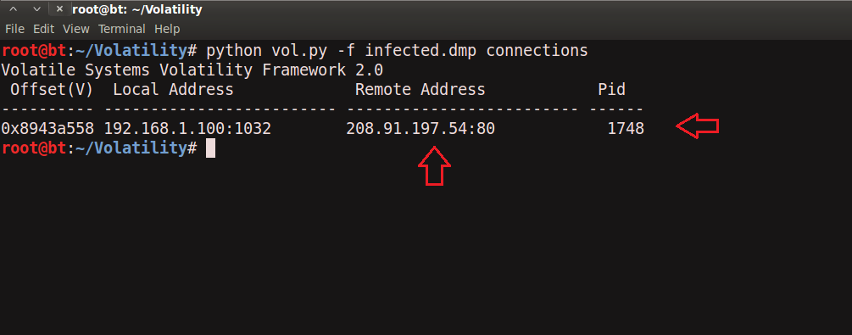
Step 1 – Start With what you know
Volatility’s connections module shows connection to the malicious ip by pid 1748
www.SecurityXploded.com

Slide 14
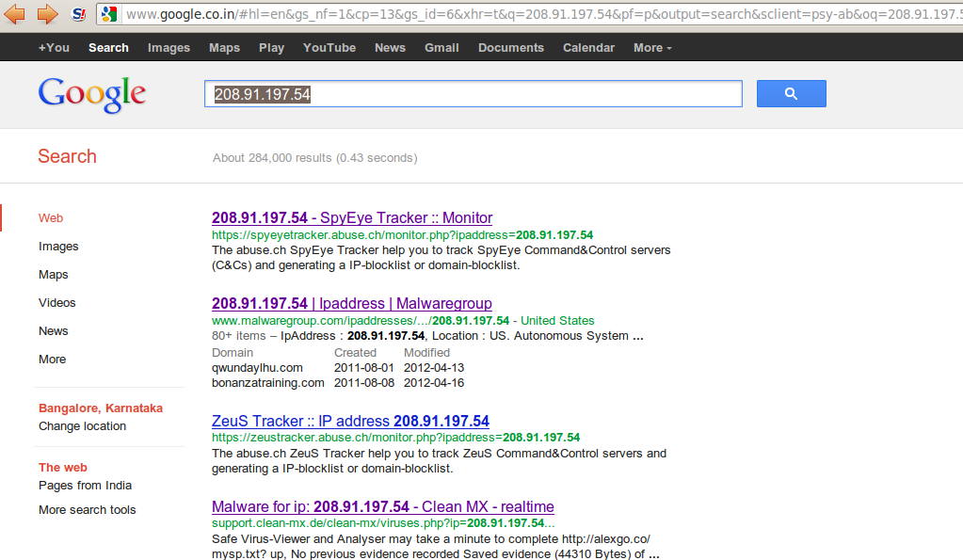
Step 2 – Info about 208.91.197.54
Google search shows 208.91.197.54 associated with malware, probably “spyeye”, we need to confirm that yet.
www.SecurityXploded.com

Slide 15
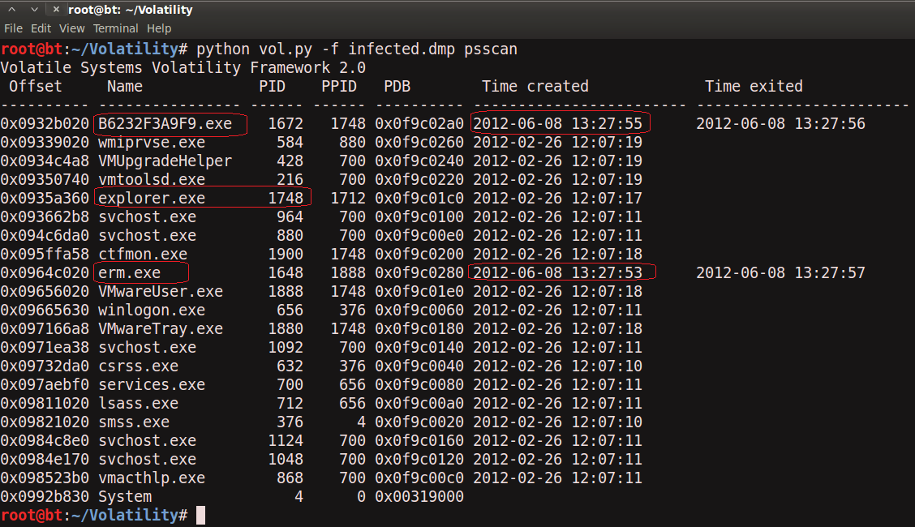
Step 3 – Who is Pid 1748?
“psscan” shows pid 1748 belongs to explorer.exe, also two process created during same time reported by security device (i.e june 8th 2012)
www.SecurityXploded.com

Slide 16
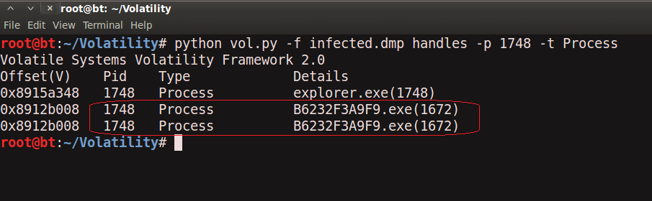
Step 4 – Process handles of explorer.exe
Explorer.exe opens a handle to the B6232F3A9F9.exe, indicating explorer.exe created that process, which might be malicious…focusing on explorer.exe for now.
www.SecurityXploded.com

Slide 17
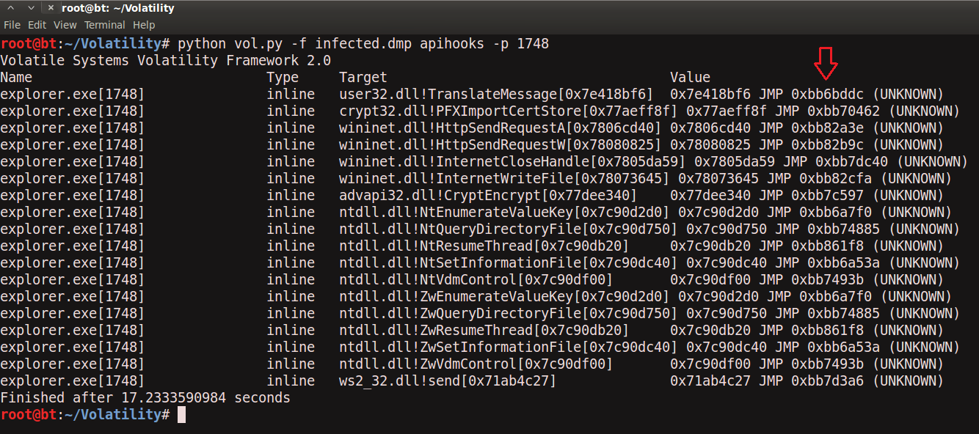
Step 5 – apihooks in explorer.exe
apihooks module show, inline api hooks in explorer.exe and jump to an unknown location
www.SecurityXploded.com

Slide 18
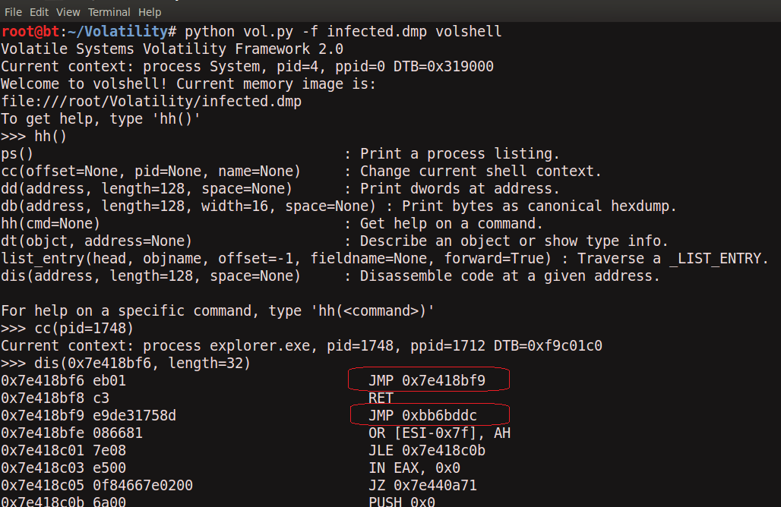
Step 6 – exploring the hooks
Disassembled hooked function (TranslateMessage), shows a short jump and then a long jump to malware location
www.SecurityXploded.com

Slide 19
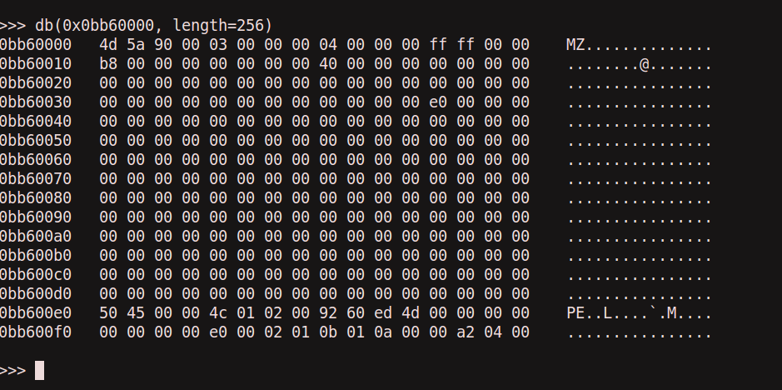
Step 7 – Embedded exe in explorer.exe
Printing the bytes show the presence of embedded executable in explorer.exe
www.SecurityXploded.com

Slide 20
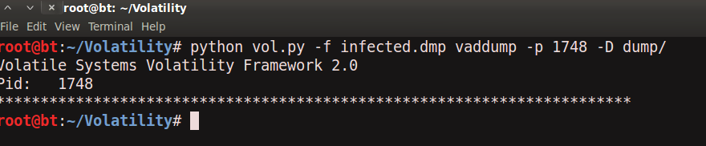
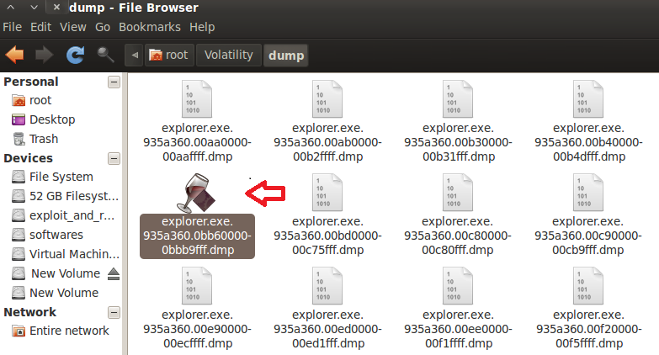
Step 8 – dumping the embedded exe
vaddump dumps the embedded exe from explorer.exe
www.SecurityXploded.com

Slide 21
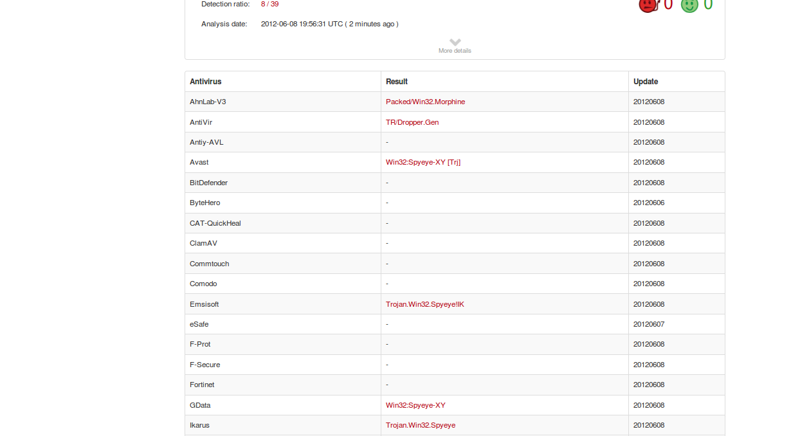
Step 9 – virustotal submission
Submission to virustotal, confirms the dumped executable as component of “spyeye”
www.SecurityXploded.com

Slide 22
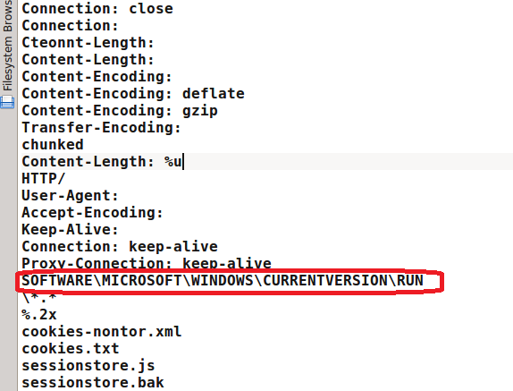
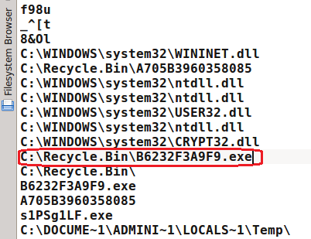
Step 10 – Can we get more info?
Strings extracted from the dumped executable, show reference to interesting artifacts (executable and the registry key)
www.SecurityXploded.com

Slide 23
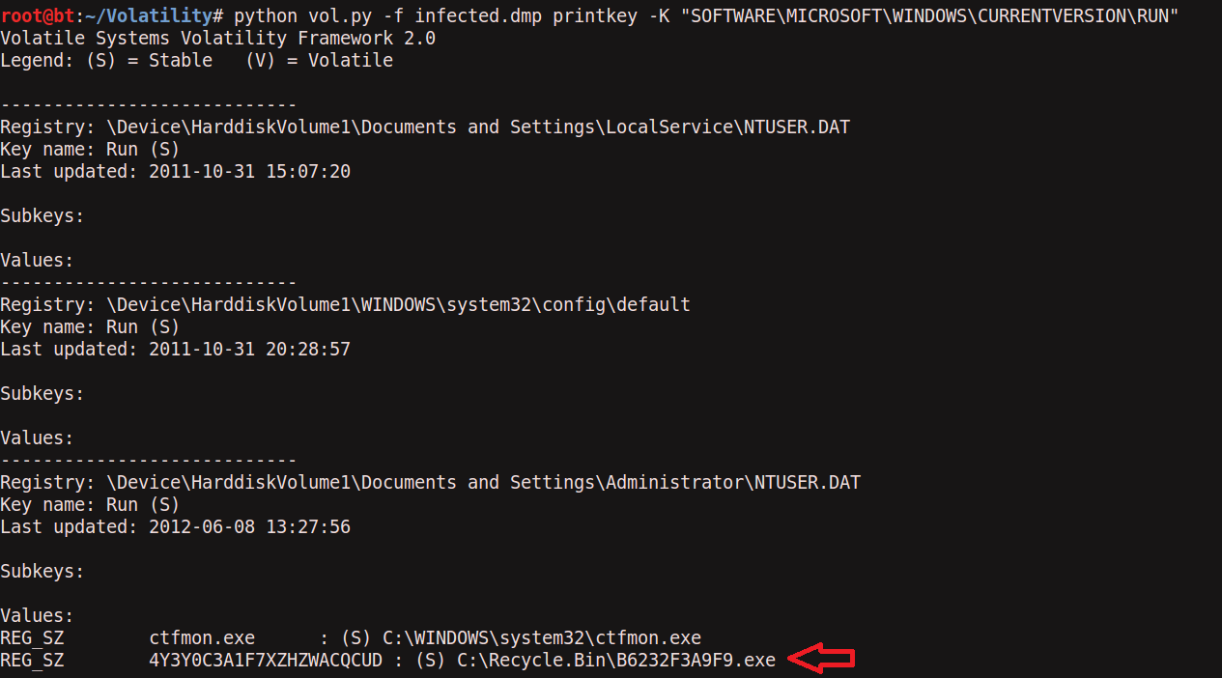
Step 11 – Printing the registry key
Malware creates registry key to survive the reboot
www.SecurityXploded.com

Slide 24
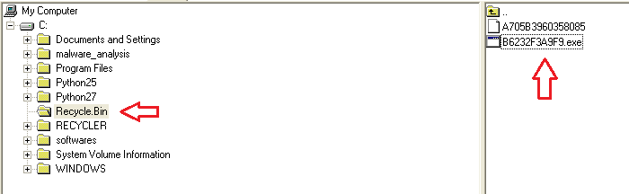
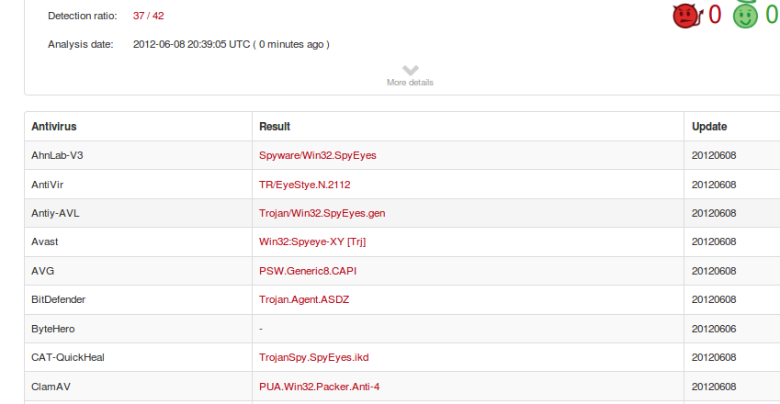
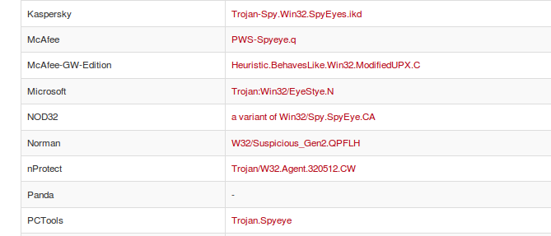
Step 12 – Finding the malicious exe on infected machine
Finding malicious sample from infected host and virustotal submission confirms spyeye infection
www.SecurityXploded.com

Slide 25
Reference
Complete Reference Guide for Reversing & Malware Analysis Training
www.SecurityXploded.com

Slide 26
Thank You !
www.SecurityXploded.com

