Slide 1

Practical Reversing IV – Advanced Malware Analysis
Reverse Engineering & Malware Analysis Training
Monnappa (m0nna)
www.SecurityXploded.com

Slide 2
Disclaimer
The Content, Demonstration, Source Code and Programs presented here is "AS IS" without any warranty or conditions of any kind. Also the views/ideas/knowledge expressed here are solely of the trainer’s only and nothing to do with the company or the organization in which the trainer is currently working.
However in no circumstances neither the trainer nor SecurityXploded is responsible for any damage or loss caused due to use or misuse of the information presented here.

Slide 3
Acknowledgement
Special thanks to null & Garage4Hackers community for their extended support and cooperation.
Thanks to all the trainers who have devoted their precious time and countless hours to make it happen.

Slide 4

Reversing & Malware Analysis Training
This presentation is part of our Reverse Engineering & Malware Analysis Training program. Currently it is delivered only during our local meet for FREE of cost.
For complete details of this course, visit our Security Training page.

Slide 5
Who am I
Monnappa
  m0nna
  Member of SecurityXploded (SX)
  Info Security Investigator @ Cisco
  Reverse Engineering, Malware Analysis, Memory Forensics
  Email: monnappa22@gmail.com, twitter@monnappa22

Slide 6
Contents
Why Malware Analysis?
Types of Malware Analysis
Static Analysis
Dynamic Analysis
Memory Analysis
Demo
www.SecurityXploded.com

Slide 7
Why Malware Analysis?
To determine:
the nature and purpose of the malware
Interaction with the file system
Interaction with the registry
Interaction with the network
Identifiable patterns
www.SecurityXploded.com

Slide 8
Types of Malware Analysis?
Static Analysis
- Analyzing without executing the malware
Dynamic Analysis
- Analyzing by executing the malware
Memory Analysis
- Analyzing the RAM for artifacts
www.SecurityXploded.com

Slide 9
Static Analysis
Steps:
  Determine the file type
  tools: file utility on unix and windows (need to install)
  Determine the cryptographic hash
    tools: md5sum utility on unix and windows (part of unix utils for windows)
  Strings search
    tools: strings utility on unix and windows , Bintext
  File obfuscation (packers, cryptors and binders) detection
  tools: PEiD, RDG packer detector
  Submission to online antivirus scanners (virustotal, jotti, cymru)
  tools: browser and public api of Virustotal
  Determine the Imports
    tools: PEview, Dependency Walker
  Disassembly
  tools: IDA Pro, Ollydbg

Slide 10
Dynamic Analysis
Involves executing the malware in a controlled environment to determine its behavior
Steps:
  Determine the File system activity
    tools: process monitor, capturebat
  Determine the Process activity
  tools: process explorer, process monitor, capturebat
  Determine the Network activity
  tools: wireshark
  Detemine the Registry activity
    tools: regmon, process monitor, capturebat

Slide 11
Memory Analysis
Finding and extracting artifacts from computer’s RAM
  Determine the process activity
  Determine the network connections
  Determine hidden artifacts
  Detemine the Registry activity
  Tools:
  Volatility (Advanced Memory Forensic Framework)
  Advantages:
  helps in rootkit detection
  helps in unpacking

Slide 12
Demo 1
http://youtu.be/592uIELKUX8

Slide 13
Static ANALYSIS

Slide 14
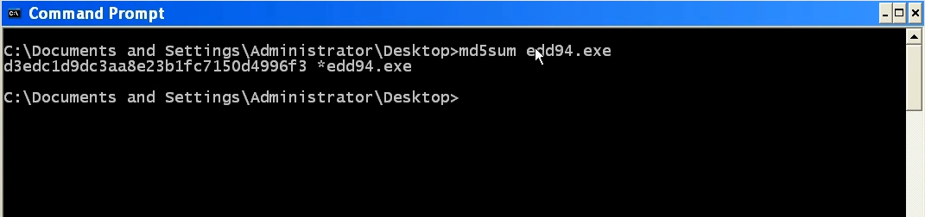
Step 1 – Taking the cryptographic hash
The below screenshot shows the md5sum of the sample
www.SecurityXploded.com

Slide 15
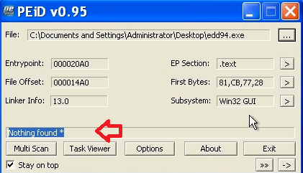
Step 2 – Determine the packer
PEiD was unable determine the packer
www.SecurityXploded.com

Slide 16
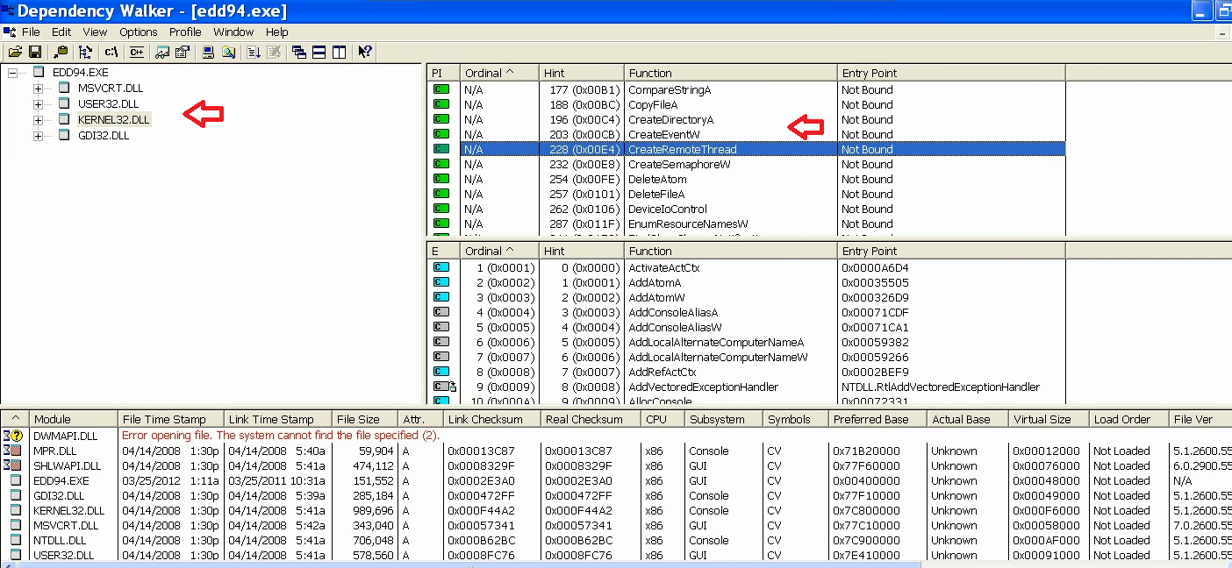
Step 3 – Determine the Imports
Dependency Walker shows the DLLs and API used by malicious executable
www.SecurityXploded.com

Slide 17
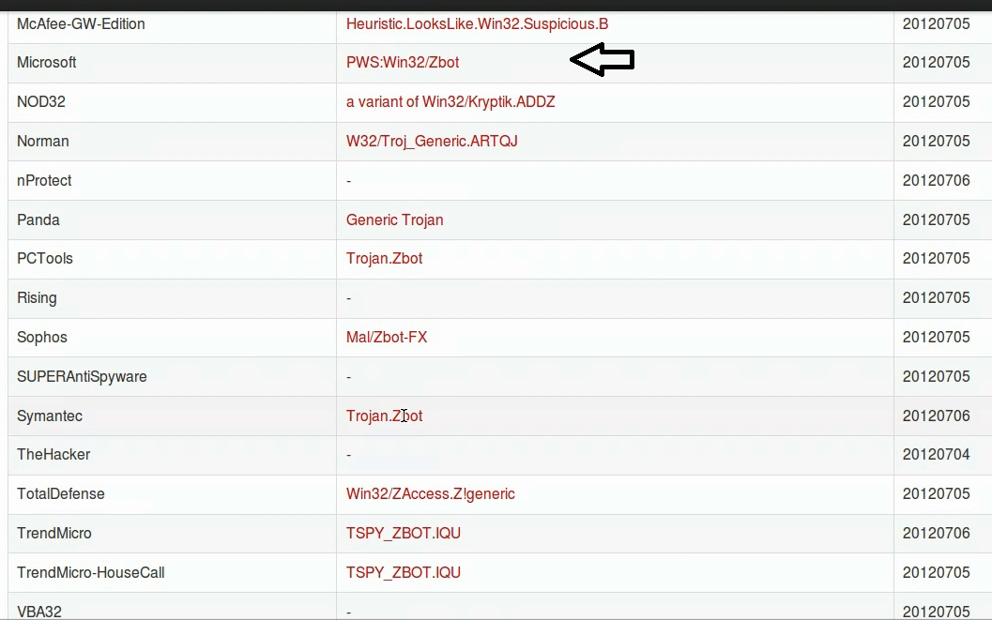
Step 4 – VirusTotal Submission
VirusTotal results show that this sample is a zeus bot (zbot)
www.SecurityXploded.com

Slide 18
dynamic ANALYSIS

Slide 19
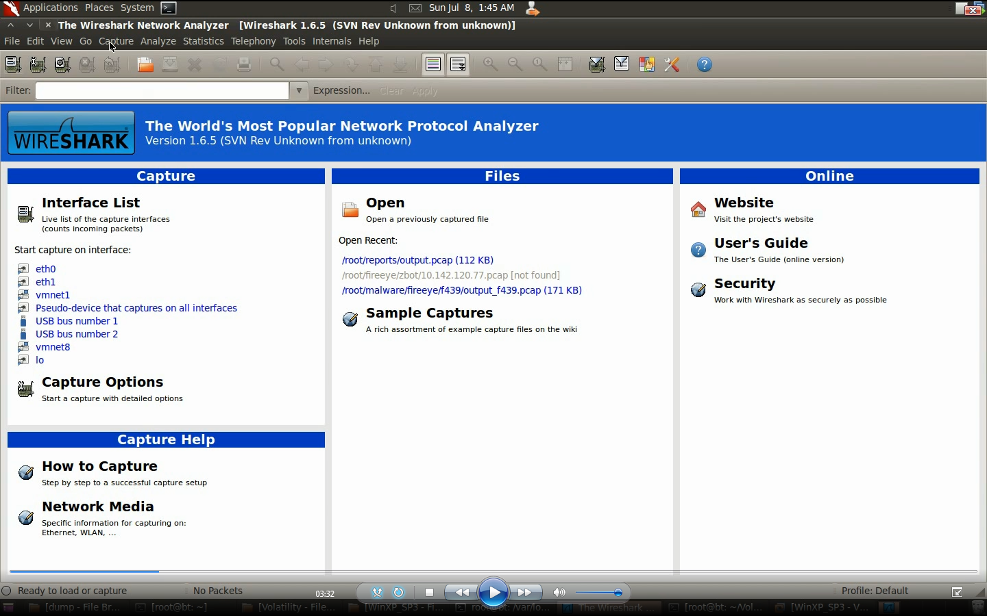
Step 1 – Running the monitoring tools
Before executing the malware, montioring tools are run to capture the activities of the malware
www.SecurityXploded.com

Slide 20
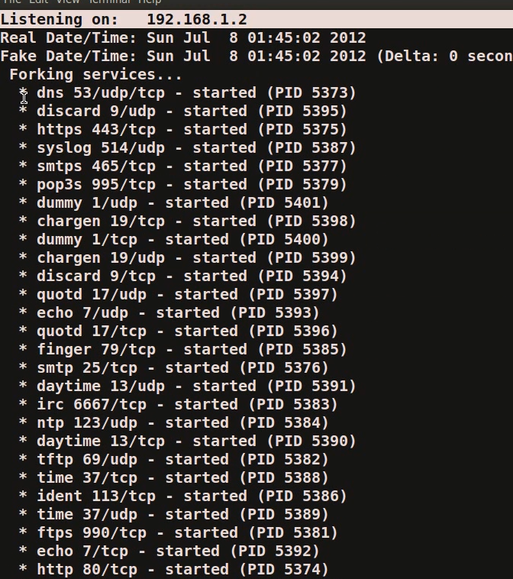
Step 2 – Simulate Internet Services
Internet services are simulated to give fake response to malware and also to prevent malware from talking out on the internet
www.SecurityXploded.com

Slide 21

Step 3 – Executing the malware (edd94.exe)
www.SecurityXploded.com

Slide 22
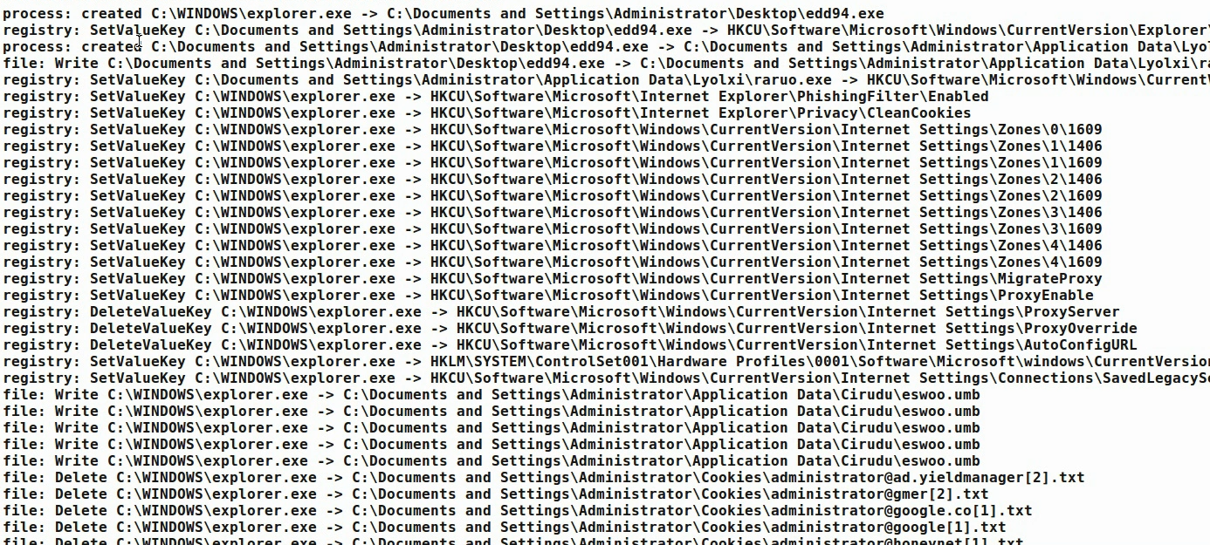
Step 4 – process, registry and filesystem activity
The below results show the process, registry and fileystem activity after executing the malware (edd94.exe), also explorer.exe performs lot of activity indicating code injection into explorer.exe
www.SecurityXploded.com

Slide 23
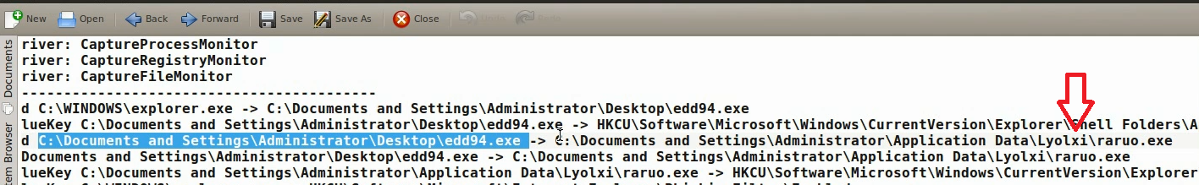
Step 5 – Malware drops a file (raruo.exe)
The below results show the malware dropping a file raruo.exe and creating a process.
www.SecurityXploded.com

Slide 24
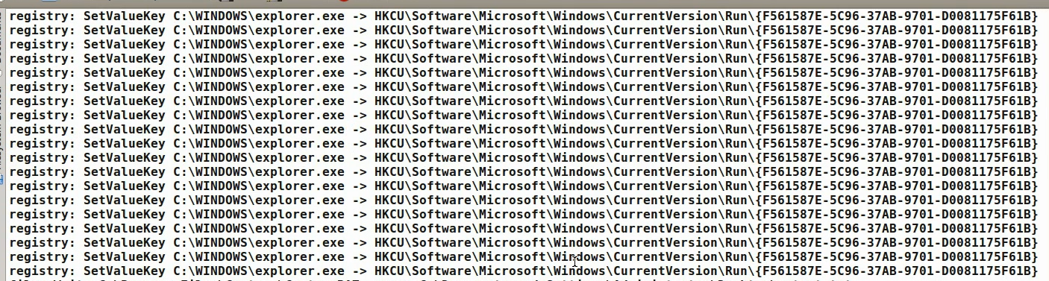
Step 6 – Explorer.exe setting value in registry
The below output shows explorer.exe setting a value under run registry subkey as a persistence mechanism to survive the reboot.
www.SecurityXploded.com

Slide 25
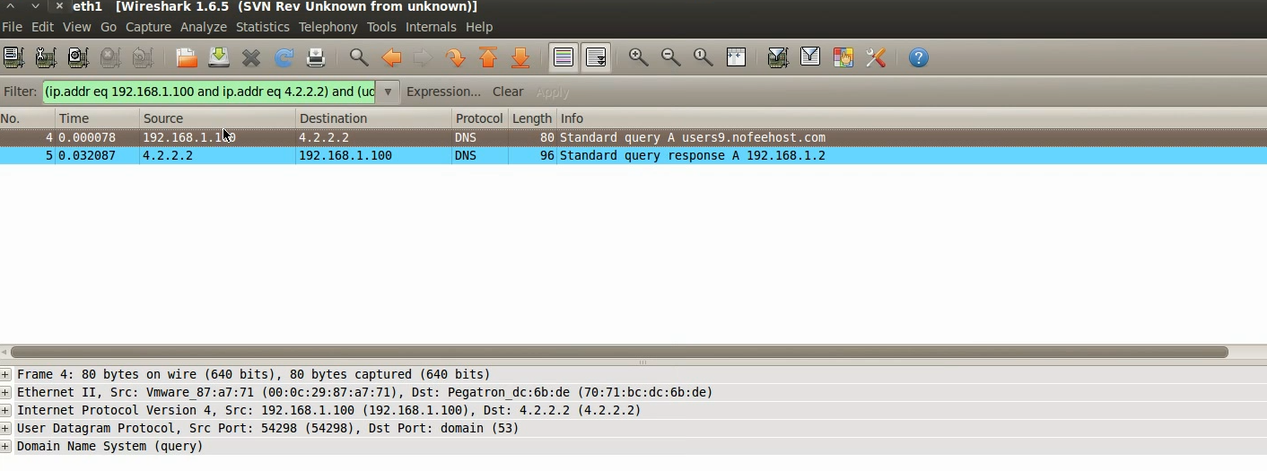
Step 7 – DNS query to malicious domain
Packet capture shows dns query to users9.nofeehost.com and also response shows that the “A” record for the domain is pointed to the machine 192.168.1.2, which is simulating internet services.
www.SecurityXploded.com

Slide 26
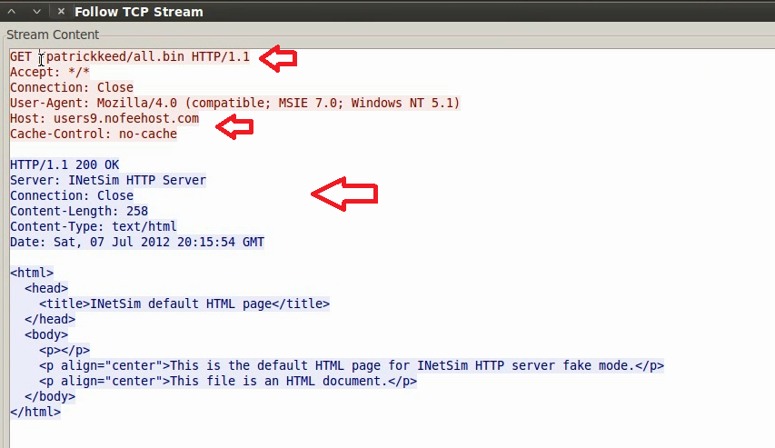
Step 8 – http connection to malicious domain
The below output shows zeus bot trying to download configuration file from C&C and also the fake response given by the inetsim server.
www.SecurityXploded.com

Slide 27
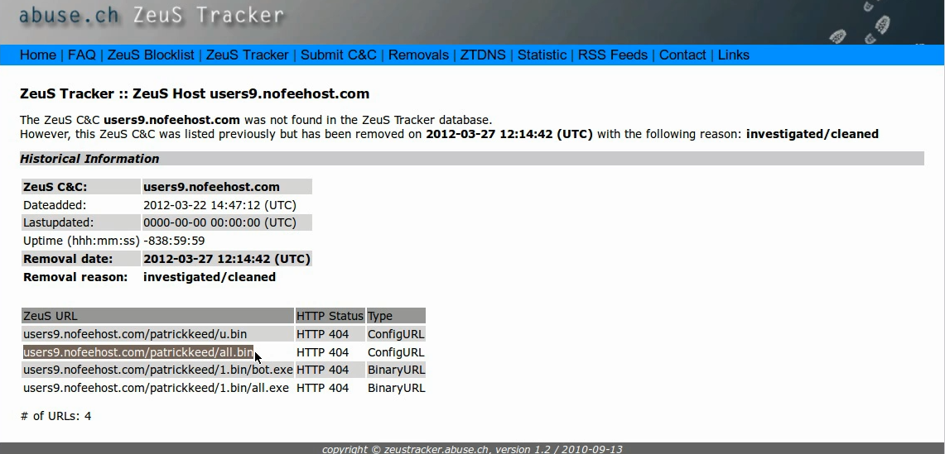
Step 9– ZeuS Tracker result
ZueS Tracker shows that the domain was a ZeuS C&C server
www.SecurityXploded.com

Slide 28
MEMORY ANALYSIS

Slide 29
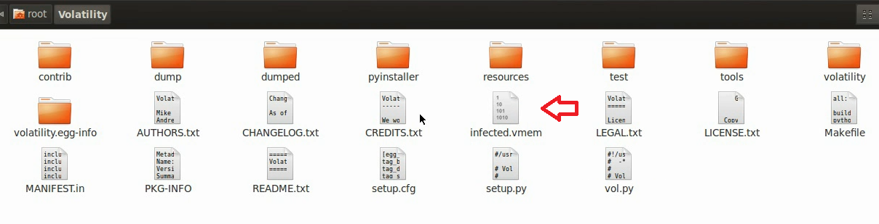
Step 1 – Taking the memory image
Suspending the VM creates a memory image of the infected machine, the below screenshot show the memory image (infected.vmem) of the infected machine
www.SecurityXploded.com

Slide 30
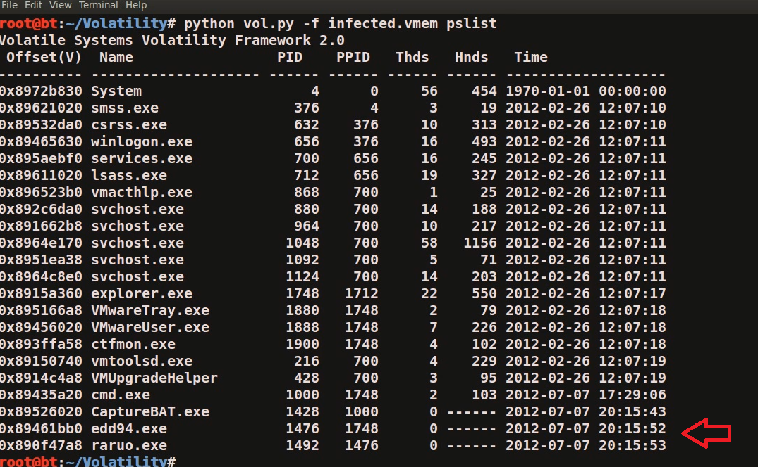
Step 2 – Process listing from memory image
Volatility’s pslist module shows the two process edd94.exe and raruo.exe
www.SecurityXploded.com

Slide 31
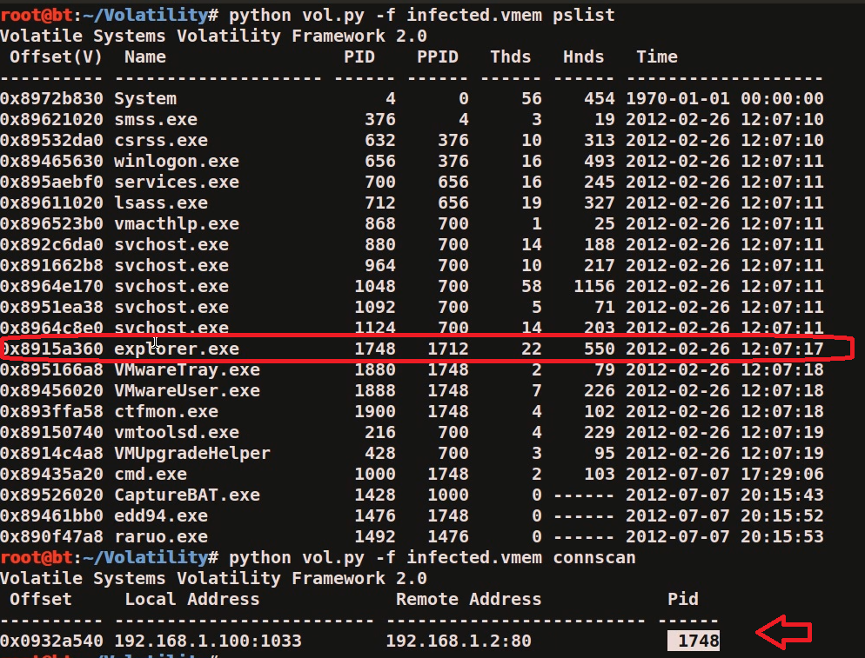
Step 3 – Network connections from memory image
Volatility’s connscan module shows pid 1748 making http connection, this pid 1748 is associated with explorer.exe
www.SecurityXploded.com

Slide 32
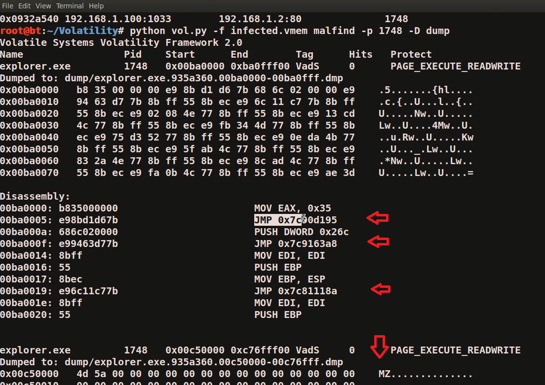
Step 4 – Embedded exe and api hooks in explorer.exe
The below output shows the inline api hooks and embedded executable in explorer.exe, and also the embedded executable is dumped into a directory (dump) by malfind plugin
www.SecurityXploded.com

Slide 33
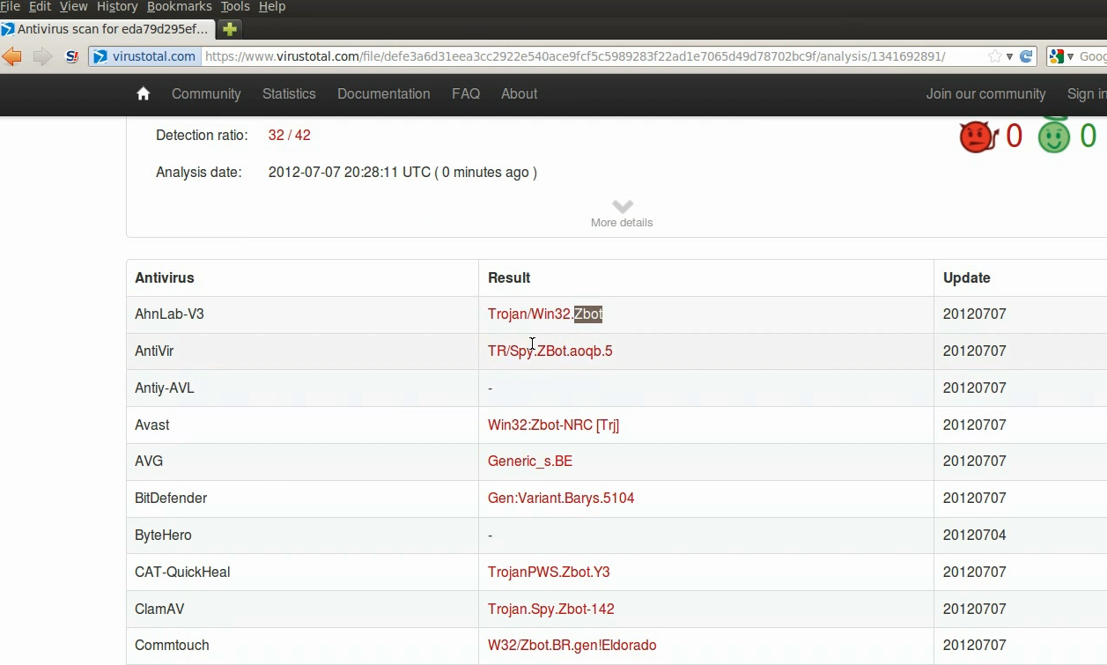
Step 5 – Virustotal submission of dumped exe
The virustotal submission confirms the dumped exe to be component of ZeuS bot
www.SecurityXploded.com

Slide 34
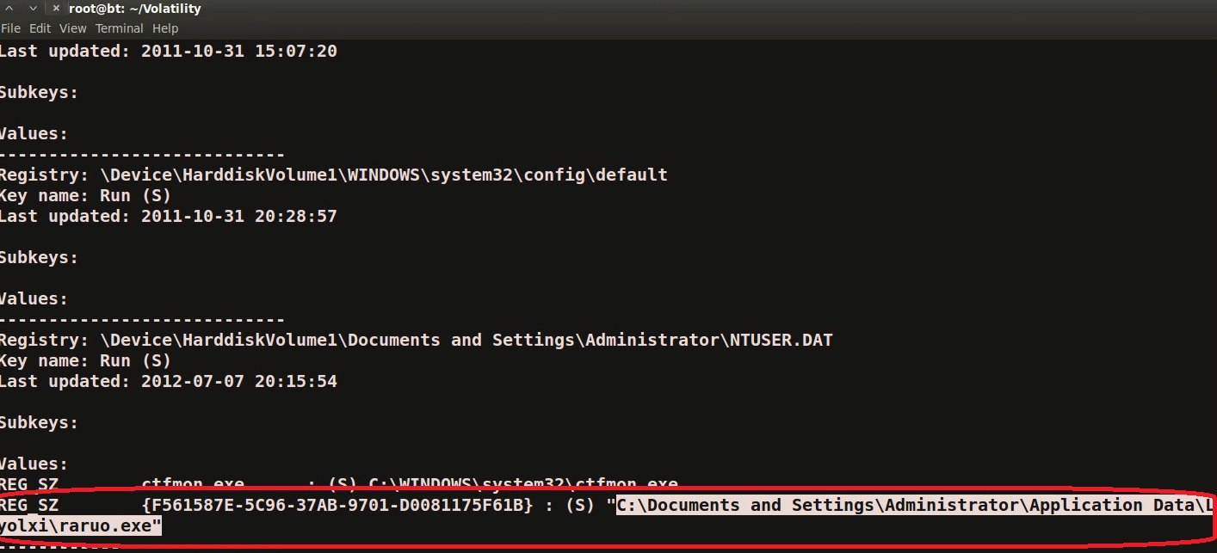
Step 6 – Printing the registry key
Malware creates registry key to survive the reboot
www.SecurityXploded.com

Slide 35
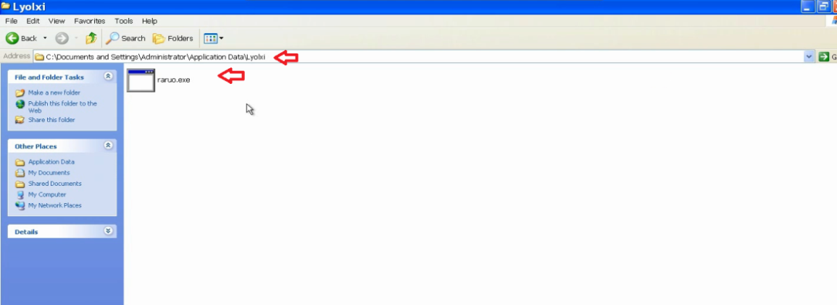
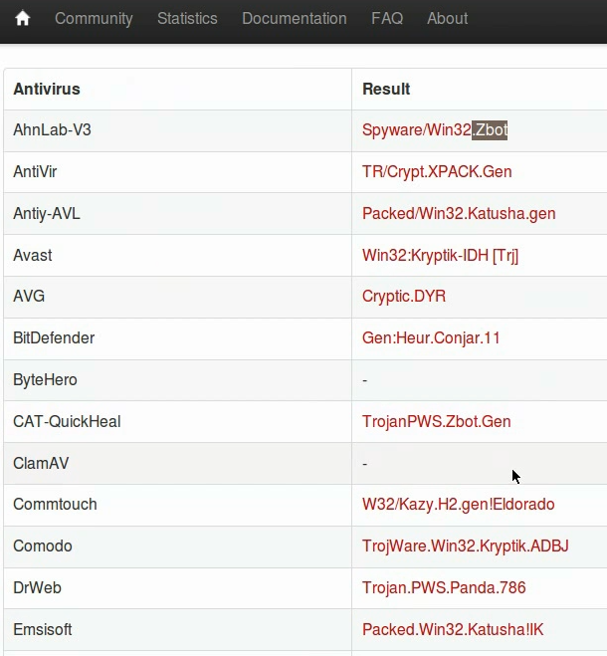
Step 12 – Finding the malicious exe on infected machine
Finding malicious sample (raruo.exe) from infected host and virustotal submission confirms ZeuS(zbot) infection
www.SecurityXploded.com

Slide 36
Advanced Malware analysis

Slide 37
Demo 2
http://youtu.be/3bxzvrGf5w8

Slide 38
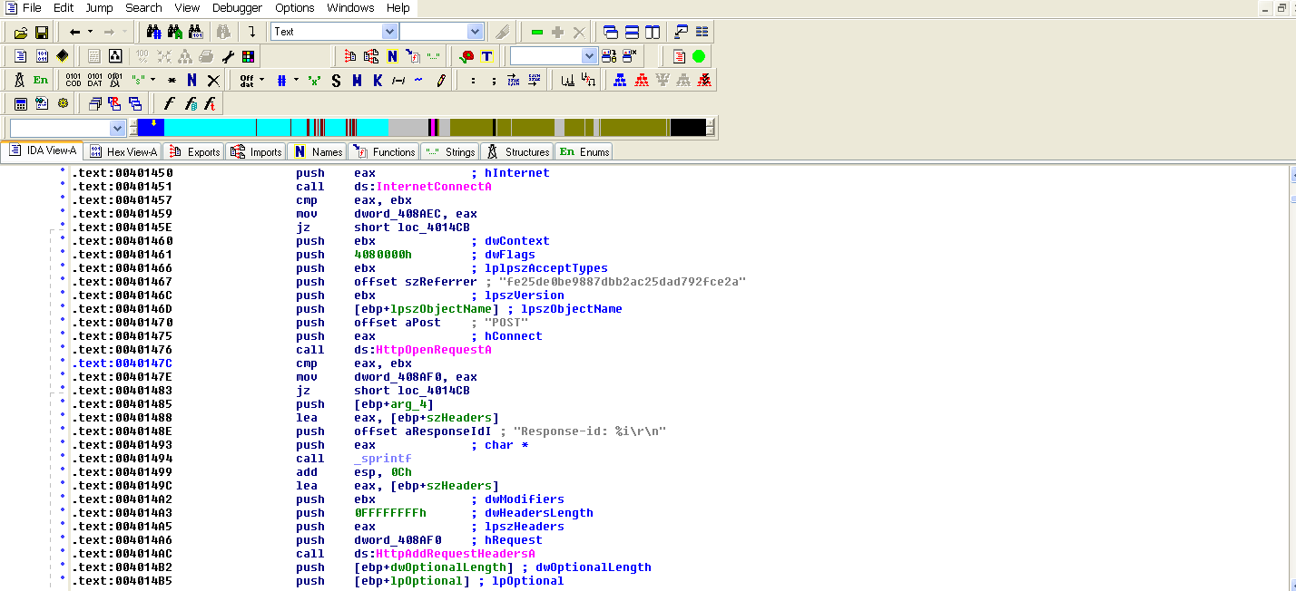
Disassembly Example
The below screenshot shows the disassembly of http bot, making connection to the C&C
www.SecurityXploded.com

Slide 39
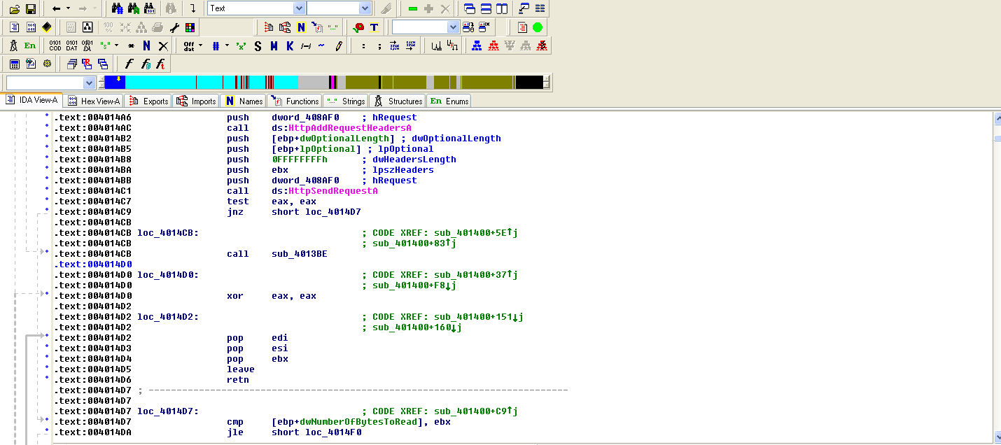
Disassembly Example (contd)
The bot send the http request to the C&C
www.SecurityXploded.com

Slide 40
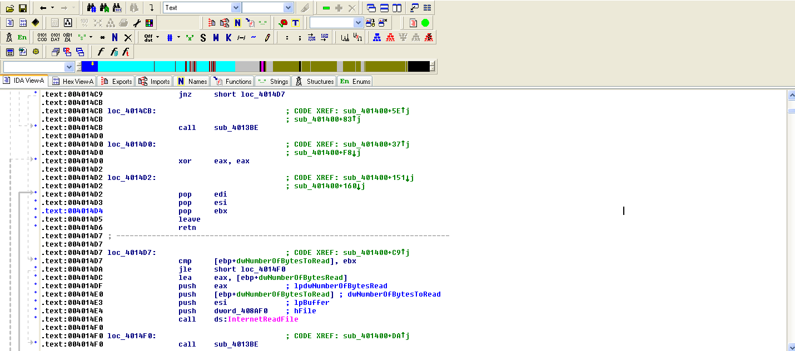
Disassembly Example (contd)
The bot retireves data from C&C
www.SecurityXploded.com

Slide 41
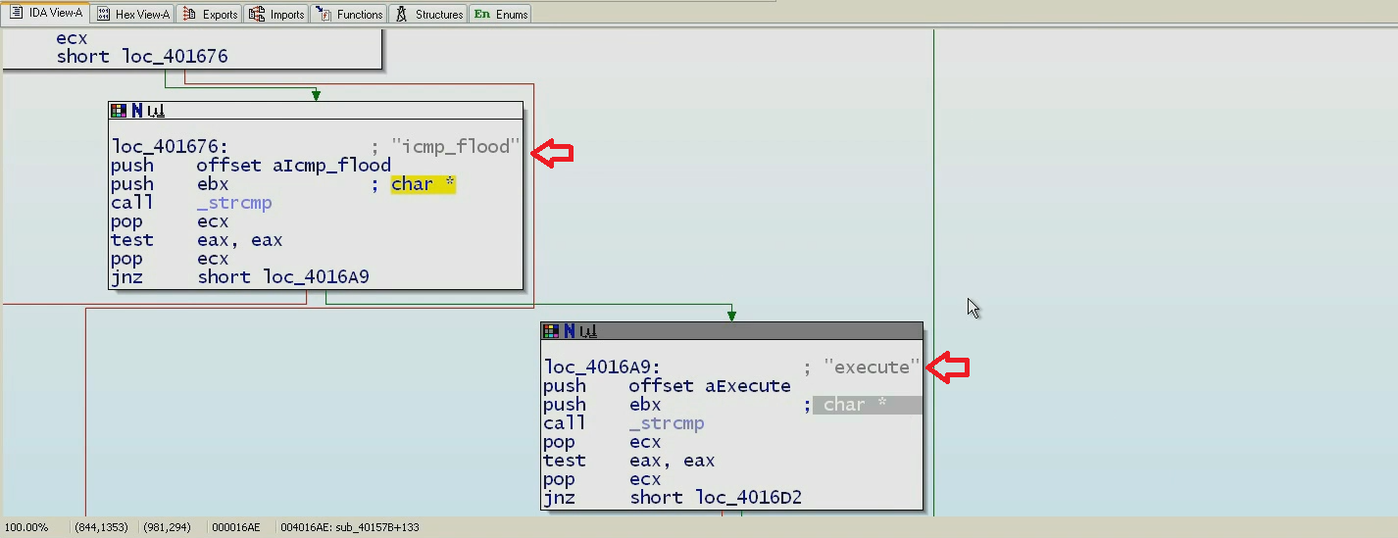
Disassembly Example (contd)
The below sceenshot shows some of the supported commands of this http bot
www.SecurityXploded.com

Slide 42
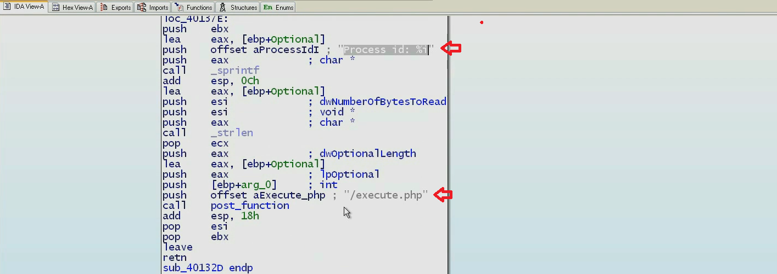
Disassembly Example (contd)
Bot runs the below code if the received command is “Execute”, it creates a process and sends the process id to the C&C server
www.SecurityXploded.com

Slide 43
Reference
Complete Reference Guide for Reversing & Malware Analysis Training
www.SecurityXploded.com

Slide 44
Thank You !
www.SecurityXploded.com

